Slide 1
Changing care systems for people with frailty during and beyond the pandemic
Adam Gordon
Professor of the Care of Older People, University of Nottingham
President Elect, British Geriatrics Society
@adamgordon1978

Slide 2
What we’ll cover……
Frailty – definitions and why it’s a useful concept
The evidence underpinning interventions for frailty
The impact of the pandemic
How to move forward (including recommendations from GIRFT)

Slide 3
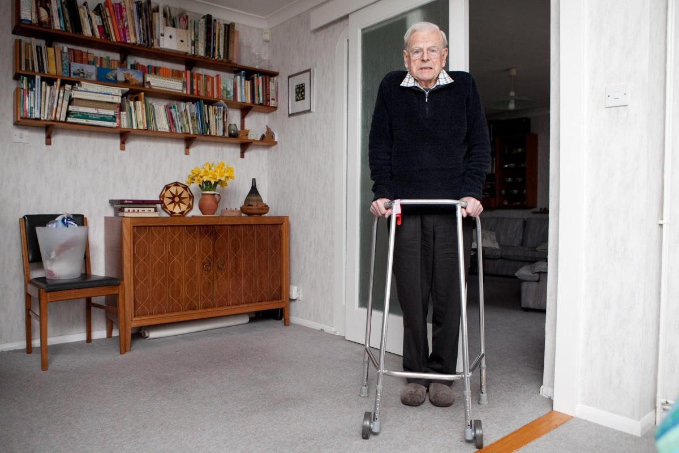
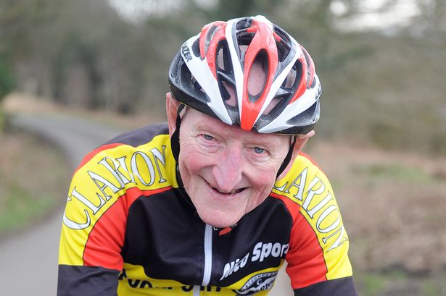
How old do you have to be to be referred to a geriatrician?

Slide 4
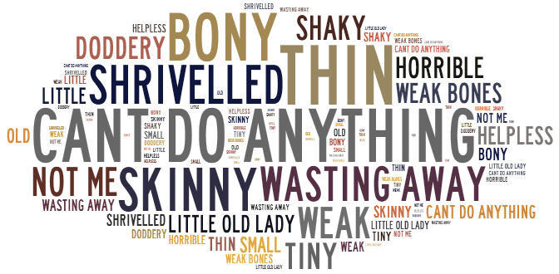

Slide 5
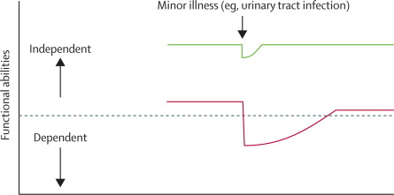
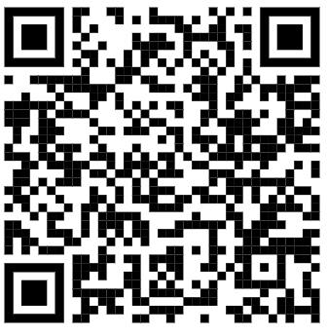

Slide 6
Frailty (the Fried Criteria)
unintentional weight loss >4.5 kg in the past year
<20th population centile for grip strength
self-reported exhaustion
low physical activity such that persons would only rarely undertake a short walk
slowed walking speed, defined as lowest population quartile on 4 minute walking test

Slide 7
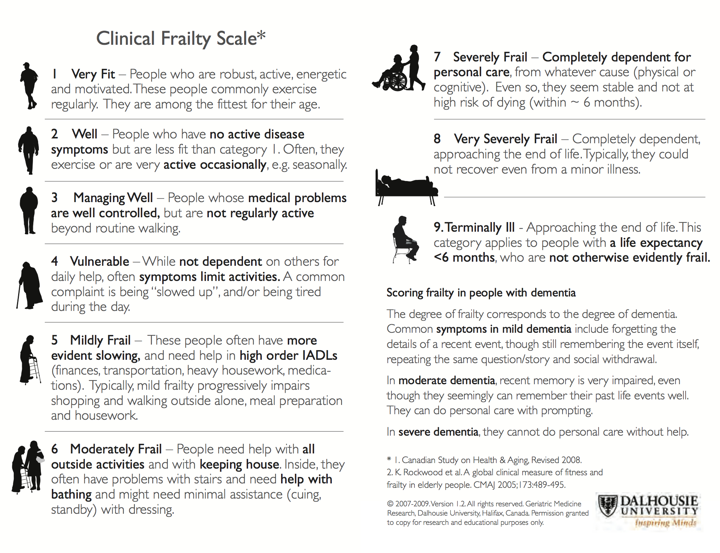

Slide 8
Why is frailty important?
5-10% of ED attendances
30% of patients in acute medical units
Across England, 4000 admissions a day pre-pandemic
NHS GIRFT Programme

Slide 9
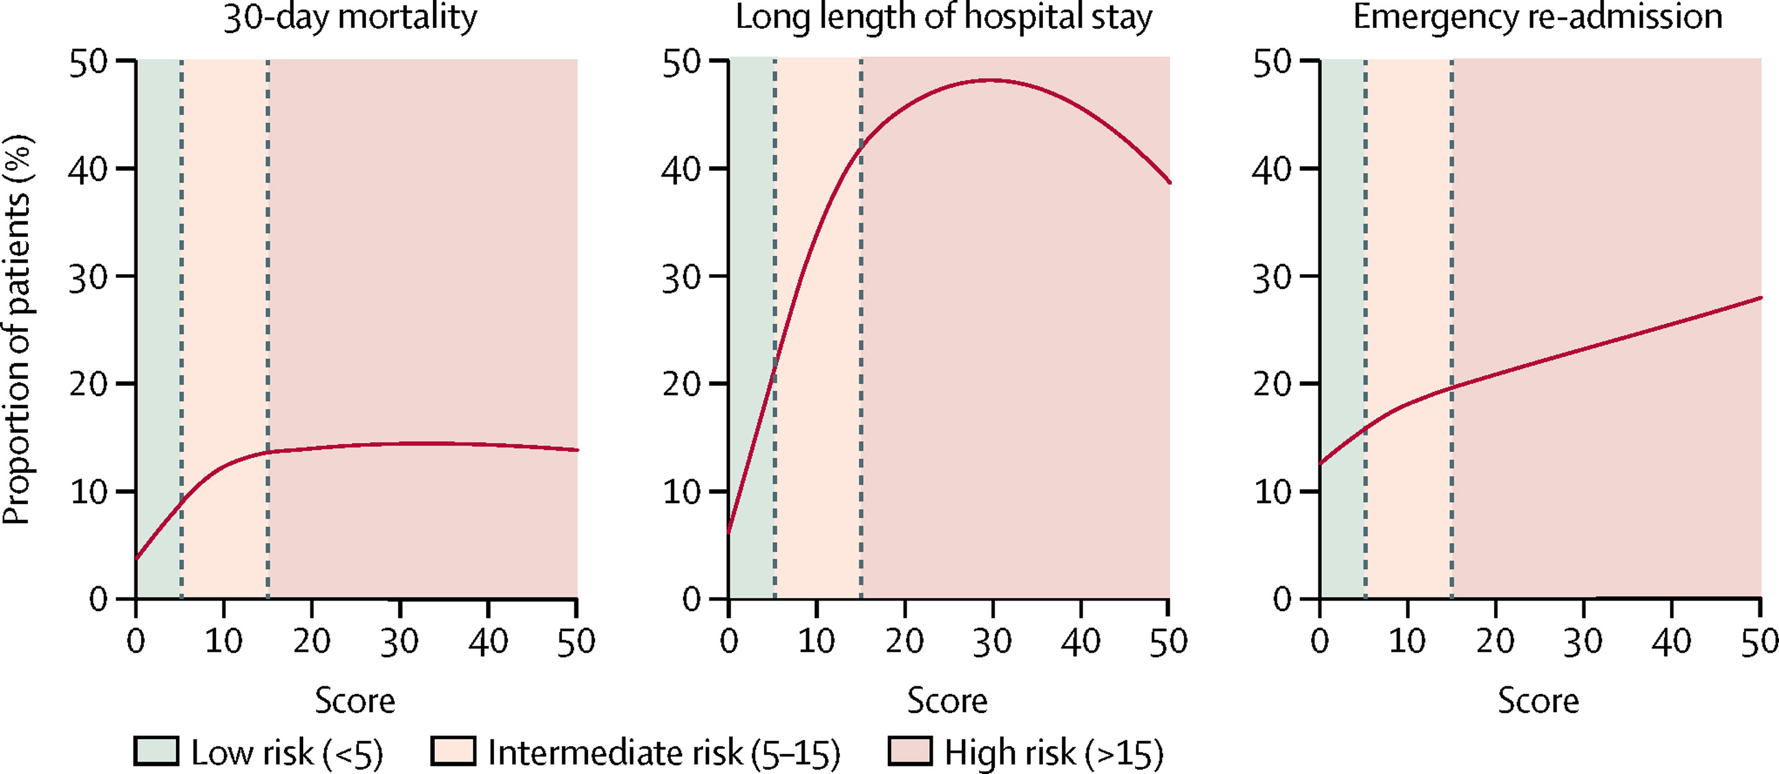
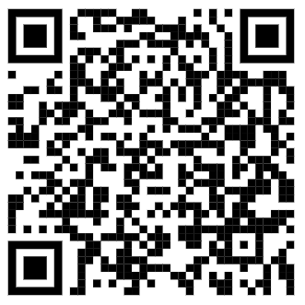
The Lancet 2018 3911775-1782DOI: (10.1016/S0140-6736(18)30668-8)
Notes:
Relation between Hospital Frailty Risk Scores and outcomes after emergency admission in the national validation cohort
The vertical dashed lines show thresholds for categorising patients as low frailty risk (score <5), intermediate frailty risk (score 5–15), or high frailty risk (score >15).

Slide 10
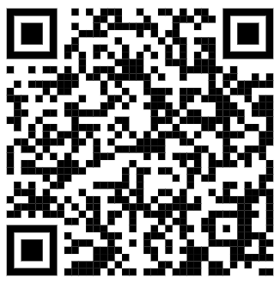
COVID-19 and Frailty
More likely to get COVID.
More likely to die from COVID.
More likely to be disabled or dependent following COVID.

Slide 11
Unanswered questions
More likely to have isolated?
More likely to be deconditioned?
More likely to fall or develop a fracture?
More likely to present with undiagnosed late stage illness?

Slide 12
COVID-19 and frailty
48% of deaths during the first wave of the COVID-19 pandemic in care homes
Ongoing precarity in business models for most care homes and domiciliary care providers.
Peaks and troughs in demand for primary care compounding longstanding staffing and resource issues (supply-demand mismatch)
Spiral of poor system flow resulting in stranded patients further compounding system flow.

Slide 14
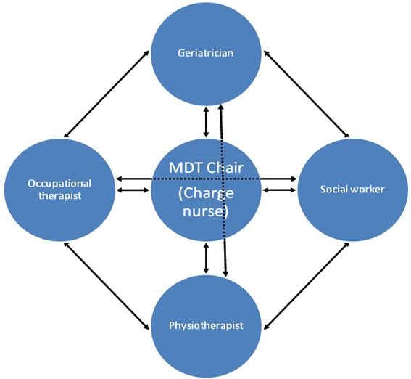
Physical
Psychological
Functional
Social
Environmental
Assessment
Stratified problem list
Bespoke Management Plan
Goals

Slide 15
What is the evidence base for this concept?
Type | Mortality | Living at home | Readmission | Physical function | Cognitive function
Institutional | 0.78 (0.62-0.97) | 1.19 (1.01-1.39) | 0.85 (0.70-1.03) | 1.22 (0.84-1.78) | 1.79 (0.73-1.46)
Non-institutional | 0.91 (0.77-1.07) | 1.26 (1.10-1.44) | 0.89 (0.78-1.01) | 0.99 (0.77-1.27) | 1.03 (0.73-1.46)
Combined | 0.86 (0.75-0.98) | 1.26 (1.10-1.44) | 0.88 (0.79-0.98) | 1.06 (0.86-1.30) | 1.41 (1.12-1.77)
Stuck, A.E. et al., 1993. Comprehensive geriatric assessment: a meta-analysis of controlled trials. The Lancet, 342(8878)

Slide 16
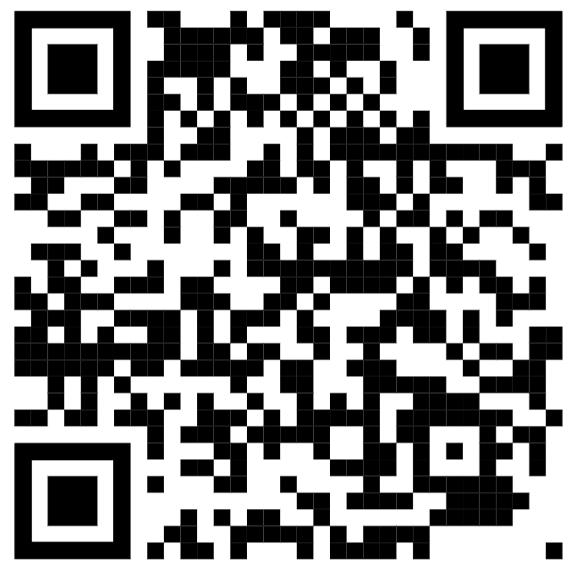
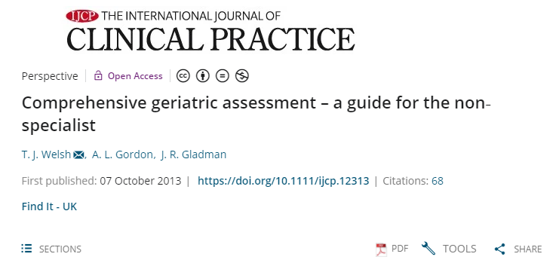

Slide 17
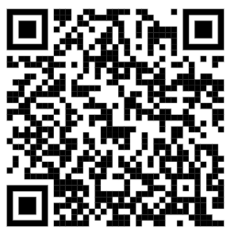
What do GIRFT say?
Assess all older patients for frailty in the emergency pathway
Mobilise early to prevent worsening frailty
Appoint accountable officers for frailty
Provide basic frailty training
Look for and manage delirium
Focus on removing barriers to discharge
Integrate frailty across health systems

Slide 18
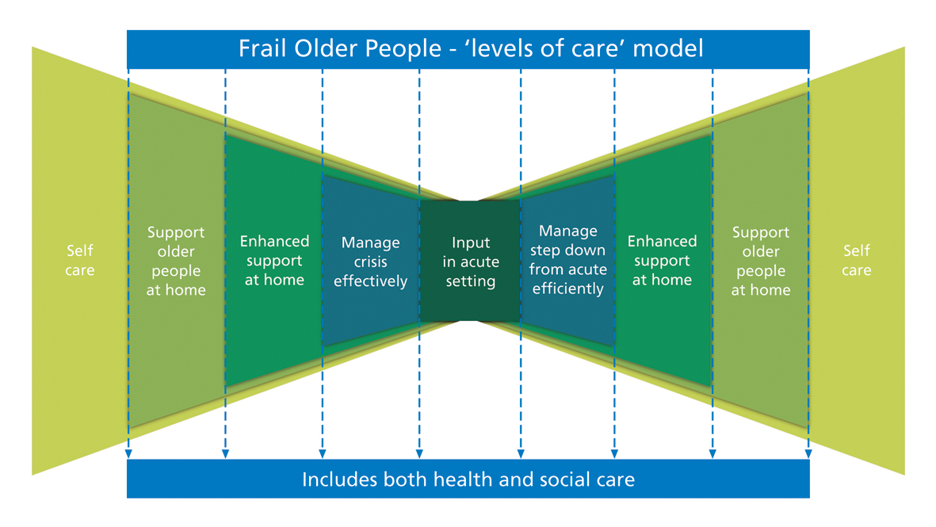

Slide 19
NHSE Ageing Well programme
Urgent Community Response
Enhanced Health in Care Homes
(Anticipatory Care)
(Discharge to Assess)

Slide 20
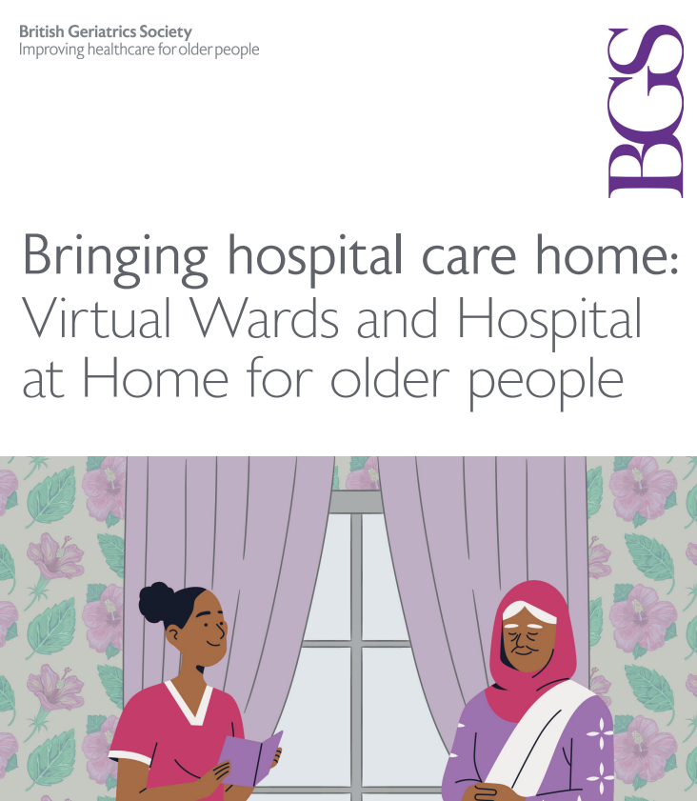
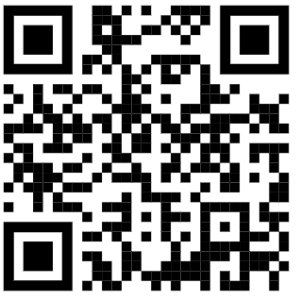
https://www.bgs.org.uk/virtualwards

Slide 21
In conclusion
Frailty is useful because it’s measurable, predicts adverse outcomes and shapes the care of a large and important group of NHS patients.
The pandemic has made the pre-frail frail, the frail frailer, and hobbled the systems that would usually support both groups.
The principles of good care – pathway integration around CGA – remain the same post-pandemic as they were before.
But…service constraints mean that systems are likely to have to make choices about where they invest for maximal impact on frailty outcomes.
Hopefully, the rest of today will help you consider what these choices are.

Slide 22
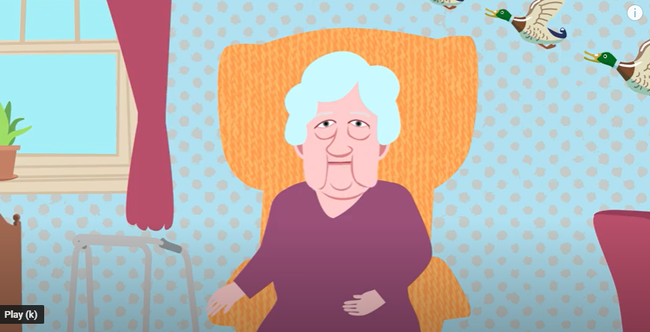
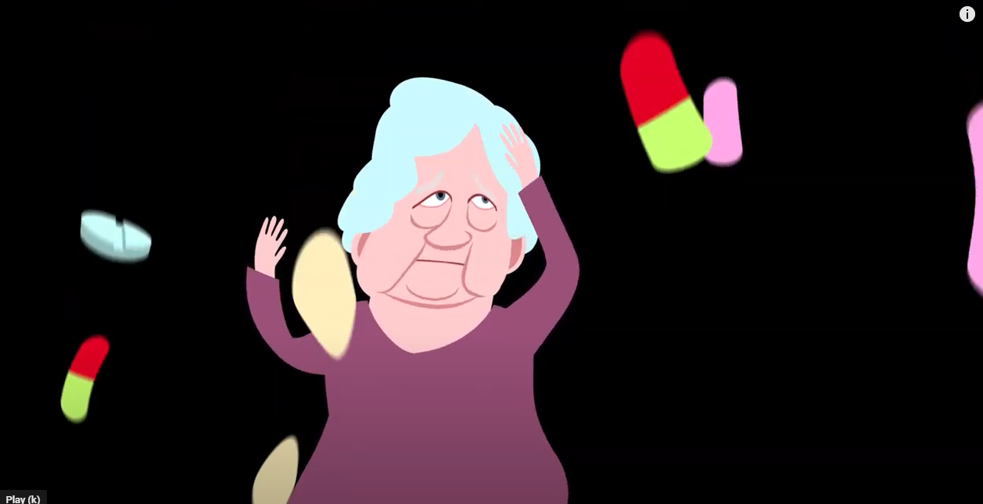
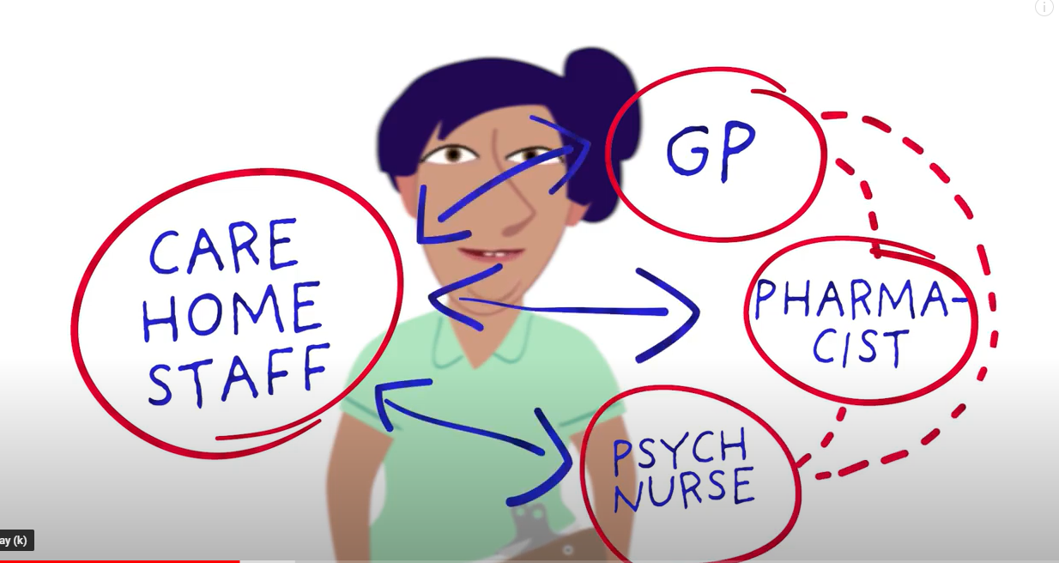
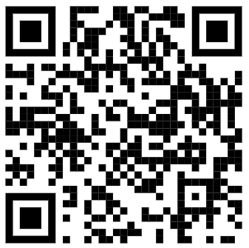
Mrs Andrews did have had a happy ending…
https://www.youtube.com/watch?v=Vz9RT1NoauY

