Slide 1
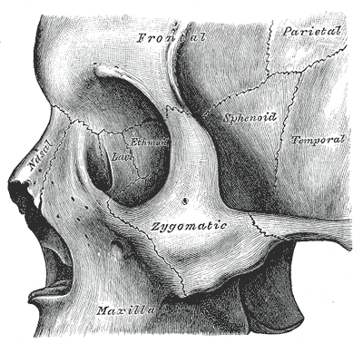
Day case treatment of zygomatic and orbital fractures An evidence based protocol
James Douglas
Lily Long
Subegh Srao
Lachlan Carter
Jiten Parmar

Slide 2
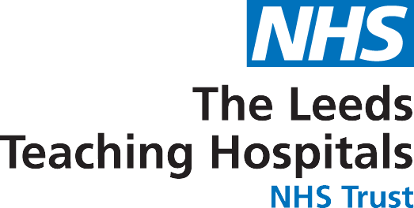
Background
In patient beds valuable
Dedicated lists aid patient flow
GIRFT – reduce variability and utilise day case
Re-admission rates lower for elective vs. emergency
Many units do ‘arch’ surgery as day case
“Reduction of fracture of zygomatic complex bones” now listed in BADS directory
Notes:
facial fractures that requires surgery and are immediately admitted to hospital as an inpatient, surgery can be delayed as theatre time is prioritised for more urgent cases. This can result in a lengthy preoperative hospital stay.
“Getting It Right First Time” (GIRFT) programme, which aims to reduce variability in outcomes for patients across hospitals in England. The 2018 GIRFT national report for oral and maxillofacial surgery recommended that trusts Improve theatre utilisation and use of day-case for emergency care in order to reduce length of stay for non-elective patients

Slide 3
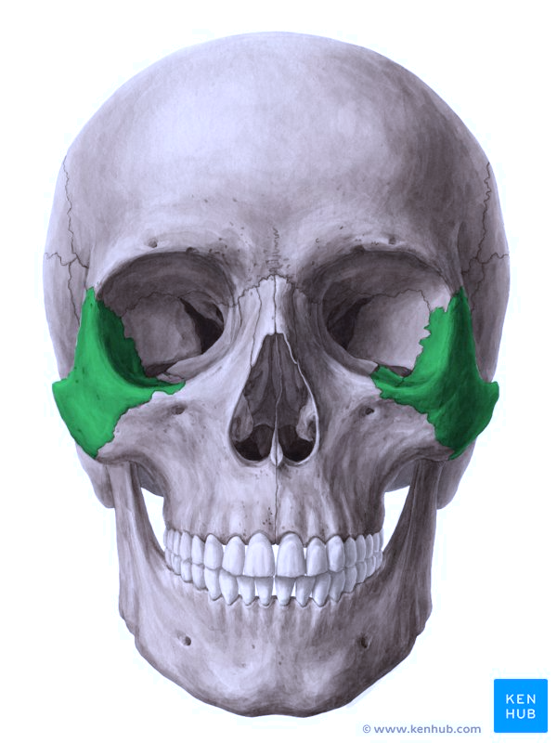
Anatomy
Zygoma forms inferior and lateral aspect of orbit
Fractures here can cause oedema and bleeding behind orbital septum
Surgical manipulation poses same risks
WWW.GALANCOMPANY.COM
Notes:
Zygomatic bone forms inferior and lateral aspect of orbit
Fractures here (ZMC and orbit) can cause oedema and bleeding bleeding behind the orbital septum
Elevating and maneuvering a fractured bone here pose same risks

Slide 4
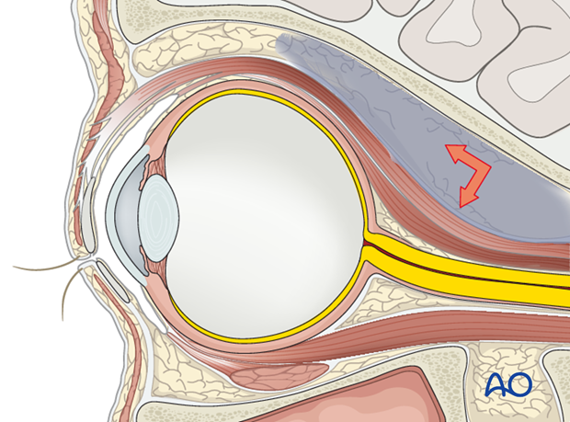
Orbital Compartment Syndrome
Space occupying lesion in the orbit -> anterior displacement of orbital structures as pressure increases
Nerve damage by direct compression by bony fragments or indirect compression mass effect

Slide 5
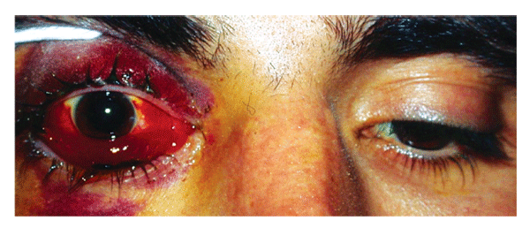
01
Pain
Eyelid haematoma
04
02
Proptosis
Nausea & vomiting
05
03
Subconjuctival haemorrhage
Visual disturbance
06
Notes:
Retrobulbar Haemorrhage
Pain
Proptosis
Subconjuctival haemorrhage
Eyelid haematoma
Vomiting and nausea
Visual disturbance

Slide 6
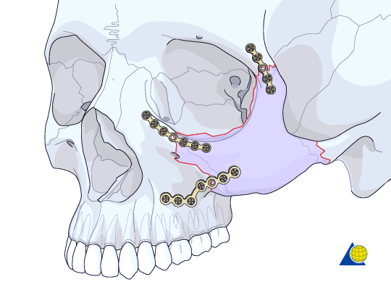
History
ZMC and orbit fractures requiring ORIF routinely admitted overnight for eye observations
Perceived risk of OCS

Slide 7
Literature
01
Ord et al. 1981
02
Barry et al. 2012
03
Combined
1405 patients with zygoma and orbital floor fractures
4 post-op RBH
1517 patients with zygoma fractures
3 post-op RBH (All immediate)
0.24%
Notes:
Ord et al. 1981 – Canniesburn, Glasgow
1405 patients with zygoma and orbital floor fractures
90% required surgery
4 post-operative retro-bulbar haemorrhages
Barry et al. – Ulster Hospital, Belfast
1517 patients with zygoma fractures
3 post-operative retro-bulbar haemorrhages, all immediately post-op
Combined 0.24%

Slide 8
Our Pathway
DAY 0
1 WEEK
2 WEEKS
4 WEEKS
A&E
Clinic
Surgery
Follow Up
> ED
> workup > referral
> 7 days > operative plan
> am surgery > 7 hrs eye obs > same day > discharge
> 2/52 post op
Notes:
No antibiotics
Current protocol at LGI
Pushed by appointment of dedicated OMFS trauma Consultant in late 2016
Surgery 2 post op doses

Slide 9
Methodology
Retrospective review
Jan 1st 2014 – 31st Dec 2020
Key terms: ‘ZMC’, zygoma, orbital floor, orbit, cheek bone, zygomatic maxillary complex
Collated on spreadsheet
Reviewed patient records
Notes:
Retrospective review of all electronic theatre records
Jan 1st 2014 – 31st Dec 2020
All those mentioning ‘ZMC’, zygoma, orbital floor, cheek bone, zygomatic maxillary complex compiled
Collated on electronic spreadsheet
Reviewed patient records for accuracy

Slide 10
Results
INCLUSION: 371
154 ZMC
68 arches
112 orbits
35 both
2 infra-orbital rims
01
03
INITIAL SEARCH: 415
SUCCESSFUL DAYCASE
44 discounted:
21 no orbital involvement
11 concomitant mandibular #
7 complex midface
3 pan-facial series
2 Frontal bone injuries
Overall 199/371 (53.6%)
Zygoma 91/154 (59%)
Orbits 46/112 (41%)
Both 10/35 (29%)
Arches 51/68 (75%)
IO rims 1/2 (50%)
02

Slide 11
Results
SURGICAL COMPLICATIONS
04
Minor post-op: 3
OCS: 4 (1.07%)
ALL WITHIN 4 HOURS
IN-PATIENTS: 172
Afternoon operation: 33
Major trauma patient: 22
Social issues: 3
Complex/CEPOD 1: 10
Medical complication: 3
Surgical complication: 7
Unclear from notes: 95
05
Notes:
7/371 = 1.9%
Buccal haematoma (1) – RTT
Epistaxis (1) – overnight stay with packs Balloon stabilisation arch required (1)
Orbital compartment syndrome (4) = 1.07%
1 zygoma:
1 immediate RTT
3 orbit:
2 return to theatre, 1 from recovery, 1 within 4 hours
1 opened lateral canthotomy on ward, medical treatment
CONCLUSION: am op, not MTC, no social, no emergency

Slide 12
Change Over Time
TRAUMA CONSULTANT
DEDICATED TRAUMA LIST
Notes:
This is percentage
ABSOLUTE NUMBERS STAYING FAIRLY STATIC
Trauma list availabilit

Slide 13
Notes:
Weve done a lot of work in Leeds where the majority of zygomas and midface and orbital injuries are treated as day case surgery….
We looked at the data… in partnetship with GIRFT…

Slide 14
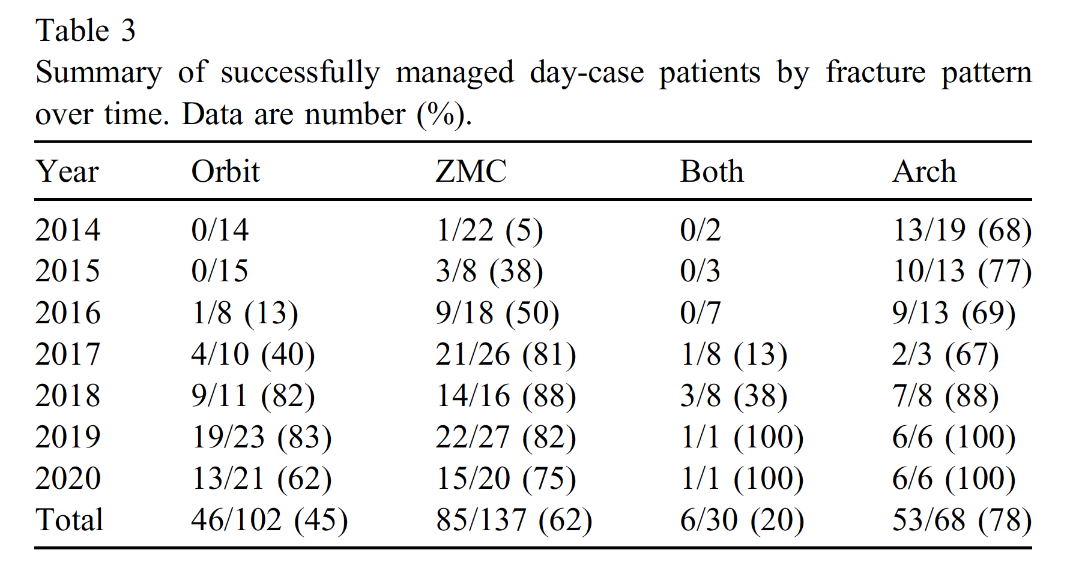
to DC surgery
Publication Data

Slide 15
Re-Audit
01/09/2021 to 31/08/2022
53 patients. 17 discounted:
2 No orbital involvement
2 concomitant mandibular fractures
8 complex midface (2x Le Fort 1, 6 multiply injured)
3 Upper ⅓ injuries
2 pan-facial series

Slide 16
Re-Audit 2021-2022
01/09/2021 to 31/08/2022
Included: 36 patients
16 ZMC fractures
5 arches
1 ZMC + orbital floor
7 Orbital floor repairs
7 Custom orbital implants
Successful day case:
Overall 32/36 (94.4%)
ZMC 13/16 (81.3%)
Arches 5/5 (100%)
ZMC + orbital floor 1/1 (100%)
Orbital floor (inc Custom) 13/14 (92%)
Notes:
Inpatients:
1 not geographically suitable
1 had unexpected intra-operative HTN which led to anaesthetic decision for overnight monitoring
1 PM operation plus not geographically suitable
1 patient planned as day case but developed post op tachycardia. Previously known to have PEs, and had had DOAC stopped prior to surgery. Had CTPA and kept overnight
Complications:
Minor post op 2/36
OCS 0/36

Slide 17
(re-audit) | Orbit | ZMC | Both | Arch
2021-2022 | 13/14 (92%) | 13/16 (81.3%) | 1/1 (100%) | 5/5 (100%)
Total | 59/116 (50%) | 98/153 (64%) | 7/31 (23%) | 58/73 (79%)

Slide 18
Increase Per Treatment Group

Slide 19
Conclusions
Day case surgery is safe
No cases of post-op OCS missed
Consolidating sub-specialist expertise aids success

Slide 20
References
Ord RA. Post-operative retrobulbar haemorrhage and blindness complicating trauma surgery. Br J Oral Surg. 1981 Sep;19(3):202-7
Barry T, Beresford A, Ramsay-Baggs P. Day case malar fracture reduction - is it safe?. British Journal of Oral and Maxillofacial Surgery. 2012;50:S10
Gray WK, et al. Can elective surgery for mandibular and zygomatic complex fractures reduce overall hospital stay without compromising outcomes? Analysis of administrative datasets by the GIRFT programme. Br J Oral Maxillofac Surg (2020)

