Slide 1
Safe Staffing at Ward Level: Getting it Right in Practice
Lena Johnson
RCN Professional Lead- Nursing Workforce (England)

Slide 2
Overview
#MyNameIs
Implementing RCN Workforce Standards on the ward
Managing staffing through fluctuating Demand
Business Continuity Plan
My experience on safe staffing
Challenges faced by Ward Managers

Slide 3
About me
BSc Biomedical Science
PGDip Adult Nursing
Ward Manager
50 Staff, Respiratory & Covid-19 Ward, Level 2 (HDU) Patients.
The Standards in Practice
PL-Nursing Workforce
NWS
Checklist
Workshops
Notes:
Acute Medicine mainly
To promote positive changes: patient, staff and myself
Nursing Workforce Standards to
Staff Retention
Improve staff wellbeing,
Establishment Review,
CPD/PPD
Improvement Project around Staff Redeployment

Slide 4
Challenges faced by Ward Managers
Vacancy
The Workforce
Absences
Organisational Support
Notes:
England (46,828) 47000 short
-40,000 left in the last year
University 8% less
length of time to train a nurse 2-3 years
International recruitment
Tired Workforce/ Overworked / underpaid/undervalued/
Industrial actions
Sickness Long-term and Short term, Annual leave, study leave – Planned and Unplanned
Long Covid / Stress related illness
Matron cover (awareness of the organisational challenges) one hospital team mentality

Slide 5
Implementing the RCN’s Nursing Workforce Standards
1. Responsibility & Accountability
2. Clinical Leadership & Safety
3. Health, Safety & Wellbeing
Notes:
Designed to support a safe and effective nursing workforce
3 Themes: Timely, cost-effective and sustainable care
What are the right number, skill, place & time
Legislation in some countries (Australia and Some part of the USA) VS
Acuity & Dependency / Professional Judgement
Retention and staff wellbeing

Slide 6
Implementing the RCN Workforce Standards on Our Ward
Rights
Numbers
Skills
Place
Time
Notes:
Ultimate Goal: Care that is
Safe
Compassionate
Effective
Patient-centred
High quality
Numbers,
Knowledge, Skills, competencies, attitude
Place and Time
Redeployment of staff???? Skills & Place

Slide 7
Responsibility & Accountability
Establishment
Mitigations
Raise concerns Early
Evidence-based practice
Notes:
Budget settings (service needs)
Be active, be involved. Have a say about your ward (apart from your staff, no one knows the ward more than you)
Biannual Safer Nursing tool :1f
No plan is set in stone- review the mitigations based on the ward’s needs & Risk assess (Right Skill, Place & Time)
Open & Honest. Transparency: Raise concerns to seniors & Datix
(Floor to Board Assurance)
National Standards (Acuity & Dependency) /professional Judgement
Senior Nurses Positively Engaging with Ward Teams

Slide 8
Responsibility & Accountability
RED FLAGS
Key Partners
Engage Staff
Fair Pay
Notes:
RED FLAGS: Increase Sickness & High Staff Turnover (Dashbooards) 2b
HR, Recruitment Team, OH, & Finance
Be proactive: Monthly meetings with partners:
Engagement: Listen, Enable, Encourage & Respond
Students are supernumerary
Hazard Pay: Covid-19 Patients

Slide 9
Ward Manager’s Supervisory Time
Working with new starters
Supervising Clinical Practice
Support with any complex issues
1:1
Appraisal
Clinical Supervision
Coaching
Listening Sessions
Teaching
Patient Experience
WM walk rounds
Audits
Complaints
RCA & SI
Datix Management
Roster
Sickness Management
Referrals
Organising Study Days
Planning
MDT
Service Line Meetings
Networking
Newsletters
Notes:
Standard 6: 100% SS Time Francis Report 2013 (Mid Staffordshire)
time & resources to deliver safe and effective care
Ward Manager Visibility
Safety, Quality of Care, Patient Experience/Outcome and Mental Health & Wellbeing of Staff
Learning, compassionate Leadership, Planning, innovation
CQC Well-led service
NMC (sharing knowledge and skills with staff to improve patient outcome
Take home === How much S/s do our ward managers have and how can we support them

Slide 10
Staff & Practice Development
Stretch & challenge staff
Career Progression
Succession Planning
CPD
Notes:
Link Roles : Leadership at all levels
Life Long Learning: Revalidation & Preceptorship
Continuous Profession Development
Clinical Supervision, Teaching & Training, Assessments
Staff portfolios for each member of the team
!monitor for discrimination, fair access
Embrace diversity

Slide 11
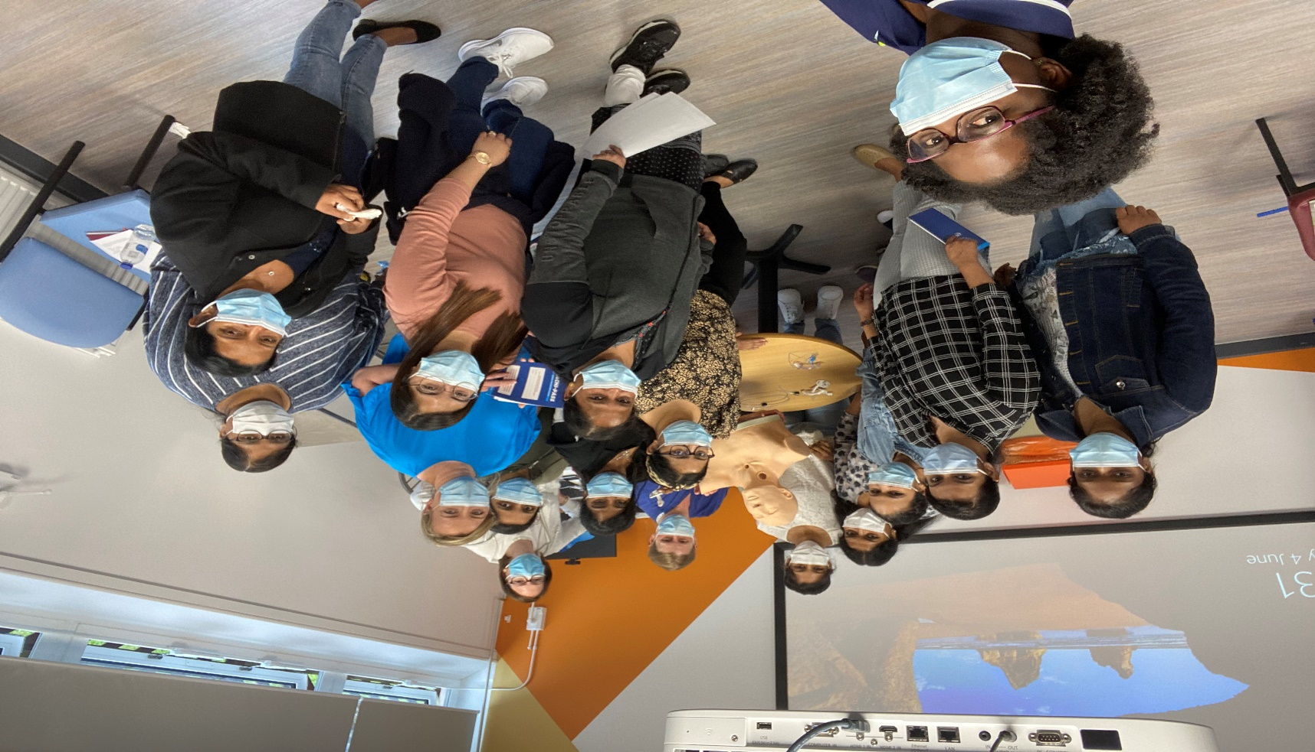
Practice Examples
Respiratory Study Days
Monthly Big Four
Shared Decision-Making Forum
Team Meetings
Accreditation
Notes:
Inviting other acute ward
Big Four: 4 top Issues (harm-free care, well-being, new initiatives)
Monthly SDM
Clinical Psychologists
Charity funding
Won Silver in our recent Accreditation

Slide 12
Clinical Leadership & Safety
Professional Judgement
Establishment Tools
Whole-Time Equivalent (WTE)
Uplifts
Notes:
Standard 8
Uplifts: Planned & Unplanned Leave
(AL, Sickness, Unplanned Absence, Training, Maternity, Compassionate Leave & Supernumery Time)
Staff isolation, Long Covid-19
Monthly Finance Meetings –Red Flags, Increased Negotiate
Bank and Agency Use
Induction and enable and encouraged ask for support and escalate concerns

Slide 13
Good Rostering
Flexible working
6 Days Off
Senior Visibility
Annual Leave
Notes:
Roster Analyser (Safe, Effective, within Budget & Fair)
Supporting staff = Staff Retention
Fixed shifts :Childcare needs, supporting the female dominate workforce
Good rostering (break between shifts, no more than 3 nights in a row),
24 Hours NIC day & Night
Band 6, 2nd On, Skill-mix & Experience
Overseas nurses: 3-4 weeks annual leave

Slide 14
Psychological Safety
Compassionate Leadership
Raising concerns
Career Opportunities
Diversity
Well Staff = Well Patients
Notes:
Compassion Leadership (style & Behaviour)
Respect, dignity & rights for staff
Individualised Staff Needs
Embrace & Celebrate Diversity (Europe, Asia, Africa, Australia & America)
Feel safe to raise concerns and will be listened to!!!!
NO BLAME CULTURE
Equal opportunities

Slide 15
Practice Examples
Open Door
Team Building
Wellbeing Tuesdays
Coping Skills Coaching Sessions
Samosa Fridays
Counselling/OH
Clinical Psychologist
WhatsApp group
Notes:
Confidential Care (CiC) details
Monthly, senior colleague
WhatApp rule but very supportive
Assertive skills- pushing back political leadership

Slide 16
Managing Staffing Through Fluctuating Demand
Summer Vs Winter
Annual Leave
Daily Escalation
Training
Notes:
Peak & Off-peak
Good Rostering
Timely AL, Training
Management Email
48 hour roster review by NIC
PEC (Patient Escalation Chart)
RED Escalation + Datix + Data Capture

Slide 17
Business Continuity Plans
Robust?
Responsive?
Reviewed?
Notes:
3 Rs
Area specific
Escalation when activated
Up to date

Slide 18
My Experience of Safe Staffing
Continually support wellbeing and engagement (ask staff & tell staff )
Notes:
It is hard & constant
Negotiation Skills & Use evidence-based
Continually support staff
All hands-on deck/ Team Approach
Self-care
24-48 Roster check by WM & NIC
Based on acuity & dependency : Daily PEC
ESCALATE !!!

Slide 19
Conclusion
Nursing Workforce
Visible leadership
Flexibility & Kindness
“Compassion leaders get the most out of their teams”
Notes:
ensuring patient’s care is safe & effective
Good visible leadership:
ensures our patients & staff get the best deal possible
WMs: making a difference and bringing positive changes
Working differently and being flexible supports your team the most
Safe staffing at ward level

Slide 20
References
Bedfordshire NHS Foundation Trust (2021) Our Trust THRIVED Values. Bedfordshire Hospitals, Bedford.
Department of Health (2000) Comprehensive Critical Care: A Review of Adult Critical Care Services. London: DH
Francis, R., 2013. Report of the Mid Staffordshire NHS Foundation Trust public inquiry: executive summary (Vol. 947). The Stationery Office.
Griffiths, P., Saville, C., Ball, J., Jones, J., Pattison, N., Monks, T. and Safer Nursing Care Study Group, 2020. Nursing workload, nurse staffing methodologies and tools: A systematic scoping review and discussion. International Journal of Nursing Studies, 103, p.103487.
HM Government (1974) Health and Safety at Work Act Act 1974. https://www.legislation.gov.uk/ukpga/1974/37/contents on 20/10/21
Kalisch, B.J., 2006. Missed nursing care: a qualitative study. Journal of nursing care quality, 21(4), pp.306-313.
NHS (2020) The People Plan 2020/21. NHS England, London.
NHS (2021) Our NHS People Promise. NHS England, London.
NHS (2021) The Matron’s Handbook for Aspiring and Experienced Matrons. NHS, London.
NHS Improvement (2018) The ward leader’s handbook. NHS Improvement, London.

Slide 21
References
NICE (2014) Safe Staffing for Nursing in Adult Inpatient Wards in Acute Hospitals. Safe Staffing Guideline. NICE, London.
NMC (2018) The Code, Professional Standards of Practice and Behaviour for Nurses and Midwives. NMC, London.
NHS (2022) NHS Vacancy Statistics England April 2015-June 2022 Experimental Statistics. NHS England, London
RCN (2010) Guidance on safe nurse staffing levels in the UK. RCN, London
RCN (2021) Nursing Workforce Standards: Supporting a Safe and Effective Nursing Workforce. RNC, London
Roper, N., Logan, W.W. and Tierney, A.J., 2000. The Roper-Logan-Tierney model of nursing: based on activities of living. Elsevier Health Sciences.
Senek M, Robertson S, Ryan T, King R, Wood E and Tod A (2020) The association between care left undone and temporary Nursing staff ratios in acute settings: a cross- sectional survey of registered nurses., BMC Health Services Research, 20(1), pp. 1–8. Available at: https://search.ebscohost.com/login.aspx?direct=true&AuthType=ip,shib&db=c8h&AN=144498160&authtype=shib&site=ehost-live&custid=s7108731&authtype=ip,shib (Accessed 29 September 2022)

Slide 22
Any questions?

Slide 23
Thank You
@LenaJohnsonS Lena.Johnson@rcn.org.uk
Notes:
Please do get in touch
Bespoke session on the NWS for senior managers and managers

