Slide 1
Integrating Human Factors and Ergonomics into Health and Social Care
Laura Askins- Postgraduate Clinical Lecturer- HF & Civility
Nov 2022

Slide 2
Aims and objectives
Share the experiences of South Tees NHS Foundation Trust in regards to integrating Human Factors principles to improve patient safety
Discuss the application of Human Factors and civility within our trust to improve quality of care
Demonstrate the impact of Covid-19 on safety at South Tees NHS Foundation Trust
Share a case study that demonstrates the application of the PESTO model (South Tees adapted SIEPS)

Slide 3
Background

Slide 4
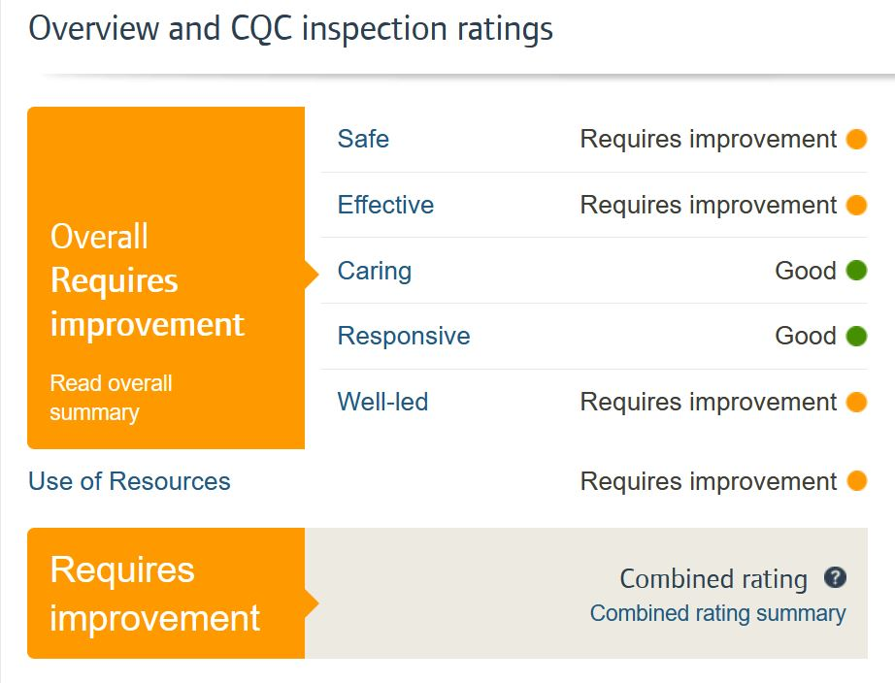
2019

Slide 5
LISA
Objective: Safety and Quality First
Strategy: Provide Leadership and Safety Development to support our clinical leaders of today and tomorrow to shape the safe care - and the teams delivering safe care – for the now and the future.
Tactics: To provide a range of evidence-based development opportunities to enable clinical leaders to have the core skills and leadership training to support the delivery of safe, quality care.
Notes:
Quite simply – STRIVE made a pledge to support full Trust learning in patient safety
We did this because we believe that leadership and safety are 2 sides of a coin and if we can come together and learn from each other we will lead a safer culture of care for our patients
Compassionate leadership enables shared learning

Slide 6
PEOPLE ARE INSPIRED & ENERGISED WHEN THINGS WORK BETTER

Slide 7
Where did we start?

Slide 8
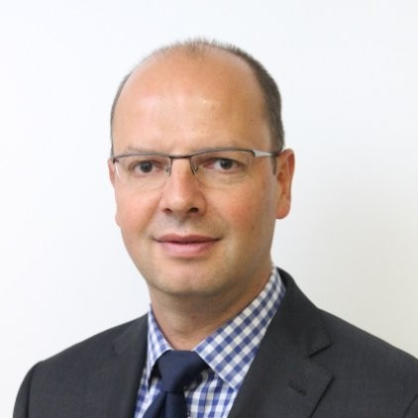
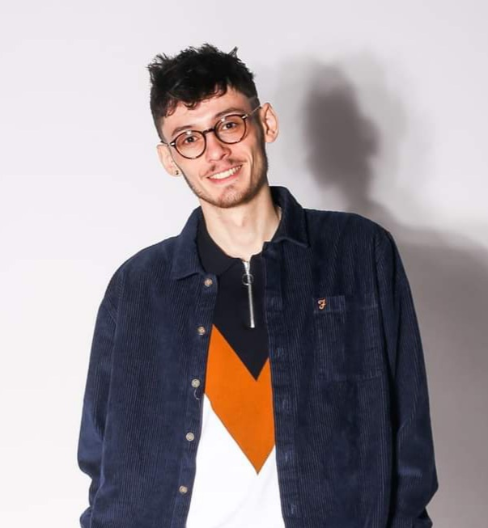
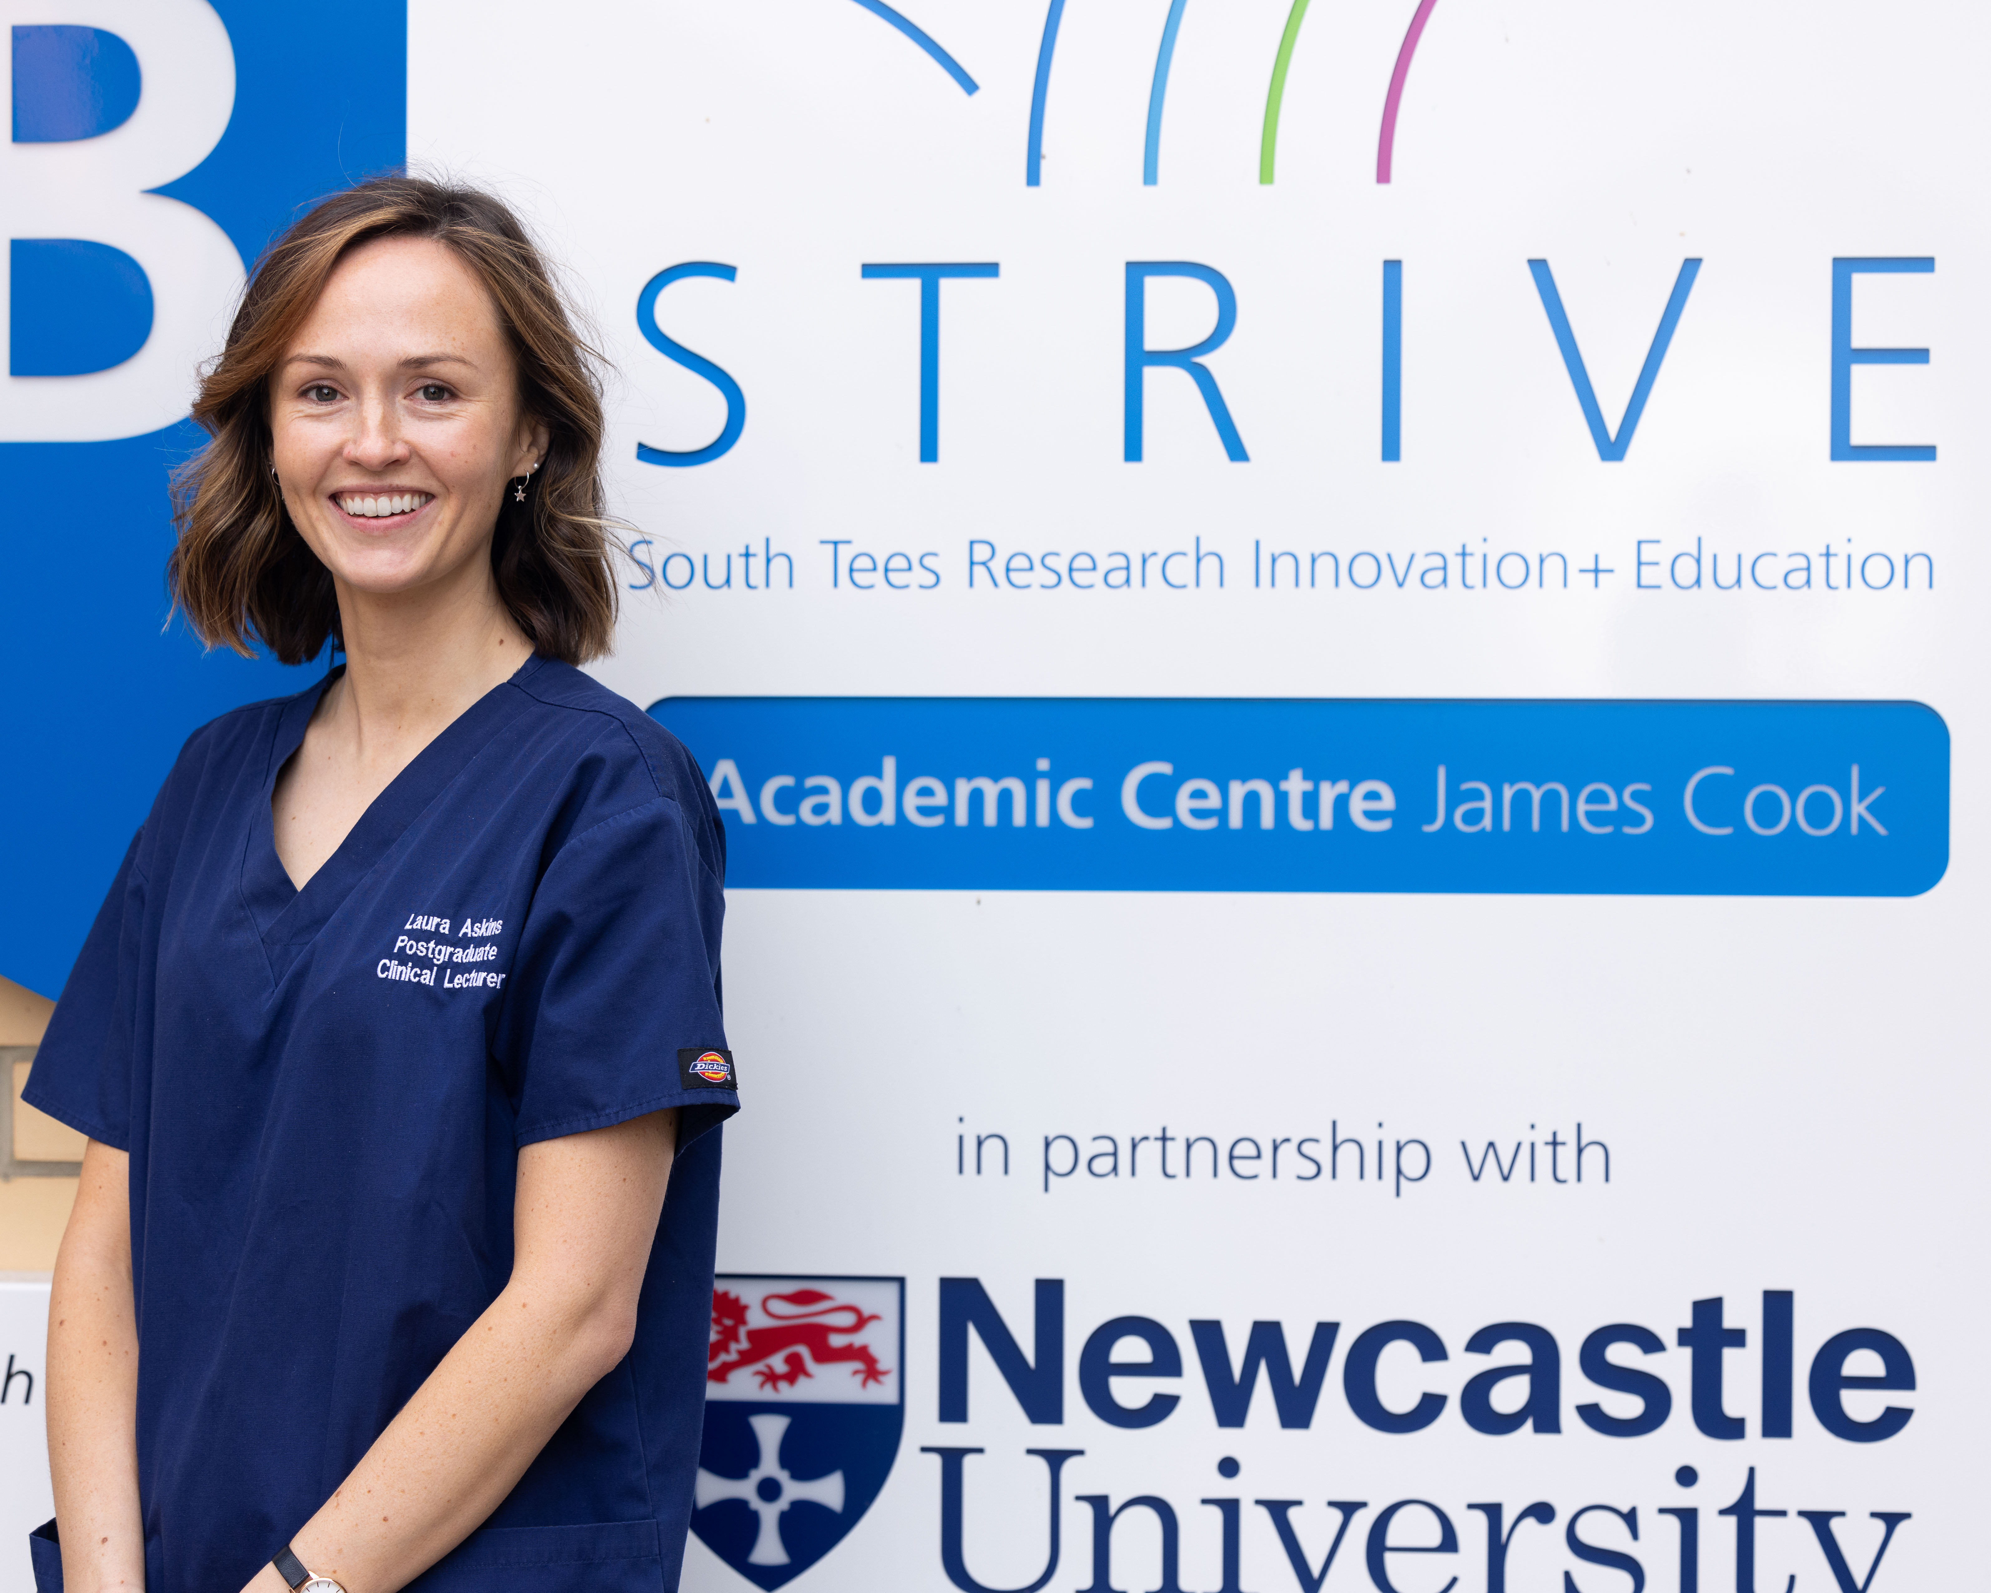
Faculty- difficult, initially targeted senior members of staff, spoke with SLT, CEO
Compiled a strategy
Recognised the link with leadership, OD and QI
Notes:
CWEE edit

Slide 9
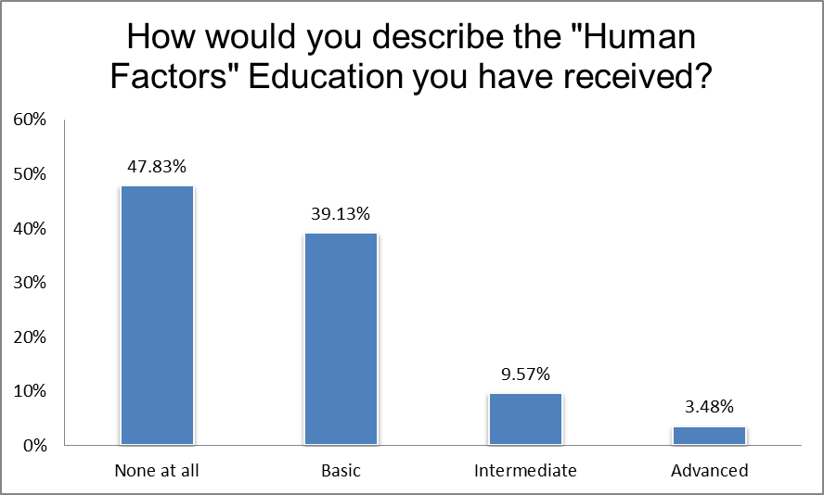
Notes:
CWEE edit

Slide 10
Patient Safety Day
Patient Safety Day 2
Nov 2020
Compassionate Leadership
Learning from incidents – medication safety, ng tubes, iv oromorph
LocSSIPS
LISA – what safety training means in STRIVE
Civility Saves Lives
Patient Safety Day 3
July 2021
Civility and Human Factors
Culture – how we each make a difference
Patient Safety Day 1
Safer Surgery Audits 2019 and 2020
2 half day safety education sessions
Shared learning across all surgical specialities with theatres leading to changes within theatre setting
Facilitated learning around safety incidents and what would make us safer
Patient Safety Day 4
Oct 2021
Civility saves lives
Learning from excellence – where can we go with Safety 2 learning?
Learning from incidents – nasogatric tubes
Culture for learning
Simulation and human factors
Maternity safety
Notes:
Thign to focus on is that inline with LISA mission, ¾ safety days included facilitated sessions around HF and civilty

Slide 11
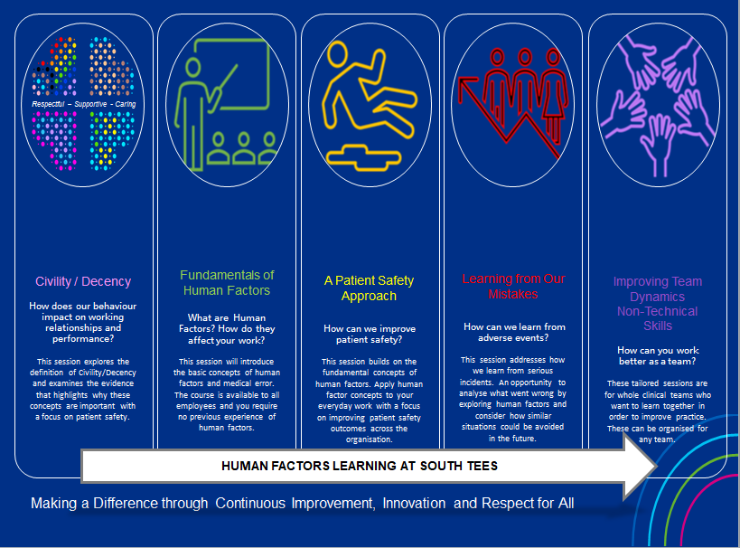

Slide 12
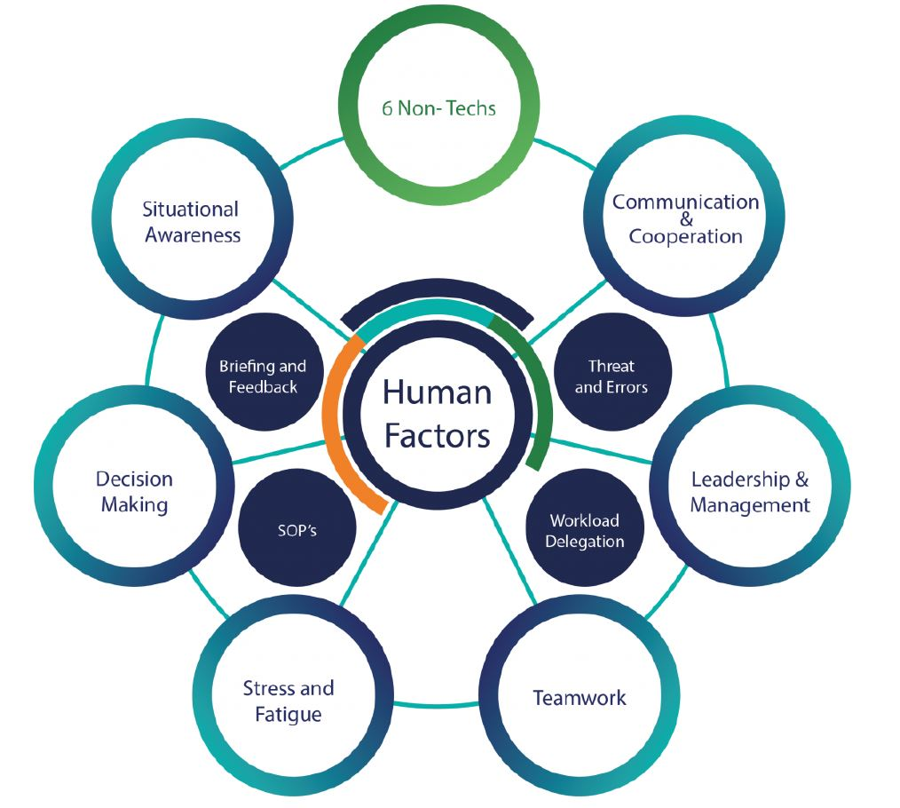

Slide 13
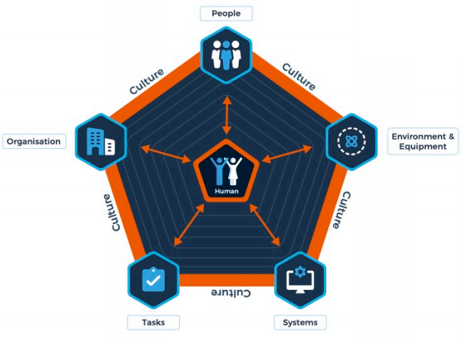
Risk arises when we interact with
People
Environment & Equipment
Systems
Tasks
Organisation
Notes:
One of the resources we developed was PESTO based on SIEPS

Slide 14
Resources
How did we deliver this?
Videos
Targeted introductions
Induction
Online resources
Consulting
45 minute session at induction
Online and Face to face teaching
Hospital based intelligence on teams that needed support
Worked with HR and safety team
Notes:
Hospital based intelligence: Freedom to speak up, DATIX and CQC. E.g. crit care had a surge of SI’s and never events so programe of learning and support was offered to them

Slide 15
Notes:
How did the impact of COVID affected the way we work, report and respond to incidents.

Slide 17
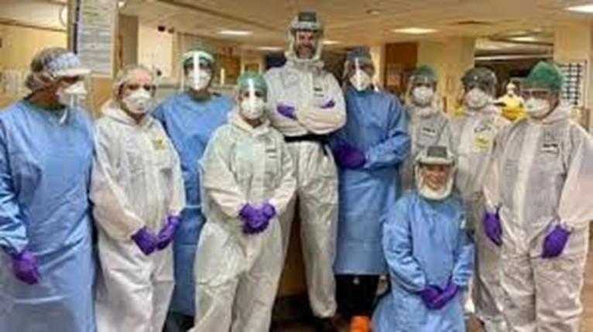

Slide 18
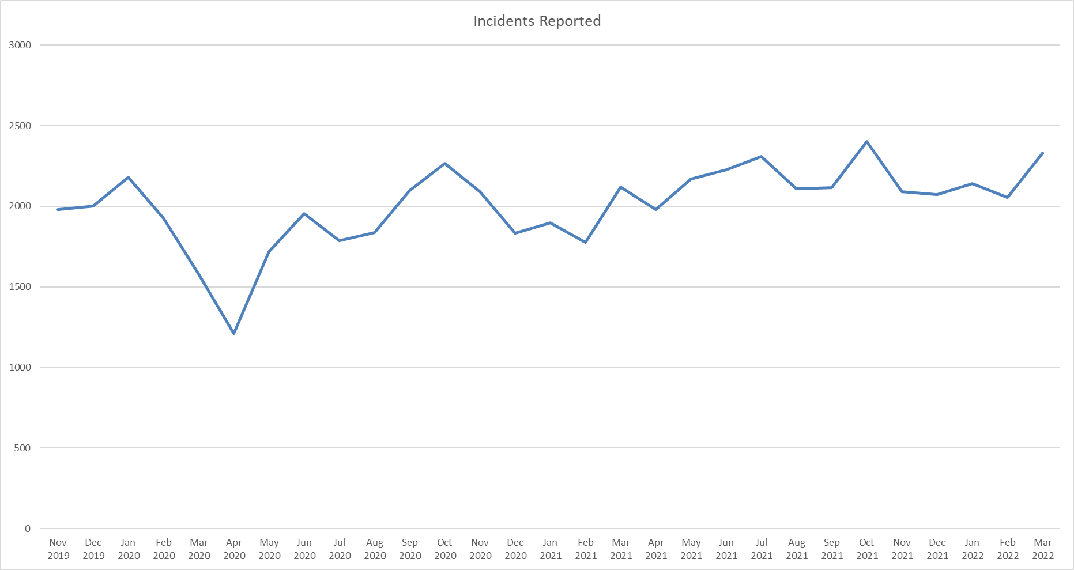
Incident levels during COVID

Slide 19
A case study
human factors: the impact of Covid-19

Slide 21
Task: Consider the content of the video and apply PESTO to understand why it may have happened?
People
Environment & Equipment
Systems
Tasks
Organisation
Notes:
5 mins

Slide 22
What’s next?

Slide 23
Results
Staff survey has improved- 2 years in a row
Incidence reporting initially increased, then levelled out however levels of harm have decreased significantly
Feedback is unanimously positive, tangible increase of awareness across the trust

Slide 24
What's next?
Build on HF and civility with psychological safety and joy at work
Restorative Just Culture integration
Discovery interviews and stronger links with OD
Measuring the impact

