Slide 1
The Caldicott Guardian and Safeguarding Concerns
Dr Joy Shacklock
RCGP Safeguarding Representative
Named GP for Adult and Child Safeguarding, North Yorkshire and City of York
GP Partner, Practice Safeguarding Lead and Homeless Health Lead, The Spa Surgery, Harrogate

Slide 2
Importance of information sharing
Golden thread of safeguarding
Essential to keeping children and adults safe from harm
Case study
Parent sharing concerns about their child being groomed

Slide 3
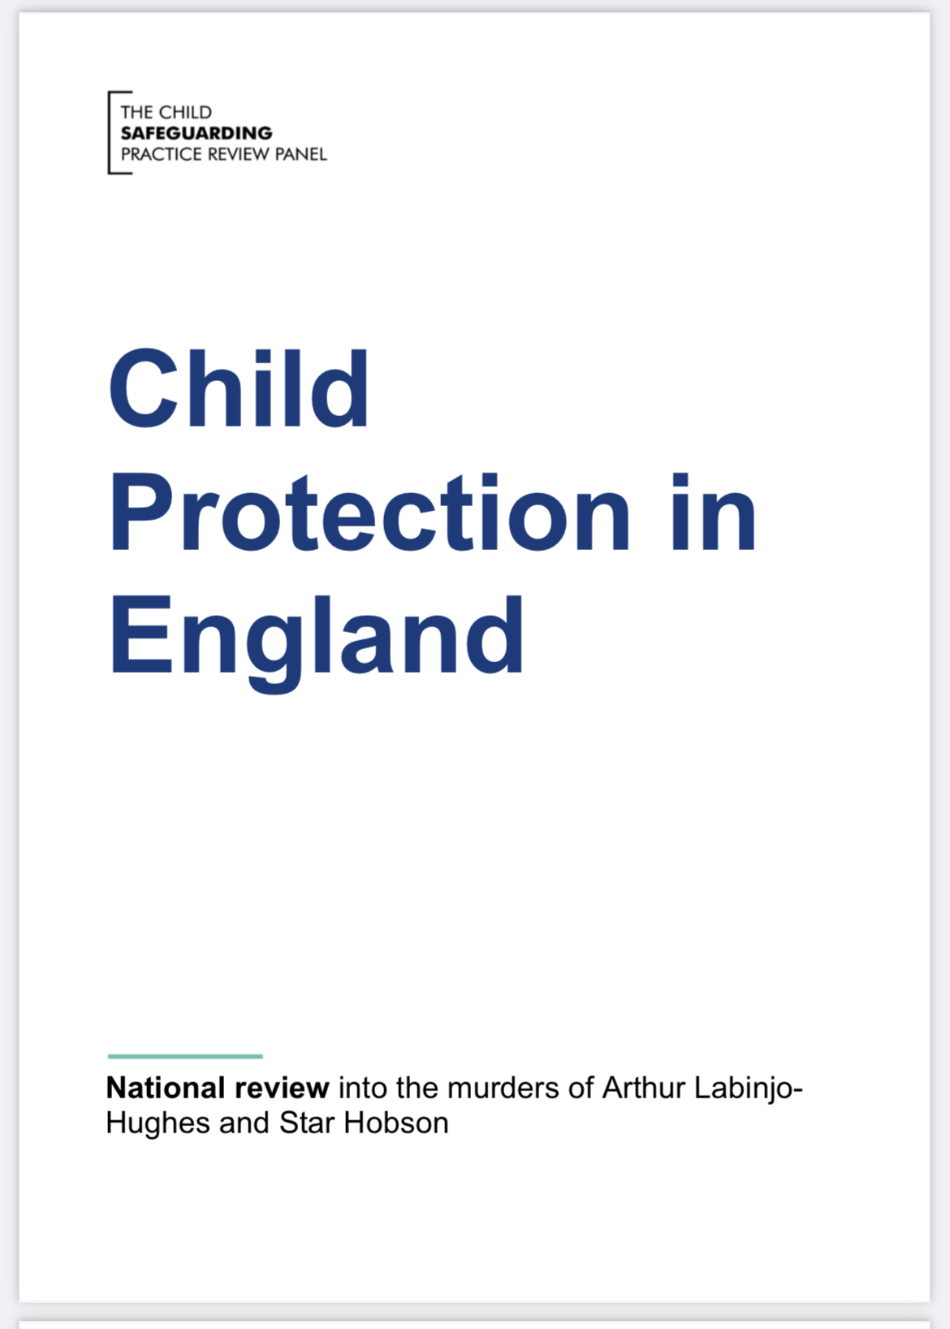
National Review into the murders of Arthur Labinjo-Hughes and Star Hobson
Child Protection in England - May 2022 (publishing.service.gov.uk)

Slide 4
Learning lessons from review around appropriate information sharing and seeking
To make good decisions about children in need of protection, professionals have to have a full picture of what is happening in a child’s life.
In Arthur and Star’s cases, three main information sharing issues:
a lack of timely and appropriate information sharing;
limited information seeking
evidence not being pieced together

Slide 5
Learning lessons around critical thinking and challenge within and between agencies
Prominent issues:
a lack of confidence to challenge decisions
a lack of clarity about how to escalate concerns
a lack of reflective space

Slide 6
Information Sharing
The GMC provides detailed guidance based on the law on confidentiality and information sharing.
“Sharing information appropriately is essential to providing safe, effective care both for the individual and for the wider community.”
GMC: Protecting children and young people: The responsibilities of all doctors
“Confidentiality is an important ethical and legal duty but it is not absolute .”
GMC: Confidentiality: good practice in handling patient information

Slide 7
Information Sharing
Information sharing is a key factor identified in many serious case reviews where poor information sharing has resulted in missed opportunities to take action that keeps children and young people safe.
Information sharing. Advice for practitioners providing safeguarding services to children, young people, parents and carers. Department for Education. July 2018
Sharing the right information, at the right time, with the right people, is fundamental to good practice in safeguarding adults but has been highlighted as a difficult area of practice.
Safeguarding Adults: Sharing Information January 2015, updated January 2019 https://www.scie.org.uk/safeguarding/adults/practice/sharing-information

Slide 8
Balancing Act…..

Slide 9
Risks of information sharing
Worsening abuse for the victim or someone else
Barrier to seeking healthcare
Breakdown of GP – patient relationship
Complaints/legal action

Slide 10
Challenges of information sharing
Increased requests from other agencies to share information e.g social care, Police
Often no information shared about why the information has been requested – e.g. what is the risk
Other agencies don’t understand complexity of confidentiality in a health setting nor that as GPs we are data controllers [Case study – Prevent]
GP’s lifelong relationship with patients often misunderstood
Agencies pick and choose which laws to quote to health
Consent - has it been given and who has given it – even if yes, is it true informed consent – do patients know what is in their record? [Case study – Police request/LD patient]
It is often information about parents/carers/adults that causes the most challenges

Slide 11
Challenges of information sharing continued..
Low level safeguarding concerns
To share or not to share?
If consent not given?
Subject Access Requests [Case study – abusive parent requesting child’s records]

Slide 12
When can information be shared without consent?
Other people are, or may be, at risk, including children
Sharing the information could prevent a serious crime
The alleged abuser has care and support needs and may also be at risk
A serious crime has been committed
Staff are implicated
The person has the mental capacity to make that decision but they may be under duress or being coerced
The risk is unreasonably high and meets the criteria for a multi-agency risk assessment conference referral
A court order or other legal authority has requested the information
Safeguarding Adults: Sharing Information January 2015, updated January 2019
https://www.scie.org.uk/safeguarding/adults/practice/sharing-information

Slide 13
Patient online access

Slide 14
What information is potentially harmful?
Important: any information can be used by perpetrators of abuse
Personal disclosures by patients of their experience of abuse or information about perpetrators of abuse including criminal records
Information from the police, social care and education services
Confidential third-party information
Mental health, substance abuse, contraception, sexual health, pregnancy, terminations, gender identity, etc

Slide 15
What harm can be caused?
DIRECT HARM
Coercion to share records (coercive control)
Increased risk of harm to victims of abuse, which could be life-threatening
e.g. victim of domestic abuse suffers physical violence as a ‘punishment’ for disclosure of abuse to a health professional
The ‘absence’ of information in the record can also infer to a perpetrator that their victim has disclosed abuse or other information
Can be used as another tool of abuse to control victims
Just as other methods are used such as monitoring emails, social media etc
Triggering significant distress or trauma reactions
Aggressive behaviour towards practice staff
Retraumatisation

Slide 16
What harm can be caused?
INDIRECT HARM
Barrier to healthcare
Loss of trust in confidential health service e.g victim of sexual exploitation no longer seeks healthcare for any health issues due to consultations no longer being confidential from their abuser
Persuasion to share records e.g. parents wanting to see records to support their child with their health but this can act as a barrier to the child seeking healthcare
Increasing health inequalities
E.g digital poverty, poor literacy, blind/visually impaired, use languages other than English, communicate in different ways
Professional behaviour change
Stop recording important information - especially ‘soft’ safeguarding information, professional concerns
Other professionals stop sharing information with primary care

Slide 17
Who might be more vulnerable to coercion to share or misuse online access?
16 – 17 year olds, especially LAC, those on CPP
Victims of any type of abuse, especially domestic abuse, modern slavery, trafficking & exploitation of any kind
Those with learning disabilities, dementia, autism
Asylum seekers and those whose immigration status is uncertain
Those with severe mental illness
Those with substance misuse issues
Prisoners
Those with visual impairment/blind, poor literacy, use languages other than English, communicate in different ways, have other accessibility issues such as dyslexia
https://www.rcgp.org.uk/patientonline

Slide 18
What do you do if you suspect a patient is in an abusive situation?
Ideally: discuss with the patient F2F on their own
share your concerns,
manage risk and concerns about abuse in the usual way, follow your usual safeguarding procedures (child and adult)
discuss online access
Risk of coercion to access records?
How risks can be mitigated as much as possible
If the patient is adamant that there is no abuse but you still have significant concerns:
Discuss with practice safeguarding lead/Caldicott guardian to make a decision on whether online access should be granted/disabled

Slide 19
Risk assessment

Slide 20
How do you risk assess ?
Do we have all the information we need to make a decision?
If not – request the information you need
What is the risk of harm to this child/adult?
The most vulnerable person in the situation may not be your patient
Consent
Do you have it? Is it from the right person?
Do you need it?
Do you need to gain consent yourself? [case study – Army request for records]
What is the risk of sharing information?
What is the risk of not sharing information?
High risk decisions should always be discussed and shared
Relevant and proportionate information sharing

Slide 21
Be a critical friend
As a Caldicott Guardian you are so, so important in safeguarding
Embed a culture of openness, discussion and respectful challenge
Be a critical friend to your colleagues and in particular, your safeguarding lead
Don’t be afraid to ask for advice or help

Slide 22
Questions

