Slide 1
Working in and embedding your Maternity Voices Partnership
Emma Taylor
South East Maternity Service User Voice & MVP Network Lead
Maternity Voices Partnership Chair, Reading, Wokingham, & West Berkshire
Chair, Shared Voices Network, RCM
Director, National Maternity Voices
© Copyright National Maternity Voices 2022

Slide 2
What is an MVP?
Maternity Voices Partnership
Service users (women, partners, and their families)
Maternity commissioners
Midwives, doctors and maternity support workers
Service user representatives (doulas, antenatal teachers)
Other stakeholders (Health Visiting, breastfeeding organisations, HealthWatch)

Slide 3
Different models of working
Chair
Vice chair
Co-chair
Secretary
Project lead
Equity lead
Volunteer parent reps

Slide 4
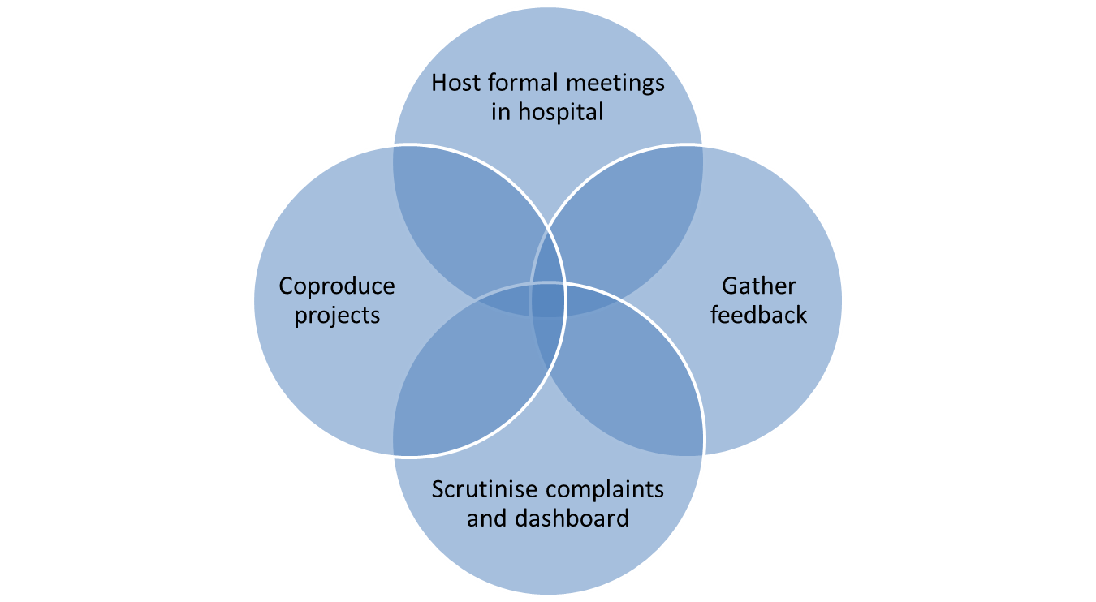
What an MVP does
Build relationships
Surveys
Focus groups
Events
Critical friend
Community work

Slide 5
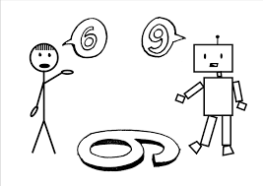
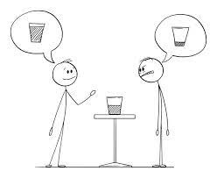
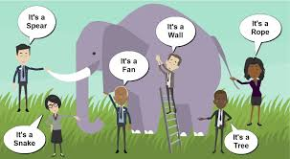
Challenge and perspectives

Slide 6
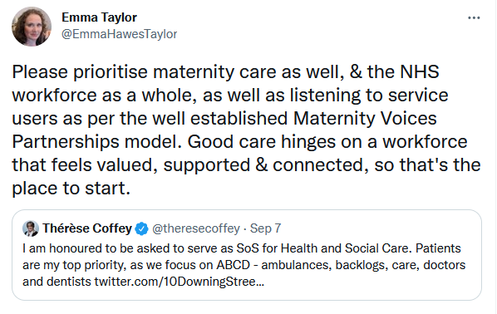

Slide 7
Service users spearhead safety

Slide 8
Why use service user feedback in safety?
Triangulation: a technique to analyse results of the same study using different methods of data collection.
Used for three main purposes: to enhance validity, to create a more in-depth picture of a research problem, and to interrogate different ways of understanding a research problem.
Most often, triangulation helps validate research findings by checking that different methods or different observers of the same phenomenon produce the same results. It can also be used to interrogate inconsistencies and data that are not expected to align.

Slide 9
Evidence-based approach to involving service users
Commitment to safety and improvement at all levels, with everyone involved
Technical competence, supported by formal training and informal learning
Teamwork, cooperation and positive working relationships
Constant reinforcing of safe, ethical and respectful behaviours
Multiple problem-sensing systems, used as basis of action
Systems and processes designed for safety, and regularly reviewed and optimised
Effective coordination and ability to mobilise quickly
These features appear to have a synergistic character, such that each feature is necessary but not sufficient on its own: the features operate in concert through multiple forms of feedback and amplification.
Seven features of safety in maternity units: a framework based on multisite ethnography and stakeholder consultation Liberati EG, Tarrant C, Willars J, et al. BMJ Qual Saf 2021;30:444–456.

Slide 10
Evidence-based approach continued…
“In our original analysis, we identified the importance of monitoring multiple sources of intelligence as a feature of maternity unit safety. Our extended analysis reaffirmed this while further emphasising the value of using multiple problem-sensing systems as a basis of action.
“This feature was visible when staff gathered insights and knowledge from multiple sources to continuously learn and improve, and those in management roles acknowledged the importance of listening to those at the frontline of care.
“Members of staff and families accessing the service were actively encouraged to share ideas and concerns, and their experience was used to sense problems, self-assess and learn.”

Slide 11
Evidence-based approach continued…
“Critical to harnessing soft intelligence was the nurturing of a psychologically safe environment, where people felt they could share ideas and concerns, that they would be taken seriously and that action will be taken as a result.”

Slide 12
Requirements
CNST Safety Action 7:
Can you demonstrate that you have a mechanism for gathering service user feedback, and that you work with service users through your Maternity Voices Partnership (MVP) to coproduce local maternity services?
Ockenden Immediate and Essential Action 2:
Maternity services must ensure that women and their families are listened to, with their voices heard.
CQC inspections must include an assessment of whether women’s voices are truly heard by the maternity service through the active and meaningful involvement of the Maternity Voices Partnership.

Slide 13
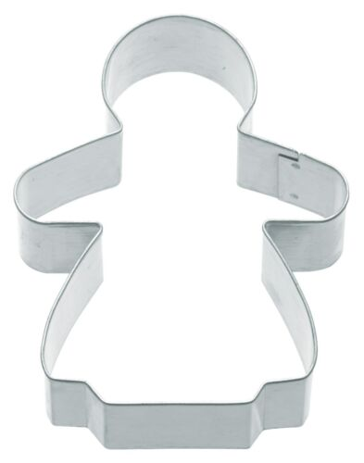
Balancing safety and individual decision making

Slide 15
What types of meeting should the MVP service user chair attend?
Clinical governance
LMNS board
Maternity services steering group
LMNS SI panel
Obs & gynae board
Intrapartum strategy

Slide 16
Who should the MVP service user chair have meetings/conversations with?
Safety champions
Director of Midwifery
Head of Midwifery
Chief Nurse
Maternity NED
Team leads

Slide 17
“A wide-ranging report by the Health and Social Care Committee on maternity safety in England finds that improvements in maternity services have been too slow, with the CQC’s Chief Inspector of Hospitals reporting evidence of a ‘defensive culture’, ‘dysfunctional teams’ and ‘safety lessons not learned’. Professor Ted Baker told the inquiry that more than a third of CQC ratings for maternity services identified requirements to improve safety, larger than in any other specialty.”

Slide 19
THANK YOU
I’D LOVE TO HEAR YOUR QUESTIONS
Continue the conversation:
Twitter: @EmmaHawesTaylor
LinkedIn: emmahawestaylor

