Slide 1
Pressure Ulcers Prevention at the end of life
Anne Nash March 2022

Slide 2
Aims
Discuss experience of supporting staff to prevent, recognise and manage pressure ulcers toward the end of life
Improving pressure ulcer prevention for end of life patient’s. Our experience
Pressure ulcers and frailty
Training carers to support the reduction of pressure ulcers at home

Slide 3
NICE definition ( 2014)
Pressure ulcers are caused when an area of skin and the tissues below are damaged as a result of being placed under pressure sufficient to impair its blood supply

Slide 4
Pressure Ulcer quality standards June 2015
Risk assessment in hospitals and care homes
Risk assessment by community nursing services
Reassessment
Skin assessment
Advise on repositioning
Help with repositioning
Pressure redistribution devices
Prevention of medical device related pressure ulcers

Slide 5
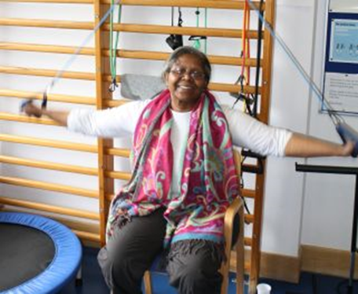
Hospice experience
Challenges of care

Slide 6
Hospice UK National Patient Safety Programme 2021 /2022
168 hospices took part in the data collection
7,440 pressure ulcers reported Nationally by Hospices across the UK .
44 % of those Pressure ulcers on admission
The larger hospices national average approx. 23.2% ulcers per quarter
St Christopher’s between 54- 71% per quarter
Over the year of 2021- 22
St Christopher’s has 37 ulcers that were category 3 and above – compared to 9 per year average nationally

Slide 7
34% of pressure ulcers developed on the Units Nationally across the Hospice population
Over a year St Christopher’s noted
32 ulcers that were category 1 ulcers Compared to Hospice average of 8
31 category 2 – compared hospice average of to 7.8

Slide 8
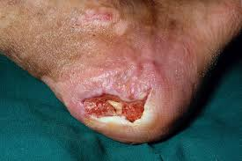
Challenges of pressure ulcer prevention and frail older people
Landi , Onder, Usso , Bernabei 2007 , Campbell 2009 , Barry and Nugent 2015
Social isolation
Clinical leadership
Need for staff education
Multi- professional team work
Mortality risks
Need for joint working and communication between services
Use of frailty model

Slide 9
Support to Staff
Regular clinical update – focusing on themes that emerge for recent RCA’s
Bi-monthly tissue viability group – links for all areas including community and AHP to focus , reflect and update on care practices
Quality Improvement
To focus on repositioning
Focusing on use of AHP team to support patient and cares understanding around pressure ulcer care and repositioning
Learning from RCA’s
Use of frailty score
Use of AKPS (Australia – modified Karnowski Performance Status)

Slide 10
Example of our Quick quiz
What is the time standard for skin and wound assessment when a patient is admitted?
How many different mattresses are available in the IPU?
How many can you name and what level of pressure ulcer are they suitable for ?
Where would you find tissue viability guidance ?
What is the name of the PU risk assessment tool we use on the IPU?
Where can this tool be found in the electronic record
What are the 5 elements of the SSKIN bundle?
What is the difference between a category 2 and category 3 pressure ulcer?

Slide 11
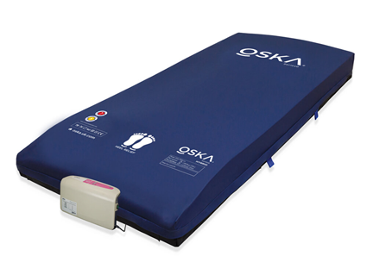
Regular updates on Mattresses
OSKA hybrid Mattresses
Use with or without a pump
We have Lateral tilt and Alternating
Bottom left on the cover gives detail of pressure relief specifications.
OSKA have devised a system, the OSKA Selector, to help carers identify if the patient is on the correct mattress

Slide 12
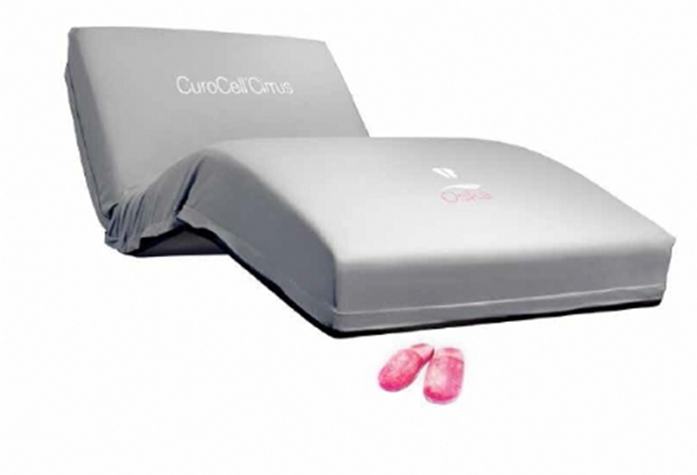
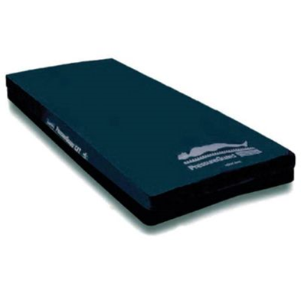
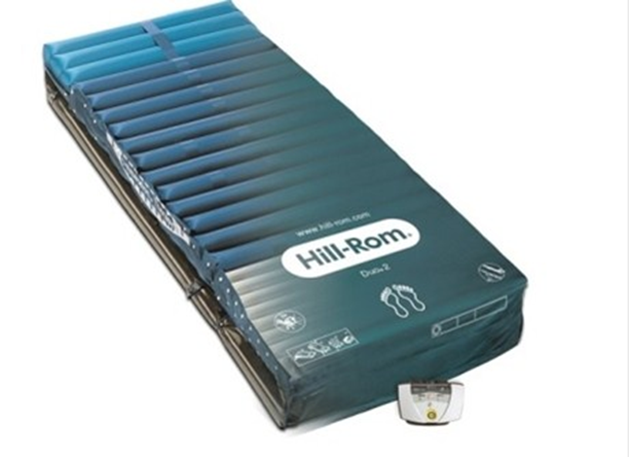
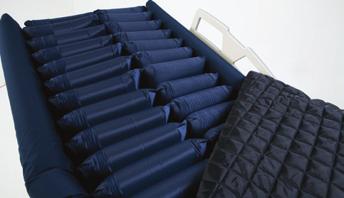
Mattresses in IPU
Non-powered hybrid mattress
Prevention rating: High Risk
Treatment: Category 2*
ClinActiv+ MCM
Prevention rating: Very High Risk Treatment (Pumped): Deep - Category 3 & 4
Bari10a Turncair Mattress
Prevention rating: Very High Risk
Treatment (Pumped):
Deep - Category 3 & 4
PressureGuard® APM Bariatric
Prevention rating: Very High Risk
Treatment (Pumpless): Superficial - Category 1 & 2
Currently on Medstrom bed

Slide 13
Challenges for us
Patient Capacity and balancing understanding of risk and benefit of repositioning and quality of life
Assessment of darker skin tones
Nice Guidance notes that there is not currently enough evidence for the recommendation for diagnosis tools – such as sub-epidermal moisture scanning
Need for further evidence base research with the Challenges of researching these ethically vulnerable Patients – study Gillian Raine 2021
– 22 bed hospice 47% reduction with the need to consider the hawthorn effect
Our experience .

Slide 14
PAN PACIFIC PRESSURE INJURY CLASSIFICATION SYSTEM FOR DARK SKIN TONES
Normal skin |  | Text adapted from: International NPUAP/EPUAP Pressure Ulcer Classification System (2009,2014) published in in National Pressure Ulcer Advisory Panel (NPUAP), European Pressure Ulcer Advisory Panel (EPUAP), Pan Pacific Pressure Injury Alliance (PPPIA), Prevention and Treatment of Pressure Ulcers: Clinical Practice Guideline. 2014: Emily Haesler (Ed.) Cambridge Media: Osborne Park, WA. 3D graphics: Owned by PPPIA. Photos: All photos courtesy Dr Keryln Carville, used with permission. Also available in this series: PPPIA Classification System: Multicultural, PPPIA Classification System for Adults with Light Skin Tones, PPPIA Classification System for Neonates and Children, PPPIA Classification System for Asian Skin Tones, PPPIA Classification System for Older Adults. More information and permission for use:www.pppia.org © PPPIA 2020
Stage 1 Stage 2 Stage 3 Stage 4 Unstageable Suspected Deep Tissue Injury
Intact skin with non-blanchable redness of a localised area usually over bony prominences. Darkly pigmented skin may not have visible blanching; its colour may differ from the surrounding area. The area may be painful, firm, soft, warmer or cooler as compared to adjacent tissue. Stage I pressure injuries may be difficult to detect in individuals with darkly pigmented skin tone. May indicate ‘at risk’ individuals (a heralding sign of risk).
Partial thickness loss of dermis presenting as a shallow open ulcer with a red/pink wound bed, without slough. May also present as an intact or
open/ruptured serum-filled blister. Presents as a shiny or dry shallow ulcer without slough or bruising (bruising indicates suspected deep tissue injury). Stage 2 pressure injuries should not be used to describe skin tears, tape burns, perineal
dermatitis, maceration or excoriation.
Full thickness tissue loss. Subcutaneous fat may be visible, but bone, tendon or muscle are not exposed. Slough may be present but does not obscure depth of tissue loss. May include undermining and tunnelling. The depth of Stage 3 pressure injuries varies by anatomical location. The bridge of nose, ear, occiput and malleolus do not have subcutaneous tissue and Stage 3 ulcers can be shallow. In contrast, areas of significant adiposity can develop extremely deep Stage 3 pressure injuries. Bone/tendon is not visible or directly palpable.
Full thickness tissue loss with exposed bone, tendon or muscle. Slough or eschar may be present on some parts of the wound bed. Often include undermining and tunnelling. The depth of a Stage 4 pressure injury varies by anatomical location. The bridge of nose, ear, occiput and malleolus do not have
subcutaneous tissue and these ulcers can be shallow. Stage 4 pressure injuries can extend into
muscle and/or supporting structures (e.g. fascia, tendon or joint capsule) making osteomyelitis possible. Exposed bone/tendon is visible or directly palpable.
Full thickness tissue loss in which the ulcer base is covered by slough (yellow, tan, gray, green or brown) and/or eschar (tan, brown or black) in the wound bed. Until enough slough and/or eschar is removed to expose the base of the wound, the true depth, (and therefore Stage) cannot be
determined. Stable (dry, adherent, intact without erythema or fluctuance) eschar on the heels serves as ‘the body’s natural (biological) cover’ and should not be removed.
Purple or maroon localised area of discoloured intact skin or blood-filled blister due to damage of underlying soft tissue from pressure and/or shear. The area may be preceded by tissue that is painful, firm, mushy, boggy, warmer or cooler as compared to adjacent tissue. Deep tissue injury may be difficult to detect in individuals with dark skin tones. Evolution may include a thin blister over a dark wound bed. The wound may further evolve and be covered by thin eschar. Evolution may be rapid, exposing additional layers of tissue even with optimal treatment.

Slide 15
a.nash@stchristophers.org.uk

