Slide 1
Prescribing in Immuno-oncology
Trudy-Jane Guinan
IO Nurse Consultant

Slide 2
Aims
Introduce Immunotherapy.
Understand toxicities related to Immunotherapy.
The management of toxicities.
The prescribers role in the management of these toxicities.

Slide 3
Immunotherapy – A wide field
Immunotherapy
Monoclonal Antibodies
Oncoolytic virus therapy
T-Cell Therapy
Cancer Vaccines
Non-specific Immunotherapy
Checkpoint Inhibitors
CTLA4
ipilimumab
PD1
nivolumab
pembrolizumab
Interferons
interleukins
PD L1
atezolizumab
Olsson-Brown, 2018

Slide 4
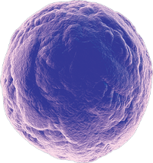
Immunotherapy
[ˌɪmjʊnəʊˈθɛrəpi, ɪˌmjuːnəʊˈθɛrəpi]
NOUN
medicine
the prevention or treatment of disease with substances that stimulate the immune response.
Tumor Specific
T Cell
Activation of a person’s own immune system to identify and target their cancer
CTLA-4
PD-1
CD28
T Cell Receptor
MHC
PD-L1
B7
Tumor Cell or Antigen Presenting Cell
CD = cluster of differentiation; CD28 = T cell‒specific surface glycoprotein CD28; CD80 = T‑lymphocyte activation antigen CD80; CD86 = T‑lymphocyte activation antigen CD86; CTLA‑4 = cytotoxic T‑lymphocyte protein 4; PD‑L1 = programmed cell death ligand.
Image adapted from Ford ML, et al. Nat Rev Nephrol. 2014;10:14-24 and Pardoll. Nat Rev Cancer 2012. Text taken from google.

Slide 5
Just the beginning………..

Slide 6
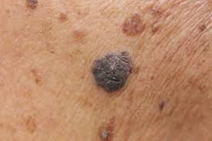
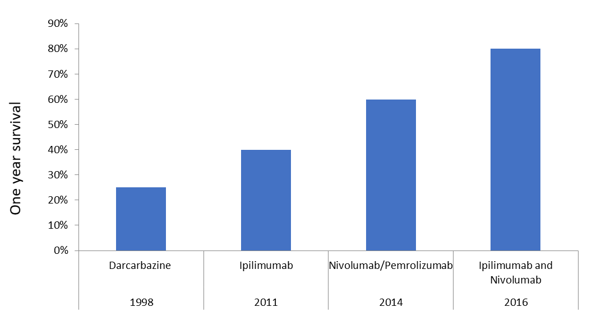
The impact of IO in melanoma
Very poor prognostic malignancy prior to the introduction of immunotherapy and (for some) targeted agents
Median prognosis was 7 months from diagnosis to death up until the early 2000’s
Chemotherapy had a limited role due to very limited efficacy (ORR 5%)
One year overall survival increased from ~20% to ~80% with the introduction of checkpoint inhibitors
Early suggestions are a 2 year enduring response in ~50% of individuals
Response to immunotherapy continues after drug is stopped due to toxicity and often responses can be seen after initial progression
https://www.researchgate.net/figure/Fig-1-FDG-PET-scan-images-of-a-patient-with-metastatic-melanoma-before-A-and-after_fig1_51925763

Slide 7
Indications for use
ICI
Immunotherapy
Melanoma
NSCLC
Renal Cell Carcinoma
Urothelial malignancies
Head and neck malignancies
Hodgkin Lymphoma
Merkel Cell Carcinoma
Upper GI malignancies
Triple Negative Breast Cancer
3040 clinical trials
Skin Squamous Cell Carcinoma
Clatterbridge Cancer Centre.

Slide 8
Immune Related Adverse Events irAE’s
Checkpoint inhibitors block the inhibitory mechanisms that suppress the body’s immune system, these mechanisms protect tissues from an unconstrained immune response.
Whilst the use of Immunotherapy has transformed the treatment of cancer; it has exposed a group of immune related adverse events (irAEs). Many of these events/toxicities are driven by the same mechanisms that produce the drugs therapeutic effects.

Slide 9
Immune Related Adverse Events
Whilst the use of Immunotherapy has transformed the treatment of cancer; it has exposed a group of immune related adverse events (irAEs). Many of these events/toxicities are driven by the same mechanisms that produce the drugs therapeutic effects.
When toxicity occurs it is as a result of a uncontrolled immune system for which there is no extrinsic control therefore it is likely that patients will need to be treated with Immuno-suppressants as the toxicities rarely resolve on their own.
Early recognition and intervention is of paramount importance.
Timely access to corticosteroids is key!

Slide 10
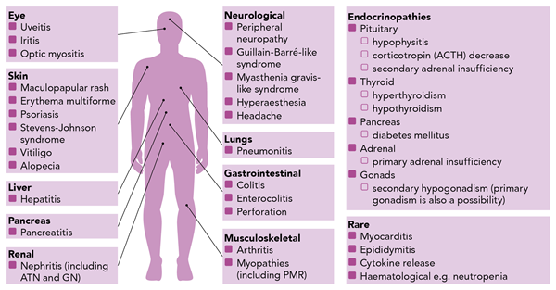
Immune-Related Adverse Events (irAEs)
Olsson-Brown, Harker. 2018. Guidelines in Practice

Slide 11
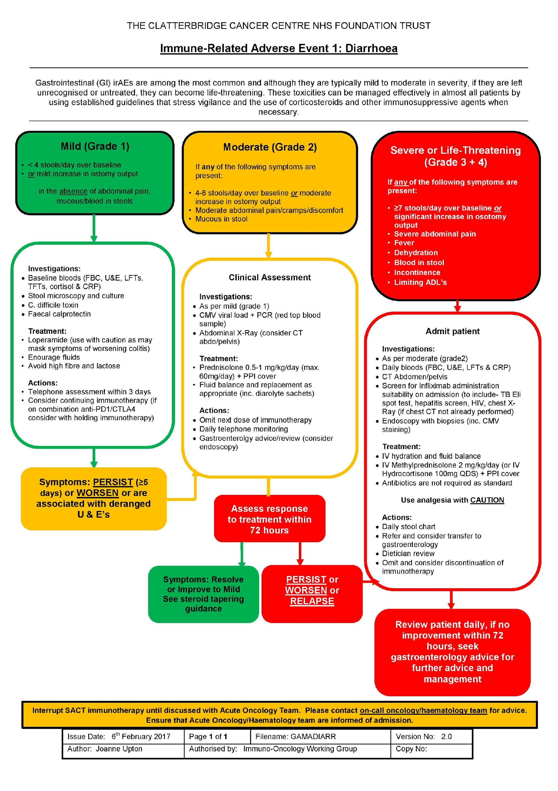
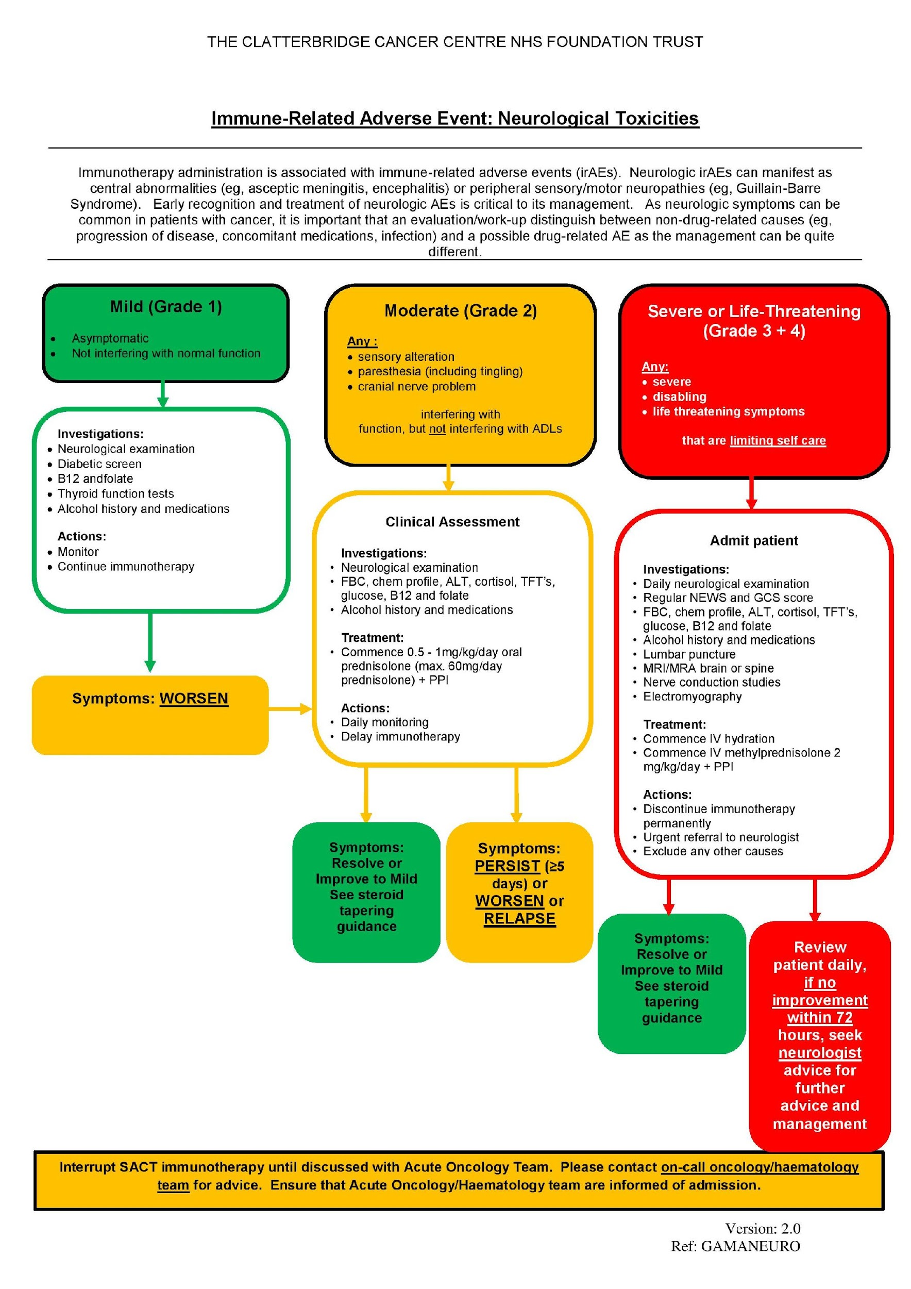
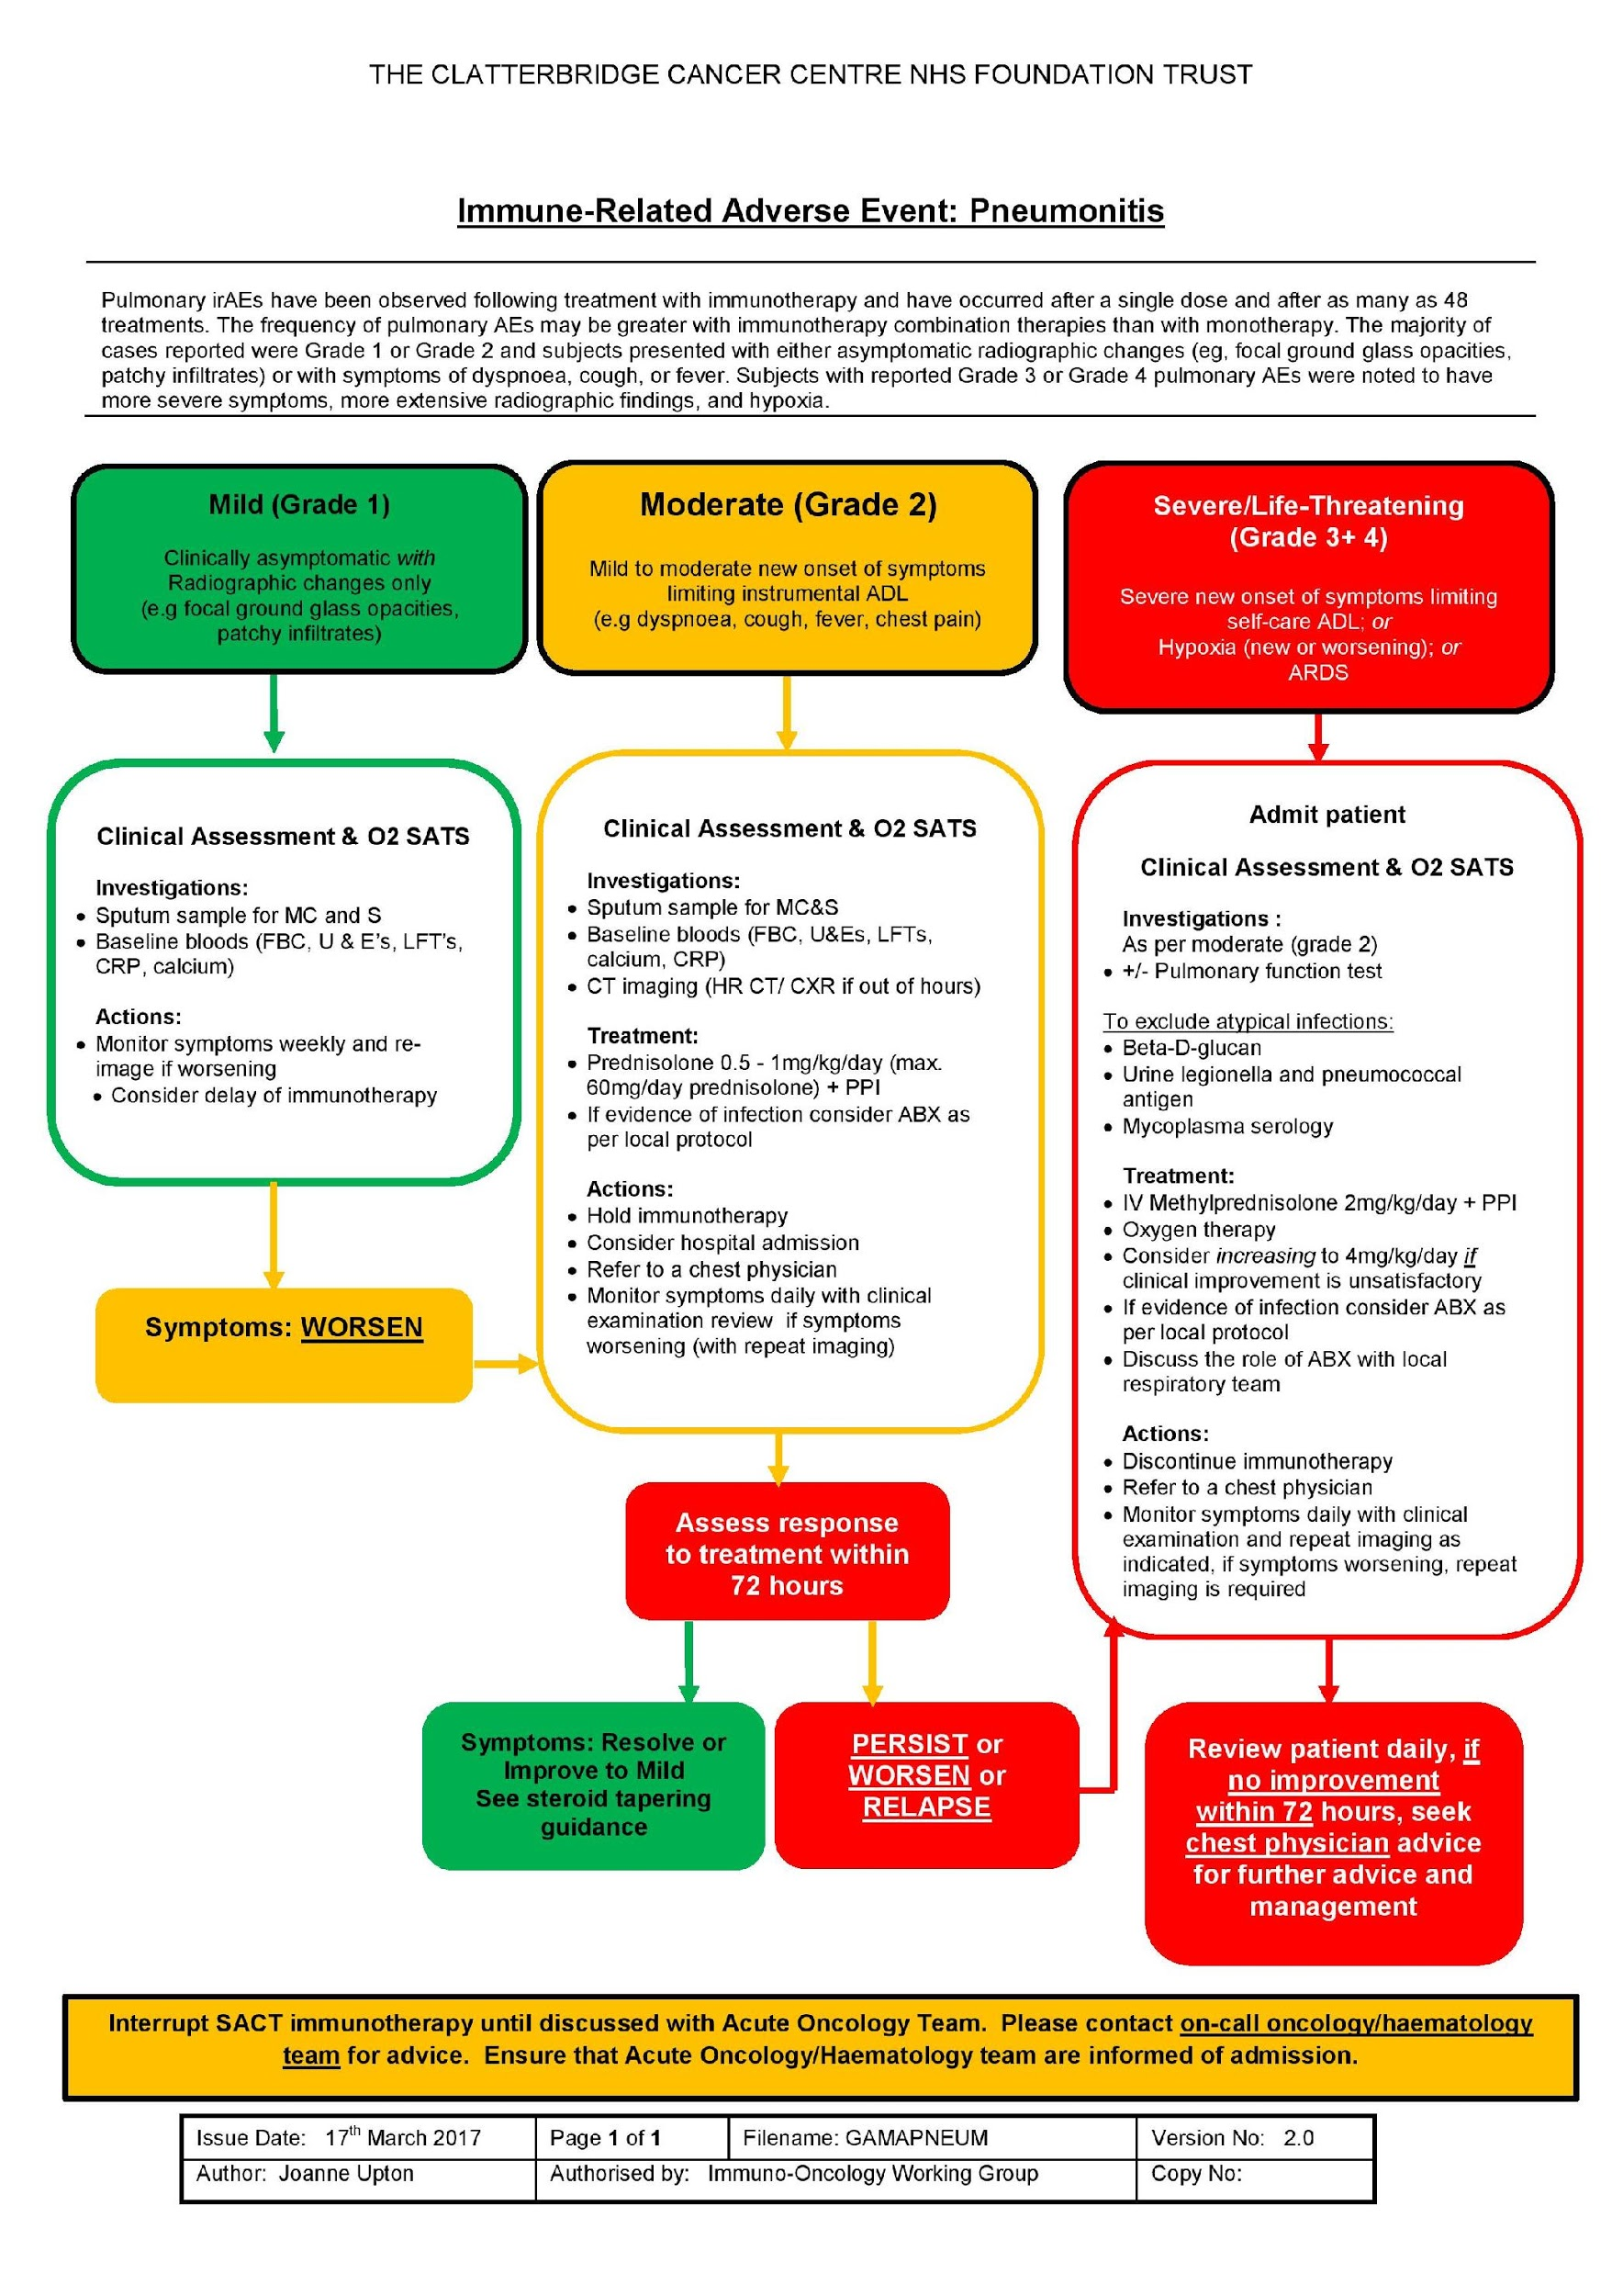
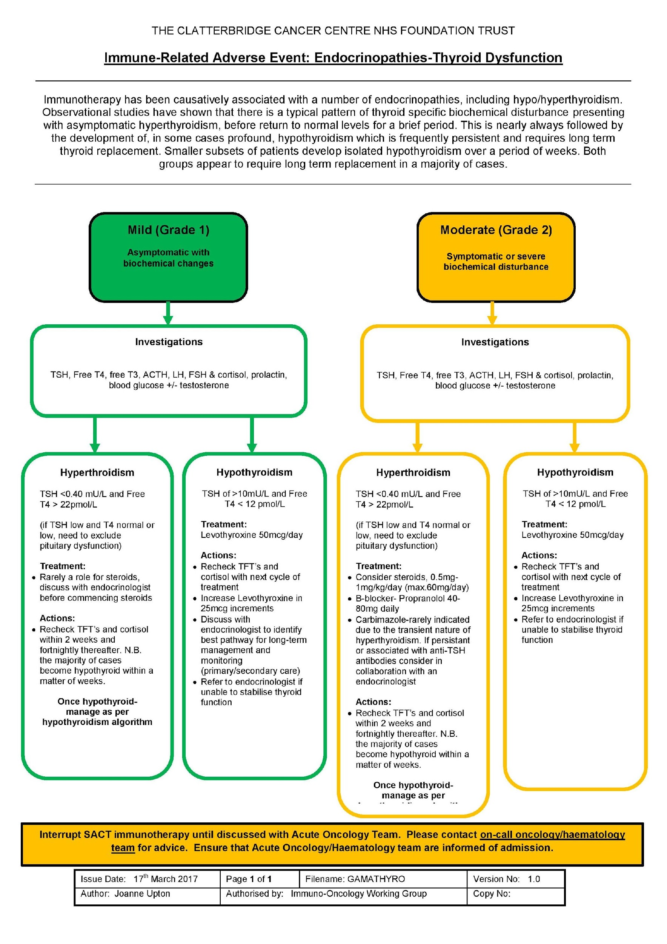
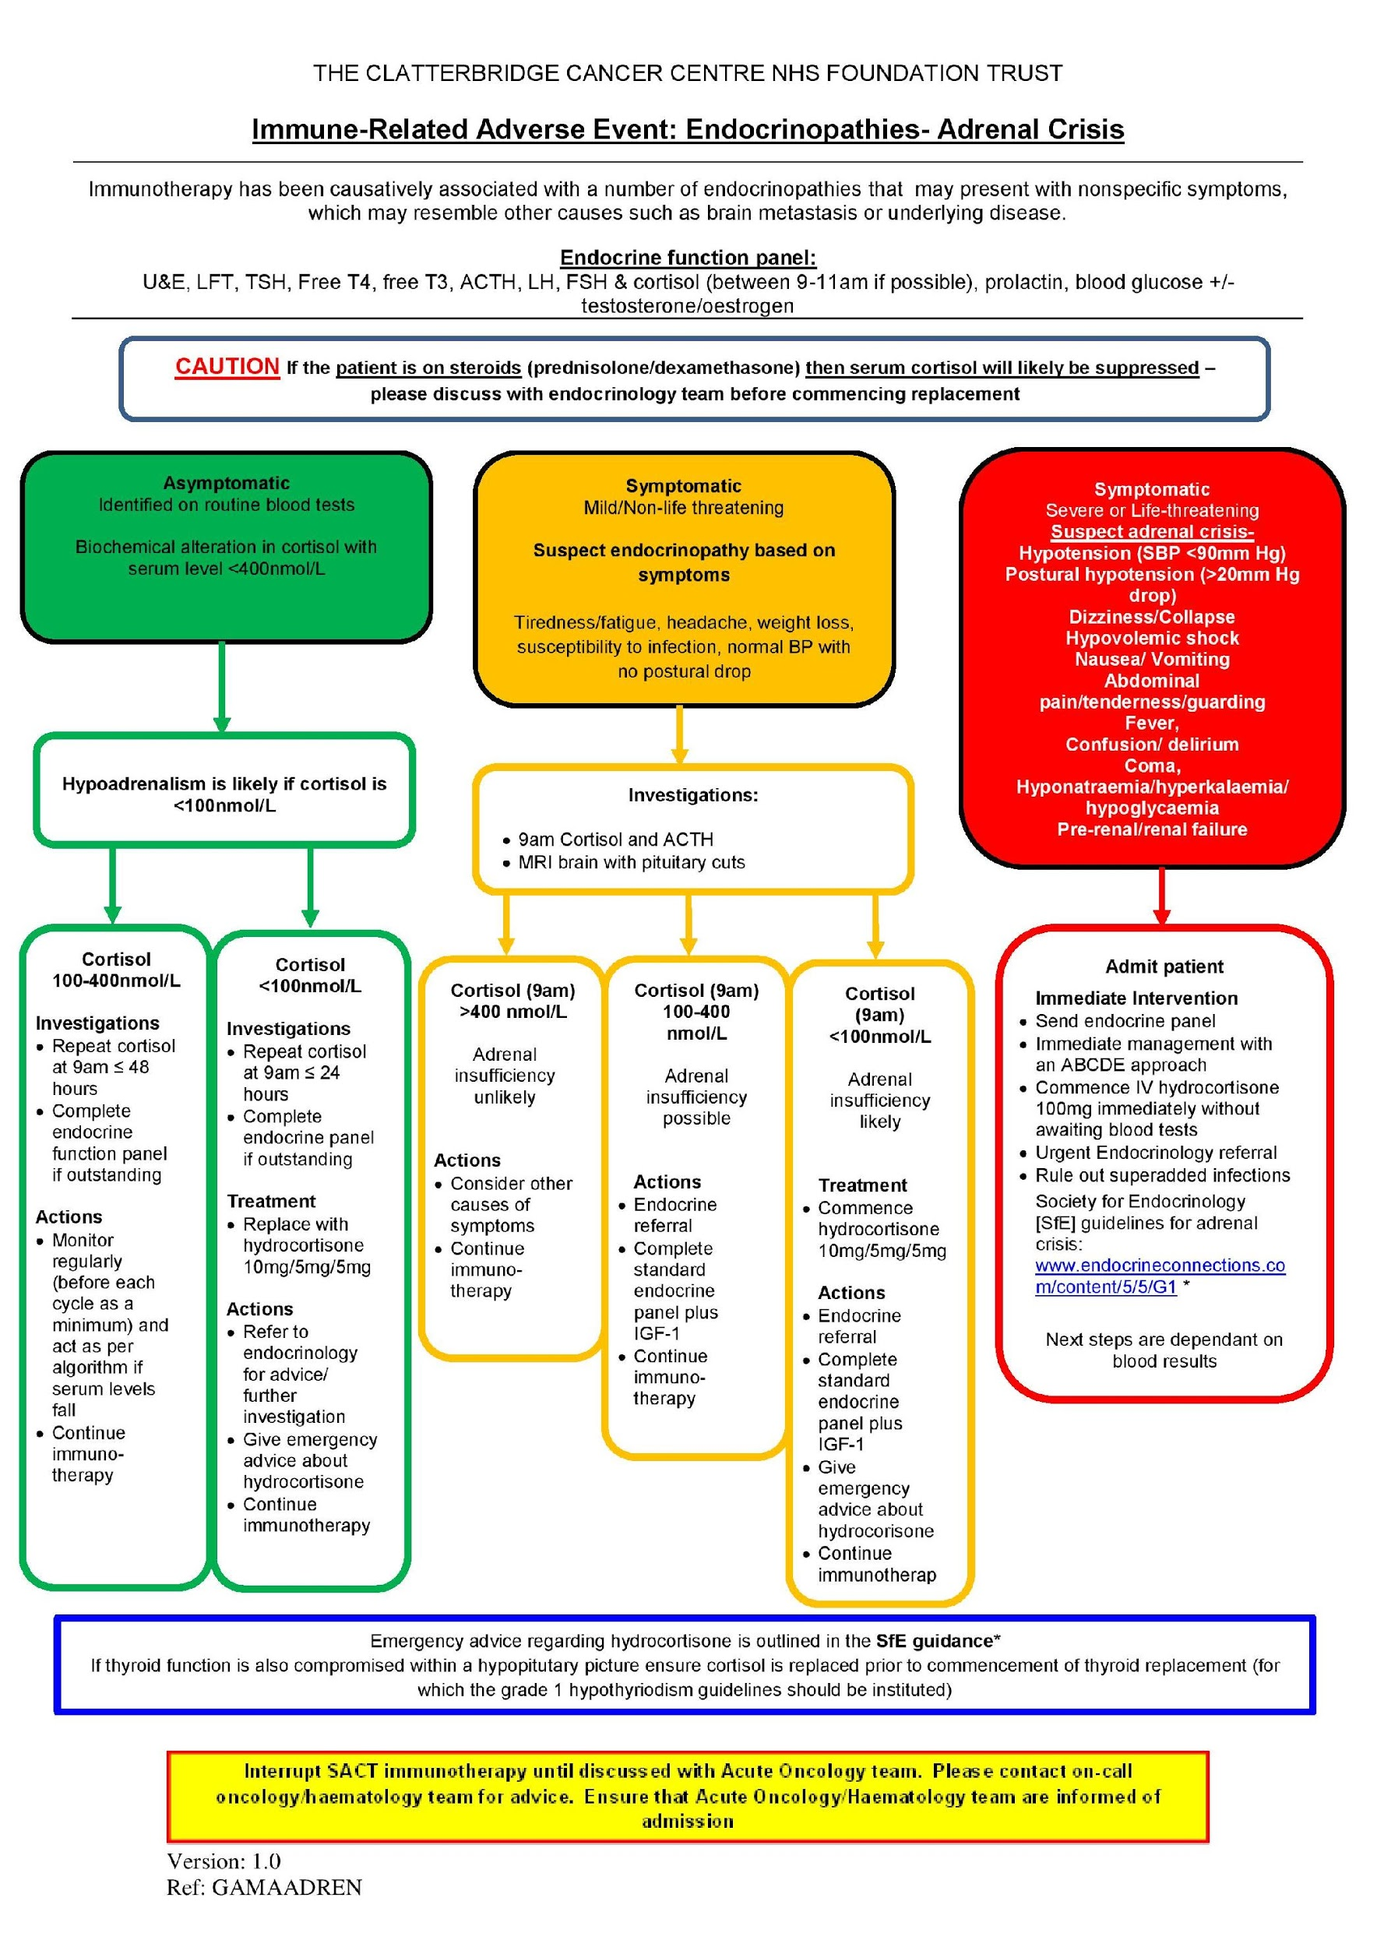
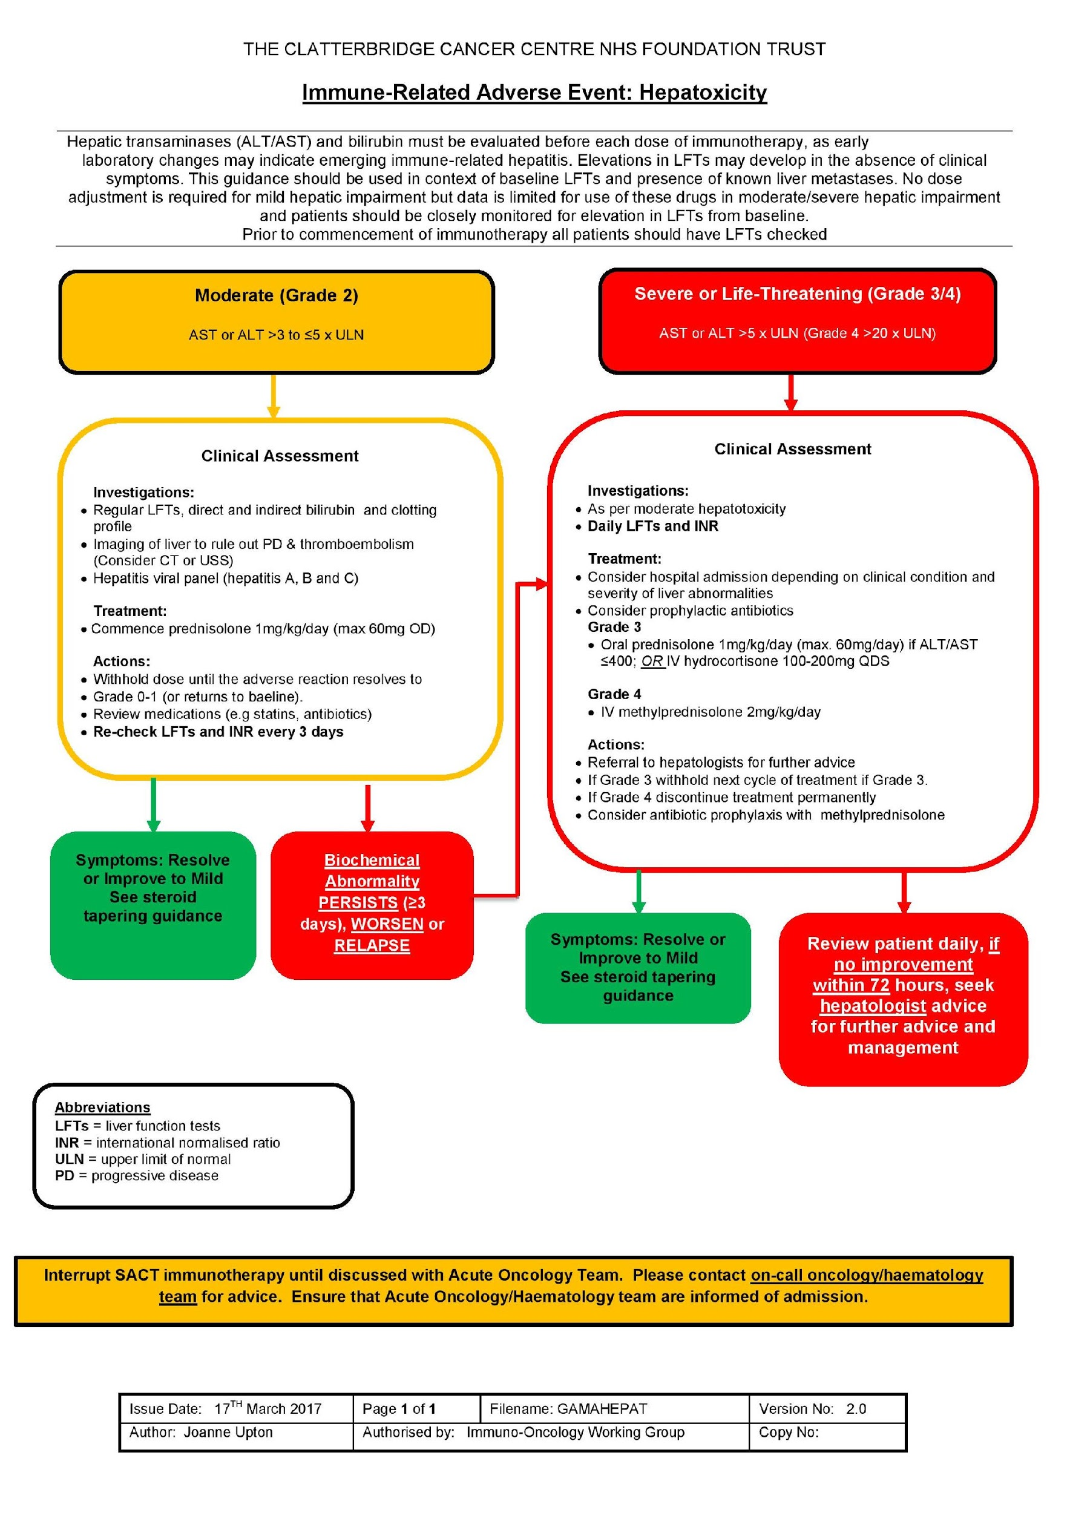
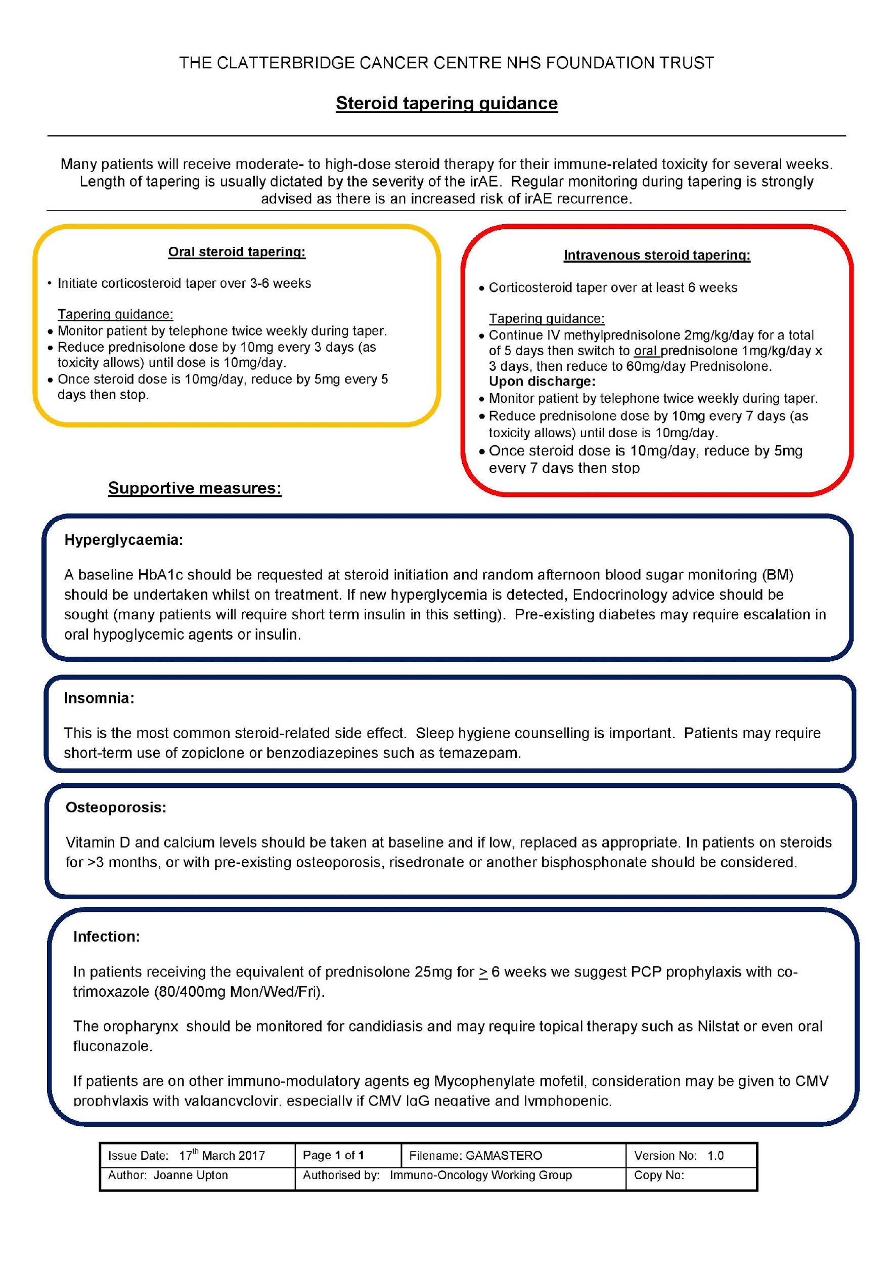
Toxicity Grading
To enable staff to grade and manage these unique toxicities, we have developed a series of management algorithms. These tools provide evidence-based, expert-recommended management strategies for immune-related adverse events based on the type and severity of the event.
They can be found on:
Intranet site
Policies and Documents > Guidance
CCC Trust website
https://www.clatterbridgecc.nhs.uk/professionals/guidance-1

Slide 12
https://www.clatterbridgecc.nhs.uk/professionals/guidance-1

Slide 13
Patient assessment
Past medical history.
Current medications.
Allergies or previous drug sensitivities.
Drug interactions.
Previous toxicities.
Informed verbal consent.

Slide 14
Toxicity management
Surveillance/monitoring.
Corticosteroids (Methylprednisolone/Prednisolone.
Hormone/endocrine replacement.
Steroid sparing immunosuppression.
Speakers own.

Slide 15
Infliximab
Infliximab is a IgG1κ monoclonal antibody that binds to soluble and transmembrane forms of TNF-α with high affinity to disrupt the pro-inflammatory cascade signalling. Binding of the antibody to TNF-α prevents TNF-α from interacting with its receptors.
Used to treat Immune mediated Colitis, increasingly being considered for the treatment of steroid refractory Myocarditis.
https://go.drugbank.com/drugs/DB00065

Slide 16
MMF
Mycophenolate mofetil (MMF, CellCept) is a prodrug of mycophenolic acid (MPA), an inhibitor of inosine-5'-monophosphate dehydrogenase. MPA depletes guanosine nucleotides preferentially in T and B lymphocytes and inhibits their proliferation, thereby suppressing cell-mediated immune responses and antibody formation.
Primarily used in the treatment of Hepatitis, Nephritis and skin toxicities.
https://pubmed.ncbi.nlm.nih.gov/15803924/

Slide 17
Tacrolimus
Tacrolimus bonds to an immunophilin, FK506 binding protein (FKBP). This complex inhibits calcineurin phosphatase. The drug inhibits calcium-dependent events, such as interleukin-2 gene transcription, nitric oxide synthase activation, cell degranulation, and apoptosis.
Primarily used to treat severe steroid refractory and MMF resistant Hepatitis.
https://pubmed.ncbi.nlm.nih.gov/8588225/

Slide 18
Side effects of steroid use
Hyperglycaemia.
Insomnia.
Bone integrity.
Adrenal suppression.
Mood disturbance.
Increased appetite.
Cushing's.

Slide 19
Supportive treatments
Bisphosphonates.
Calcium.
Diabetes management.
Night sedation
PCP prophylaxis.
Antifungals.

Slide 20
10 Principles of IO toxicity
Take notice of vague symptoms and investigate fatigue - a clinically well patient does not mean they do not have toxicity
A blood test and a symptomatic review can rule out toxicity
An expanded blood panel as standard
Treat the most severe parameter/toxicity
Monitor, monitor, monitor – things change quickly and follow-up is essential
Know your local and national protocols
Treat early with high doses of steroids. If steroids aren’t working → switch
Reach out to medical specialists
Omit and potentially discontinue IO depending on the grade and type of AE
Ensure side effects of management are recognised and acted on and reported on the yellow card system

Slide 21
Thank you for listening.
Any questions?

