Slide 1
Medication Errors
Supporting Staff & Families
Dr Immad Qureshi
MBBS, MSc Critical Care, RCPathME, MAcadMEd, AFICM, FRCEM

Slide 2
Objectives
Understanding of the different types of cultures within organisations.
Understanding of systems-based analysis.
Support for staff involved in incidents.
Supporting patients/families through incidents.

Slide 3
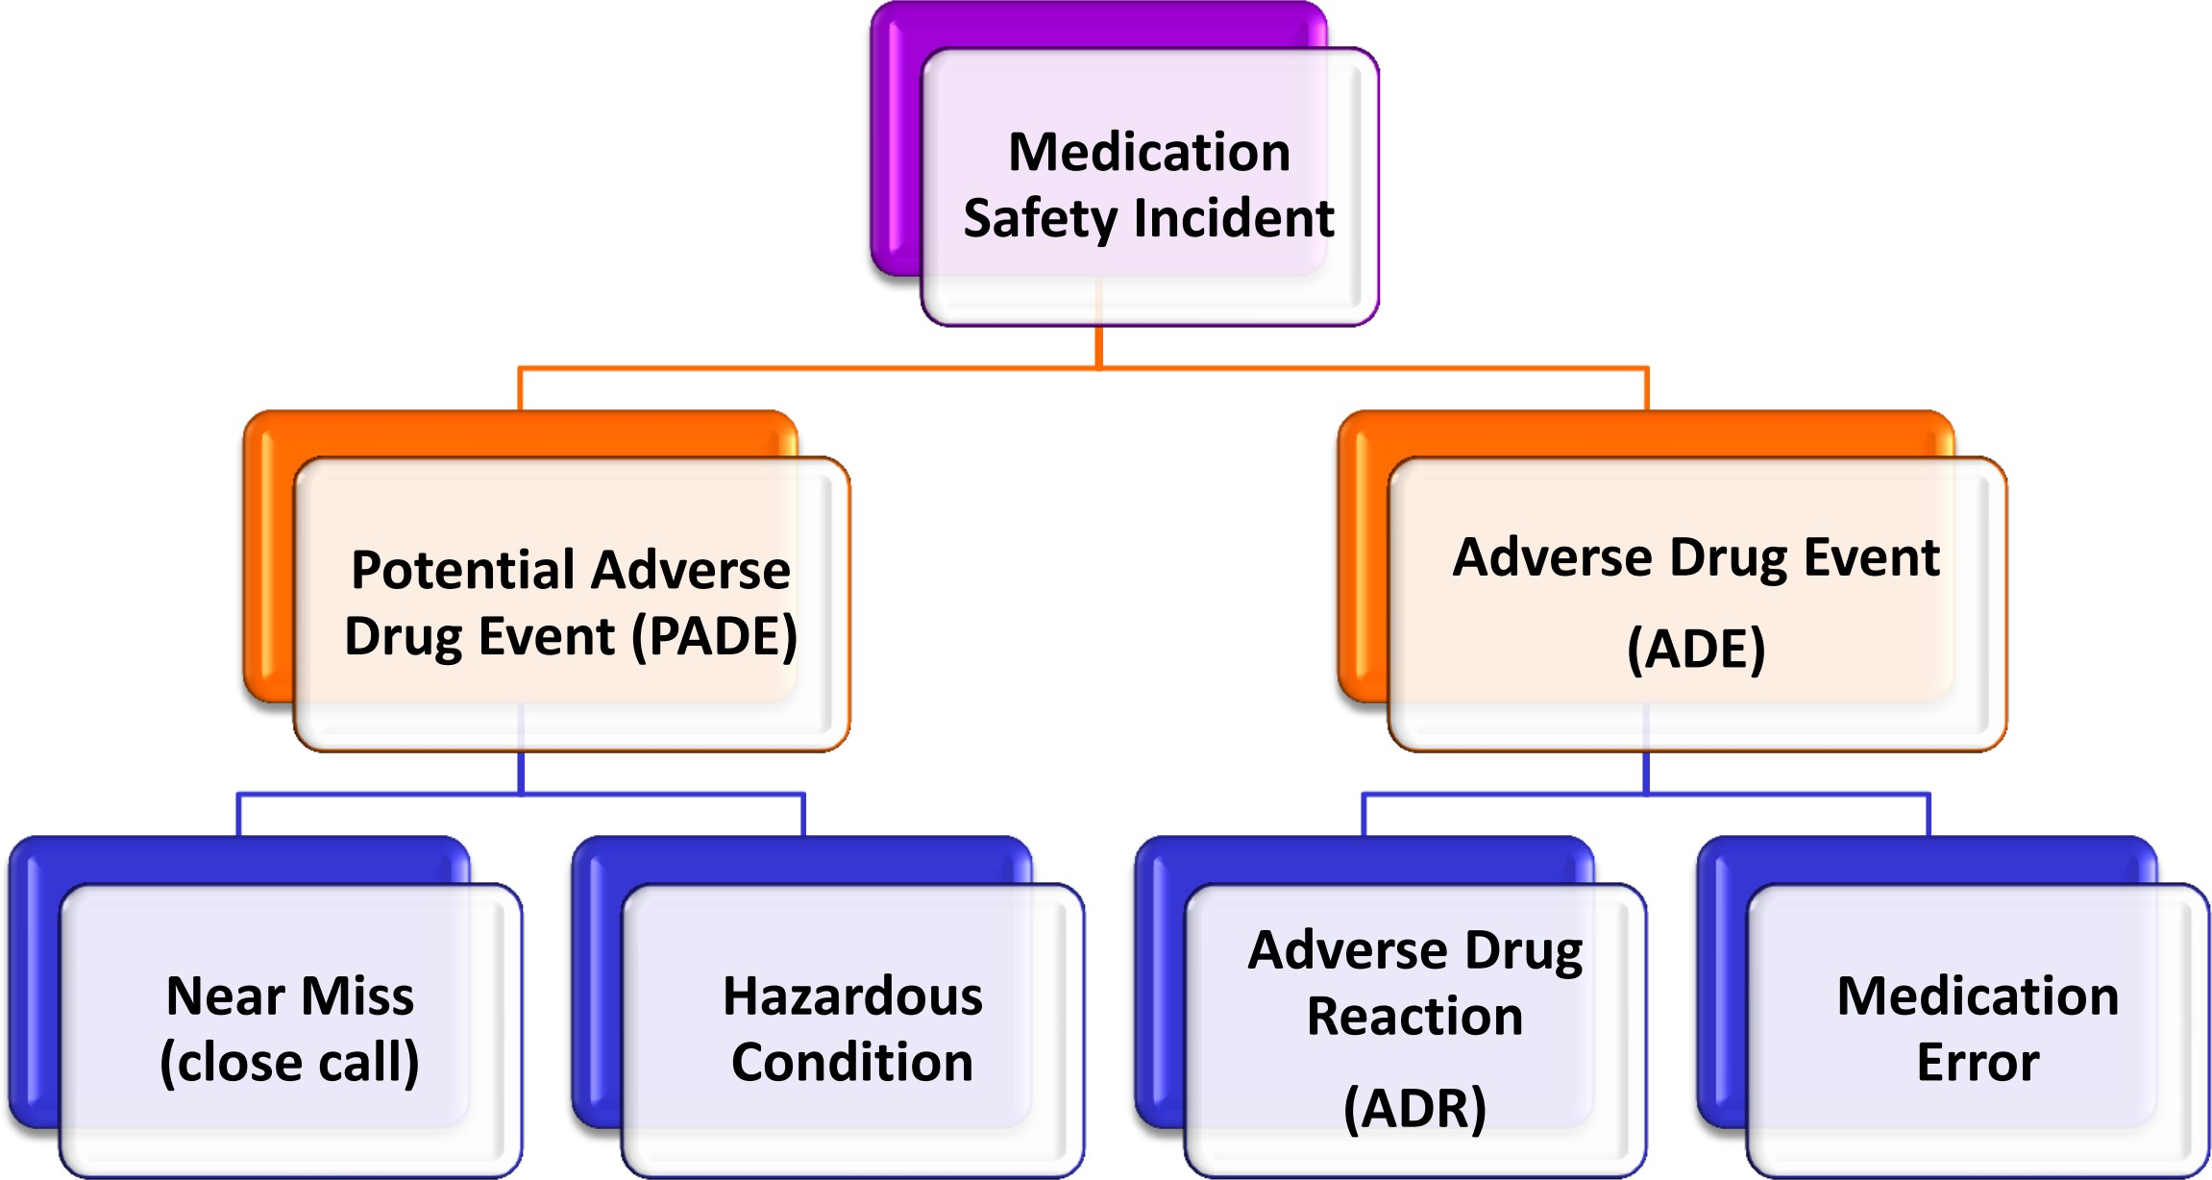
What to Report

Slide 5
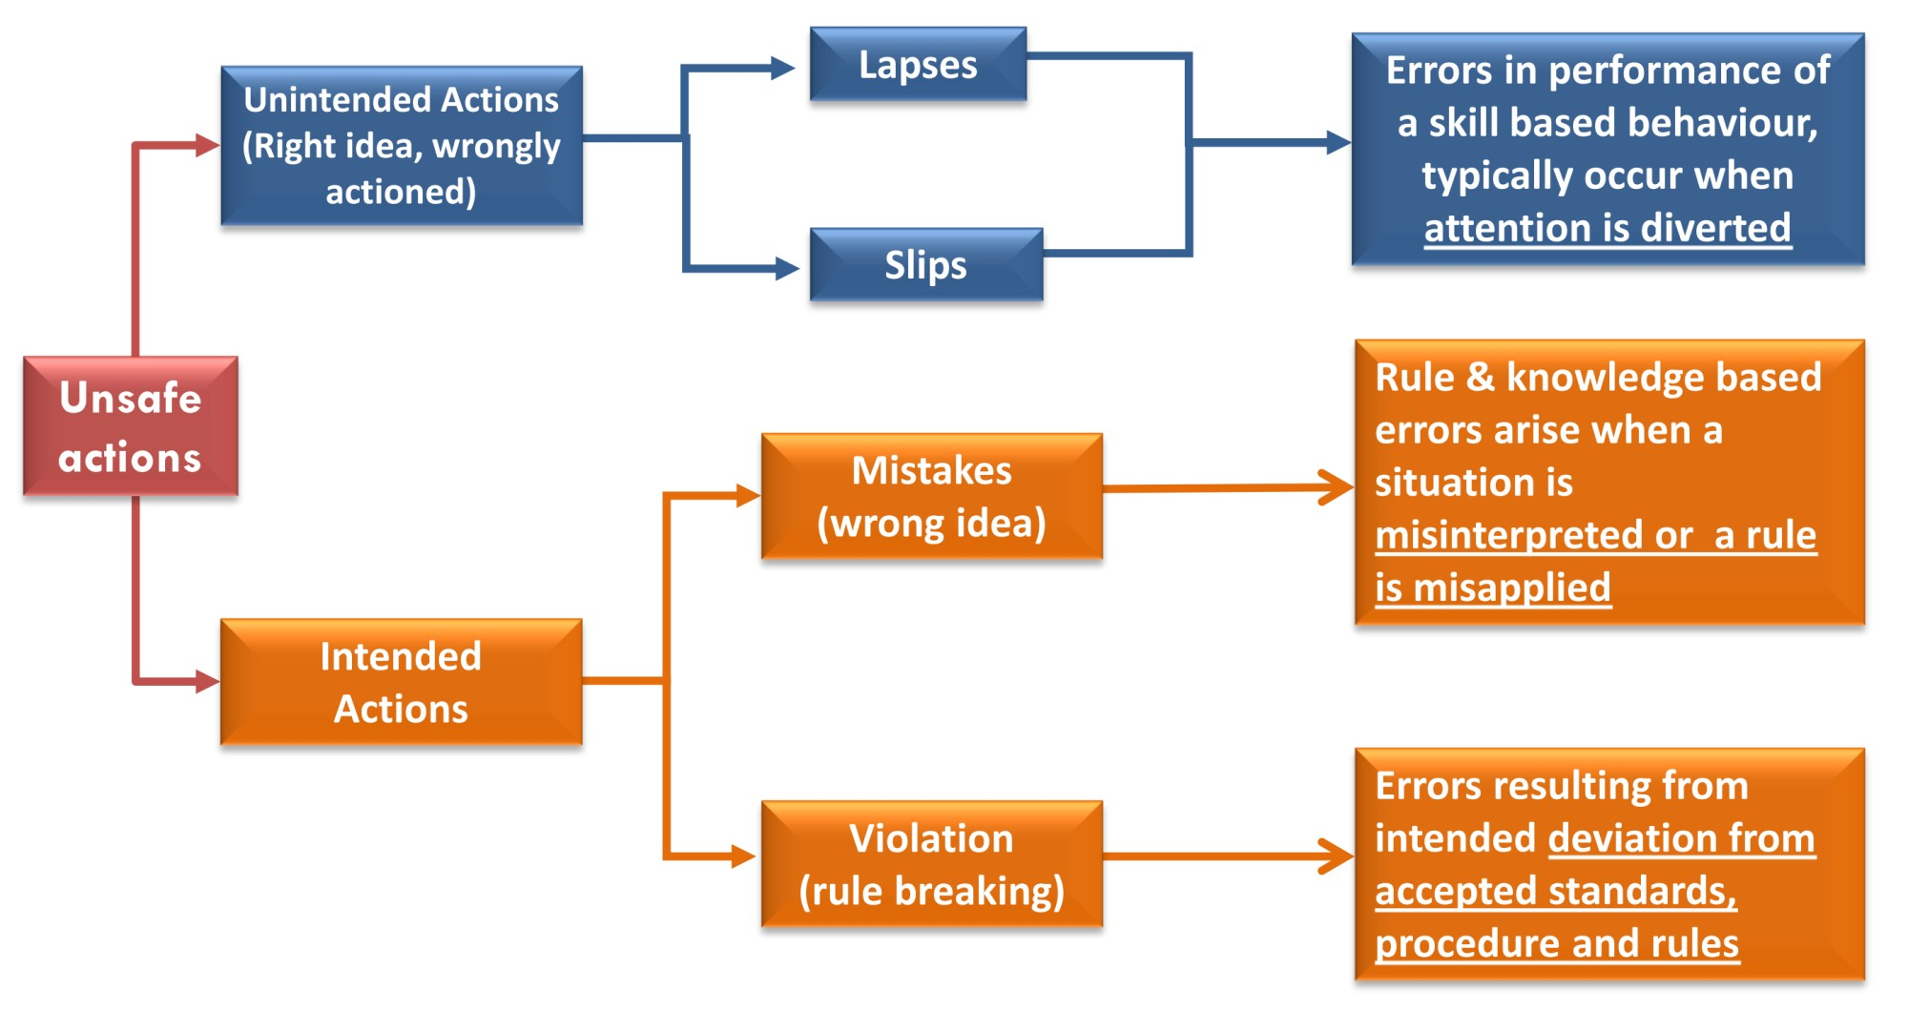

Slide 7
Before the 1990s
Frontline workers were afraid to report their own errors or those of a colleague
Missed enormous opportunities to learn about Errors
Little insight into System-based causes
NEW
Recognize that humans are imperfect so errors will and can happen to anyone
Staff are encouraged (even rewarded) for reporting errors
There is a well- established system of accountability
High insight into
System-based Causes
By the mid 1990s
Supported a "no- blame" response to errors
Unsafe acts were the result of mental slips or lapses, or honest mistakes
Fails to tackle individuals who make unsafe/reckless behavioral choices

Slide 8
Creating the right culture

Slide 9
Creating the right culture

Slide 10
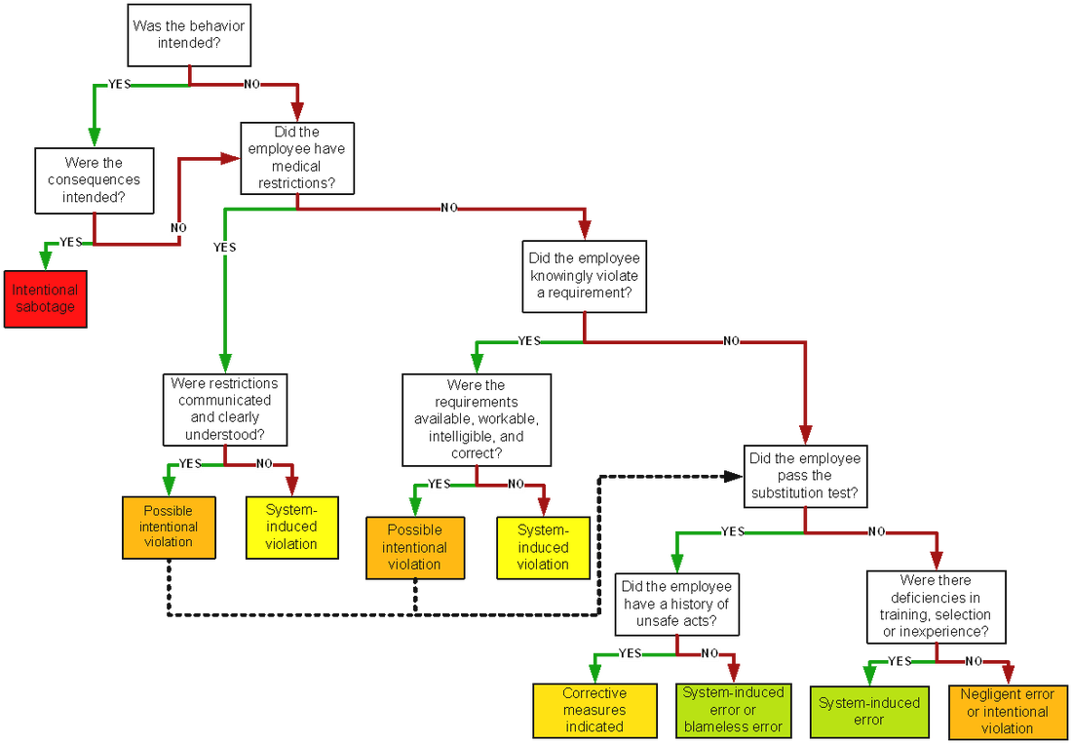
Culpability Matrix

Slide 11
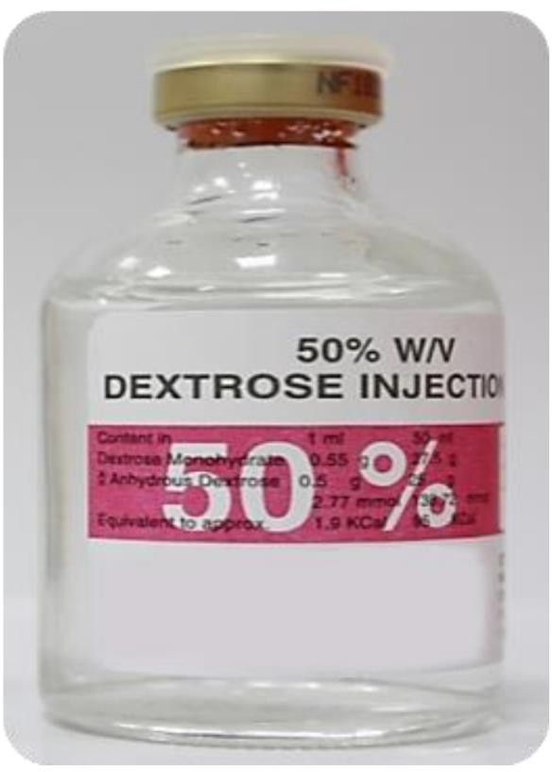
A medication error

Slide 12
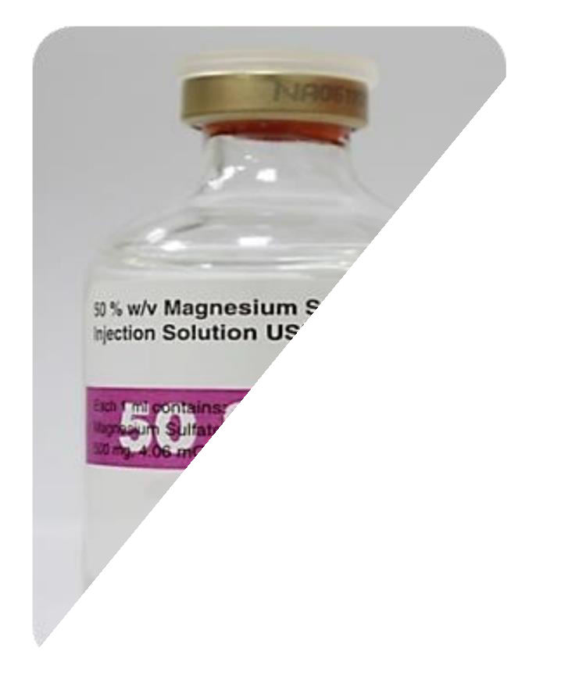
A medication error

Slide 13
Risk to Staff
Anxiety/Depression
Guilt
Regulator referral
Dismissal
All of these result in becoming a second victim

Slide 14
Supporting Staff
Close mentoring and supervisory support
Access to wellbeing service (may include counselling)
Time off
Phased return to work

Slide 15
A medication error

Slide 16
Risk to Families
Anger/Frustration
Not knowing what happened
Loss of trust in healthcare service
Inability to move on with life

Slide 17
Supporting Families
Being Open
Statutory Duty of Candour
Establish single point of contact
Involve in the investigation process
Use of empathic language in report

Slide 18
Summary
Human Factors and Ergonomics are the cause of the majority of medical errors
Systems-based approach to incidents helps prevent errors in future
A culture that promotes reporting of near misses stimulates learning and prevents harm to patients
Involving staff and families in incident investigations helps prevent making second victimes.

Slide 19
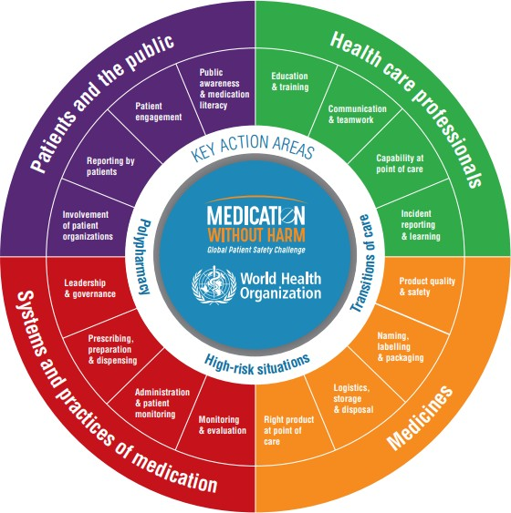
Global Patient Safety Challenge

Slide 20
Thank You
immad.qureshi@nhs.net
Twitter: @AMColian

