Slide 1
Improving information sharing whilst ensuring patient confidentiality at the end of life
My experience as a Caldicott Guardian in end of life care
Dr Sam Edward
Medical Director &
Consultant in Palliative Medicine
North London Hospice
sedward@northlondonhsopice.co.uk

Slide 2
The Brief
What issues do I see as a Caldicott Guardian?
Examples in practice: Case studies and information sharing around Covid-19
Caldicott decision making: improving practice and supporting frontline staff.

Slide 3






My Experience: Clinician’s Experience
Notes:
My Story Living History
Next year 20 years as Dr
10 in EOLC
6 as Caldicott Guardian
April 2016 St Joseph’s Hospice: inherited the role as departing cons- knew very little about IG
Went on first training with Christopher: 7 CG principles, no manual or checklist 2017
Asked to join IT Enabler group City & Hackney- became involved and succeeded in joining STJH up to eLPR HIE
Kings Fund Digital Change in Health and Social Care: Impact
2019 Moved to North London Hospice and got the job of CG again
North London Partners: Improve access Last Year of Life Sustainability and Transformation Plans: Digital Change project NCL with Co-ordinate My Care
March 2020 Covid 19
Dec 2020 8th Caldicott Principle added
27th July 2022 Urgent Care Plan (UCP) London Launched

Slide 4
What are the issues?
Notes:
Spelling Caldicott!
As a CG working in PEoLC

Slide 5

Understanding and evidencing the CG role
https://www.ukcgc.uk/caldicott-guardians-manual
Notes:
New: Checklist
Understand the role: Training needs- annual training and updates
Share the role/have a deputy
Raise the profile in your organisation
Make sure people know what the role means: at induction
Keep a log of your activity/decisions
Work with your IG team: shared decision making internal to your organisation
Seek support external:
Email the council- invited to observe
Hospice UK CG
Caldicott Guardians’ digital forum

Slide 6
Covid 19: Accelerated the need for access to Shared care records

Slide 10
Key themes in successful digital change management

Slide 11
Case Studies & Information sharing around Covid 19

Slide 12
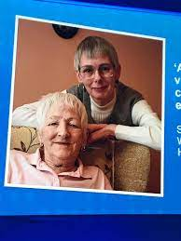
https://www.cerner.com/gb/en/client-achievements/st-josephs-hospice-improving-hospice-access-to-shared-care-records

Slide 13
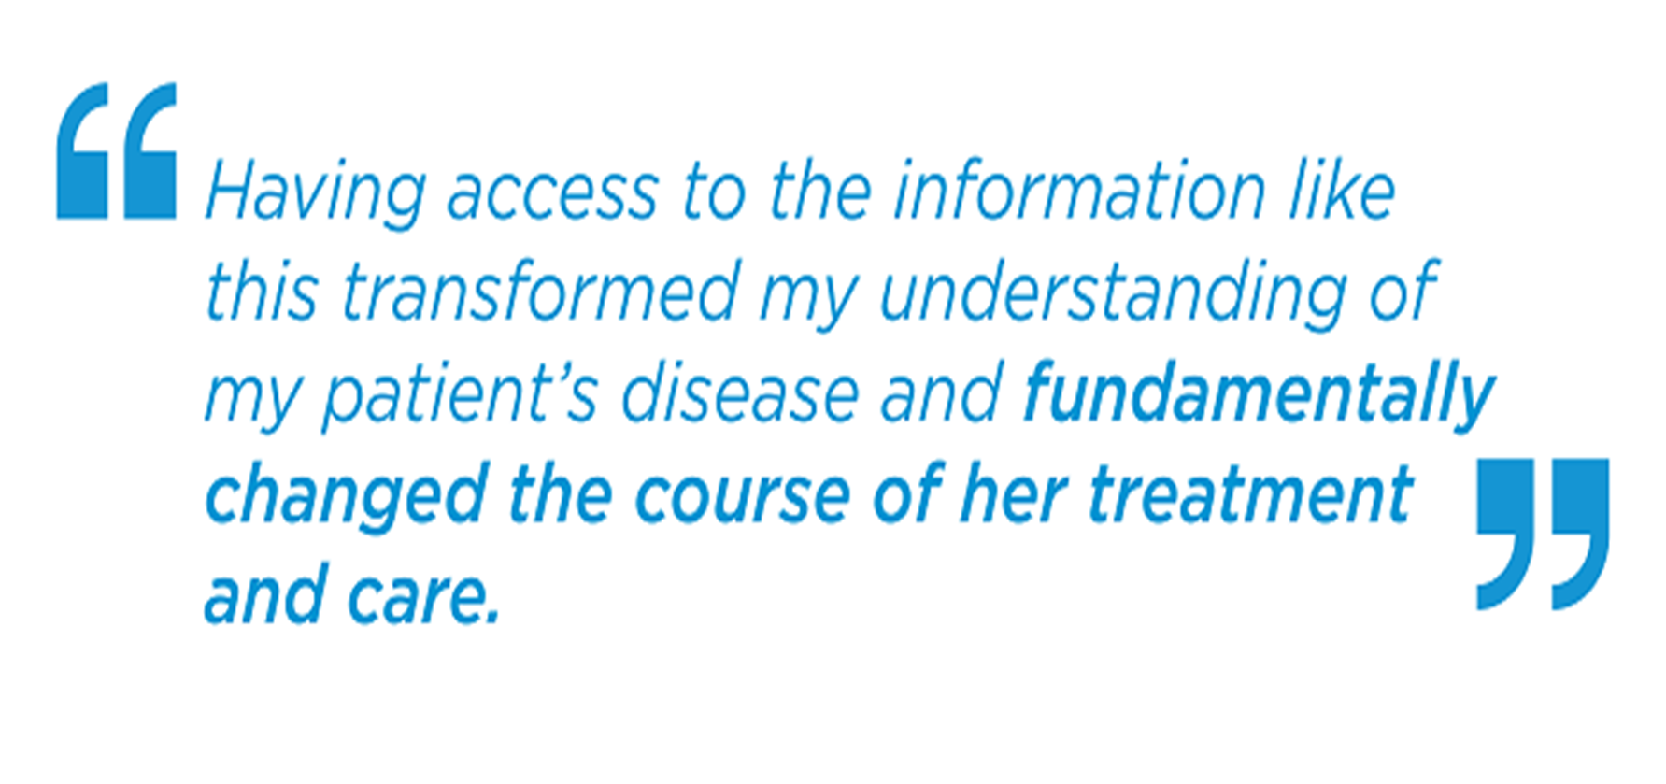

Slide 14
Covid 19: Sharing information
National Data Guardian and Dame Fiona Caldicott
Published
  3 April 2020
‘Health and care information will be vital in our response to coronavirus. We must continue to use it well and inform the public to maintain and build trust’
‘Information sharing must be done differently to support the fight against COVID-19 and to protect citizens compared to ordinary times. Information may need to be shared more quickly and widely across organisations than normal, or different types of information may need to be collected and used’
National Data Guardian, Dame Fiona Caldicott 3rd April 2020
Notes:
Dame Fiona Caldicott was appointed National Data Guardian for health and adult social care in 2014, and her position was made statutory in April 2019 after the passing of the Health and Social Care (National Data Guardian) Act 2018. She performed this role until her death in February 2021.
Note of caution: concerns about blanket decision making

Slide 15
Covid 19: Concerns and Access to medical records
Separation of family, friends, NLK at the bedside
Challenges of communication: telephone communication
Changes not directly observed
Concerns raised re:care and neglect across organisations

Slide 16
Improving practice and supporting frontline staff

Slide 17
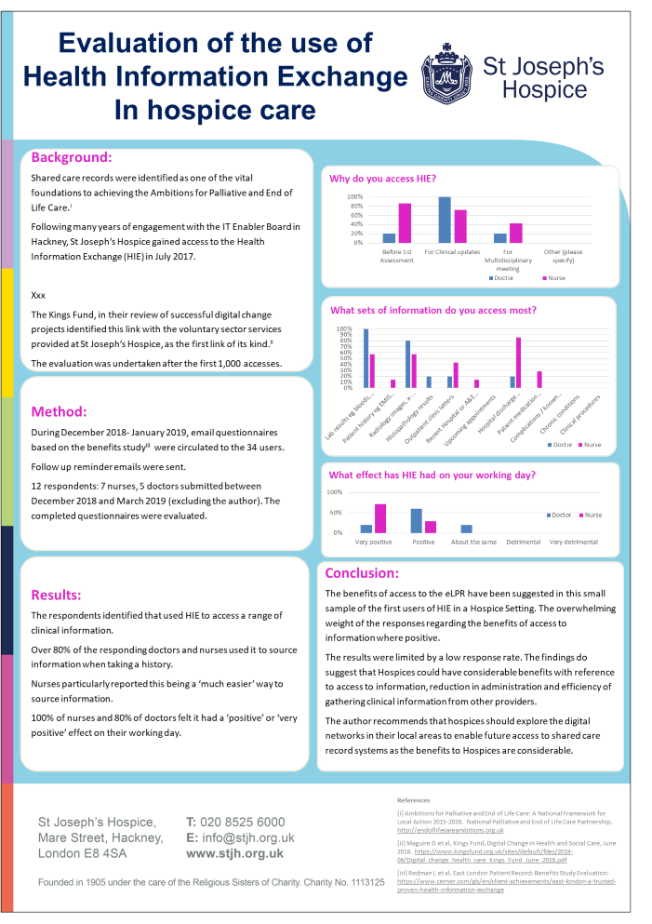
Heath Information Exchange
North London Hospice
Launched Access Dec 2020
in context link EMIS
Date | Usage
April 2020-March 2021 | 2,902
April 2021-March 2022 | 26,618
Notes:
10x increase
Lots of work underpin
NCL data sharing agreement

Slide 18
Raise CG profile: New staff inductions to introduce the role
Working with Information Governance Steering Group: SIRO, DPO, CEO etc
Email address for enquiries internal and shared public
Respond to incidents, learning and requests for records.
Support digital record sharing: HIE and Medical Examiners’ service pilot scrutiny of inpatient unit deaths.
Quality group UCP

Slide 19
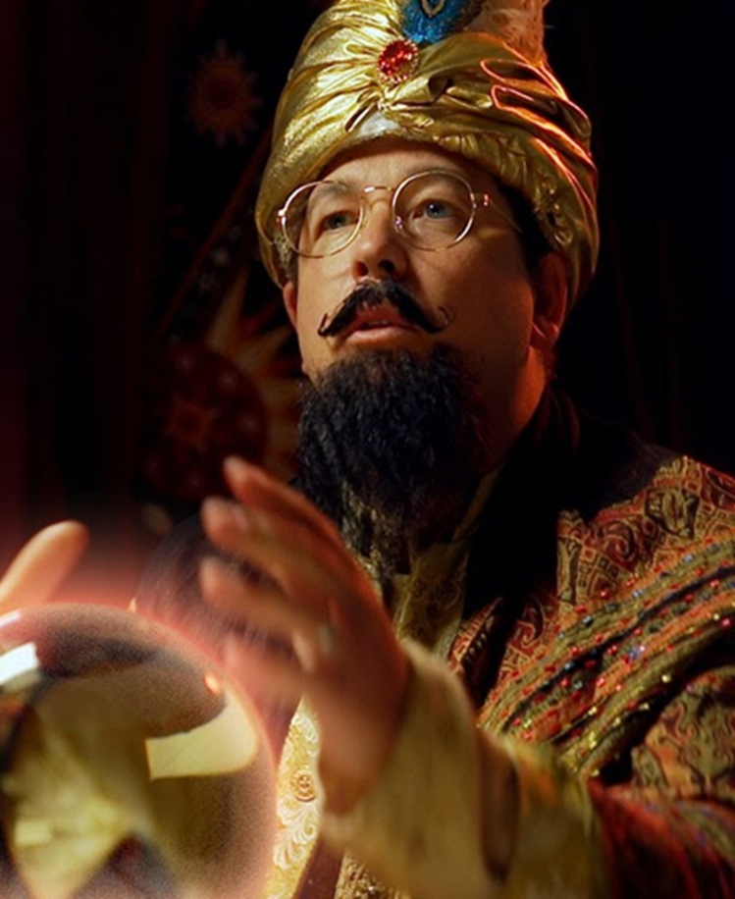
What next?
NCL Single point of Access
Medical Examiners Service pilot
Research
Sharing NLH data: reciprocity

Slide 20
Thank you

