Slide 1
Ward Accreditation: Strengthening quality assurance by implementing an evidence-based revision of a ward accreditation programme
Kim O’Keeffe BEM
Chief Nurse Royal Cornwall Hospital Trust / Cornwall Partnership Foundation Trust / Deputy CEO RCHT
Kim.okeeffe@nhs.net
Louise Dickinson
Deputy Director of Nursing Midwifery and AHPs louise.dickinson2@nhs.net
Notes:
Kim

Slide 2
Objectives
Provide context to the introduction of our ward accreditation programme
Describe the development of the programme and our early adoption successes
Reflect with you on the dichotomy of programme success and waning assurance
Share our learning from the adoption of the latest workforce evidence base to drive new assurance confidence
Notes:
Kim

Slide 3
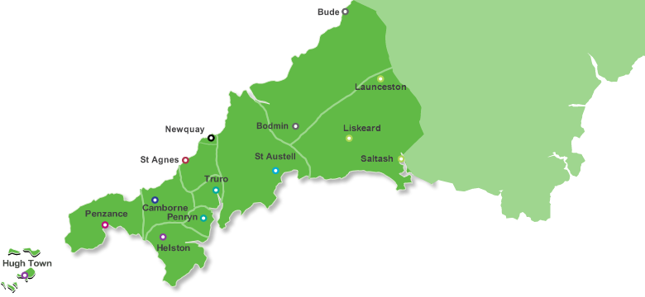
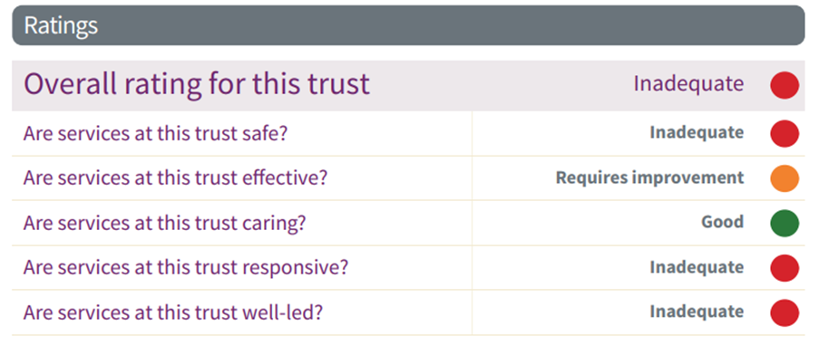
St Michael’s Hospital
Royal Cornwall Hospital
West Cornwall Hospital
2017
Notes:
Kim
The Royal Cornwall Hospitals NHS Trust is the principal provider of acute care services in the county of Cornwall serving a population of around 532,273 people, a figure that can be doubled by holidaymakers during the busiest times of the year.
The Royal Cornwall Hospitals NHS Trust has approximately 750 in patient beds spanning 3 sites.
West Cornwall Hospital has 2 medial wards caring mainly for older people and one surgical day case ward.
St Michael’s Hospital has 2 wards which since January 2019 has provided the majority of the elective orthopaedic work
The Royal Cornwall Hospital is the Trusts main hospital site with 28 in-patient wards (including maternity and paediatrics)
We employ approximately 6,500 staff

Slide 4
The challenges we faced as we went in to ‘Special Measures’
Unbelievable levels of scrutiny
Challenged leadership and continuity
Clinical quality and patient safety variations across all inpatient wards
The need for assurance, not re-assurance versus ‘false assurance’
Culture: inspection mentality versus continuous improvement
Notes:
Kim

Slide 5
Ward Accreditation ?
Why – what did it offer a Trust in special measures?
What – which framework to adopt?
How – with a workforce experiencing low morale and disenfranchised?
Who – has capacity and capability to lead such a programme and embed a transformational change?
Notes:
Louise (asking of Kim, the sort of question staff would ask)

Slide 6
Ward Accreditation - The Solution
Why – an improvement framework – “we need to improve”
What – we have expertise within our ‘buddy’ hospital of a successful framework
How – our Ward Leaders want this type of practical help to improve quality and safety for their patients and staff
Who – Dedicated Senior Nurse Leader support from our buddy hospital, was enabled utilising special measures financial support
Notes:
Kim (responding to Louise as she would to staff)

Slide 7
Our approach to ASPIRE: Creating the conditions for psychological safety
Board support and leadership - fundamental
Leadership group – ownership and authenticity
Learning from other Trusts: RDE, Salford Royal, UCLH
Wide workforce engagement in creating our approach (all disciplines) – ASPIRE
Culture of collaborative development and testing
Being clear what is was and what it wasn't
Pace: ‘we can do this’ ‘we want to do this’
First pilot wards celebrated and acknowledged
Deliberately not weighted in first 12 months: psychological safety – shared learning
Certificates, Trust Board attendance and ‘Gold’ wards attendance at awards evening
Launched Trust-wide six-months after going into special measures – COMITMENT IN ACTION NOT WORDS
Notes:
Kim
ASPIRE - song and video produced to support the launch.

Slide 8
What did we measure?
Patient experience – questionnaire
Staff experience - questionnaire
Staff knowledge - interview
Observation of practice - observed
Environmental standards – observed
Well led standards - interview
Documentation - observed
Notes:
Louise
Detail numbers ect…

Slide 9
How did we measure?
Multi-professional Team allocated to a ward – with a Head of Nursing or Senior Corporate Nurse
A day was put aside to conduct the Accreditation Programme
Unannounced visit
Wide team engagement on visit
Debrief to team at end of Accreditation focussing on what went well first , areas for improvement
Data collection and electronic data system supports outcome calculation
Notes:
Louise
Team members, Duration

Slide 10
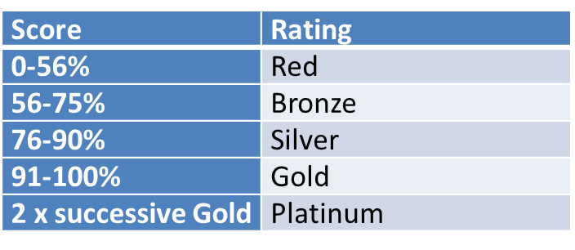
ASPIRE outcomes: first round
5 wards were awarded Bronze
17 wards were awarded Silver
2 wards were awarded GOLD
Notes:
Louise

Slide 11
Our first ASPIRE GOLD wards
Our reflections on going for Gold
Wellington Ward (Respiratory)
Cardiac Investigations Unit
Notes:
Kim and Louise

Slide 12
Our first ASPIRE GOLD wards
Staff reactions:
‘Over the moon’
‘Amazing’
‘Incredible news for team after so much pressure’
‘Proud’
‘Icing on the cake’
‘Providing best care for patients’
‘Real Buzz’
‘Fantastic achievement’
Notes:
Kim and Louise

Slide 13
ASPIRE Outcomes: The Next Round
Staggered re-accreditation intervals depending on outcome
Twelve months in we had 19 silver wards and 5 gold wards
Assurance concerns arising: non-alignment with other quality metrics, complaints and serious incidents.
A weighted version was introduced and scoring adjusted – managing expectations from Ward-to-Board
Notes:
Louise
Documentation 20%
Observation of practice 15%
Staff knowledge 20%
Patient experience 15%
Staff experience 15%
Well organised ward 15%
0-65% (previous 0-56%)
Red
66-85% (previous 56-75%)
Bronze
86-94% (previous 76-90%)
Silver
94-100% (previous 91-100%)
Gold
2 x successive Gold (unchanged)
Platinum

Slide 14
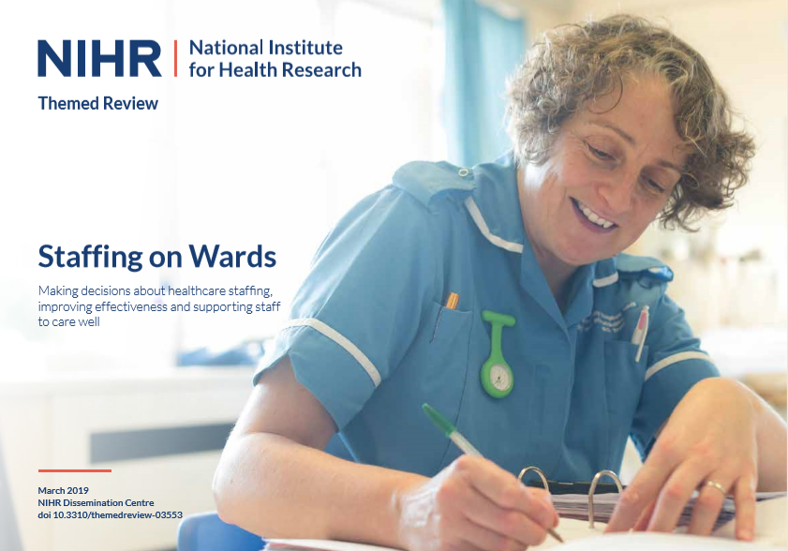
A new evidence-based approach
March 2018 NIHR Themed Review
https://www.dc.nihr.ac.uk/themed-reviews/Research-on-ward-staffing.htm
Notes:
Kim

Slide 15
Two Significant Facts
High Registered Nurse contact time with patients strongly associated with reduced harm and low mortality rates (linked to reduced failure to rescue incidents)
Ward Climate, the cohesiveness of the ward team, corelates to levels of patient satisfaction with care – high cohesiveness equals high satisfaction and levels of safety
Senior Clinical Cabinet discussions felt that these 2 elements were not explicit in our programme
Notes:
Kim

Slide 16
Outcome: ASPIRE Version 4:
Three new measures added:
Direct Care Time
Observations of Care
Ward Climate survey to replace staff questionnaire
And a full review of all questions was undertaken (significantly reviewed and discussed and senior team confident that the new focus on the evidence-based measures)
Piloted on one ward in July (with supportive measures in place) = Red status awarded.
Notes:
Louise

Slide 17
ASPIRE Version 4 – August 2019
Four wards with concerns reviewed:
Two wards White (previous Silver)
Two wards bronze (one previous Silver and one Gold)
How does this feel?
Notes:
Louise and Kim

Slide 18
ASPIRE Version 4
Current status September 2022.
Silver 1
Bronze 11
White 13
Notes:
Louise and Kim

Slide 19
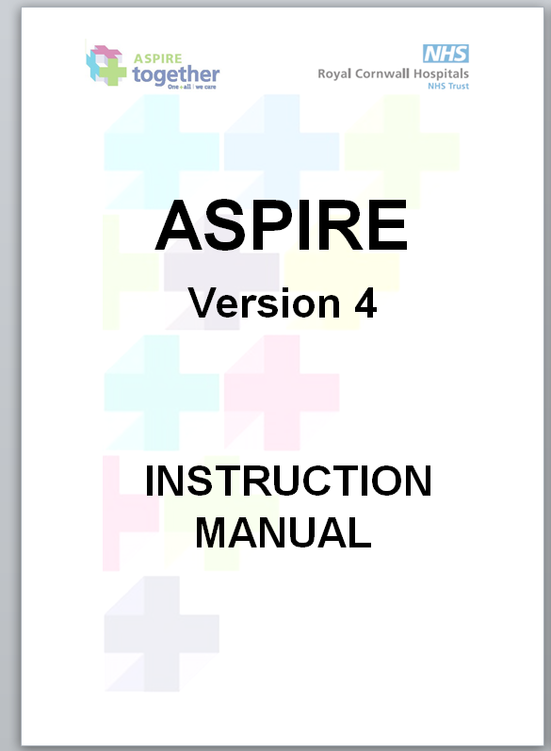
The ASPIRE Instruction Manual was developed to ensure standardisation and consistency of application
Notes:
Louise and Kim

Slide 20
ASPIRE Version 4 – Progress
RCHT:
Critical Care
ED
OPD
Theatre
Paediatrics
Maternity
And…
Published article to share our experience and outcomes
Notes:
Louise and Kim

Slide 21
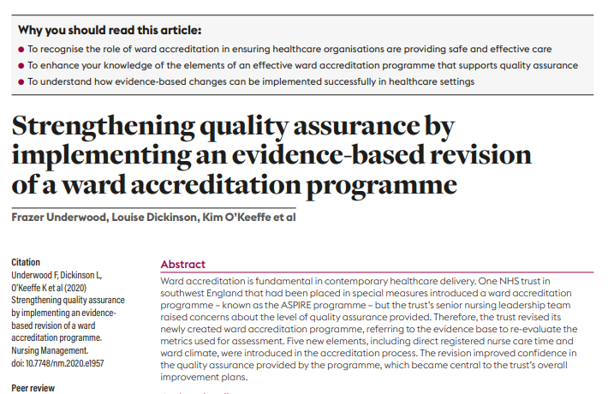
https://www.researchgate.net/profile/Frazer-Underwood/publication/344250921_Strengthening_quality_assurance_by_implementing_an_evidence-based_revision_of_a_ward_accreditation_programme/links/5f60b5eaa6fdcc1164135844/Strengthening-quality-assurance-by-implementing-an-evidence-based-revision-of-a-ward-accreditation-programme.pdf?origin=publication_detail
Notes:
Louise

Slide 22
Cornwall Foundation Trust
No programme in place.
Agreed to include as a quality priority.
Strong support from Governors.
Support from Quality Leads.
Learning from RCHT process.
Notes:
Louise and Kim

Slide 23
Cornwall Foundation Trust – current position:
13 Community hospital wards:
7 bronze award
6 white award
9 Mental Health Wards:
2 bronze
7 white
Findings reflect current concerns
Notes:
Louise and Kim

Slide 24
Next Steps
Going DIGITAL! – currently uploading the questions.
Adapt the revised programme to MIU’s, Community areas.
Re-evaluate overall programme again next month – 12 month review.
Would we do anything differently?
Notes:
Louise and Kim

Slide 25
QUESTIONS?
Notes:
Louise and Kim

