Slide 1
Dr. Anastasia Lungu-Mulenga Head of Community Engagement and Experience
Patient Safety Partners
Solent NHS Trust Approach

Slide 2
NHS SOLENT TRUST (WHO WE ARE)
Main provider of community services in Southampton
Mental health provider in Portsmouth city
Provide services from over 120 clinical sites spread
across HIOW
We work with families to help children have the best start in life
SEVEN CORE SERVICES
DENTAL CARE
PRIMARY CARE
SEXUAL HEALTH
CHILDREN AND FAMILY
PORTSMOUTH ADULTS
PORTSMOUTH MENTAL HEALTH
SOUTHAMPTON ADULTS

Slide 3
“Patients and their carers should be present, powerful and involved in all levels of healthcare organisations from wards to boards of trusts”
Don Berwick

Slide 4
IMPORTANCE OF INVOLVEMENT AND PARTICIPAPTION
Better health outcomes
Higher satisfaction
Improves patient experience
Increased Trust in our services
Enhanced Quality
Service changes that meet needs of patients
Better Supported Carers

Slide 5
Alongside Communities Programme Who are our community partners?
ORGANISATIONS PATIENTS, FAMILIES, CARERS AND MEMBERS OF THE PUBLIC
A POTENTIAL REACH INTO 400 000 HOUSEHOLDS
OUR COMMUNITY PARTNERS
ACROSS OUR PATCH - HAMPSHIRE, ISLE OF WIGHT, PORTSMOUTH SOUTHAMPTON
WIDE RANGE OF DEMOGRAPHICS

Slide 6
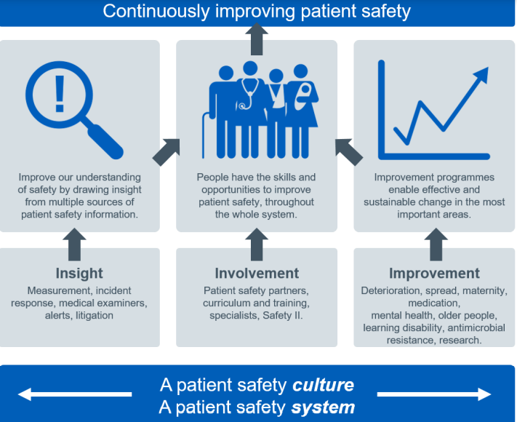
The NHS Patient Safety Strategy (2019)
The 3Is
Insight Involvement Improvement

Slide 7
JOURNEY TO OUR FIRST PATIENT SAFETY PARTNER
Conversations began in autumn 2021
We set up a working group to develop the role for patient safety partners within Solent
Wide membership including representation from all our 7 services, and 2 Community Partners
Selected as a national pilot/ early adopter

Slide 8
MEMBERSHIP OF THE PATIENT SAFETY PARTNER WORKING GROUP
All our 7 Services
Community partners /patients
Worked with our Volunteers Team in the recruitment
Community Engagement Team
Patient Safety and Governance Team

Slide 9
Our Consultation Process
Conversations with Heads of Quality and Professions
Experience of Care Group - the Group is composed of Community Partners and supported by Community Engagement Team
Learning from Experience Panel- which also has some community partners

Slide 10
ROLE OF THE WORKING GROUP CO-PRODUCTION AND COLLABORATION WAS KEY
DECISION TO HAVE 9 PSPs
WELCOME PACK
PSP ADVERT
BUSINESS CASE
RENUMERATION POLICY
ROLE PROFILE
TRAINING AND INDUCTION
PSP AGREEMENT

Slide 11
Role of our patient safety partners
Critical Friends
Meet and speak to patients
Be the patients voice
Challenge us
Participate in conversations and key safety meetings
Codesigning patient safety initiatives
Ensure compliance to relevant policies

Slide 12
Where we are now 2022
Introduced four PSP’s in four service lines
- Adult Mental Health
- Adult Services Southampton
Primary Care
Child and Family Services
Assurance and Governance meetings
Patient forums
Safety and improvement projects
Quality visits to our sites
Quality and Improvement and Risk group
Learning from Incidents and Death
Learning from Experience Panel
Development of the role and policy
Model for adoption and spread
Review and Evaluation
Aiming to have a PSP in each service line
Four Patient Safety Partners
Learn, Adopt and Spread
Notes:
Recognised each Service line required a Patient Safety Partner
Discussions with each Head of Quality and Professions, what does the role look like for their service line?
Recognised attendance at Safety Committees
Business case developed with several options, 1) 2 PSP’s 2) phase one 2 PSP’s in March and then phase two additional 7 in September 2022. 3) 2 PSP’s in March with a further recruitment of 7 PSP’s in 2023. Option 2 was recommended option, agreed by Chief Nurse. An adopt and Spread approach was preferred. Recruit 2 PSPs’ in March, who will co – design the development of the role and the policy.
Why one in each service line? We have a range of services in Solent, as explained earlier, each with their own patient safety requirements, two for the whole organisation would not enable the collaborative working the role requires. We would like them to understand our services…and be involved as listed in the second column.
Introducing a further 7 in September allows time for us to evaluate the model.

Slide 13
PRINCIPLES UNDERLYING OUR RECRUITMENT OF PSPs
INCLUSIVE APPROACH - our PSPs must be a reflection of our community
PSPs must have GENUINE INPUT AND DIALOGUE – must not be a tick box exercise
VALUING AND RECOGNISING the contributions of the PSPs across the organisation
Involve PSPs where their CONTRIBUTIONS ARE MOST NEEDED

Slide 14
RECRUITMENT PROCESS
Community partner newsletter – also shared by our partners cascading through 240 organisations and individuals covering diverse parts of our communities
Email all our community partners database –
Website
Social Media – Facebook, Twitter, whats app
Round 2 – included NHS Jobs

Slide 15
NEXT STEPS
Ongoing review to check that the process is working and assessing hours required
Apply lessons to refine the process
Recruit additional 5 patient safety partners so that we have one in each service and 2 for corporate services
We support them to meet regulalry

Slide 16
QUESTIONS?

Slide 17
THANK YOU
Anastasia.lungumulenga@solent.nhs.uk

