Slide 1
Medical Leadership at Board level
Nigel Sturrock
28/09/2022

Slide 2
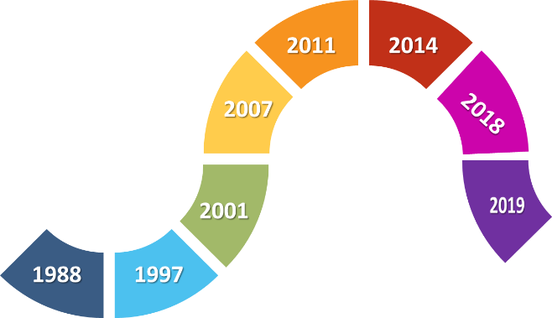
A brief story

Slide 3
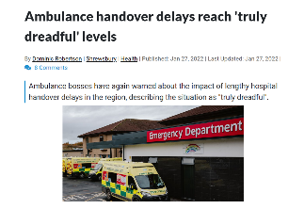
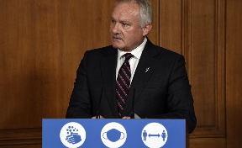
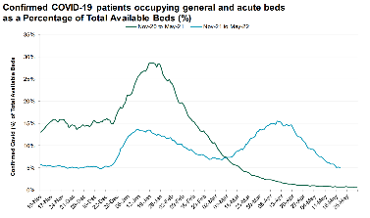
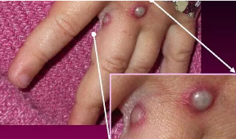
The Current Context

Slide 4
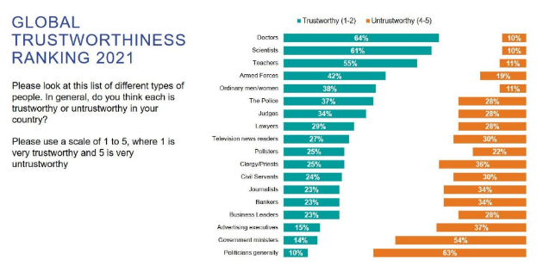
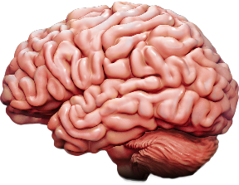
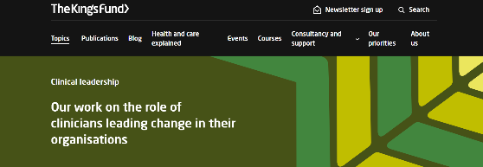
The Uniqueness of the Medical Director’s voice

Slide 5
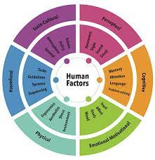
Leadership versus management?
Complicated versus Complex
Simple versus wicked problems
Standard management paradigm of cause and effect may not work in healthcare
Human factors
Complexity theory

Slide 6
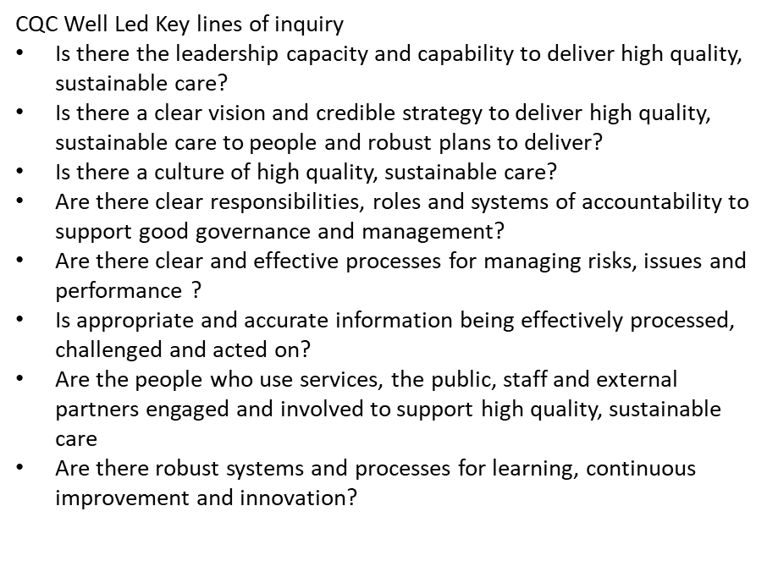
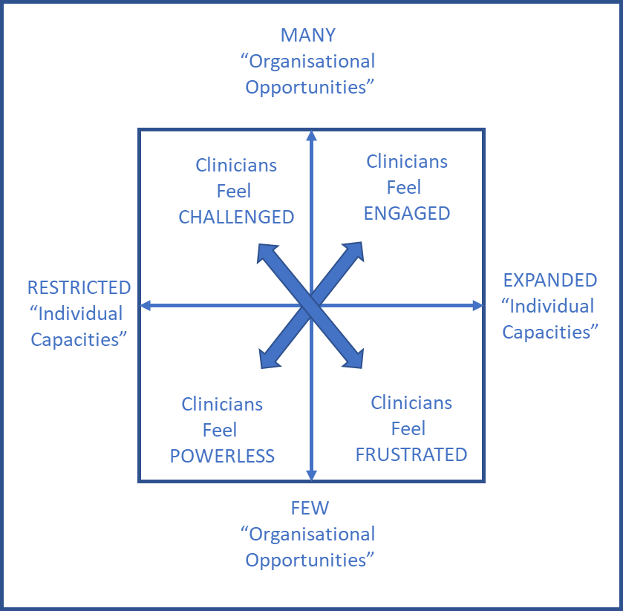
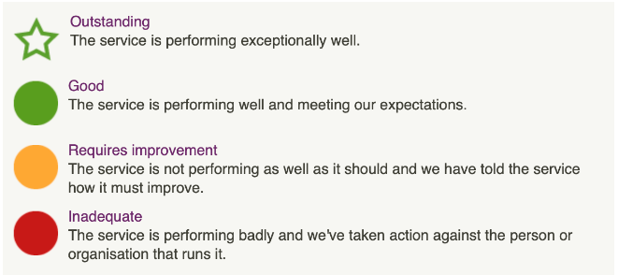
The Crucial role of Medical Directors
Leadership, governance and culture
Clinical engagement and followership
Developing the next generation of medical/ clinical leaders
"Culture eats Strategy for breakfast" Peter Drucker

Slide 7
Key characteristics of a “good” Medical Director
Identifies and Owns the issues​
Restless curiosity for what could be improved​
Passion to improve​
Harnesses the staff
Patient/ citizen focused​
"The standard you accept is the standard that you walk past and do nothing about"

Slide 8
Key qualities of a “good” Medical Director
Relationship building
Emotional intelligence
Personal Resilience
Integrity and honesty
Openness and transparency
Engaging communication skills
Visibility
Compassion

Slide 9
Key areas of interest for the Medical Director at Board level
Interpreting policy for local application
Working with all executive colleagues to focus on your organisation’s key priorities
Improving quality and patient safety with the Chief Nurse including developing and implementing a quality improvement strategy
Working with Director of workforce to develop and implement a workforce strategy to recruit, retain and ensure a skilled and competent workforce is in place
Professional regulation
Everyone else’s portfolio and assessing the impact on patients

Slide 10
Some tips for a new Medical Director
Get the Medical Director’s office and infrastructure organised as soon as possible
The importance of early engagement and visibility cannot be over emphasised
Set direction and clarify your priorities for action.
The focus may be internal but the external world is increasingly important
Learn from Director colleagues and experienced Medical Directors
Never lose or forget the clinical perspective
Be agile in your use of time and expect the unexpected
Maintain a range of interests and continuing self-development
Be prepared to speak out
Look after your own health and well-being – be kind to yourself

Slide 11
Why on earth would you want to do this job?

Slide 12
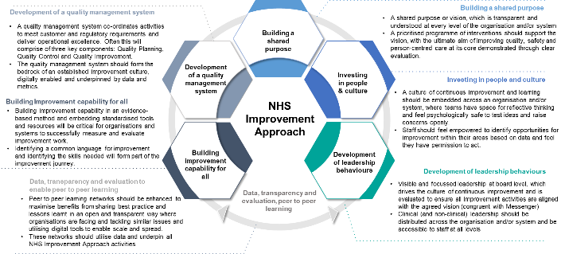
Why on earth would you want to do this job?
...ability to influence and implement improvement
Positional power to make a difference on a grand scale for patients
Hugely satisfying

Slide 13
Why on earth would you not want to do this job?

