Slide 1
Diversion of Controlled Drugs from the Legitimate Supply Chain
Grant Powell

Slide 2
SUPPLY CHAIN TEAM
Established in 2016 in reaction to increase in referrals to the MHRA.
Noted increase in unlawful websites advertising UK Supply Chain controlled drugs for sale – Prescription only Medicines being sold without prescription.
Enormously inflated prices.
Websites operated by Organised Crime Groups.
Where are they sourcing the controlled drugs from?

Slide 3
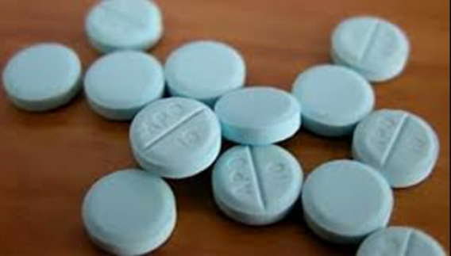
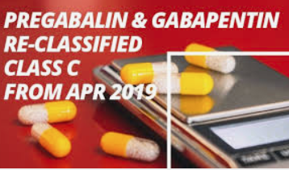

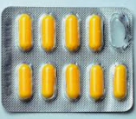
Watchlist Products
Diazepam
Nitrazepam
Zopiclone
Zolpidem
Temazepam
Tramadol
Codeine based products
Pregabalin
Gabapentin
List is not exhaustive

Slide 4
Benzodiazepines, Non Benzodiazepines Opioids and Z Drugs
Controlled Drugs - as defined by the Misuse of Drugs Regulations 2001 and the Misuse of Drugs Act 1971
Designed for short term prescription.
All carry potential for misuse and dependence.
Dependent users gradually increase dose.
The prescribed dose is normally 1 tablet per day for a restricted time (often 14 – 28 days maximum.)

Slide 5
So What’s The Issue?
GENUINE products intended for supply within the United Kingdom.
Unlawfully diverted from the legitimate supply chain.
In the majority of cases these are not stolen products.
Some wholesale dealers are wilfully neglecting their responsibilities / not completing adequate due diligence / permitting excessive purchase.
The medication is then being sold onward unlawfully to feed / supply illegally trading websites.

Slide 6
Legitimate Distribution Methods
The only legitimate methods of distribution by a pharmacist are:
Against prescription –
By authorised wholesale dealing.
  To wholesale deal TWO licences are required:
A Wholesale Dealers Authorisation (WDA(H)) including endorsements for Narcotics & Psychotropics.
A Home Office Controlled Drugs License (including export authority if export is intended).

Slide 7
Example of an Investigation
27,000 packets (28 tablets per packet) of Diazepam on three pallets were recovered from a hired van by Police in Scotland.
Original manufacturers packaging.
Order traced as part of a 50,000 packet order fulfilled by a London based wholesaler (1.4 million individual doses).
Order made via a personal e-mail account.
Payment made via a personal bank account.
Collected in person from the wholesaler.
Pharmacy that the purchaser claimed connection to does not hold a WDA(H).
Poor quality counterfeit WDA(H) was produced to the wholesaler.
No Home Office Controlled Drugs License held.

Slide 8
How much is dispensed?
An average High Street pharmacy will dispense around 10-15 packets a week against prescription (all strengths of product combined).
Usually prescribed at its lowest strength.
Higher strengths are normally used in hospitals and nursing homes.
Re-ordered following dispensing – not stockpiled.
Relatively low purchase price. Easily re-ordered.

Slide 9
How much is being purchased?
Then….
In 2016 instances of 20,000 packets of Diazepam at 10mg strength being delivered to community pharmacies.
No WDA(H) held / no endorsement for Narcotics & Psychotropics.
No Home Office Controlled Drugs Licence held.
Some wholesalers not conducting effective due diligence.
Now….
Advisory cap of 100 packets maximum order.
Greater due diligence surrounding the correct licences being in place.

Slide 10
One Pallet containing 13,440 packs of Diazepam

Slide 11
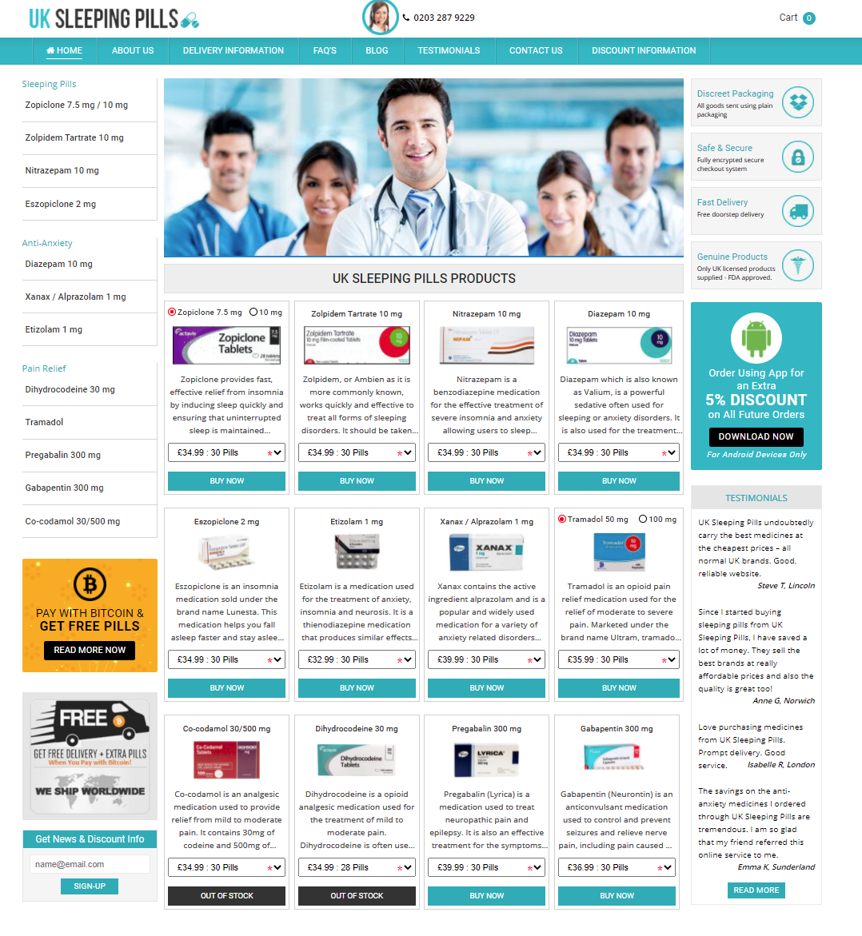


Slide 12
Types Of Pill Presentation
There are three main iterations of Pill Presentation on the websites:
Genuine Licensed UK Supply Chain Product.
Generic Product which is NOT licensed for prescribing within the UK.
Falsified Medicine (this may be presented in counterfeit packaging) – the Active Pharmaceutical Ingredient may be adulterated or completely different to the medicine it is presented as.

Slide 13
Seizure of Medication during Enforcement Activity
Op Lamborghini – 1.2 million doses of various controlled drugs Benzodiazepines / Non-Benzodiazepines seized.
Evidence of a further 2 Million doses already dispatched.
Products seized originated from various sources
UK Supply chain
Generic unlicensed medication from India / China / Europe.
Falsified medication in counterfeit packaging.
Op PYARR – 1.1 million doses seized. Packaging and posting lists indicating a further million doses dispatched

Slide 14
So what has happened since 2016……?
11 Pharmacists suspended by GPhC
18 People charged with criminal offences.
Multiple Websites taken down.
Two Data trawls completed.
Seven pharmacists convicted for Unlawful Supply of Controlled Drugs.
Several more awaiting court hearings.

Slide 15
Penalties
As a Pharmacist / Wholesale Licence Holder:
Loss of Pharmacist registration.
Loss of Wholesale Licence.
Criminal prosecution under the Human Medicines Regulations 2012 –
2 years imprisonment / unlimited fine.
Criminal prosecution under the Misuse of Drugs Act 1971.
14 years imprisonment / unlimited fine. Confiscation orders.

Slide 16
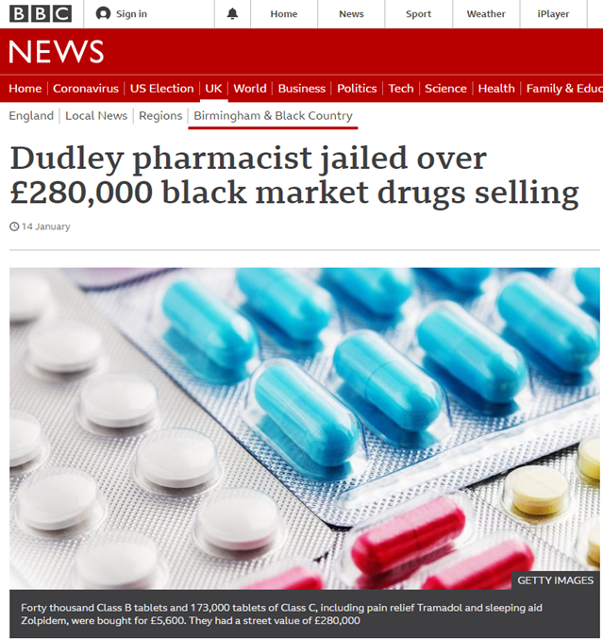
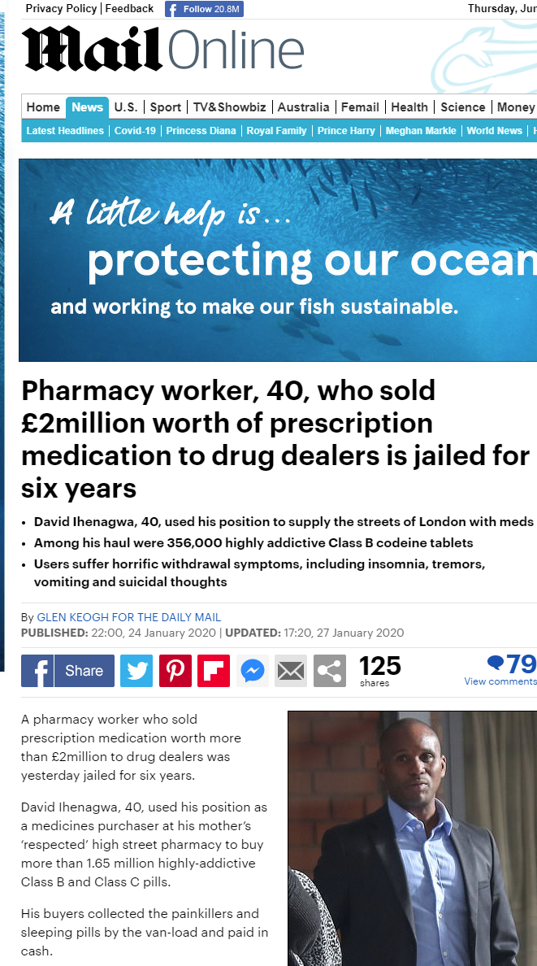

Slide 17
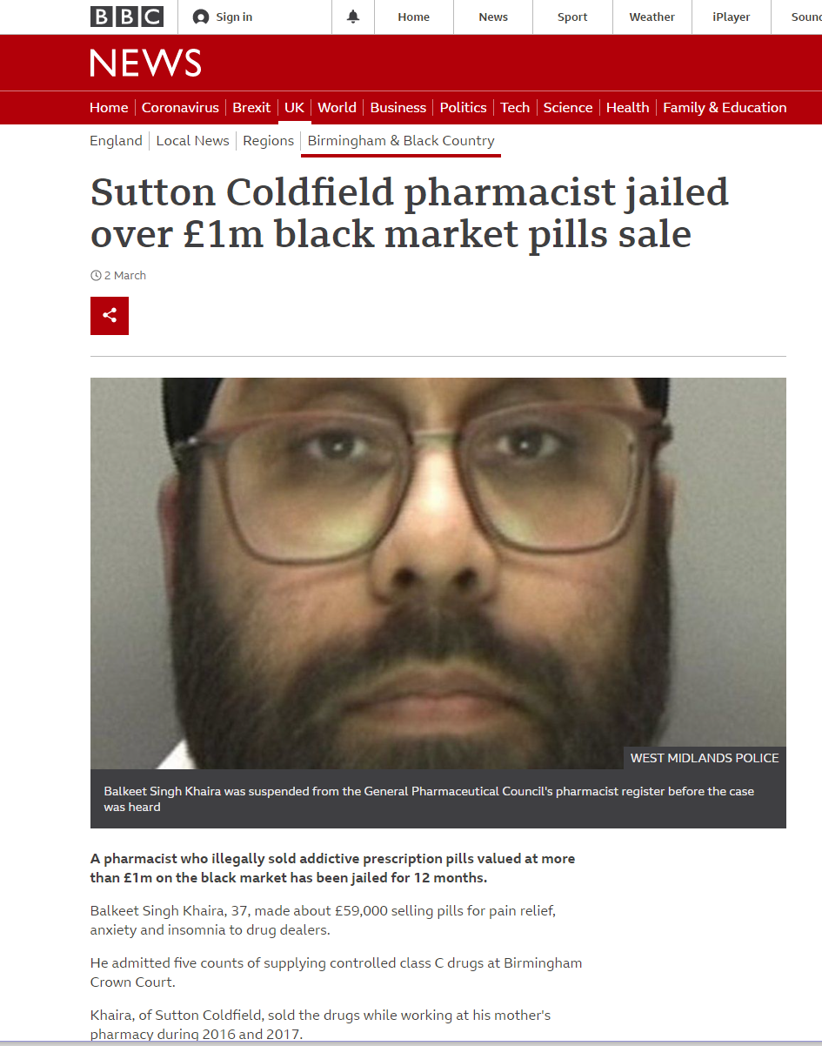
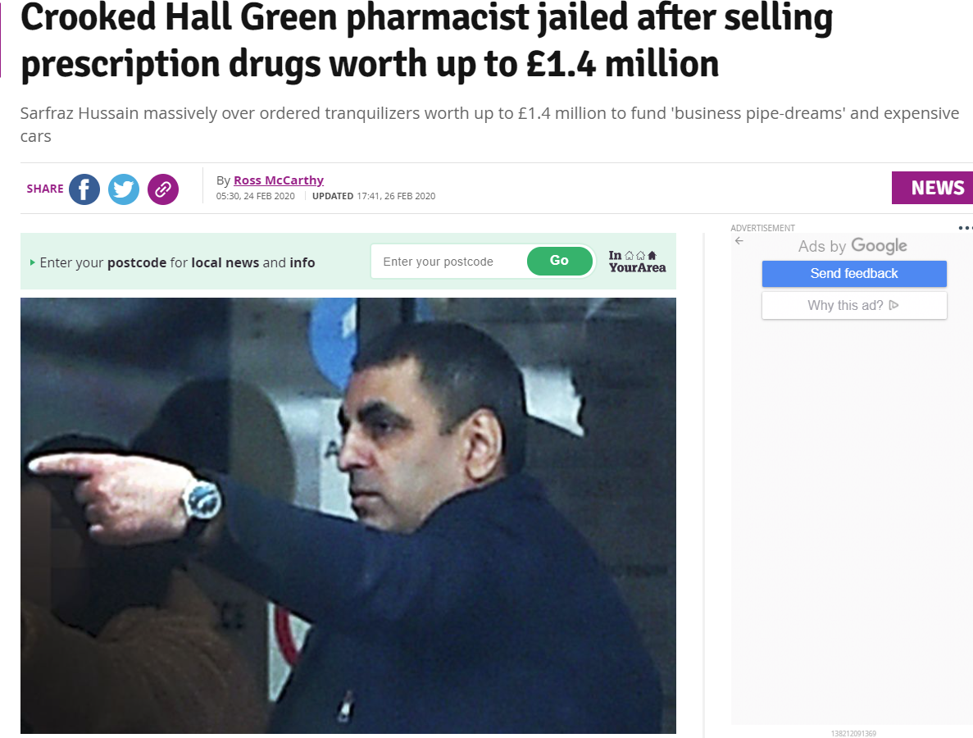

Slide 18
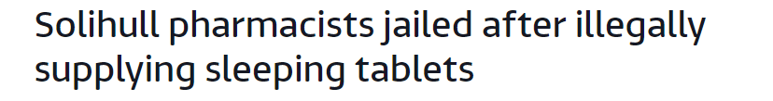
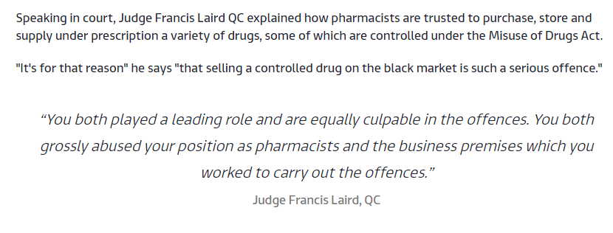
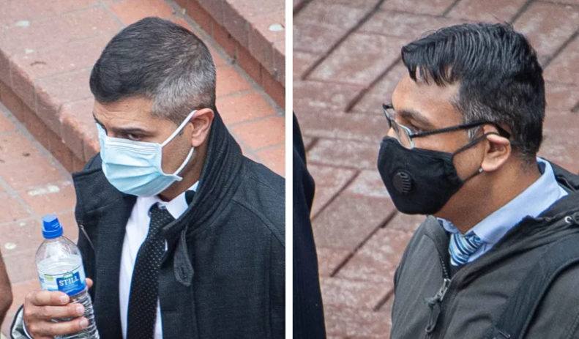
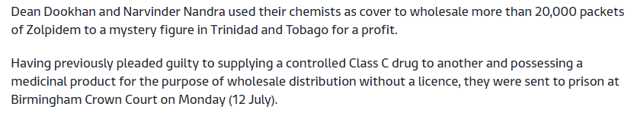

Slide 19
Some Good News…….
Greatly Reduced over-purchasing without the requisite licences.
Greater vigilance by wholesalers.
Many websites no longer offering UK Supply Chain products.
-73% reduction in wholesale of 10mg Diazepam between 2016 – 2017.
Some Bad News
Increased reporting of Burglaries / Theft from motor vehicles (lorries).
Issue not eradicated – there are still individuals determined to divert product.
Unlicensed and falsified drugs in counterfeit packaging being supplied by unlawful websites.
Knifepoint Robberies at Wholesalers.

Slide 20
The Rise of Falsified Medicines / Counterfeit Presentation
Increasing quantities of Falsified Medicines in Counterfeit Packaging being seized by Police / provided by illegal websites.
Frequently products being sold as Diazepam / Zopiclone / Zolpidem / Tramadol in recognised supply chain livery is found to contain other controlled drugs – often completely unlicensed.
In particular Flubromazolam and Etizolam
Both drugs are unlicensed for use in the UK and Europe
Considered to be extremely potent.
Why are these drugs being misrepresented as other products.
Particularly dangerous when the user is expecting a different drug.

Slide 21
Ongoing Issues………
Not enough Due Diligence being undertaken.
Examples where Wholesale Dealers without the endorsement of Narcotics & Psychotropics on their WDA(H) purchase upper limits of controlled drugs – from several wholesalers.
Recent case of very high value hospital line pharmaceuticals being stolen.
Then re-introduced to the supply chain by a ‘Wholesale Dealer’ – No WDA(H) held.
Insufficient checks made by the purchasing wholesale dealer to confirm that the vendor is authorised to sell the products.

Slide 22
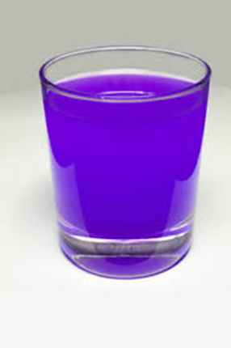
PURPLE DRANK
‘Purple Drank / LEAN / SIZZURP’ is a recreational drug, created by combining prescription-grade cough syrup with a soft drink and hard candy. The concoction originated in Houston, Texas and is popular among those who belong to the hip hop subculture – Wikipedia
Regular overordering of Codeine Linctus (Cough Medication) and Promethazine Hydrochloride (Phenergan Elixir) used to treat allergies / travel sickness / sleeping difficulties. 500 bottles at a time.
More frequent fraudulent purchasing attempts by ‘ghost purchasers’ claiming to be pharmacists.
Causes euphoria, motor-skill impairment, lethargy, drowsiness.

Slide 23
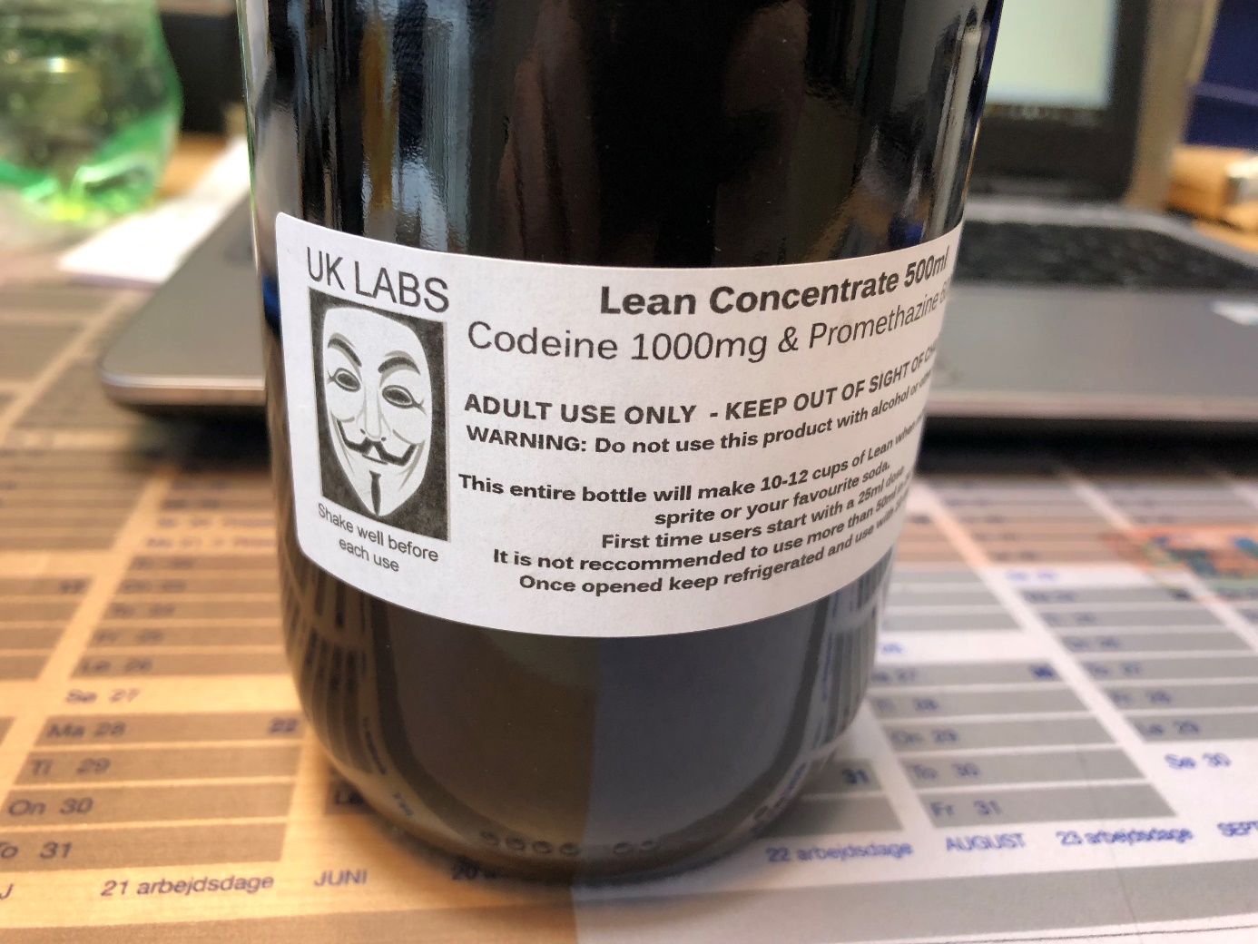
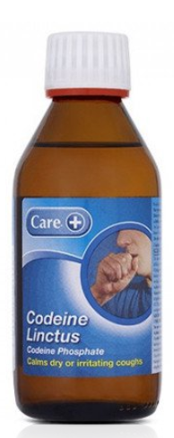
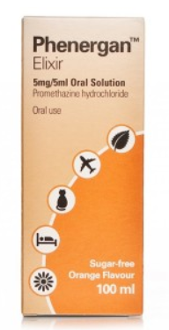
Recent Seizures of Purple Drank / LEAN
Seizures made of a premixed concoction of Purple Drank / Lean.

Slide 24
Thank You for your attention…………….
Any Questions?
Grant Powell
MHRA Criminal Enforcement Unit
grant.powell@mhra.gov.uk
07770227098

