Slide 1
Staffing for safe and effective care
Wendy Preston
RCN Head of Nursing Practice
Honorary Respiratory Consultant Nurse
Advanced Nurse Practitioner - OOH
@wendypresto

Slide 2
Why is safe staffing so important?
SAFE STAFFING
Patient safety
Lower mortality
Lower HAI
Fewer falls
Lower failure to rescue rate
Fewer medicine errors
Better patient experience
Nurse safety
Lower stress levels
Lower illness and absence rates
Better morale
Improved retention rates
Lower burnout rates
Notes:
Right numbers = safe patients, safe nurses
serious staffing shortages, the links between fair pay, staffing and patient safety

Slide 3
Safe and effective staffing: what’s the problem?
At an accountability level, no one individual or organisation is responsible for ensuring an adequate macro supply of nursing staff to deliver safe and effective care.
Calculations are based on affordability
No workforce strategy to address the problem
Sometimes, Directors of Nursing are the de facto person held to account, despite not having any control over nursing supply
https://www.rcn.org.uk/professional-development/publications/pub-006195
https://www.rcn.org.uk/professional-development/publications/pub-006415
Notes:
Calculations are not based on an assessment of population need.
Sheer need for numbers
Some places simply cannot get nurses with agency budget

Slide 4
Why do we need Royal College Standards for the nursing workforce?
Whilst there is a substantial and growing evidence base for the positive impact of registered nurse staffing ratios on patient outcomes the research evidence base for specific settings is:
varied
perceived as challenging to define and determine
scarce within non-acute care settings.
These reasons are often inappropriately cited as to why certain aspects of professional staffing guidance cannot be codified formally within systems.
Over time, a number of organisations (eg NICE, other Royal Colleges etc) have endeavoured to make recommendations regarding the nursing workforce in specific nursing environments. However, overarching nursing workforce standards had never previously been established.

Slide 5
About the Standards
The Standards apply across all areas of nursing and all sectors within the United Kingdom.
The Standards were co-created with expert consensus by the nursing professional body and the largest trade union for nurses.
The Standards are designed to support a safe and effective nursing workforce alongside each nation’s legislation. The 14 Standards are grouped into 3 key themes:
Responsibility and Accountability – 4 standards
Clinical Leadership and Safety - 6 standards
Health, Safety and Wellbeing - 4 standards

Slide 7
Executive Level Nurses
Standard
1
Examples
Responsibility and Accountability
1a – There should be an executive level nurse.
1b – If not (e.g. small organisation/ company) this should be a documented exception that is documented, reported and reviewed. This can then be supported or challenged by commissioners and regulators.
1c – Whole board are accountable.
1d - The nursing workforce establishment should be determined by the demand for services and the
need to provide safe and effective care.
1e. Setting the nursing workforce establishment should explicitly inform the organisation’s financial planning and be funded by revenue allocation rather than fitting a prescribed financial envelope.
1f - In setting the nursing establishment workforce planning and decision making should be underpinned by professional nursing knowledge and experience. The responsibility for setting nursing establishments remains with the executive nurse.
1g - Nurse leaders are integral to contracting and commissioning care in order to distinguish between nursing specific workload and that of the wider multi-professional workforce.
1h - Decisions on nurse staffing must be recorded. Discussions must detail the workforce requirements of the organisation/service in order to provide staffing for safe and effective care.
1i -Each organisation should have a board-approved risk management and escalation process in place to enable real-time nurse staffing risk escalation and mitigation with clear and transparent procedure to address severe and recurrent risks.

Slide 8
Executive Level Nurses
Standard
2
Examples
Responsibility and Accountability
2a – The nursing workforce will be a standing item for discussion at the board or accountable body for decision making in any organisation providing nursing services.
2b – Workforce data should be reviewed at least monthly and ‘red flags’ such as high rates of sickness or turnover investigated with transparency.
2c – A framework should be in place that enables regular review and decisions about service provision and workforce resourcing.
2d - A continuous quality improvement approach to staffing should be taken. A triangulated approach is required and will include:
professional judgement
patient-dependency/acuity
workload tools
clinical quality indicators
nationally agreed standards
peer reviewed published evidence
benchmark data from matched comparators who can evidence the delivery of high-quality person centred services and/or data linkage to care quality indicators.
2e - Once any review is completed, an action plan should be created to address any issues identified.
2f - Where there are nurses rostered within a multi-professional workforce rota, they cannot be counted twice.
2g. Staff who support the workforce,
such as clerical, housekeeping
and catering staff, should not be
considered within nursing workforce
numbers when determining the
nursing establishment to meet clinical
need.
2h. All nursing students must be
supernumerary when in training.

Slide 9
Registered Nurse Leadership
Standard
5
Standard
6
Examples
Registered Nurse Lead
Time & Resources to Lead
5a - Each team & service (e.g. Ward/ Community team/ Nursing Home) should have a registered nurse lead.
5b –If it is a wider MDT team and not managed by a RN then there must be a clear line to nursing leadership.
6a – Should be 100% supervisory (i.e. not planned to be in the numbers) – if not needs to be a documented exception and reported to board.
6b – list of what this resource and time is for.
6c – Role within leadership team needs to be included in job descriptions.
Notes:
DoN example

Slide 10
Executive Level Nurse examples:
A Director of Nursing presents the standards to the executive board particularly highlighting Standard 1c-i & 2a. With the nursing workforce now a standing item this is then used to work through the various standards highlighting where compliance exists and how to make step changes towards achieving this where there are gaps.
Examples:
Standard 6 set’s out the supervisory role of ward/team leaders, the DoN has worked with the nursing leadership team and determined currently this occurs on average 33% of the time. The amount of additional wte band 5/6 is calculated to initially get this to 50% within 1 year, 75% by year 2 and 100% by year 3. A business case can then be developed.
Standard 8 sets out what should be included to calculate uplift. 8a,b and c are used to evidence base a review and proposed new uplift % for the trust.
Standard 9 is used to instigate reporting every time substantive nursing workforce falls below 80%. The DoN can use the regular board agenda item to raise this which is a regular occurrence as agency/ bank use often above 20%. This is used to prompt a discussion regarding what can be done to both elevate and mitigate the problem as well as ensure risk recognised and recorded.
The internal quality assurance framework can also be reviewed and adjusted to incorporate the standards as part of the assessment process and to evidence base change. This is useful to prepare for regulator visits ect.

Slide 11
Independent sector example:
An Independent sector Chief Nurse is not currently executive level and reports to the Medical Director. Whilst on the senior management team they do not have a seat on the board.
The standards are used to highlight the need to an executive level nurse and if not 1b states that this should be a documented exception. This is used to start the conversation, challenge the corporate board and also 1c sets out that the whole board is accountable for nursing workforce.
Standard 2a also states that nursing establishment should be a standing item on each board meeting. All of these factors together make a strong case for the Chief Nurse to become an executive level post.

Slide 12
Care Home setting
The Nursing Workforce Standards are applicable to this setting and will be a very useful tool to drive change.
There are 14 standards and all have descriptors e.g. 1a,b,c
Standard
1
Standard
5
Examples
Accountability and executive level nurse
Registered Nurse Lead
1a – There should be an executive level nurse.
1b – If not (e.g. small organisation/ company) this should be a documented exception that is documented, reported and reviewed. This can then be supported or challenged by commissioners and regulators.
1c – Whole board are accountable.
5a - Each team & service (e.g. Nursing Home/ Care Home with nursing) should have a registered nurse lead (standard 6 sets out dedicated time & resources for this).
5b –If it is a wider MDT team and not managed by a RN then there must be a clear line to nursing leadership.

Slide 13
Care Home setting
Standard
10
Examples
Clinical Leadership and Safety
10a - This includes access to CPD, education, support and development to ensure the nursing workforce has the knowledge, skills and competencies required to deliver evidence based, safe, person-centred care that is of high-quality.
As a minimum this needs to include:
safeguarding
mental capacity
consent record keeping
basic life support
competency frameworks specific to the area of specialty the principles of accountability and delegation
raising concerns
health and safety related training including moving and handling, infection prevention and control and fire training.
10b - The registered nurse lead will
ensure that:
individuals appointed to the nursing workforce, including those in management roles, are allocated a period of supernumerary induction / preceptorship
individuals with no previous experience should have a preceptorship period which includes structured induction and close supervision until specialty competence and confidence are achieved
for more senior/experienced staff taking on additional or different roles, a preceptorship period is still needed until competence and confidence are achieved.
10c - For staff who are lone workers, there must be clear access to advice, supervision and support at all times as well as compliance with necessary health and safety requirements.
10d - Fostering leadership capability is integral to all members of the nursing workforce throughout their career to embed a psychologically safe culture and strengthen the nursing voice.

Slide 14
Care Home examples
A care home with nursing is looking to recruit a registered manager that is not a registrant. Standard 5a can be used to argue against this as ‘each clinical team or service that provides nursing care will have a registered nurse lead’.
There is a high reliance on agency and temporary staff particularly on night shifts. Standard 9, states that when the substantive staff ratio falls below 80% this should be reported (to the corporate board, likely management board in smaller homes). 9a includes ensuring continuity of care.
One organisation suggested that they stopped having an RN overnight and substituted with a senior carer and an on-call RN available by phone. There are lots of reasons why this could be challenged, and the standards add to this: Standard 1 (accountability: board level, in this setting likely to include owners in smaller establishments) 1a – includes responsibility to those who contract or commission services. Standards 2 – all and particulary b,c very useful here.
Insufficient time for CPD, struggle to ensure statutory & mandatory training. Standard 10 sets out what is required and Standard 8 covers ensuring uplift in establishments is sufficient.

Slide 15
Advanced Nursing Practice
Clinical
Leadership
Education & research
Standards 2 – Establishments meet demand, are reviewed & reported to board who are accountable
2b – workforce data review, at least monthly
2f – Double counting: for example if on a multi-prof rota shouldn’t also be counted in nursing numbers for that clinical area.
2h – Students are supernumerary
Standard 9 - Substantive 80%+
Standard 5a – Registered Nurse Lead for nursing teams.
b - link to nursing leadership essential e.g. if part of wider MDT team/ rota.
Standard 6 – Time to lead
6a,b Leadership parts of job plan should be supervisory & not in the numbers.
6c – Role within leadership team needs to be included in job descriptions.
Standard 7 – Practice development including CPD and Clinical Supervision
Standard 8 – Uplift
8b set’s out what must be considered
8c professional judgement
Standard 10 – CPD – appropriately prepared and work within scope of practice
Notes:
Interpretation of the standards for advanced nursing practice

Slide 16
Advanced Nursing Practice example:
An advanced clinical practitioner (nurse) is working on a multi-professional rota on the medical take, based mainly on the Acute Medical Unit. There are nursing staffing issues on AMU today due to sickness and vacancies and the Matron said in passing that they will need to also count you in the numbers today on AMU because if not the dashboard will be red.
Standard 2f states that this shouldn’t happen and that a nurse can’t be counted twice. This includes those that are rostered on any multi-professional rota.
Notes:
Case example: using the standards to influence change in advanced practice.
The standards can also work along side the RCN Advanced Practice Standards - https://www.rcn.org.uk/professional-development/advanced-practice-standards

Slide 17
Stanrds
Nursing Workforce Standards
Legislation
Escalation guidance
Pay
Staffing for Safe and Effective Care

Slide 18
They are part of a suite of resources to drive standards towards ‘staffing for safe and effective care’.
They complement our guidance published in November 2020: Raising and Escalating Concerns
View the publication

Slide 19
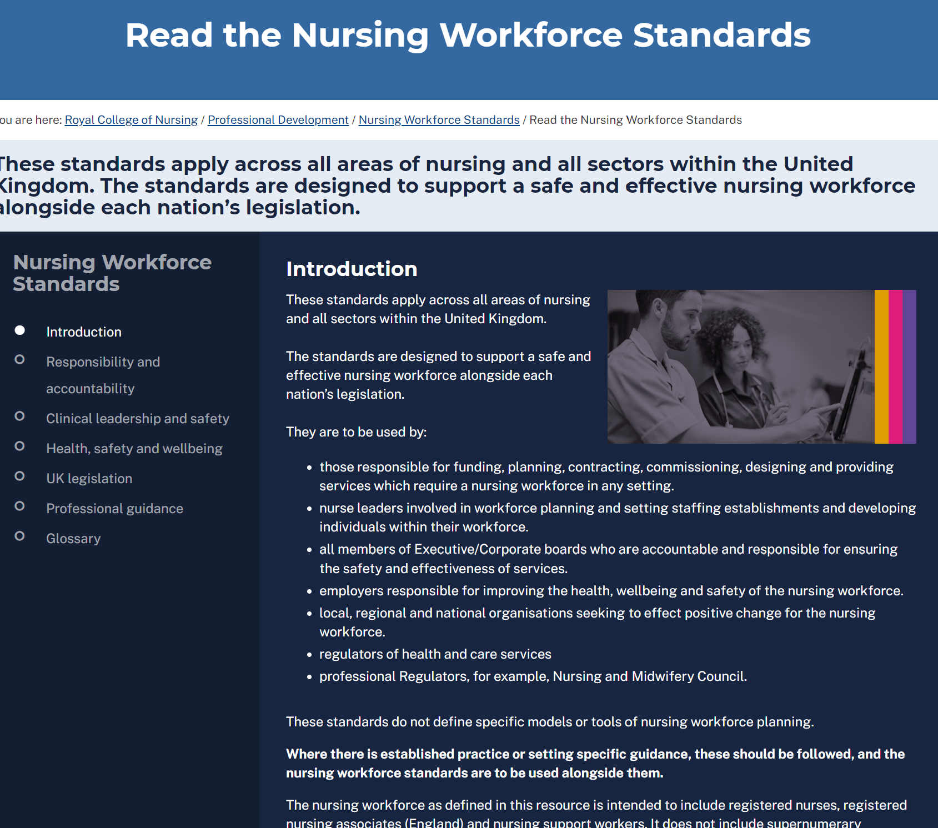
How are the Standards presented?
Online resource www.rcn.org.uk/nursingworkforcestandards
FAQs
Additional resources to support the standards
Links to psychological escalation guidance
Links to legislation and professional guidance where it exists.
The RCN vision
Every member of the nursing workforce uses the Standards in part or in whole to support
them as an individual or on behalf of a nursing workforce.
The Standards will become as well known as the NMC Code.
The Standards are used to uphold safe and effective staffing for the nursing workforce UK-wide.
Notes:
Nursing Workforce Standards | Professional Development | Royal College of Nursing (rcn.org.uk)
FAQs Nursing Workforce Standards FAQs | Professional Development | Royal College of Nursing (rcn.org.uk)

Slide 20
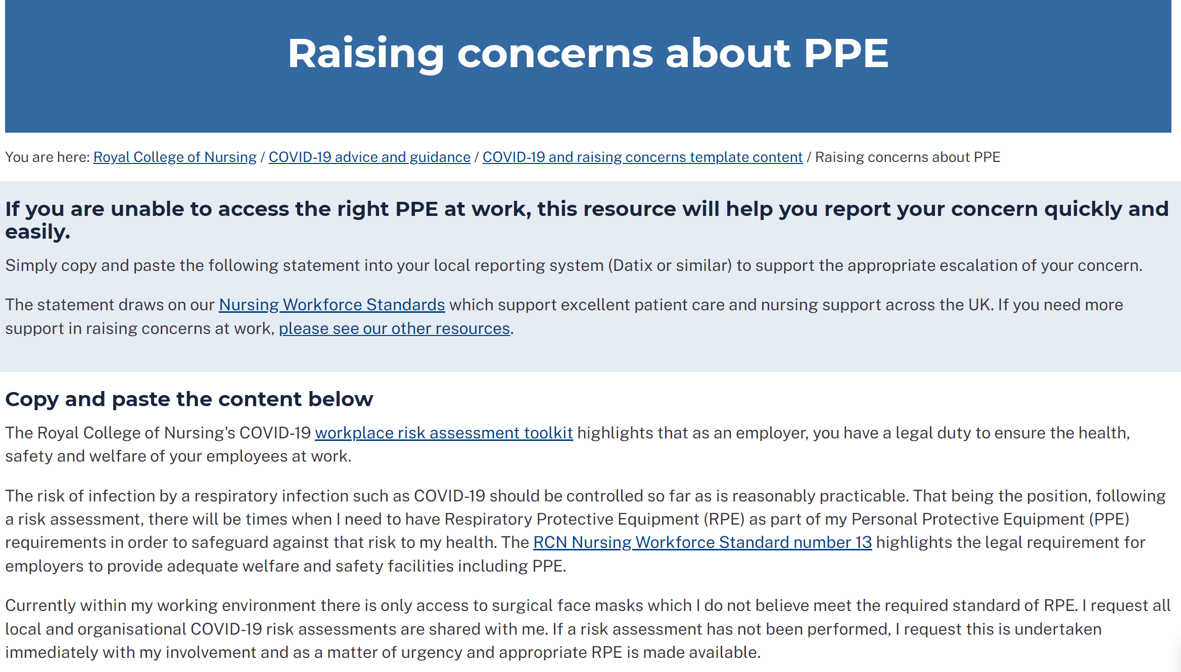
PPE & Covid 19

Slide 21
Support for the Standards
Andrea Sutcliffe, Chief Executive and Registrar of the NMC: ‘’This is useful guidance from the RCN that nurses and their employers can use to assist them navigate the operational challenges they face to deliver the safe, kind and effective care our communities need.”
Saffron Cordery, Deputy chief executive of NHS Providers: “We agree with the RCN that enough staff need to be recruited and retained not only to address existing workforce gaps, but to help build vital flexibility into the system to protect staff wellbeing and development. NHS bodies must recognise the specific workforce needs that have emerged or been reemphasised this past year, to ensure that the correct lessons are learnt.’’
Rebecca Smith, Managing Director of NHS Employers: “Employers will welcome these workforce standards for nursing. Nurses are at the heart of our NHS teams, and these standards will help to ensure that is recognised, so that nursing staff can continue to provide safe and effective care to patients and communities, while also ensuring they are properly cared for and supported themselves.”
QNI – workforce standards for district nursing

Slide 22
Any questions?

