Slide 1
Working with the Coroner
HM Coroner, Nadia Persaud
East London
11 March 2022

Slide 2
OVERVIEW
When will a Coroner investigate?
Notification of deaths to the coroner
Coroner and Medical Examiner – working arrangements
What is an unnatural death?
Investigatory role of the coroner
Opening an inquest
Interested persons and the inquest
Preventing Future Deaths

Slide 3
DUTY TO INVESTIGATE
Section 1 of the 2009 Act confirms a duty to investigate in the following circumstances:
Where the body is lying in the coroner’s area and there is reason to suspect:
The deceased died a violent or unnatural death, or
Cause of death is unknown, or
The deceased died in custody or state detention

Slide 4
NOTIFICATION OF DEATHS
Notification of Deaths Regulations 2019
Ministry of Justice Guidance https://assets.publishing.service.gov.uk/government/uploads/system/uploads/attachment_data/file/878083/revised-guidance-for-registered-medical-practitioners-on-the-notification-of-deaths-regulations.pdf
Referrals largely come from doctors (hospital or GP) and police officers
Less frequently, referrals come from families or other interested persons
Referrals are now largely electronic referrals (model coroner area)

Slide 5
CORONER AND MEDICAL EXAMINER
The ME may liaise with the coroner in relation to determining whether a death requires coronial notification
The ME can provide support to doctors in determining whether a death is notifiable to a coroner
Independent medical contact for family relating to concerns surrounding a death
Provide a source of medical assistance to the coroner
Joint training between ME and coroner’s office

Slide 6
WHAT IS AN UNNATURAL DEATH?
Oxford Dictionary – “unnatural”:
Not in accordance with the usual course of nature
Medical literature – “natural”:
Death related to an internal bodily event not influenced by external occurrences
Beitrage zur gerchtlichen Medizin (1985) 41-47

Slide 7
UNNATURAL DEATH
A death may be unnatural where it has resulted from the effects of a naturally occurring condition or disease process, but where some human error contributed to the death.
R Touche v Inner London North Coroner [2001]

Slide 8
NATURAL OR UNNATURAL?
1a Diabetic ketoacidosis II Morbid obesity
1a Lung cancer II Smoker
1a Pneumonia 1b Fall 1c Frailty of old age and osteoporosis
1a Pneumonia II Unwitnessed fall at home
1a Hypoxic ischaemic encephalopathy 1b Aspiration of food 1c Cerebrovascular accident
1a Chronic liver cirrhosis
1a Acute alcohol toxicity

Slide 9
INVESTIGATORY ROLE OF THE CORONER
The coroner has legal control of the body when a death is reported to them
The coroner must be satisfied as to the identity of the deceased
Postmortem examination may be required for the cause of death
Different forms of postmortem examination
Consideration of faith and other family wishes
Toxicology and hair analysis
DNA and odontology

Slide 10
INVESTIGATION OR INQUEST
If the preliminary investigations reveal that the duty to investigate is not triggered, the investigation can be discontinued
If there is reason to suspect that any of the criteria in Section 1 apply to the death, then an inquest must be opened

Slide 11
INVESTIGATORY ROLE BEYOND CAUSE OF DEATH
Gather evidence such as records; photographs; text messages; notes of intention; CCTV evidence; dash cam recordings
Statements from key witnesses
Internal organization governance reports
Request police overview reports
Liaise with other investigators e.g., HSE; HSIB; IOPC

Slide 12
INQUESTS - OPENINGS
Inquest will always be formally opened in Court
Opening is a public hearing
Background information will be given by the Coroner’s Officer
Directions will be set for evidence to be gathered
Dates will be set for review and the provisional hearing date
Once the inquest is open, the proceedings are active under the Contempt of Court Act 1981

Slide 13
INQUESTS
Inquests are inquisitorial, not adversarial
Purpose is set out in Section 5 – who, where, when, how
No “parties” – there are interested persons
Interested persons have rights in the proceedings
Coroner cannot determine criminal liability on part of named person or civil liability

Slide 14
INQUESTS
Witnesses are summoned to attend the inquest hearing
The Coroner can compel evidence to be provided (Schedule 5 of the 2009 Act)
Offences are set out under Schedule 6 of the 2009 Act
Inquests should be held within 6 months (any cases over 1 year old have to be reported to the Chief Coroner)

Slide 15
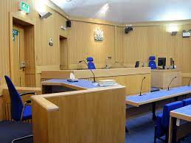
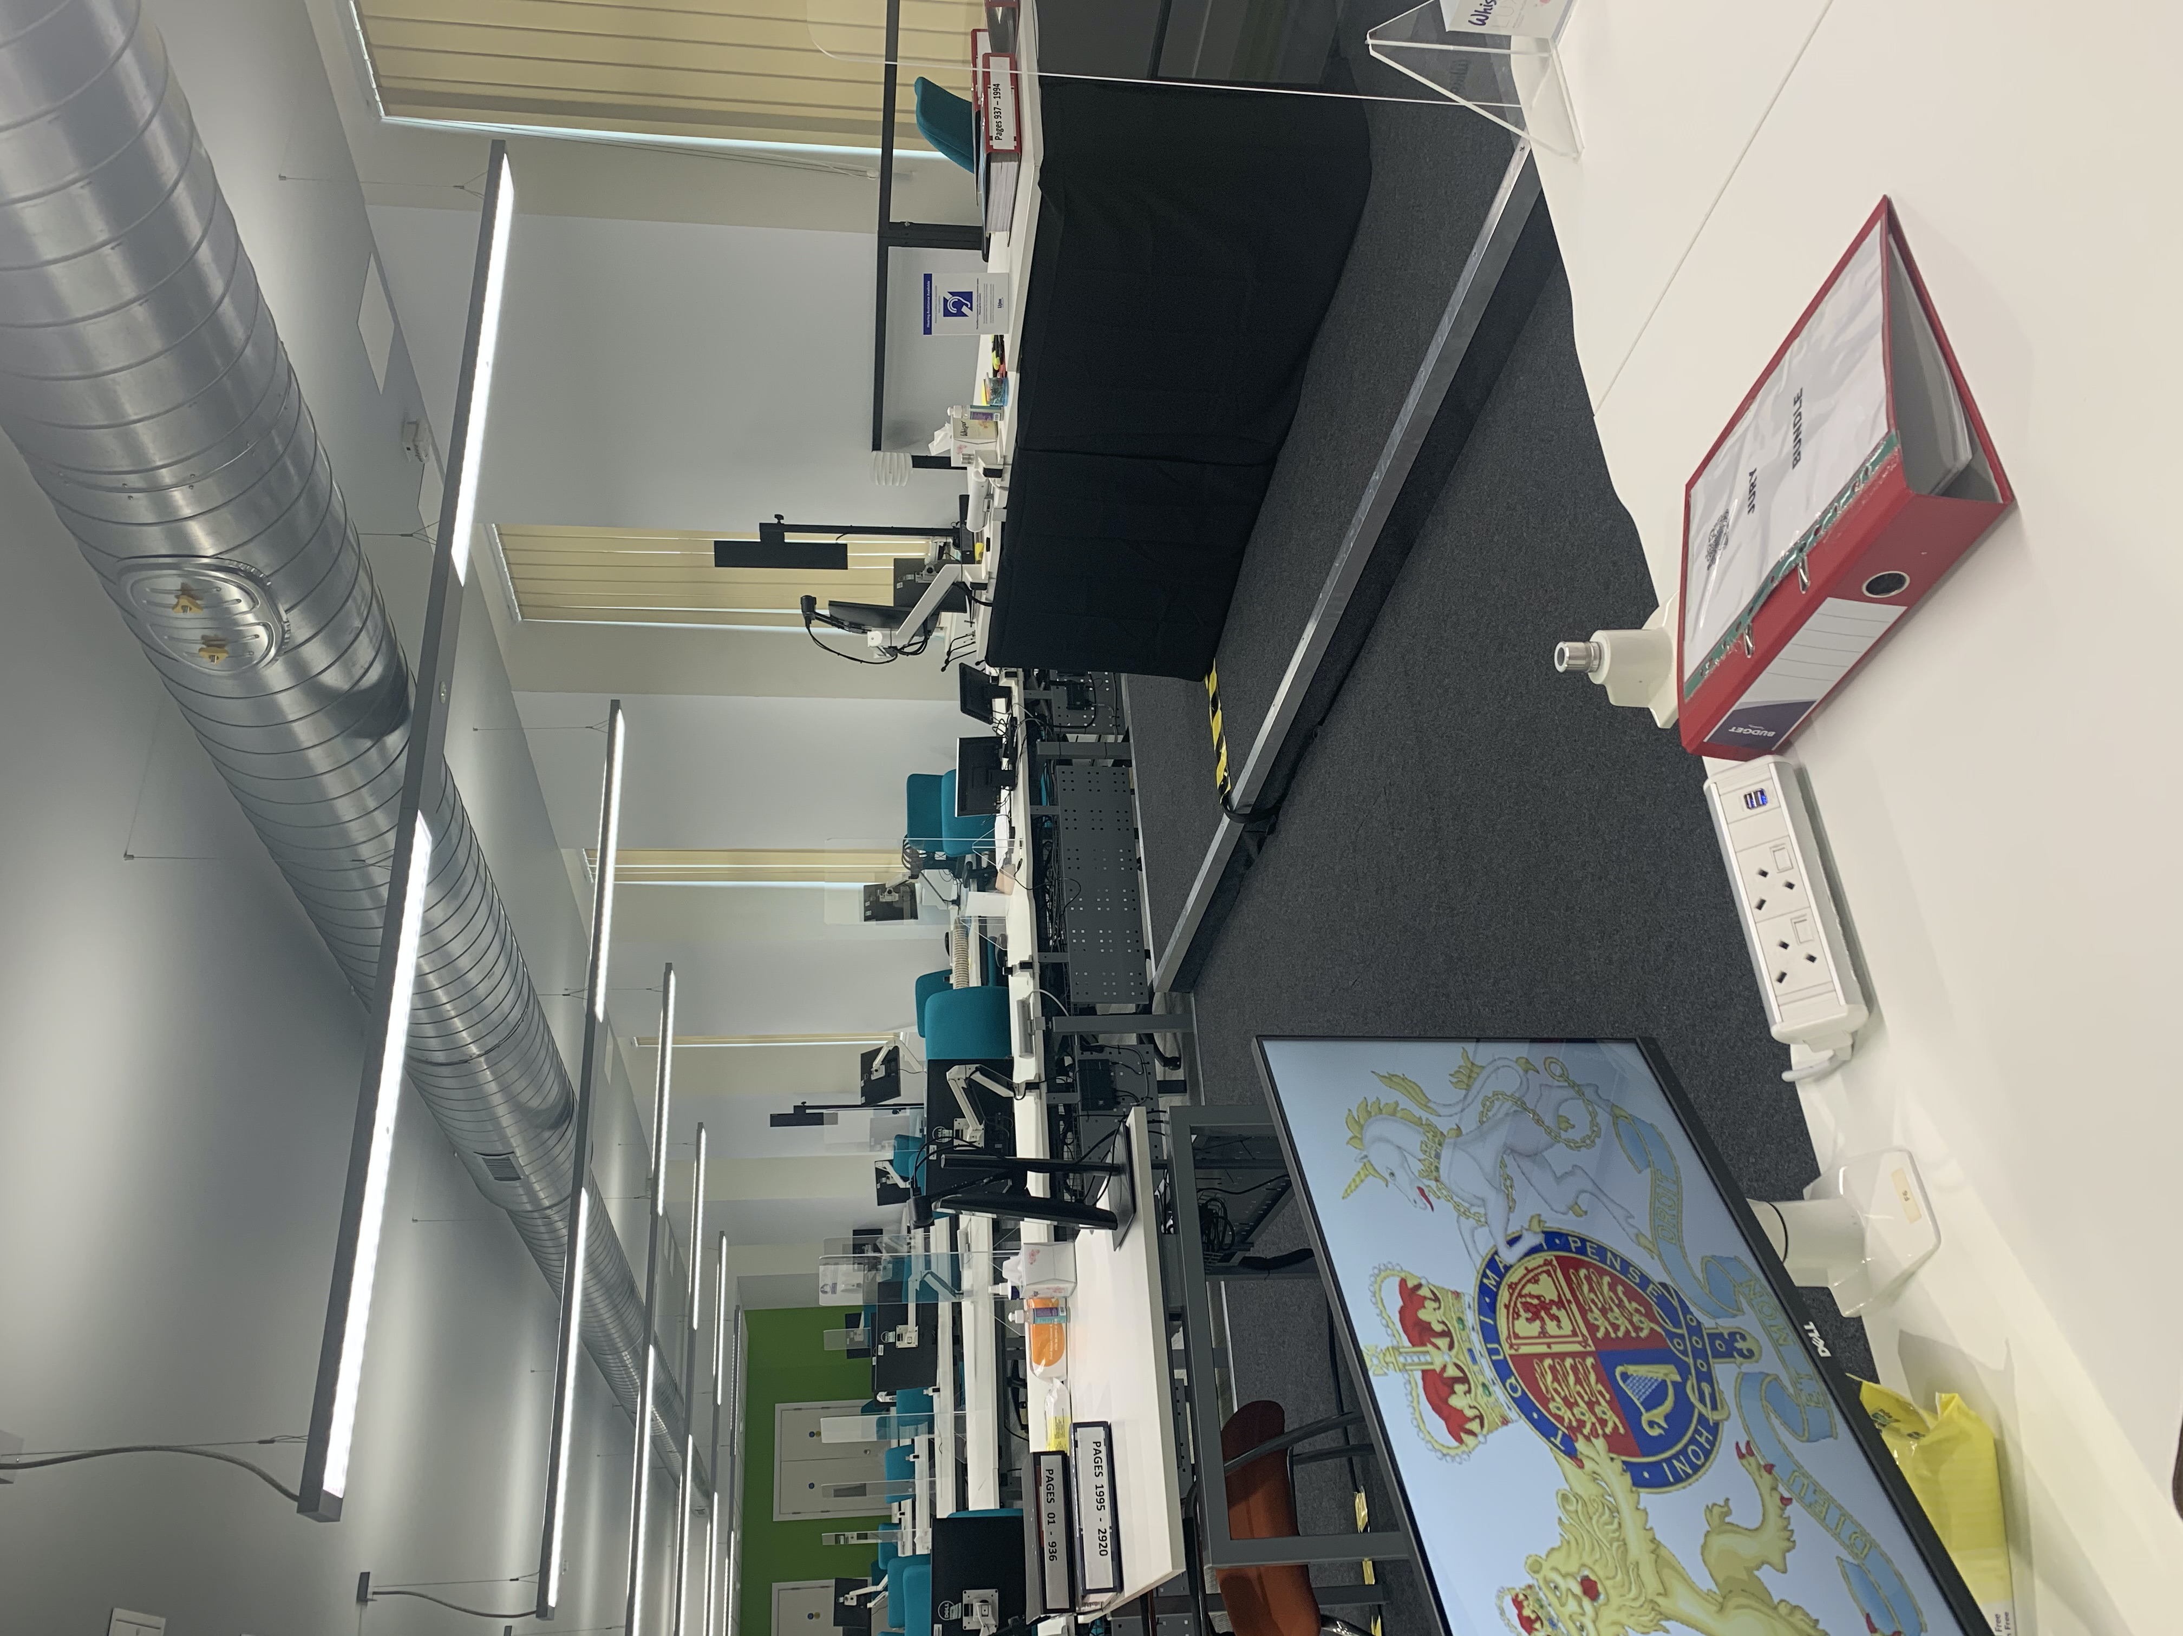

Slide 17
BREAKOUT GROUPS
How does the inquest differ from an internal NHS Trust investigation?
Are there advantages to learning from the death, at the inquest hearing? If so, what are they?
Are there limitations to learning from the death, at the inquest hearing? If so, what are they?

Slide 18
PREVENTING FUTURE DEATHS
The Coroner has a legal power and duty to write a report following an inquest if it appears there is a risk of other deaths occurring in similar circumstances. This is known as a 'report under regulation 28' or a Preventing Future Deaths report.
The report is sent to the people or organisations who are in a position to take action to reduce the risk. They must reply within 56 days.
A copy of the report and the replies will be sent to the family, Chief Coroner and other interested persons/organisations

Slide 19
THANK YOU AND
ANY QUESTIONS?

