Slide 1
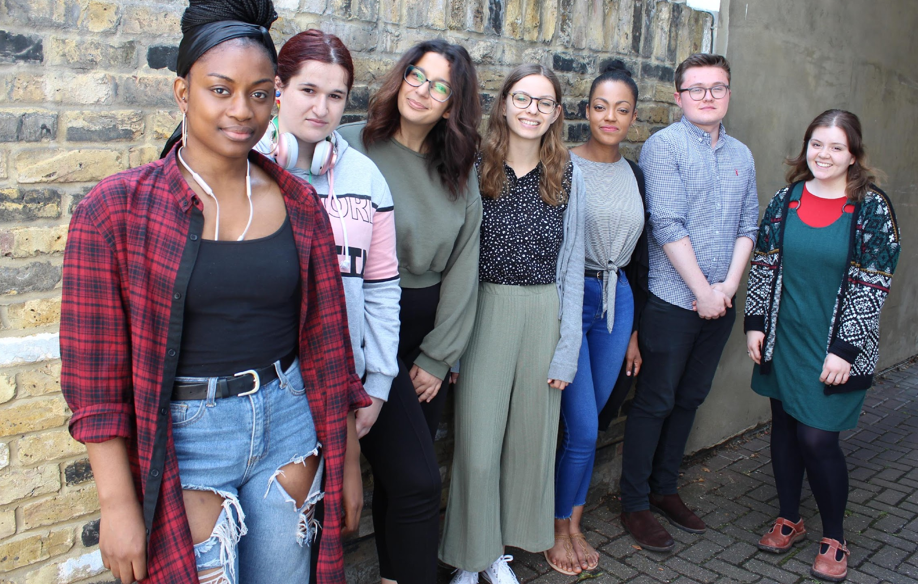
Kahra Wayland-Larty, Policy and Campaigns Manager , Youth Access
Leah Priestley-Black, Rights Advocate with Our Minds Our Future
Notes:
Youth Access is a membership organization representing over 180 youth services around the country, nay of which provide the Youth Information Advice and Counselling model, so young people can access a range of support for their mental health and the issues that underpin it, under one roof in their local area.
Our Minds Our Future is a youth-led campaign calling for a mental health system that meets young people’s human rights

Slide 2
Why we’re here
To remind you of the ‘why?’
The vision: Our Minds Our Future manifesto
The reality: our priorities for how to get there

Slide 3
Quick icebreaker
Coming out of the pandemic – what do you think are the biggest challenges and how will we overcome them?
Type your answer in the chat box.
Notes:
Where did your answer come from?....
It’s really important when we’re working out how to overcome the massive challenges facing young people today that we are actually listening to what they’ve been through and what they want.

Slide 4
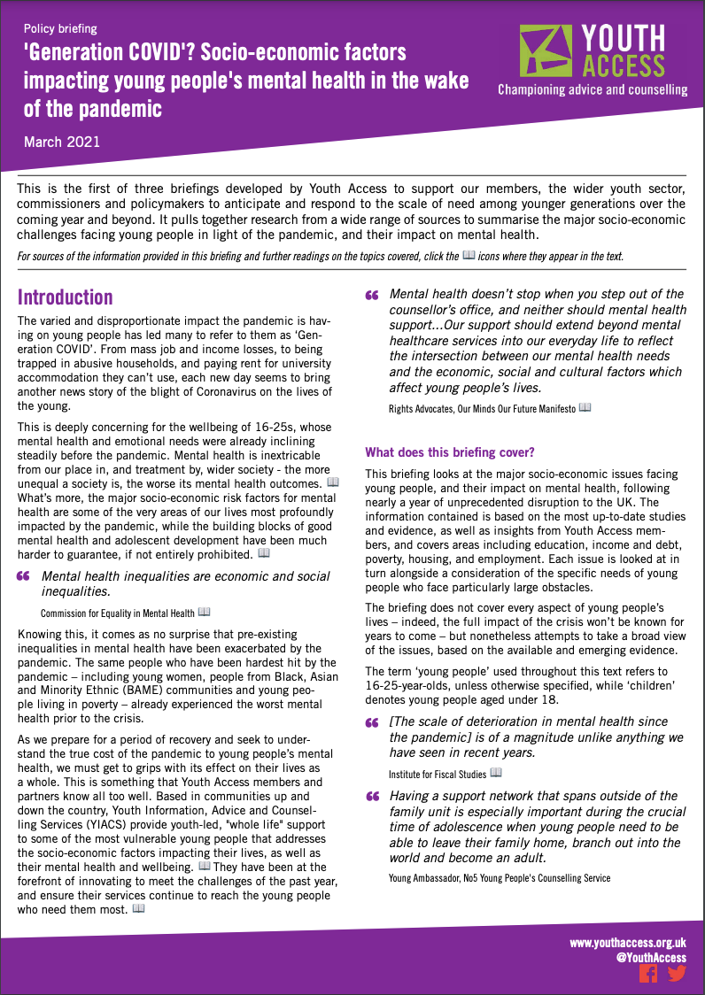
Lay of the land
Young people’s lives have turned upside down!
Professionals are burned out
Recent budget all but ignored increased CYP mental health needs
We’re hopeful about power of local and opportunities for ICSs
Government consultation on new mental health plan
Only way forward is together!

Slide 5
Young people want to be involved - and have a right to be - but we’re not always!

Slide 6
A rights-based approach
Young people have the right to ”the highest attainable standard of physical and mental health” (UNCESCR)
And to be involved in decisions that affect them– at the individual and the system level (UNCRC)
And we make better decisions & policies when we’re led by them!
"The service is designed to improve, prevent, diagnose and treat both physical and mental health problems with equal regard. It has a duty to each and every individual that it serves and must respect their human rights."​
​
NHS Constitution

Slide 7
The Our Minds Our Future Manifesto ourmindsourfuture.uk/england
We want a rights-based approach to mental health care. This means:
Experts who understand the unique issues facing young people in today’s world.
Services made for us - online and in-person, in schools, colleges and unis, and informal settings like youth clubs, drop-ins and text-based support.
Services made with us so we’re part of decisions being made about our own mental health care and the wider system.
Equity, diversity & accessibility, making sure services cater to everyone, accounting for differences and preferences.
Help when we need It, avoiding long waiting lists, arbitrary thresholds and cut-offs.
Education & training for all – so young people and all professionals working with us understand mental health and where to get help.
A ‘whole life approach’ to mental health that extends beyond the counsellors office or clinic, to offer individualised support with the economic, social and cultural issues that affect our wellbeing.

Slide 8
Our current priorities
Fund the Hubs! A joint call for a national rollout of ‘early support hubs’

Slide 9
Early support hubs/YIACS
”I was diagnosed with anorexia, but because I was still a ‘healthy’ weight, I couldn’t access support... In the end I was forced to pay for private treatment.”
Hubs are:
Youth-friendly, non-clinical setting, tailored to young people
Easy to access – travel links, walk-in
No wrong door, no thresholds, self-referral
180 Youth Access members (64 YIACS) cater to 145,000 young people – imagine a full rollout!

Slide 10
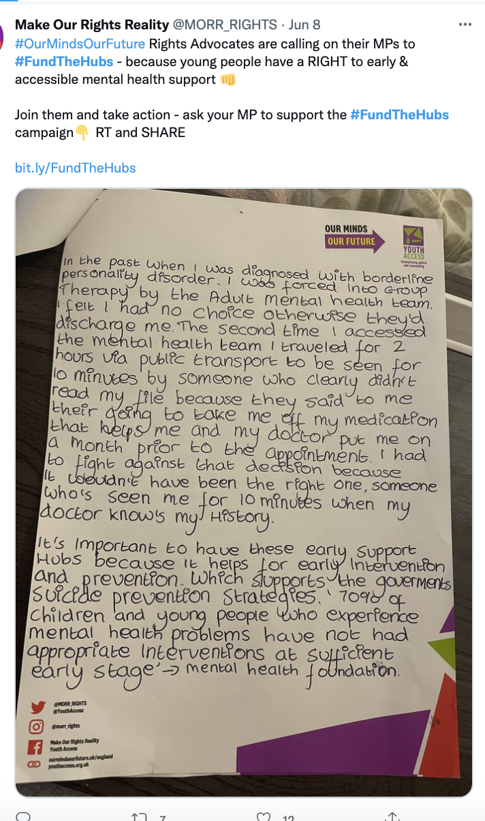
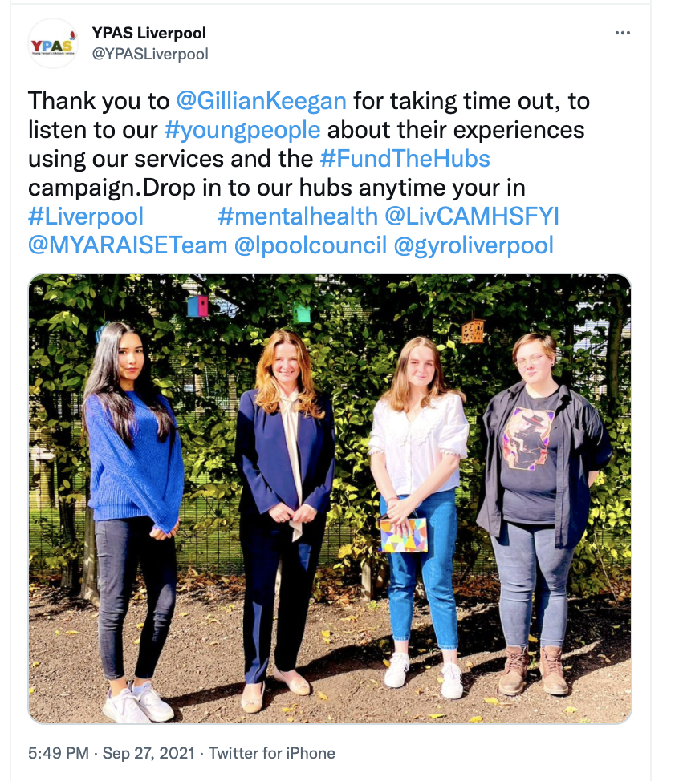
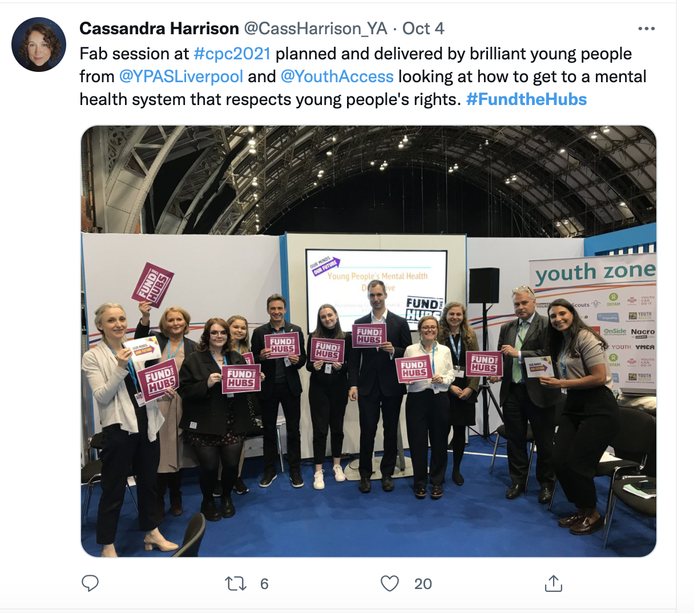
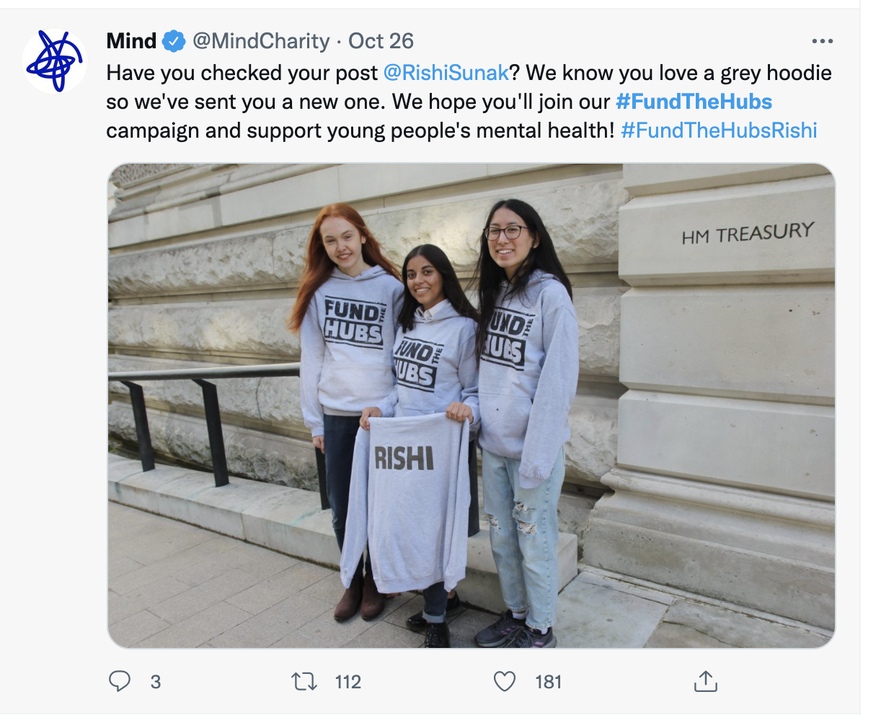
Our current priorities
Fund the Hubs! A joint call for a national rollout of ‘early support hubs’

Slide 11
Our current priorities
Fund the Hubs! A joint call for a national rollout of ‘early support hubs’
Developing ‘experts who understand’
Supporting services and practitioners to better involve young people in decisions and collective action
An honest look at equality

Slide 12
What can you do?
Consultation on Government mental health plan – big opportunity!
Listen to young people! We have a voice, how can you use it and make sure they’re heard in this process?
The Our Minds Our Future manifesto is for everyone! Use it as a starting point, share your progress, speak to us about it!
#OurMindsOurFuture ourmindsourfuture.uk/England Kahra@youthaccess.org.uk
Join the call to #FundTheHubs

