Slide 1
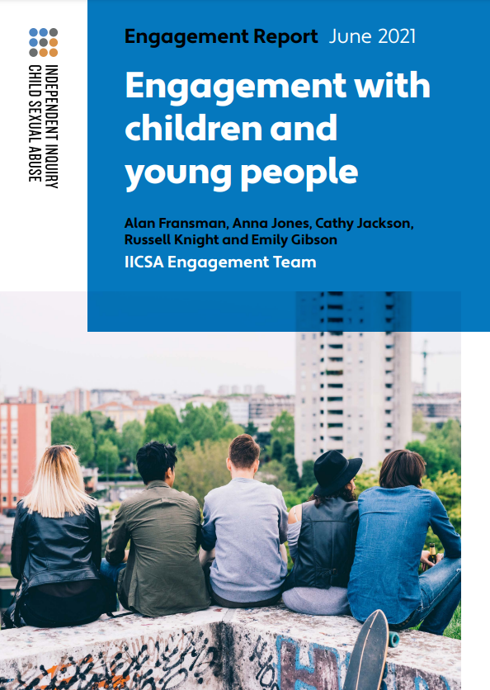
Engagement with children and young people - Report
Published: June 2021
Russell Knight
Head of Engagement
Alan Fransman
Senior Engagement Officer
Stephanie Ford
Practitioner Psychologist
Notes:
Thank the audience for inviting/enabling you to speak and share information about the Independent Inquiry into Child Sexual Abuse.
Introduce yourself and your role.
Objectives of session
Trigger warning

Slide 2
Introduction to the Inquiry
Russell Knight
Head of Engagement
Trigger warning: Mentions child sexual abuse
Notes:
Thank the audience for inviting/enabling you to speak and share information about the Independent Inquiry into Child Sexual Abuse.
Introduce yourself and your role.
Objectives of session
Trigger warning

Slide 3
About the Inquiry
Set up in 2015 to investigate organisations and institutions that have failed to protect children from sexual abuse
Led by Chair, Professor Alexis Jay OBE and three Panel members - Professor Sir Malcolm Evans, Ivor Frank and Drusilla Sharpling CBE
Supported by a Victims and Survivors’ Consultative Panel
Independent of government
Does not have the power to convict people of criminal offences, determine civil liability or award compensation
Notes:
Key messages
The Inquiry is now drawing to a close
Once the Final Report is published, the Inquiry’s work is complete
The Inquiry’s final investigation (Effective Leadership) will feature in the Final Report and will not be published as a stand alone report
The Inquiry will notify stakeholders as soon as the date of publication for the Final Report is confirmed
The Truth Project has now ended

Slide 4
Terms of Reference
consider the extent to which state and non-state institutions have failed in their duty of care to protect children from sexual abuse and exploitation
consider the extent to which those failings have since been addressed
identify further action needed to address any failings identified
consider the steps which are necessary for state and non-state institutions to take in order to protect children from such abuse in the future
publish a report with recommendations

Slide 5
Inquiry Core Projects
Investigations
Public Hearings
Truth Project
Engagement
Research
Notes:
INVESTIGATIONS - The Inquiry is examining what went wrong and why, and will challenge those institutions responsible. The evidence will inform the Inquiry’s recommendations to help protect children in the future.
All 15 investigations concluded in December 2020. 16 investigation reports have been published with three remaining during 2021. These include: The Internet and the Cambridge House, Knowle View and Rochdale Investigation report
So far, 74 recommendations have been made in investigation reports and the Interim Report.
All recommendations and responses can be tracked on the Inquiry’s website
TRUTH PROJECT - The Truth Project offers victims and survivors the opportunity to share their experience and be respectfully heard and acknowledged. Their contribution will help the Inquiry to better understand the long term impact of abuse.
Anna/Helen will discuss in more detail in their section
Victims and survivors forum
Approximately 1600 members have registered to join the Victims and Survivors Forum
To date, over 40 face-to-face and live-streamed events have taken place across England and Wales. Topics have included the criminal justice system, culture change and redress
Due to the impacts of COVID 19, we have been providing members with an opportunity to share their thoughts, views and experiences with us via online surveys
In our most recent online survey, Forum members shared with us how their protected characteristics may have affected their experiences of being a victim and survivor of child sexual abuse
RESEARCH - The Inquiry’s research programme which will fill gaps in the knowledge about child sexual abuse and make sure recommendations are informed by the latest learning.
Increase the Inquiry’s understandings of child sexual abuse and identify gaps in knowledge and current literature
Analyse the information the Inquiry receives through the Truth Project, providing a rich source of quality data from victims and survivors experiences
Carry out new research, draw together cross discipline perspectives and develop research methods
Support the Inquiry to ask the right questions.
To date, 24 research reports have been published including primary research, Truth thematic reports and rapid evidence assessments
The most recent publications are ‘Child sexual abuse in contemporary institutional contexts’ and ‘Child sexual abuse in the context of schools’
The Truth Dashboard is published twice a year

Slide 6
Recent and upcoming publications
Child Sexual Exploitation by Organised Networks (CSEN) Investigation Report (1st February 2022)
Residential Schools Investigation Report (1st March 2022)
LGBTQ+ Engagement Report
Final Report
Notes:
CSEN - The Inquiry published its 18th investigation report, Child Sexual Exploitation by Organised Networks, on 1 February 2022.
For this investigation the Inquiry identified eight themes related to child sexual exploitation by organised networks in the context of the police, local authority and other institutions within six local authority areas.
RESI - The 19th and final investigation report, Residential Schools, will be published at midday on 1 March 2022. This investigation explored how schools and other institutions responded to allegations of sexual abuse by school staff, and addressed broad questions of school culture, governance, leadership, training and recruitment.

Slide 7
Engagement with Children and Young People
Alan Fransman, Senior Engagement Officer
Stephanie Ford, Practitioner Psychologist
Trigger warning: Mentions child sexual abuse
Notes:
Thank the audience for inviting/enabling you to speak and share information about the Independent Inquiry into Child Sexual Abuse.
Introduce yourself and your role.
Objectives of session
Trigger warning

Slide 8
Engagement with children and young people
The engagement team spoke to 56 young victims and survivors from 11 organisations who have recent experiences of institutional failure.
We also listened to the challenges that 77 specialist support workers face when supporting young victims and survivors.
By doing this, we hoped to improve the Inquiry’s knowledge about present-day experiences.
The engagement activities were not formal evidence-gathering sessions, and this publication is not intended to be a comprehensive analysis of all the views we heard, nor does it make general conclusions about children who are victims of child sexual abuse in the wider population.
Notes:
Key messages

Slide 9
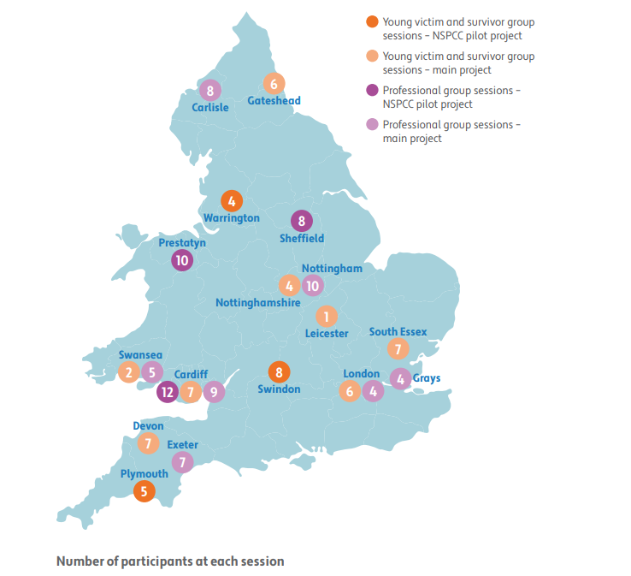
Participating organisations
Journey After Child Abuse Trauma (JACAT) Team, CAMHS, Children and Family Health (Devon)
Leicester Rape Crisis at Jasmine House
National Society for the Prevention of Cruelty to Children (NSPCC)
New Pathways (Wales)
Nottinghamshire Sexual Violence Support Services
One In Four (South London)
The Roots Foundation Wales (Swansea)
Safety Net UK (Cumbria)
SERICC Rape and Sexual Abuse Specialist Service
Ynys Saff / Safe Island SARC (Cardiff)
Young Women’s Outreach Project (Gateshead)
Notes:
Key messages

Slide 10
Discussion topics:
How society talks about child sexual abuse
How society responds to child sexual abuse
The internet and social media
Suggestions for change
Notes:
Key messages

Slide 11
Six key points
Young victims and survivors face delays in accessing support
We also heard that the government should consider the long-term negative impacts for victims and survivors who have not received earlier support.
Young victims and survivors told us that the introduction of mandatory reporting could discourage children from disclosing their experiences of child sexual abuse.
Many young victims and survivors told us that they were looking for psychological support, rather than action through the criminal justice system.
Notes:
Key messages

Slide 12
Six key points
Statutory bodies should improve their response to child sexual abuse and exploitation.
Many young victims and survivors said their experience of the statutory services was traumatising and disempowering.
There needs to be a cultural shift, so that talking about sexual abuse becomes more acceptable
We heard that the media’s tendency to sensationalise child sexual abuse and focus on the perpetrator detracts from the impacts on the child.
Notes:
Key messages

Slide 13
Six key points
Relationships and sex education (RSE) in schools does not reflect current challenges facing children, and is mostly inconsistent and inadequate.
We heard that RSE should focus on appropriate touch and consent, and should start younger.
Creators of social media apps and internet platforms must take greater responsibility.
We heard that social media companies have a duty to better protect the children and young people using their apps.
Notes:
Key messages

Slide 14
Child and Adolescent Mental Health Services (CAMHS)
The overwhelming majority of young victims and survivors we heard from shared negative experiences of their involvement with CAMHS.
They felt that most CAMHS services did not understand the impact of child sexual abuse on a child’s emotional and mental health.
We heard that CAMHS services are severely underfunded and that there are high thresholds for accessing CAMHS services and the support was limited once it started.
We also heard from one CAMHS service which is aware of these practices and criticisms, and has made an effort to operate in a different way, which was welcomed by its clients.
Notes:
Key messages

Slide 15
Final comments and reflections
The young victims and survivors we spoke to all shared the same simple, yet very powerful requests:
believe us
give us choices
listen to us
respect us
support us
Notes:
Key messages

Slide 16
Questions

Slide 17
For further information please visit our website:iicsa.org.uk
iicsa.org.uk > reports & recommendations > reports
Contact: engagement@iicsa.org.uk
Notes:
Call to action?

