Slide 1
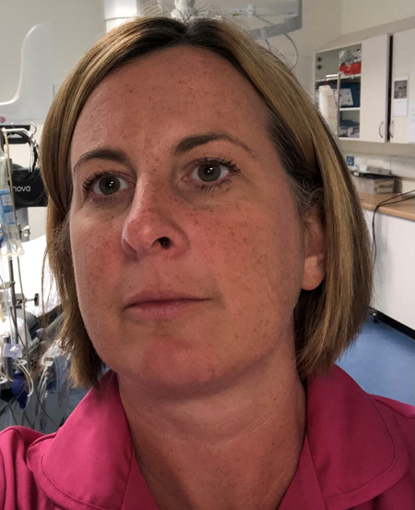
Natasha Goswell System Director of Nursing and Professional Practice. Torbay and South Devon NHS Foundation Trust
I have been a registered nurse for over 2 years my main field of practice has been within cardiac nursing within acute tertiary centre.
I have worked in a large teaching acute hospital, small challenged acute organisation and integrated acute, community and health and social care organisation in three ICS regions
I have held several senior nursing roles including Quality Improvement, Deputy Director of Nursing, Quality and Workforce and currently as System Director of Nursing and Professional Practice
Through co-design I have led the completion and publication of a health and social care clinical governance framework and the underlying operating model
Have led the reframing of the Quality and People safety Long Term Plan

