Slide 1

Appropriate Training & Consultancy Ltd
Controlled Drugs Conference
Controlled Drugs Abuse & Diversion by Healthcare Professionals
Adrian Parsons – Director
info@aptraining.co.uk
07583 154577

Slide 2








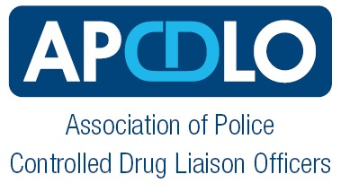

Adrian Parsons
Director of Appropriate Training & Consultancy Ltd
Drug Liaison Officer (Lincolnshire & Kent Police)
Controlled Drug Liaison Officer (Kent)
Drug Expert Evidence Coordinator (Kent)
Lincolnshire Police – 1994 – 2002
Kent Police – 2002 – 2020
Drug Expert Witness & Valuation Association
Bedfordshire Police Consultancy – 2021 – Present
NHS FT Public Governor – July 2021 – Present
2

Slide 3
Appropriate Training & Consultancy Ltd
Bespoke Drugs & Court Witnessing Skills Training Company
Court Witnessing Skills Training
For professionals that may find themselves having to give evidence in either a Civil or Criminal Court
Police Introduction to the CDLO Role
For Police Officers and Police Civilians carrying out the CDLO role
Partners Introduction to the CDLO Role
Health Partners introduction to the role, duties and powers of a Police CDLO
Drugs Awareness for Foundation & Partners
Street Drugs Awareness for Police and Partner organisations including Trends & Drug Recognition
Drug Expert & CSI Cannabis Training
Specialist Drugs Training for Law Enforcement

Slide 4
Controlled Drugs Abuse & Diversion by Healthcare Staff
Agenda
The Police CDLO role and its origins
Police CDLO Role in Concerns & Thefts by Healthcare Professionals
Identification and Warning Signs in Staff
Current issues and concerns
Case study examples
Reporting concerns and incidents involving CD’s & Colleagues
Lessons Learned from Inspections in Healthcare
Partnership Working

Slide 5
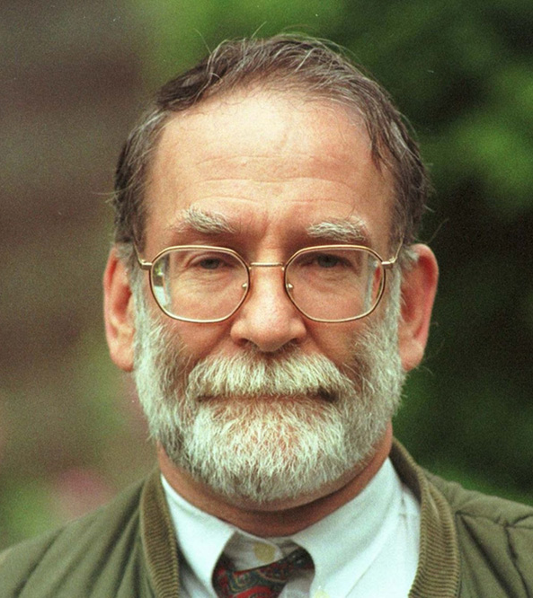
Controlled Drugs Liaison Officers – CDLO’s
Role borne out of the Health Act 2006.
Assist with allegations involving HCP criminality & CD’s….. not patients or public!
‘Targeted Inspections’ at Pharmacies and Hospitals concerning Safe Custody of CD’s.
Direct liaison with Healthcare Partners & Regulators concerning sharing of information and ANY concerns.
Attend Quarterly CD-LIN meetings.

Slide 6
Shipman Inquiry Report 2005 & The Health Act 2006
FIRST REPORT 2002
Death Disguised
SECOND REPORT 2003
The police Investigation of March 1998
THIRD REPORT 2003
Death Certification & the Investigation of deaths by Coroners
FOURTH REPORT 2004
The Regulation of CD’s in the Community
FIFTH REPORT 2004
Safeguarding Patients – Lesson learned
SIXTH REPORT 2005
Shipman – The Final Report
Health Act 2006 defined by section, the following key partners and/or organisations
S17 - Designated Body
Directly or Indirectly involved in the provision of Healthcare e.g. Hospital trusts / Private Healthcare Trusts.
S18 - Responsible Bodies
NHS England, NHS trusts, Foundation Trusts, Police, GMC, CQC, NMC, NHS Protect.
S20 - New powers of entry and inspection
S18(5) - Duty to Co-Operate
Makes provision for ‘imposing duties on the Chief of Police’

Slide 7
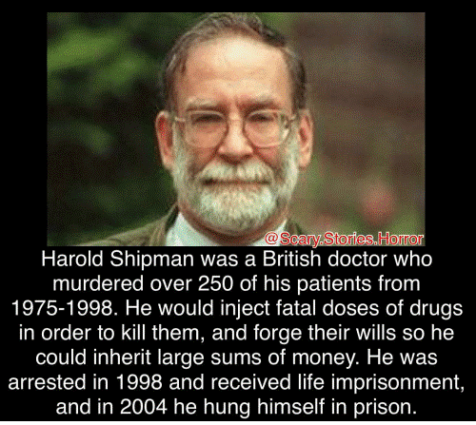
Shipman Inquiry Report 2005
Shipman killed 218 patients (Probably ~ 250)
1976: pleaded guilty to 3 counts of obtaining pethidine by deception (asked for 76 TIC’s)
GMC – Took no disciplinary action
Home Office – took no action with his ‘general licence’
Jan 2000: Shipman found guilty of murdering 15 patients

Slide 8
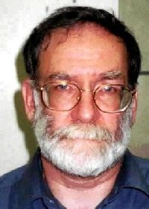
How Shipman Accessed CD’s
Health Act 2006
Shipman did not hold a personal stock of CD’s
Collected controlled drugs, from pharmacies, for patients
Suspected he then gave patients a reduced amount
In addition………..
Collected scripts after the patient’s death
&
Removed drugs from patients’ homes after their death

Slide 10
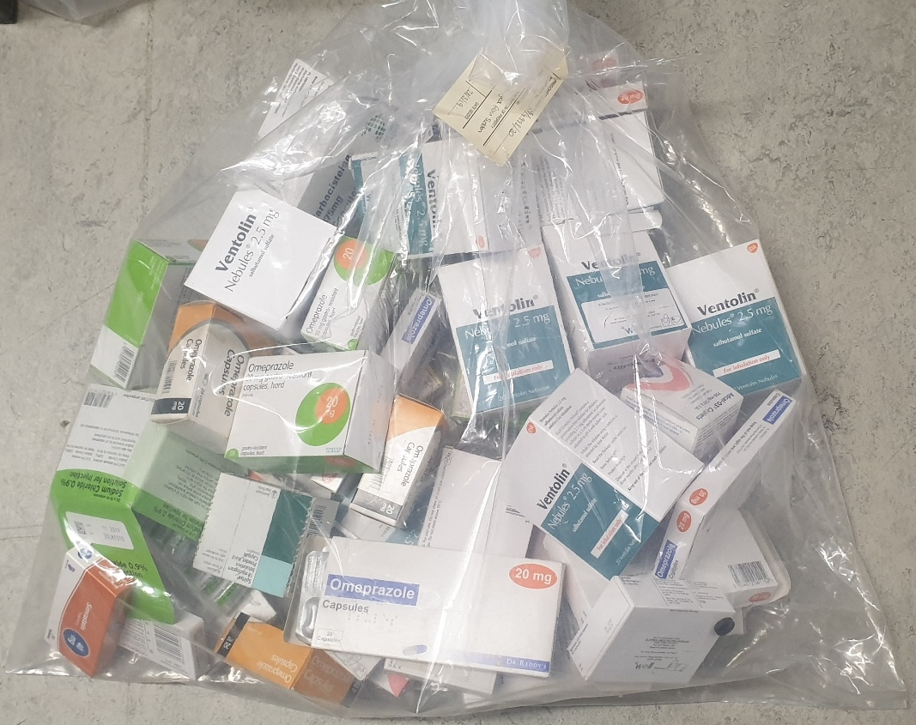

Patient Medication – Plea from your CDLO
Patient Meds following Life Extinct in community
If Police do not attend – would you be comfortable knowing it’s left there?????
All medication in Life Extinct cases BELONG TO THE CORONER – Look after it.
‘Ideally’ if body goes to the hospital mortuary - PLEASE ‘suggest’ the meds go too!
Or
Phone a CDLO
Please never knowingly allow Patient Meds to remain
with the family

Slide 11
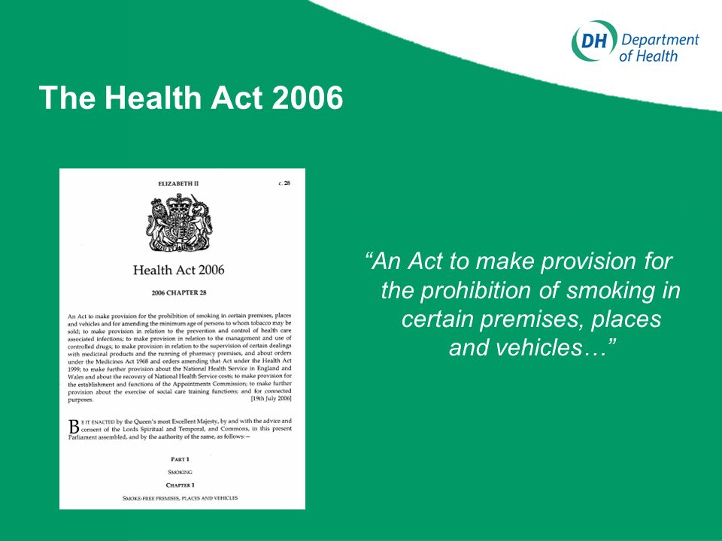
CDLO Powers & Policy
Police Officers predominantly use their powers under The Misuse of Drugs Act 1971….
but
….Powers under The Health Act 2006 & the Supervision and Management of Controlled Drugs Regulations have far wider ranging powers.
Police Civilian Employees must be Authorised by NHS England and issued with a Power of Inspection Card

Slide 12
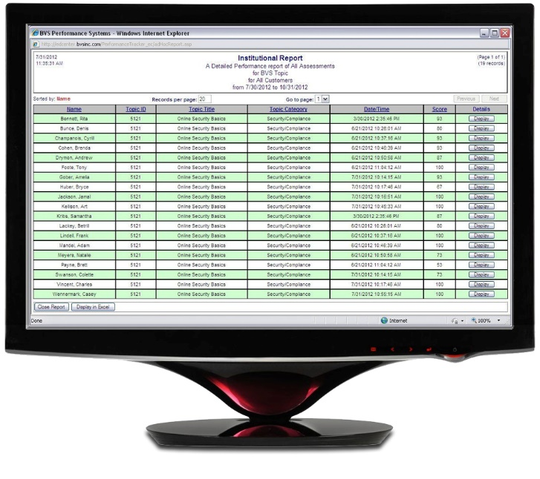
So, where can a CDLO Inspect?
Retail Pharmacies
In-patient pharmacies
Hospital wards
Theatres
Hospices
Care homes
Nursing homes
Ambulance Stations
Prisons, immigration removal centres
Custody suites
Ports
Slimming clinics
Vets
RECORD
KEEPING

Slide 13







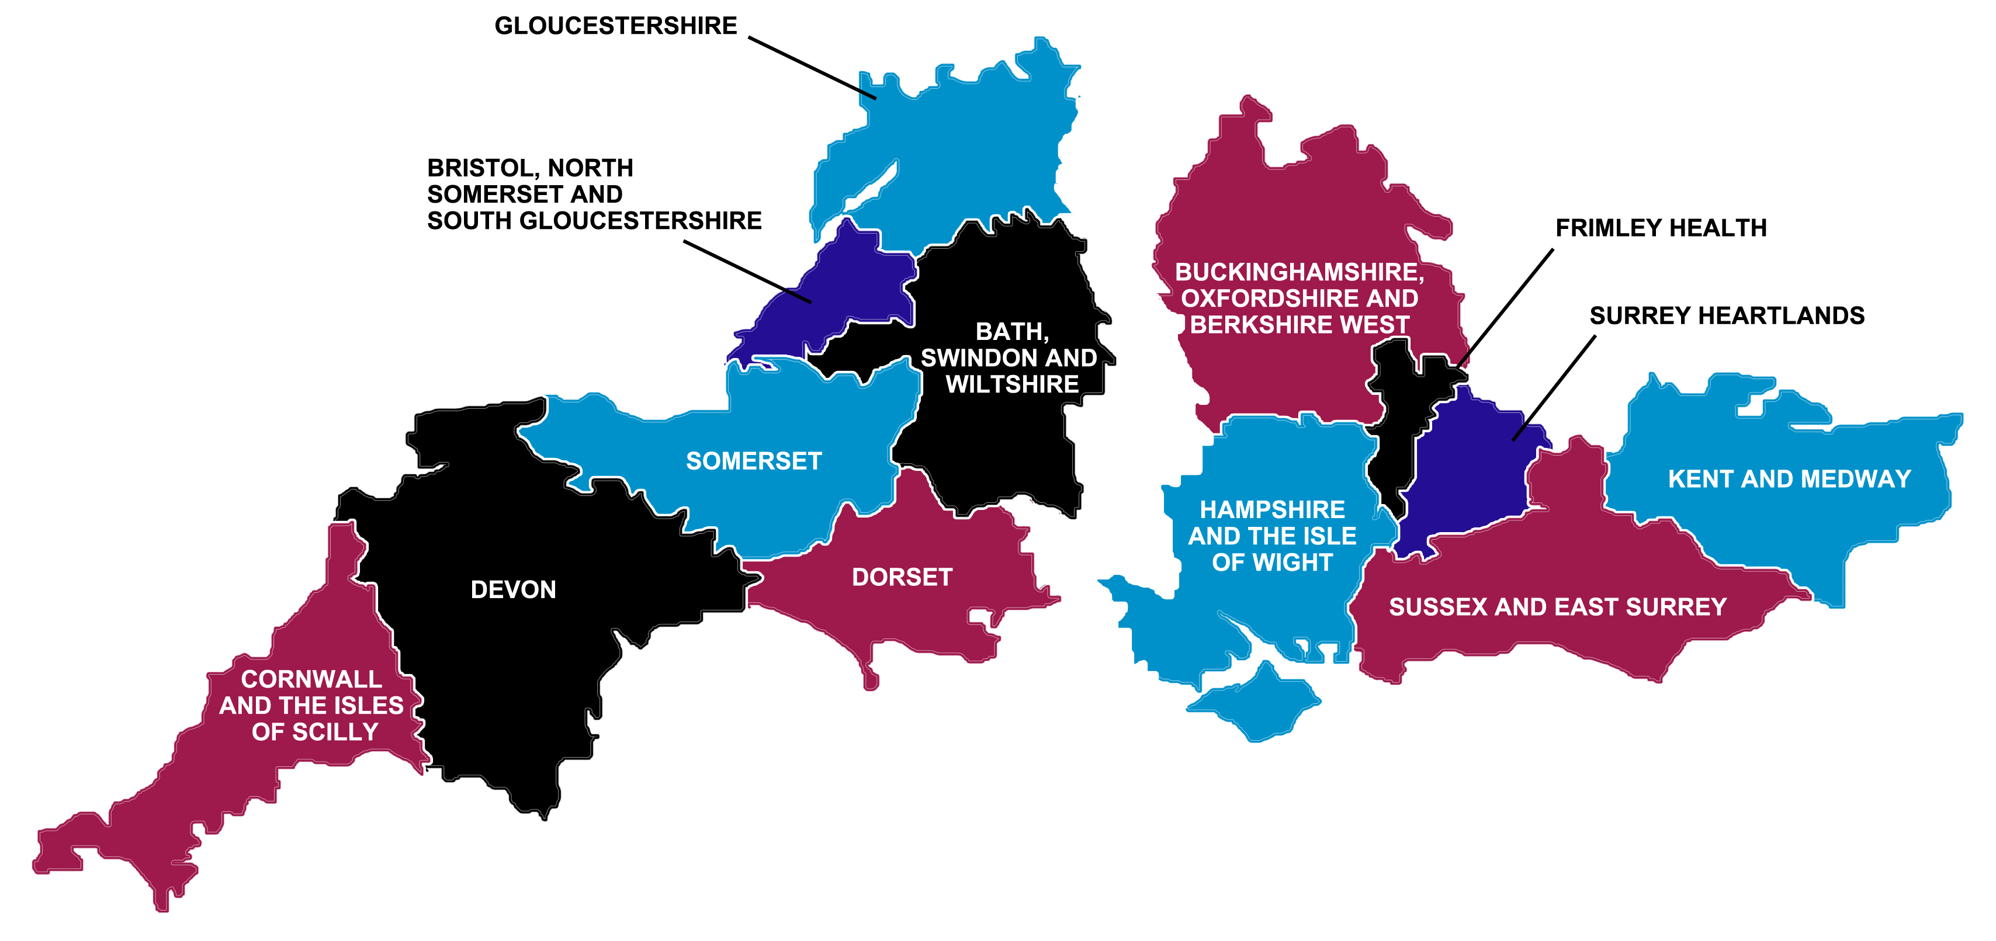








CDLO Partners

Slide 14
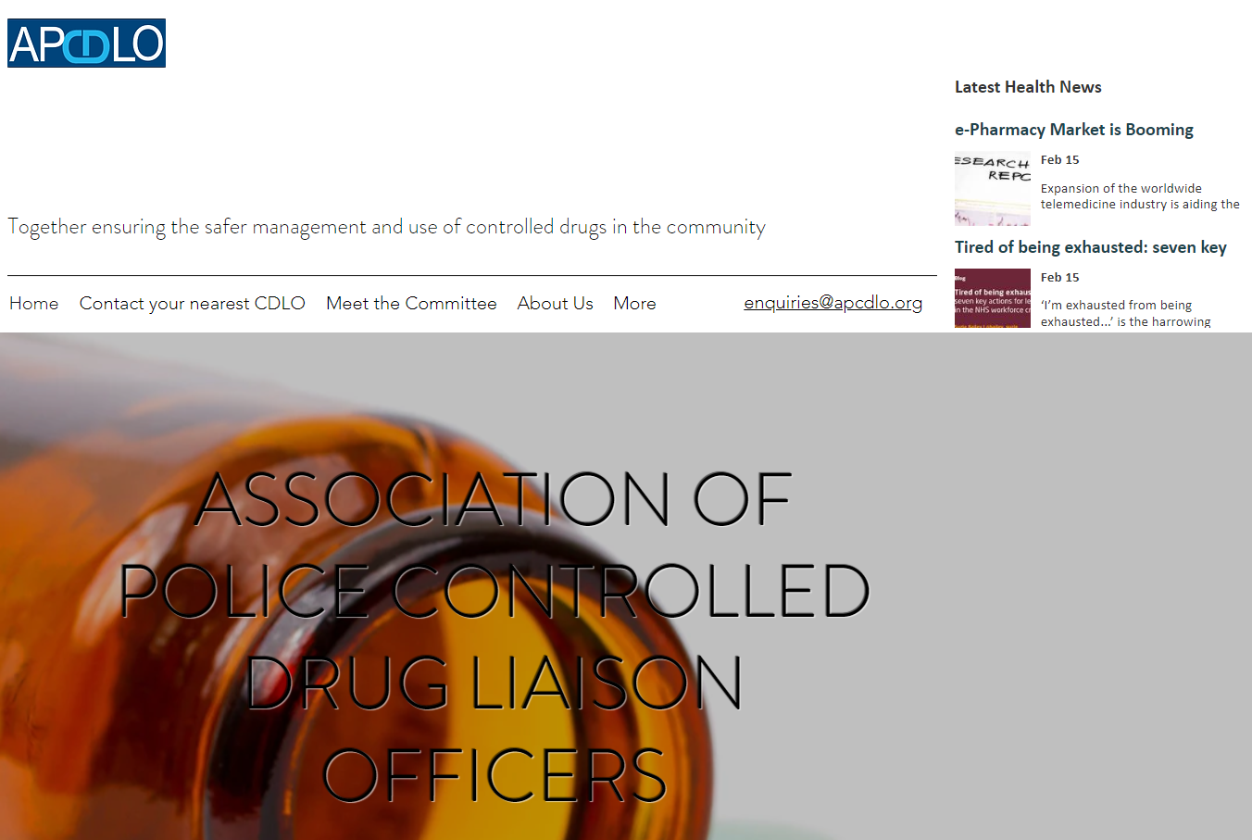
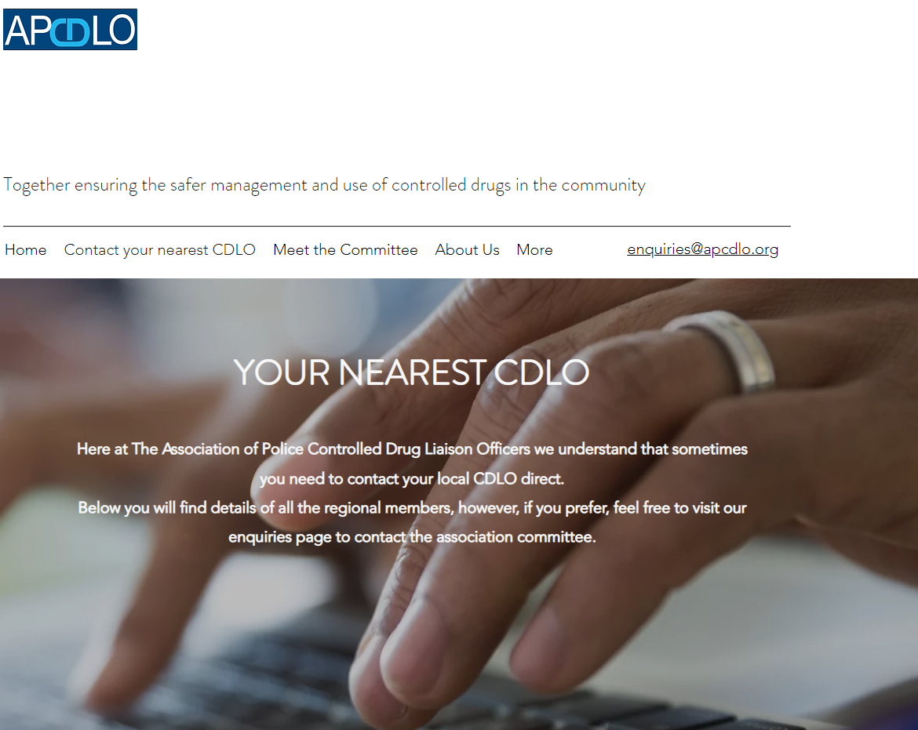
www.apcdlo.org
Annual CPD Event – 29th/30th September – Stratford upon Avon All Health Partners Welcome

Slide 15

CDLO Role in Concerns & Thefts by Healthcare Professionals
DO
Report suspicions to your LSMS contact
Keep accurate records
Keep a record of susp documents or events
Retain any CCTV or booking in/out records
Consider access pass removal / denial
DON’T
Confront the suspect initially (Unless Risk to Life)
Discuss your suspicions amongst colleagues
Investigate the allegations yourself
Ignore your suspicions or gut feelings
CDLO’s roles differ across the UK
Roles determined by what his/her chief officers want them to do
Some investigate, arrest and process the professional right through to court
Others will act as a go-between between police investigating officers and regulatory authorities or trusts.

Slide 16
Identification and Warning Signs in Staff
Abusing their Position
Corruption
Bribing or coercing others
Dishonesty
Failing to Disclose
False Representation
Unexplained visitors to work
Leaving with bags / last to leave locker room
Lateness
Coming in to work whilst off sick
Suspicious activity / Unusual behaviour
Changes in personal hygiene
Unexplained Wealth

Slide 17
Current issues and concerns
Diversion,
Theft,
& Supply
Opiates
Gabapentinoids
Antipsychotics/ Some Antidepressants
Hypnotics and Anxiolytics
Illicit Drugs and Alcohol
Significant market for Prescription Meds within the drug using population including: Addicts
Young People
Steroids users
Poly drug use common

Slide 18
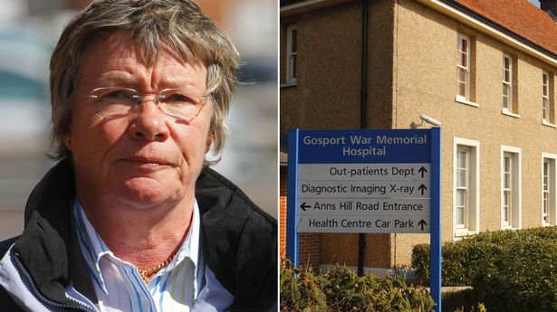
Current issues and concerns
June 2018 - Gosport Independent Panel Report stated it had found
evidence of opioid use ‘without appropriate clinical indication’ in 456 patient deaths (1989 – 2000)
‘disregard for human life and a culture of shortening lives’.
Institutionalised regime of prescribing and administering ‘dangerous doses of hazardous medications’
Dr Jane Barton - “a hard-working doctor doing my best in an under-resourced part of the NHS”.
Hospital SMT, Healthcare Organisations, Hampshire Police, Local Politicians, Coroner, CPS, GMC and NMC all failed to act in ways that would have better protected patients and relatives.
Relatives were consistently let down by the authorities.
The shocking deaths at Gosport War Memorial Hospital - BBC Newsnight
https://www.youtube.com/watch?v=TvW_3JKNcvI

Slide 19
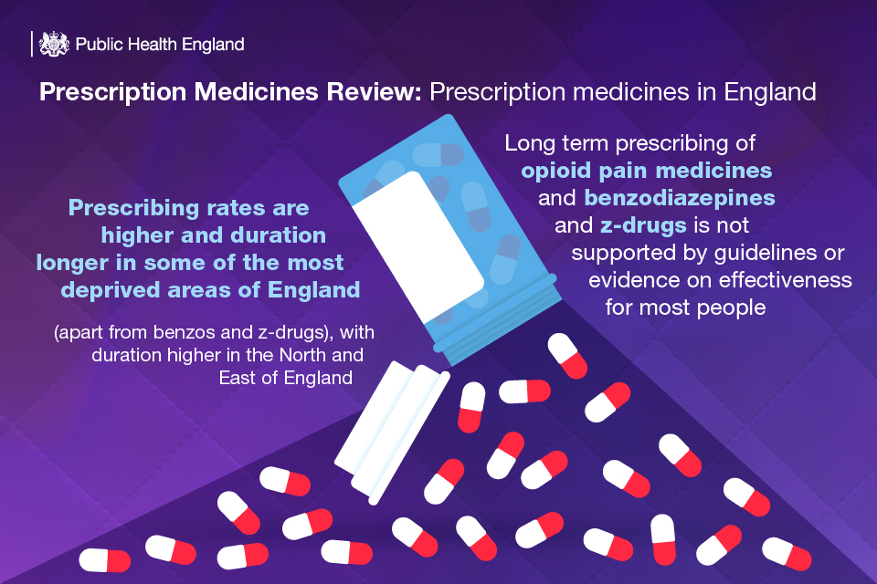
Lessons Learned from inspections in healthcare
(2018/19)

Slide 20
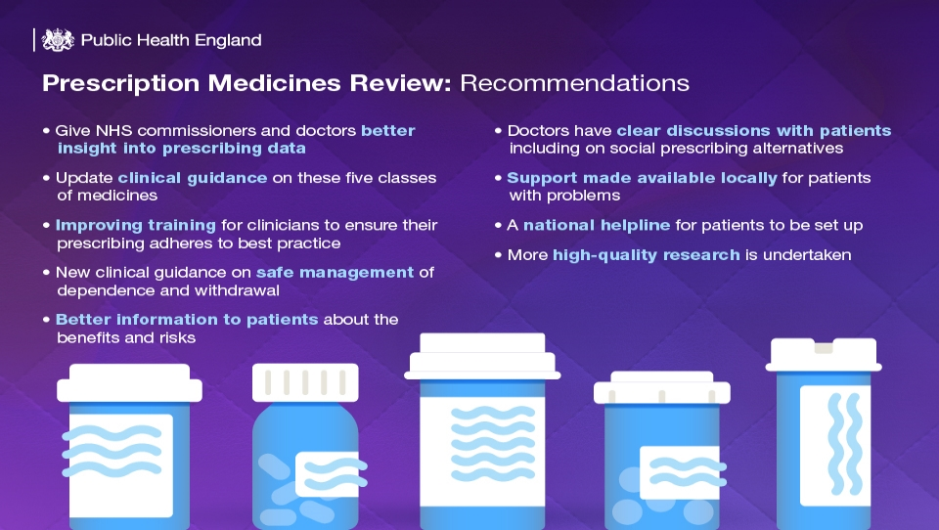

Slide 21
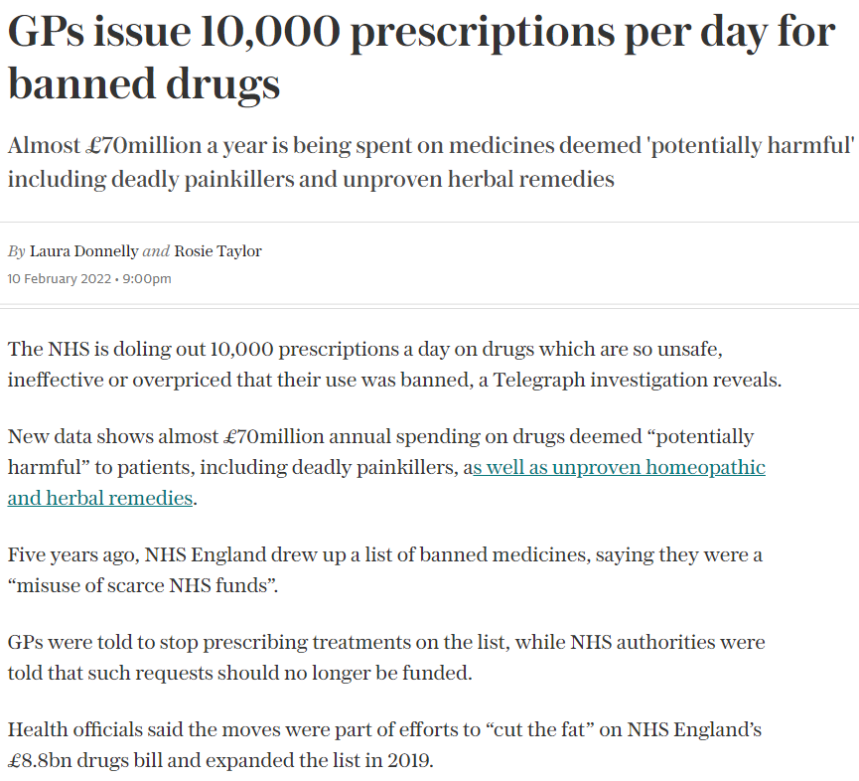
5 years on…………
Where are we?

Slide 22


Current issues and concerns
Alleged – ‘asserted to be true or to exist’…
CBD - Medicinal Cannabis –
Myths & Truths

Slide 23
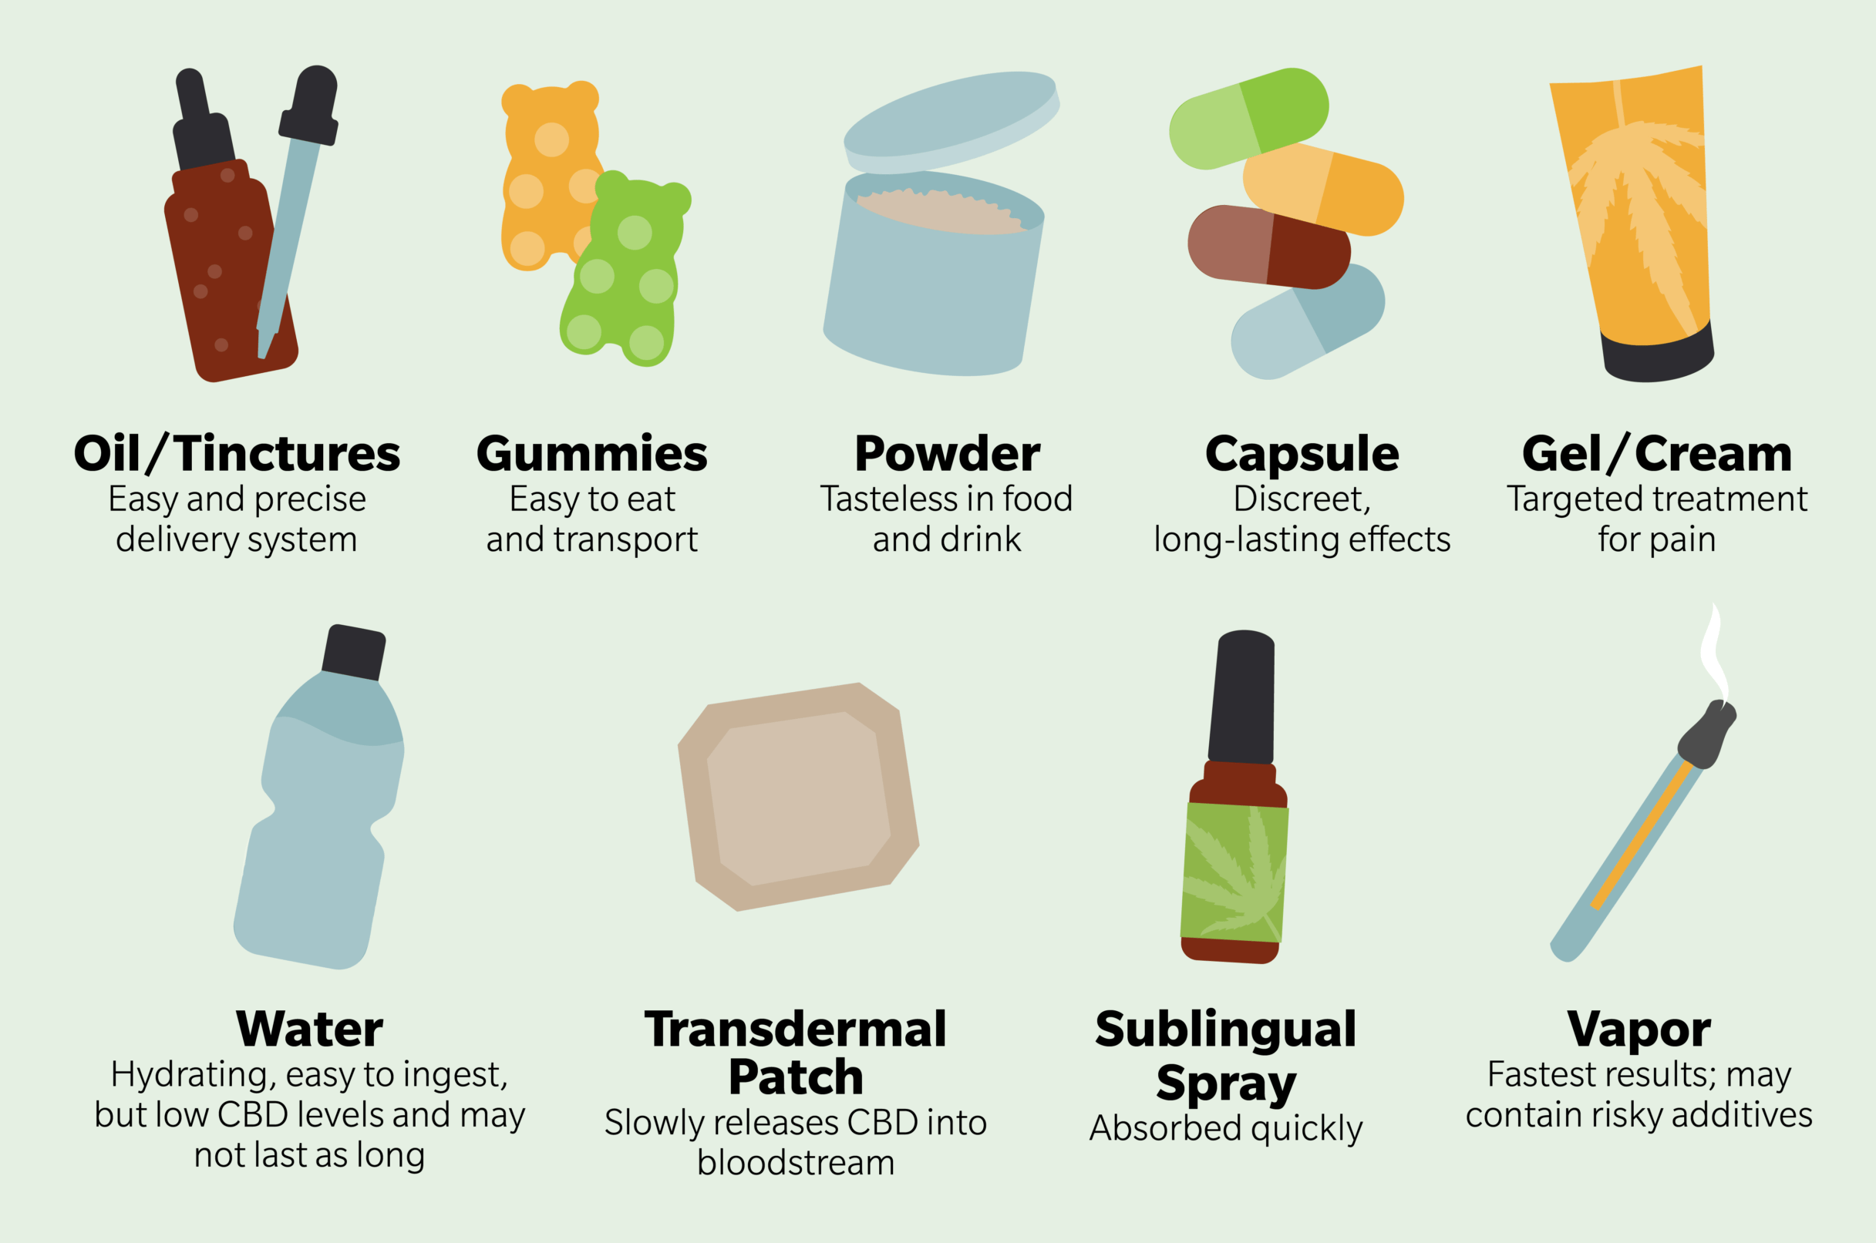
CBD Scams – Online & High Street
Gummies
Chocolates
Latte’s
Dog Treats
Skin creams
Fizzy drinks
Breakfast cereal ……many are small-time, scam suppliers with low-quality products - often containing little to no CBD, taking advantage of consumers desperate for relief.
Commonly:
1. Mislabelled products
2. Sub-standard ingredients
3. Sub-standard processes
4. Exorbitant prices

Slide 24
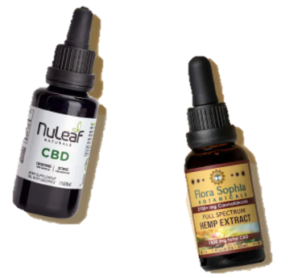


CBD Types
FULL SPECTRUM - Full spectrum CBD contains ‘traces’ of THC that scientists believe ‘boost’ the power of other compounds through a synergistic interplay known as ‘the entourage effect.’ - £20 - £80 per gram/mg/ml
BROAD SPECTRUM - Broad spectrum CBD is processed to remove its THC, though it retains the other compounds as well as trace amounts of THC. - £30 - £90 per gram /mg/ml
ISOLATE - CBD isolate contains nothing but the supposed ingredient. - £10 per gram
Cheap to make – Costly to buy
*
Costly Extraction Process – Costly to buy
*
Very Costly Extraction Process – Cheap to buy
*
*Disclaimer – The images and brands above are used as EXAMPLES of products of CBD Types only and no reference is made about their individual contents or benefits.

Slide 25
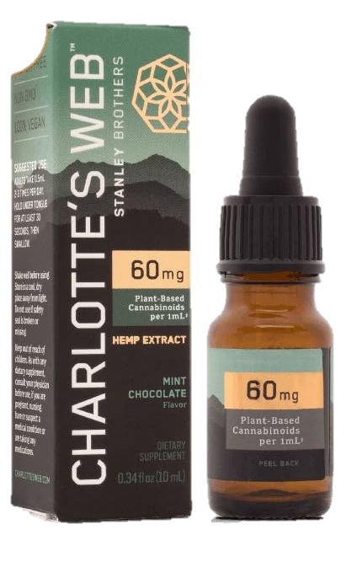
Confusion reigns…….
60mg of CBD in a serving?
Label says a 1ml serving (1 dropper) contains 60mg of plant based cannabinoids !!!
Smallprint –
60mg includes “phytocannabinoids,” ……
….which could mean a mix of CBD, CBDA, CBG, CBC, CBN, THC or other cannabinoids. (In other words, they don’t & can’t specify the exact CBD content found in a single dropper.)
Confused yet?
Branding Removed

Slide 26
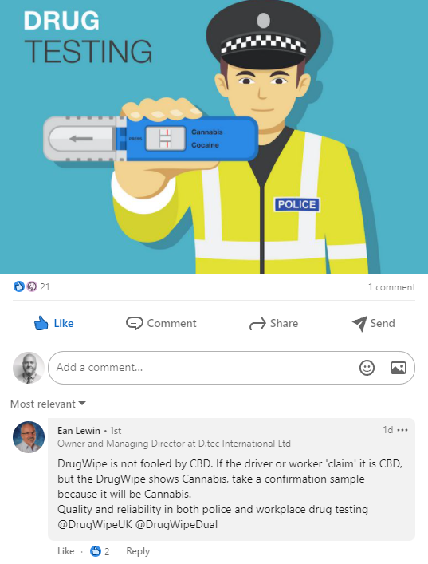
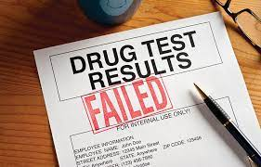
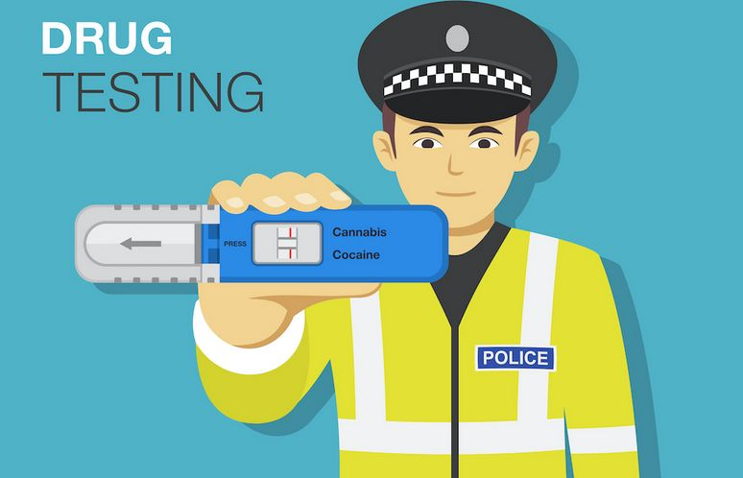
Risks to Individuals
UK Drug tests detect THC and not other Cannabinoids.
Tests will likely detect THC if consuming either Full Spectrum or Broad Spectrum products (+ve test)
All staff should consider risks associated with using a product which may contain *Controlled Drugs (*Misuse of Drugs Act 1971)
Don’t trust the labelling, especially when purchased from less reputable sources.

Slide 27

Case study examples

Slide 28

Paramedic J
J suffered from Leukaemia several years ago
Prescribed Oramorph during his treatment
Returned to work & started stealing morphine as he was by now reliant
Didn’t get caught - walked into bosses office and asked for help
Interviewed, full admission, received adult caution for theft by employee
Sacked by London Ambulance Service – now works as an NHS 111 operator

Slide 29

Paramedic D
Organisational policy to place used / remains of a drug from their drugs pack in a ‘red locker’ (for return to MRC to be restocked)
Paramedic D entered the red locker, searched the drugs packs and took whatever Oramorph was leftover for personal use.
Caught when a colleague reported him.
Interviewed, full admission – adult caution for theft by employee
Sacked

Slide 30
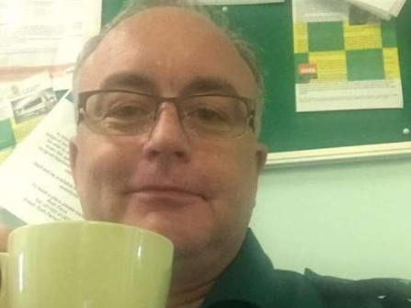
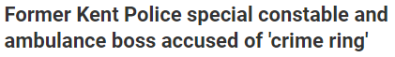
Paramedic B
Owned several private ambulance firms –
Delta Automotive Services, Delta Medical Training, Southern Ambulance Sales, UK Ambulance Services, Delta Medical Services and Delta UK Express.
Stole (and handled from burglaries) equipment stolen from SECAMB stations between 2016 & 2017
Awarded by Kent Police for dedication to duty in 2014
Crown Court Sentencing November 11 2019
Result??

Slide 31
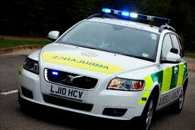
Paramedic R
Paramedic D
Fast Response Vehicle - was usually first to arrive on scene
Treated patients in the absence of Ambulance crew and handed over patient, & notes, to crew upon their arrival
Crews noticed incidents of morphine administration on patient notes but patients stating they hadn’t received any.
Investigation revealed fraudulent PN’s.
Paramedic interviewed and admitted personal IV morphine daily.
Sacked by Ambulance Service – barred from future similar work by RA

Slide 32
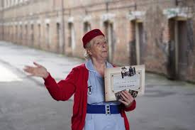
Midwife L
27 False Entries in 4 CDR’s
Arrested July 2016 – Mental Health issues
House search conducted
Large number of TTA’s found
Charged November 2016
Convicted January 2017 – one year suspended sentence
NMC informed by CDLO

Slide 33

Nurse R
July 2018 - Theatre Recovery Nurse
Off sick – accessed the CD keys !!!
Also accessed the Omnicell
Injected in front of colleagues
Admitted to a MHU
Interviewed under caution - CR issued due to significant MH issues & treatment
THE SIGNS WERE THERE !!!

Slide 34

Lessons Learned
CD Registers - Ensure strict compliance with column headers when completing
Know the signatures – check what you’re signing for
Challenge inconsistencies
Challenge crossings out or illegible entries
CD Cabinets & Keys - Safe storage of the keys – Are they left hanging around or in the nurse in charge’s pocket
TTA’s - Are they appropriate in number?
Are they managed / stored appropriately at home?
Who else in the family has access to meds?
Respect CD’s

Slide 35


Partnership Working
The Police are keen to know:
Who is supplying/diverting prescription drugs?
Where & how are they doing it?
What prescription drugs are being supplied/diverted?
Where do you think the prescription drugs are going?
Is there a risk to the public, or individuals, from a prescription drug - If so what?
Talk to your CDLO in confidence and take advice – https://www.apcdlo.org/contact-your-nearest-cdlo
Information sharing protocols exist between Police / NHS England / Ambulance Trusts
S18 imposes a duty on Responsible Bodies to Communicate & Share Relevant Information

Slide 36

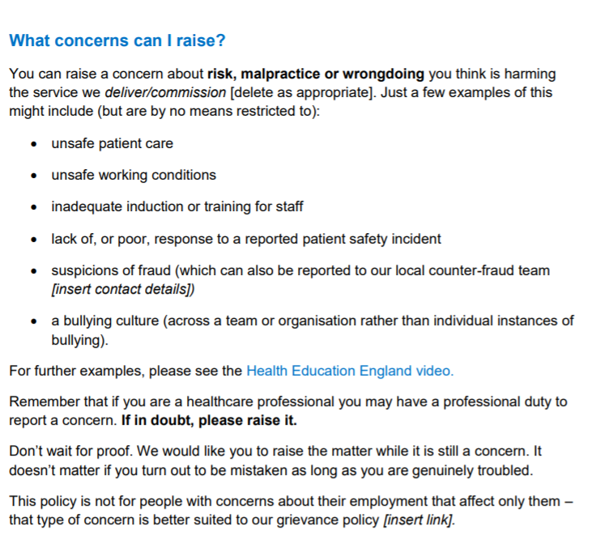

Slide 37

Thank You

