Slide 1
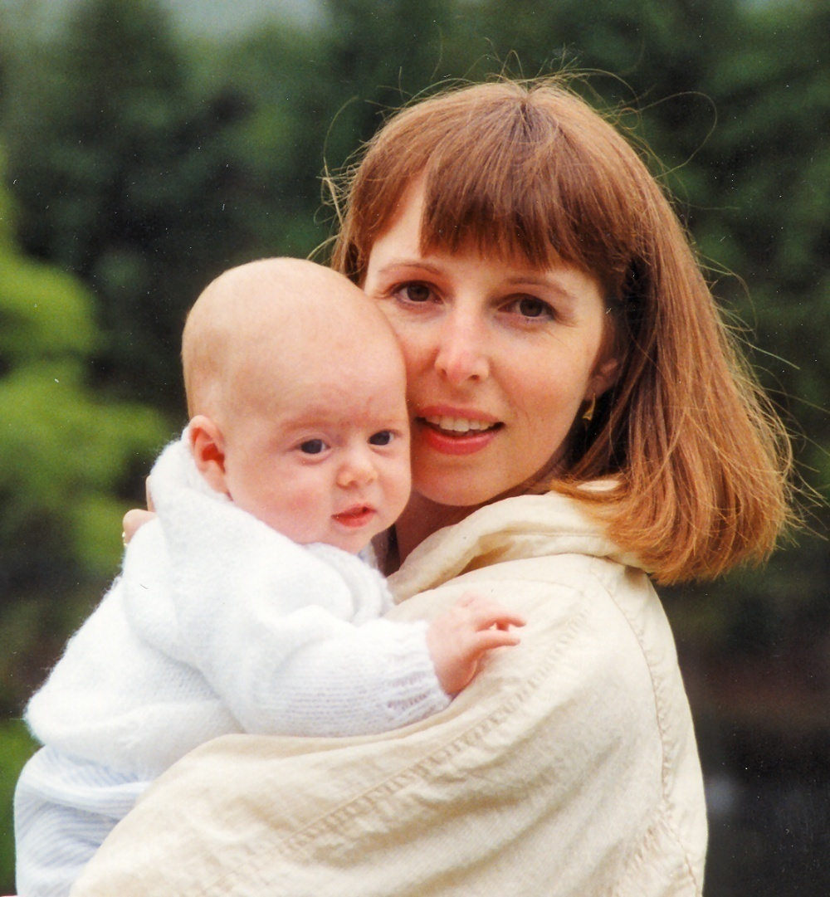
Perinatal Mental Health Crisis – what does it feel like?

Slide 2
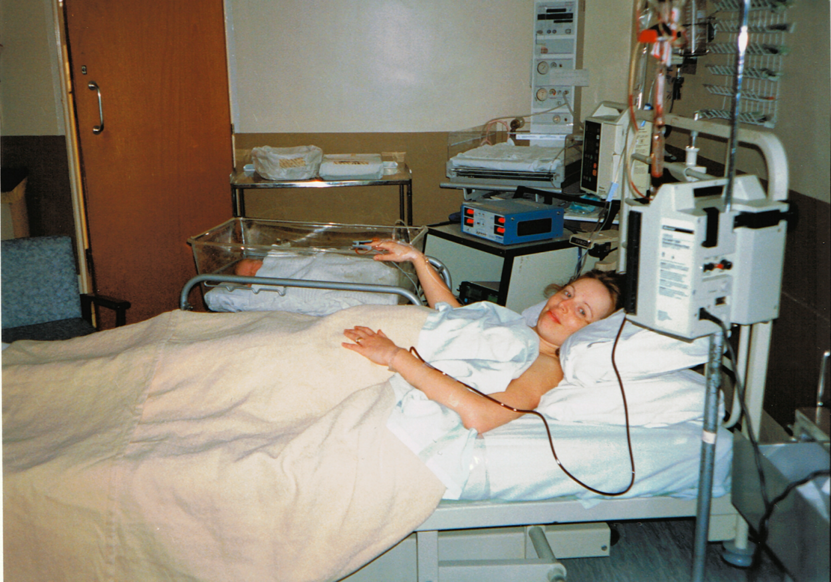

Slide 3
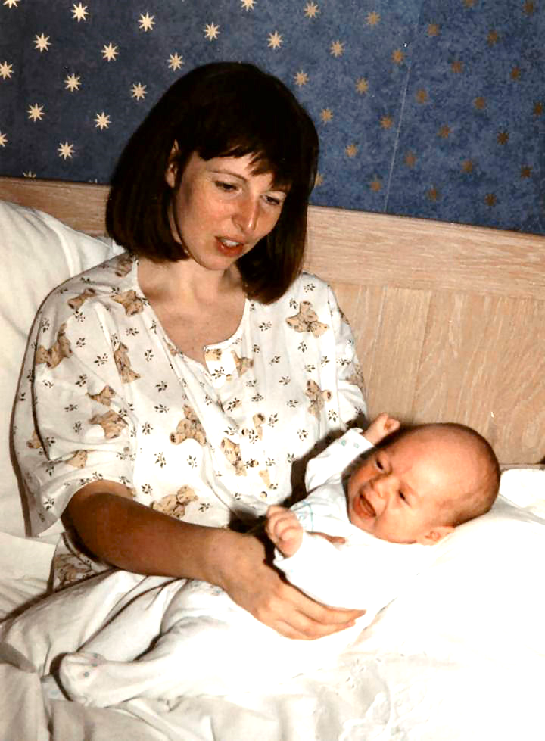
Exhausted
Lonely
Aggressive
Irrational
Nervous energy
Emotional
Notes:
Enjoyment?

Slide 4
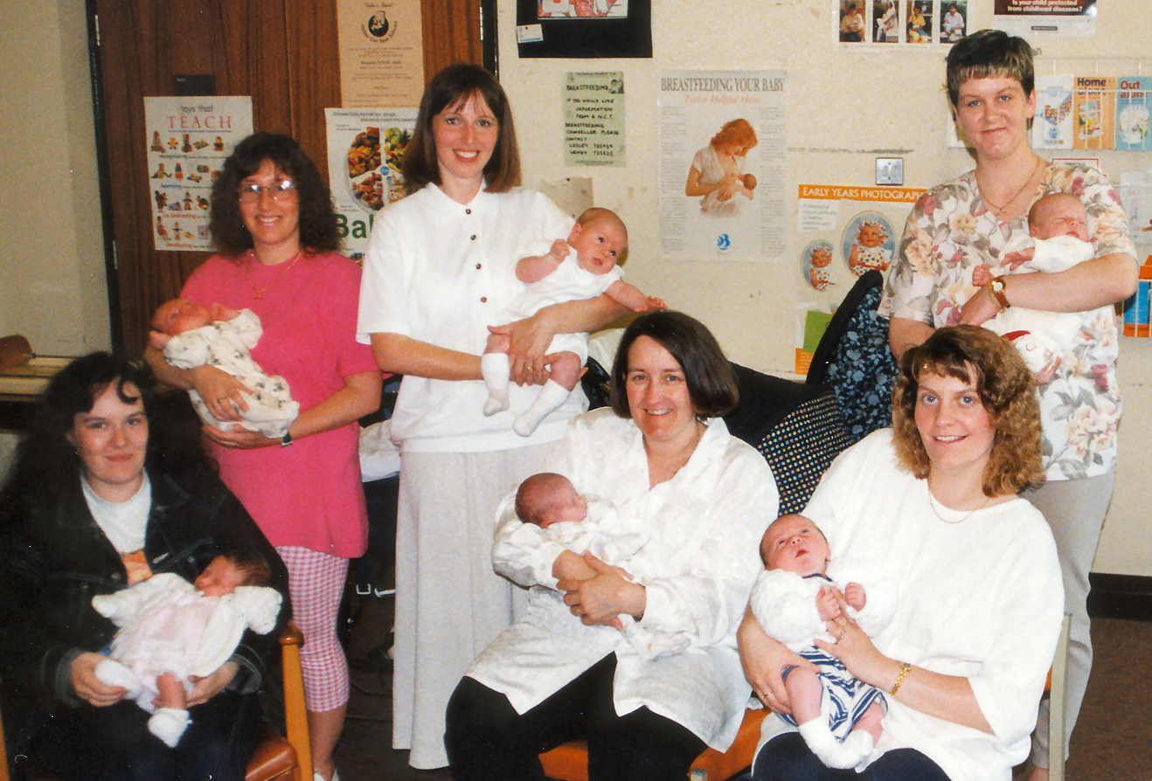
Why does everyone else seem to cope?

Slide 6
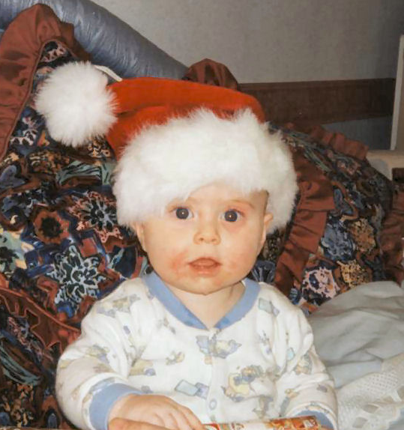
Where’s my Mum?

Slide 7
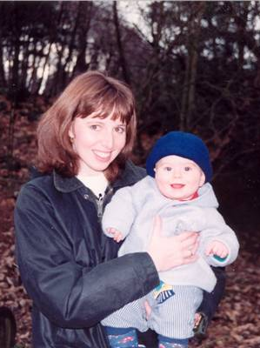
An in-patient!

Slide 8
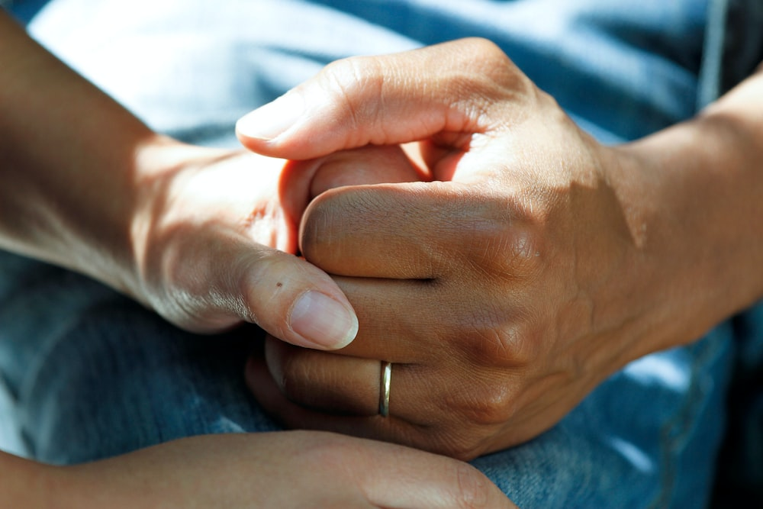
What inspired me to keep on living?
Caring people
Notes:
Empathetic HCPs
Time and patience

Slide 9
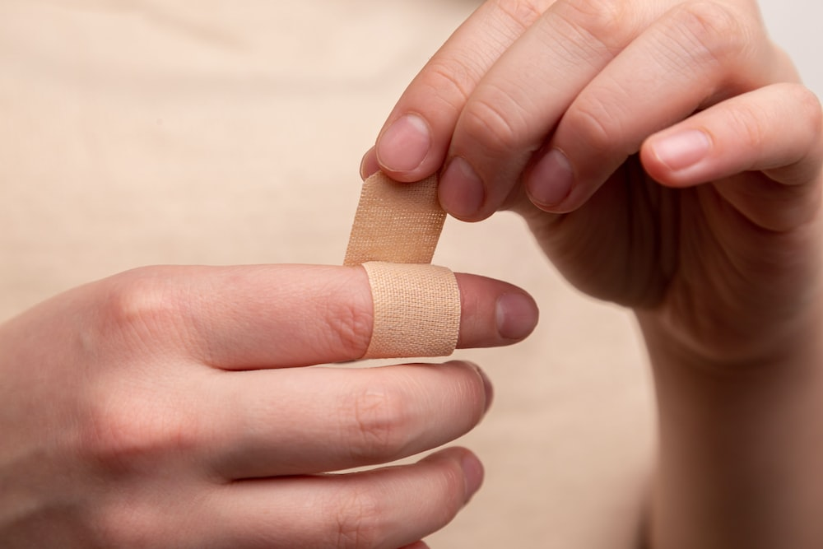
What inspired me to keep on living?
Treatment
Notes:
Being in hospital
Occupational health
ECT
Exercise

Slide 10
What inspired me to keep on living?
Hope
Notes:
My son
Family and friends
Me

Slide 11
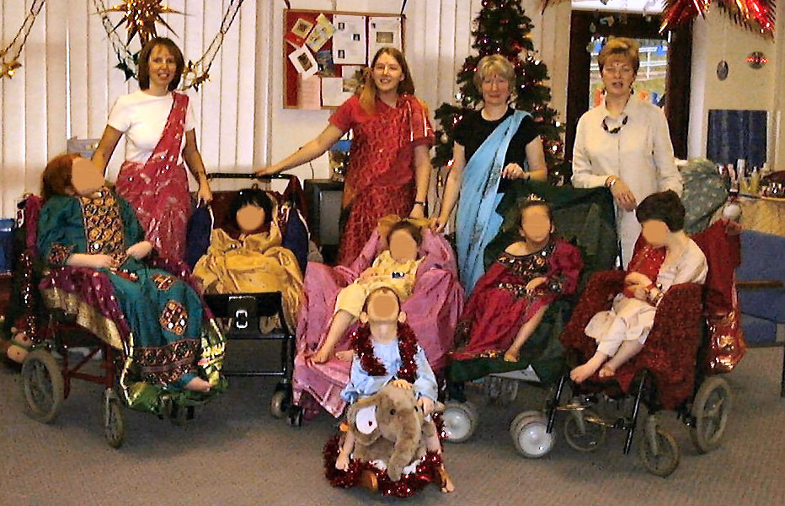
Back to life ….

Slide 12
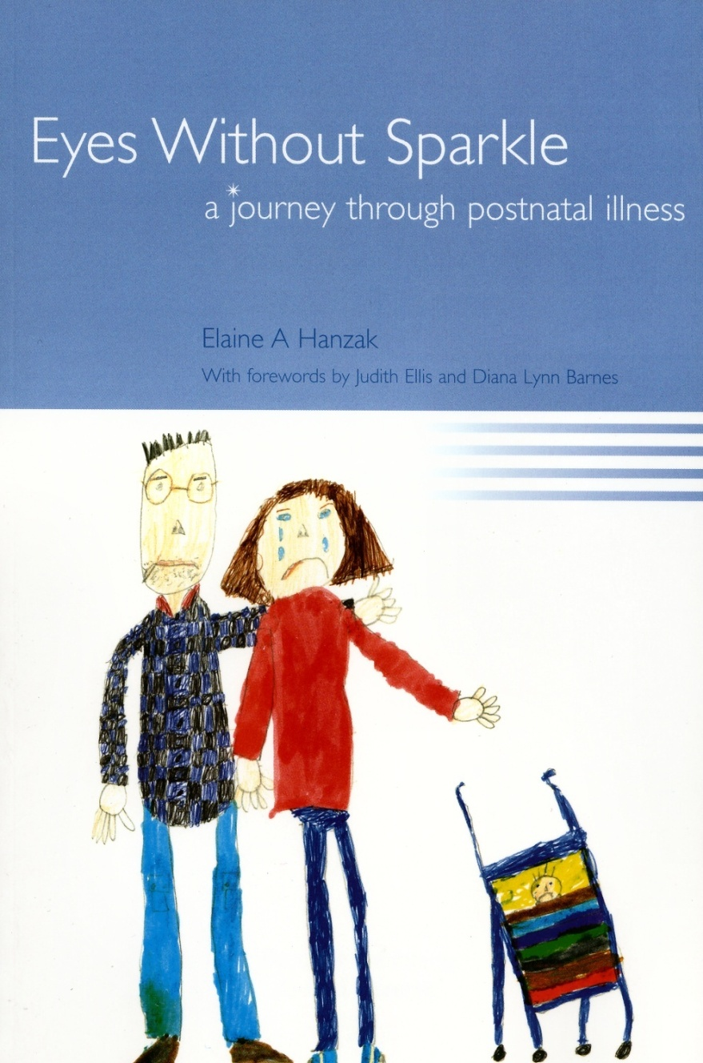
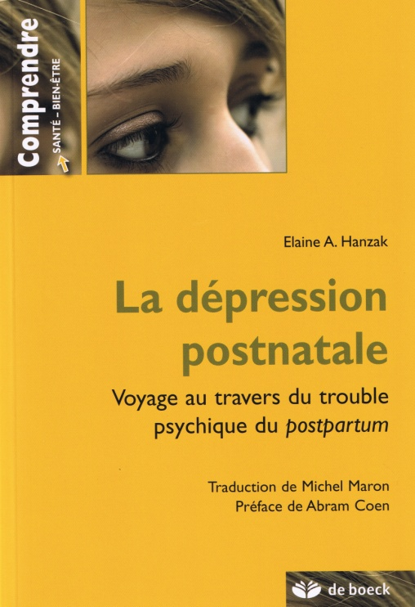

Slide 13
Suicide is a leading cause of death for women during pregnancy and in the year after giving birth

Slide 14
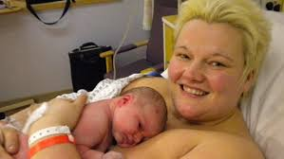
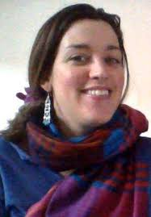
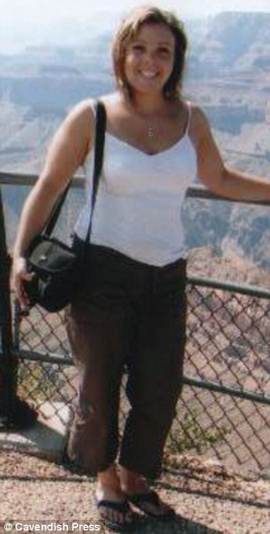
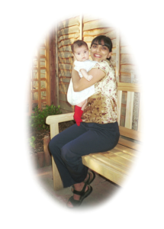
“Let’s enable their silent screams to be finally heard.”
Notes:
Claire Peake, 39 – school teacher – hung herself like scene from Officer & Gentlemen
Joe Bingley, nurse – jumped in front of a train
Charlotte Bevan + daughter – jumped off Avon Gorge in Bristol
Dr Daksha Emson & Freya – stabbed and set fire
In the words of Daksha Emson’s husband on what would have been his daughter’s 18th Birthday – ‘Let’s enable their silent screams to be finally heard’.

Slide 15
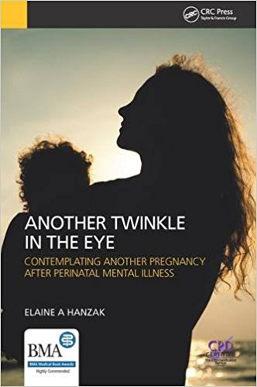
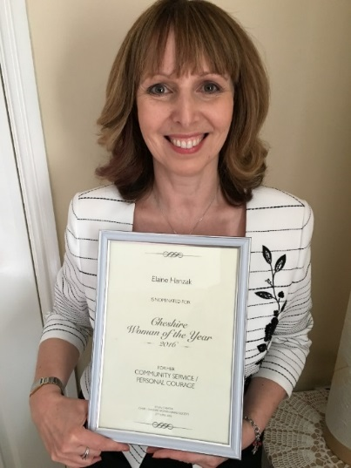

Slide 16
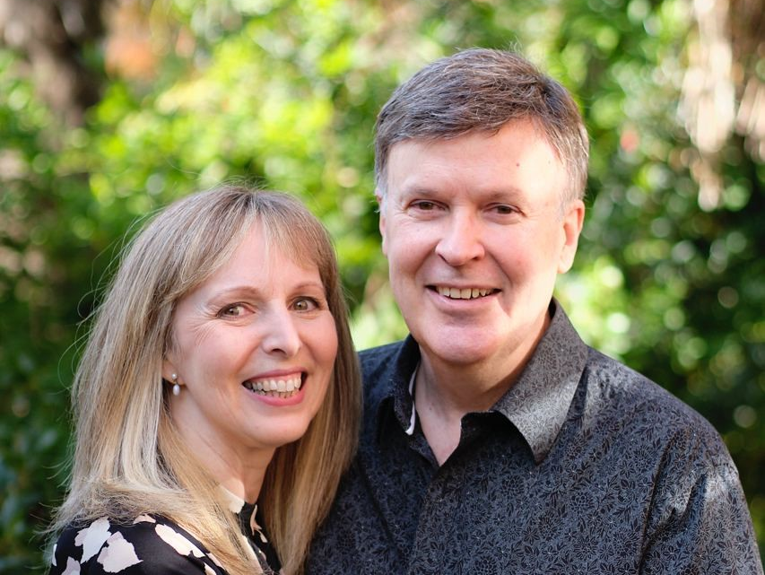
COVID-19
COVID-19 & Long COVID

Slide 17
‘’During and after pregnancy, women have faced a greater likelihood of poor mental health during the pandemic, including anxiety, depression, loneliness and suicidal thoughts’’

Slide 18
Dr Margaret Oates OBE
Notes:
https://www.youtube.com/watch?v=KVQNLEgq3OM
1.20 – 2.07
RCPsych Lifetime Achievement Award 2013 - Dr Margaret Oates

Slide 19
What will MY
legacy be?
Notes:
https://www.youtube.com/watch?v=KVQNLEgq3OM
1.20 – 2.07
RCPsych Lifetime Achievement Award 2013 - Dr Margaret Oates

Slide 20
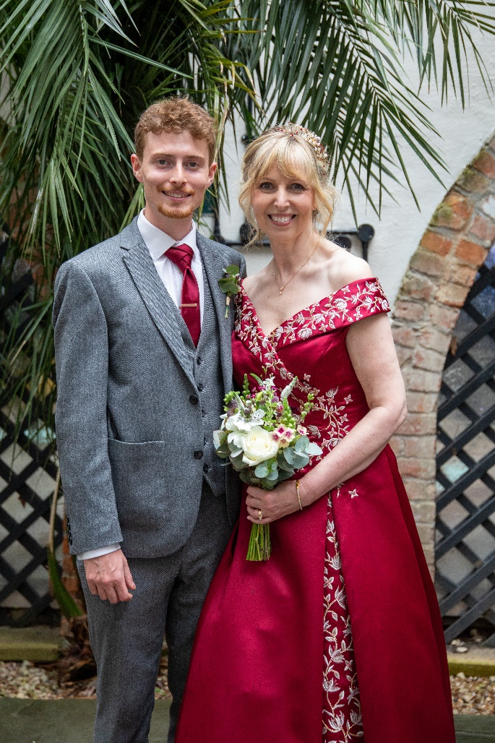
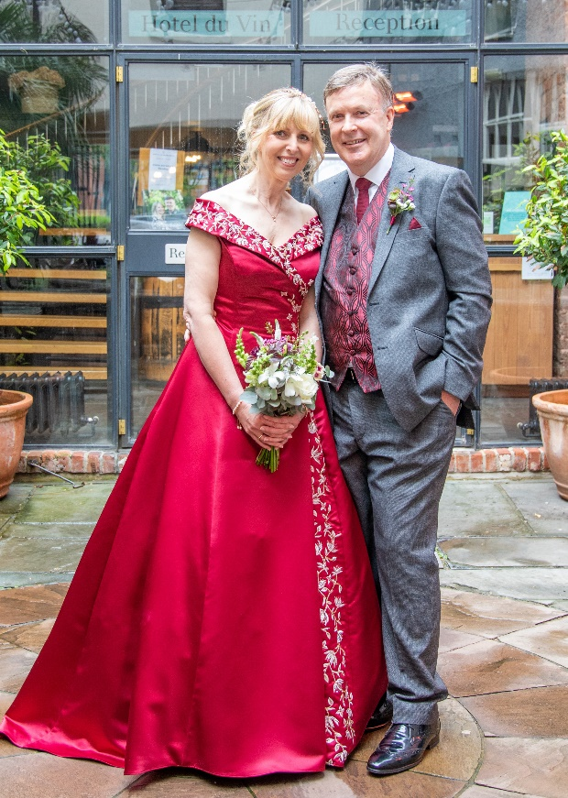
Gratitude

Slide 21
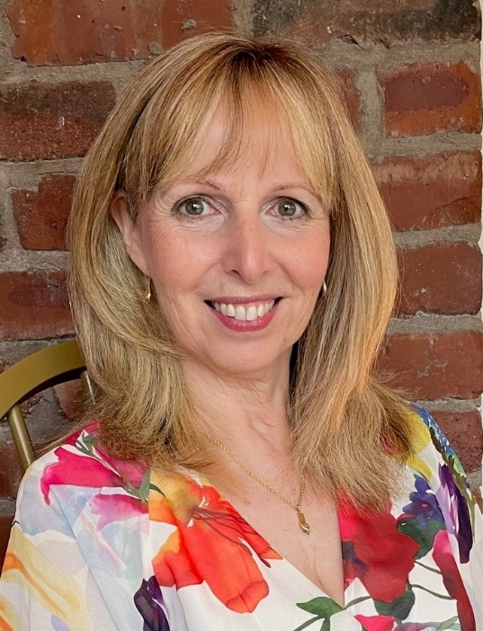
Please contact me at www.hanzak.com
E-mail: elaine@hanzak.com

