Slide 1
Prescribing in Infants, Children and Young People
Claire Osborne
Paediatric Advanced Practitioner Trust Lead for Advancing Practice & Non-medical Prescribing (OUHFT) Lecturer in Advanced Practice (OBU)
February 2023

Slide 2
Aims
Overview of prescribing in ICYP
Key considerations for prescribers in ICYP
Opportunities or challenges
Future trends and developments

Slide 3
Themes
Pharmacology in ICYP
Litigation & Risks
Sustainability
New advancements
Decision-making & adherence
ISP Responsibilities
References to RPS Framework or key links on slides

Slide 4
Pharmacology
Pharmacokinetics …what the body does to a drug
Pharmacodynamics …what the drug does to the body
https://bnfc.nice.org.uk/medicines-guidance/guidance-on-prescribing/

Slide 5
Decision-making and Adherence
RPS 1.2, 1.13, 2.6, 3.1-3.6,

Slide 6
What do ‘we’ want?
Compliance
Adherence
Concordance
https://www.nice.org.uk/guidance/cg76/documents/medicines-concordance-guideline-consultation
RPS 5.1-5.5

Slide 7
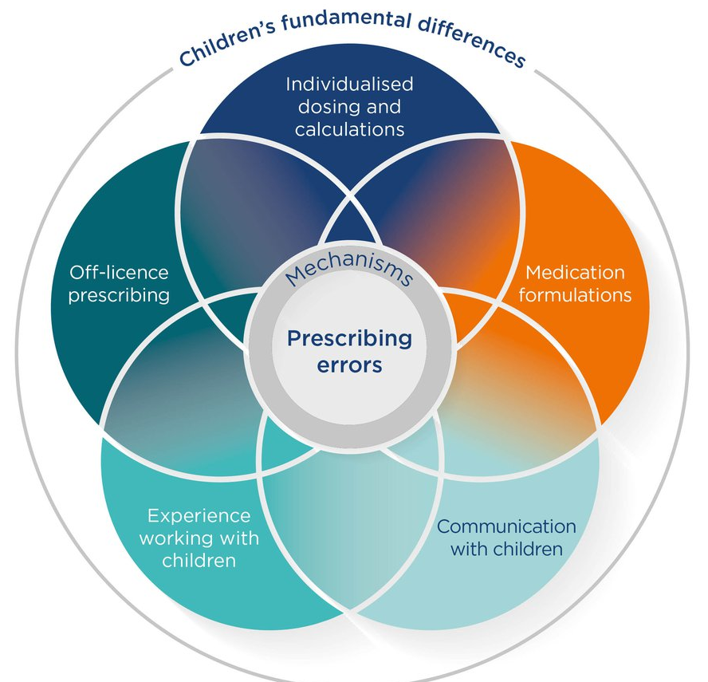
Risk and Litigation
Error avoidance – see HSIB for case studies https://www.hsib.org.uk/investigations-and-reports/weight-based-medication-errors-in-children/weight-based-medication-errors-in-children/
Awareness prescribing off license or off-label
Clinical trial limitations in ICYP - consent, participation and ethics
Pharmacological implications
Adverse effects
How will you report any adverse effects of a medication?
https://www.ncbi.nlm.nih.gov/pmc/articles/PMC4345945/
RPS 4.11-4.13, 6.1-6.4

Slide 8
If you think it, report it…
https://em3.org.uk/foamed/20/1/2020/lightning-learning-yellow-card-scheme
https://yellowcard.mhra.gov.uk/
RPS 6.1-6.4

Slide 9
Safe prescribing, know your symbols…
What does a black triangle next to a drug in the BNF or BNFC mean? ▼
Check the formulary, PIL, SPC information – does not mean its unsafe, but does does mean they are subject to additional monitoring.
https://www.gov.uk/guidance/the-yellow-card-scheme-guidance-for-healthcare-professionals#black-triangle-scheme

Slide 10
Sustainability
https://www.england.nhs.uk/greenernhs/a-net-zero-nhs/
RPS 9.7

Slide 11
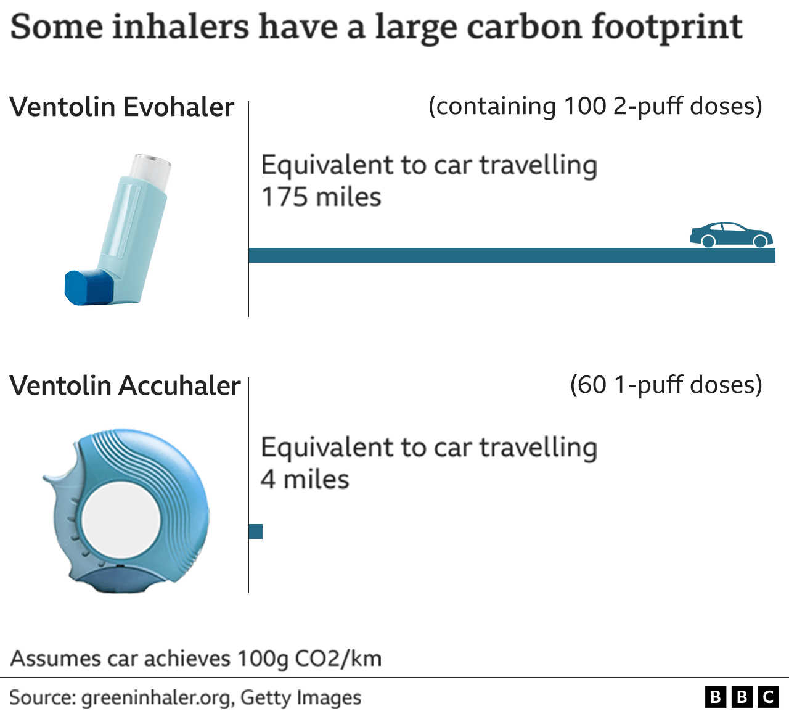
Make a switch?
Barriers to green prescribing? - Patient choice - Clinical judgement/bias - Pharmacy availability - Costs
@PharmDeclares
#GreenNHS
https://www.bbc.co.uk/news/health-59997297
https://jme.bmj.com/content/medethics/49/2/92.full.pdf
RPS 9.7

Slide 12
New advancements
https://www.genomicseducation.hee.nhs.uk/education/core-concepts/what-is-genomics/
RPS 2.4, 2.9

Slide 13
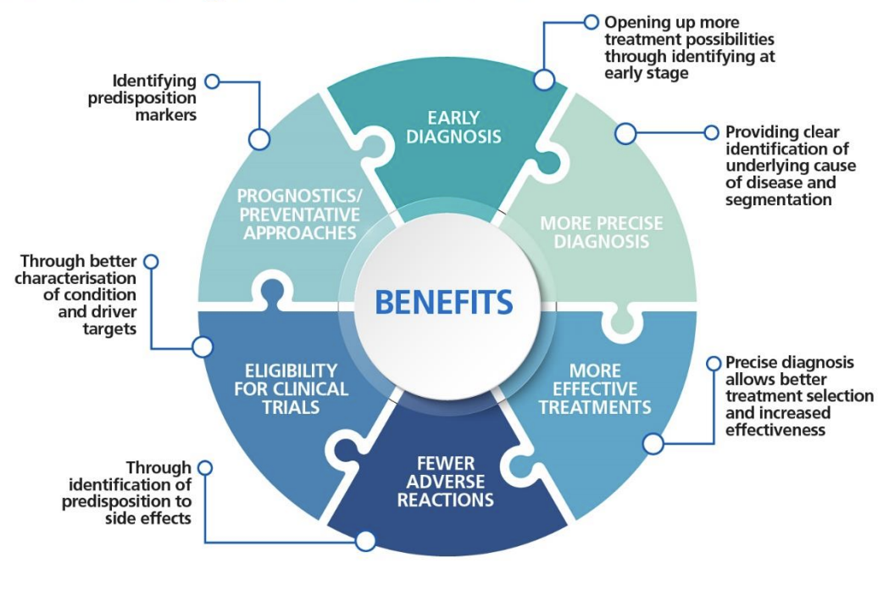
Precision medicine - personalised medicine?
https://transform.england.nhs.uk/ai-lab/explore-all-resources/understand-ai/precision-medicine/
https://www.england.nhs.uk/wp-content/uploads/2022/10/B1627-Accelerating-Genomic-Medicine-October-2022.pdf

Slide 14
Unknown reference, 2023.

Slide 15
In the interests of balanced arguments…
Financial disparity
Social justice
Genetic discrimination
Informed consent for ICYP?
Risk of mis-interpreting genetic data
Access to genetic testing
Unprepared widely in primary care?
https://www.drugtopics.com/view/limitations-persist-in-growth-of-precision-medicine

Slide 16
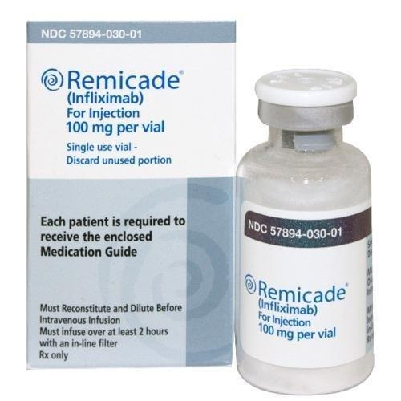
But what else is out there now?
https://www.england.nhs.uk/wp-content/uploads/2018/08/Biologic-therapies-for-the-treatment-of-juvenile-idiopathic-arthritis.pdf
https://bnf.nice.org.uk/medicines-guidance/guidance-on-prescribing/#biological-medicines

Slide 17
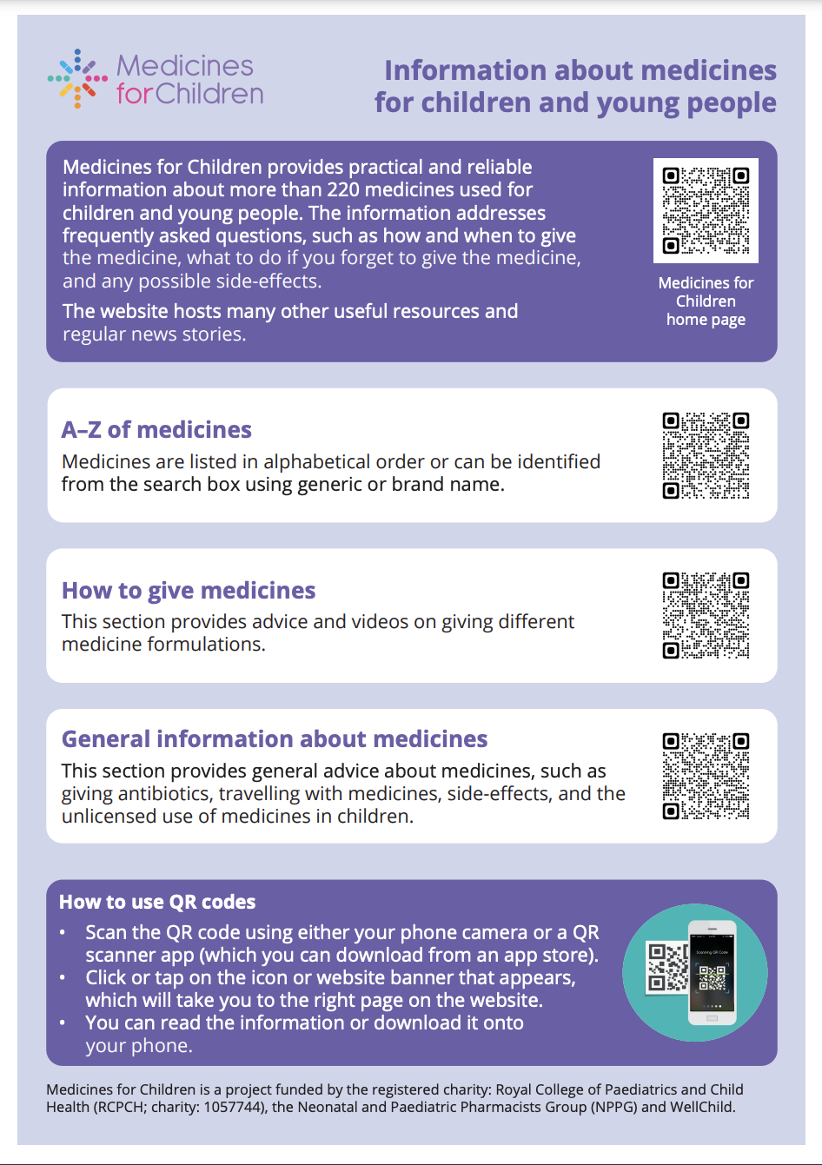
ISP Responsibilities
RPS Competencies and Expanding Practice Framework
Auditing your practice for ICYP, developing competency and capability
- Consider supporting AMS programs in your workplace?
Consent, decision-making and patient information
Storing, giving medications and swallowing tablets – help the ICYP and the parent/carer to learn!
https://www.medicinesforchildren.org.uk/wp-content/uploads/sites/8/2023/01/Information-on-MfC-for-families-A4.pdf
https://www.medicinesforchildren.org.uk/
RPS – nearly all of them!

Slide 18
Summary
Overview of prescribing in ICYP, factors affecting me
Key considerations for my prescribing in ICYP
Benefits or challenges I might face in practice
Future trends and developments – what’s ahead!
Sustainability
Litigation & Risk
Pharmacology
New Advancements
Decision-Making
Responsibilities

Slide 19
Thank you
Thank you for listening today,
any feedback welcomed and appreciated
– hope you enjoy the rest of the event. 📧 claire.osborne@ouh.nhs.uk
👩‍💻 @claireozz
Copies of slides, with all references/links available on the corresponding slides available from HCUK

