Slide 1
NHS Complaints Summit
Friday 3 March 2023
Paula Brennan
Patient Experience Manager CDDFT
www.cddft.nhs.uk

Slide 2
CDDFT -Complaint Standards Pilot Site
Why
CDDFT?
www.cddft.nhs.uk

Slide 3
Our Experience of Pilot
Guidance for new standards provided by the PHSO were clear and easy to understand.
Gap analysis really helped our CDDFT care groups to get involved.
We included local advocacy agents from the outset.
Buy in from the outset from the CDDFT Board and Trust Care Groups.
We used two care groups for the pilot before rolling it out Trustwide in October 2021.
Administration time required, but this complimented our review of the service.
Engaging training sessions from the PHSO, had really positive feedback.
www.cddft.nhs.uk

Slide 4
What did we learn from the rollout
Trustwide rollout would have been better.
New timescales have reduced the need for complaints being extended at CDDFT.
CDDFT already had really good practice in place and the
pilot did not really impact this.
www.cddft.nhs.uk

Slide 5
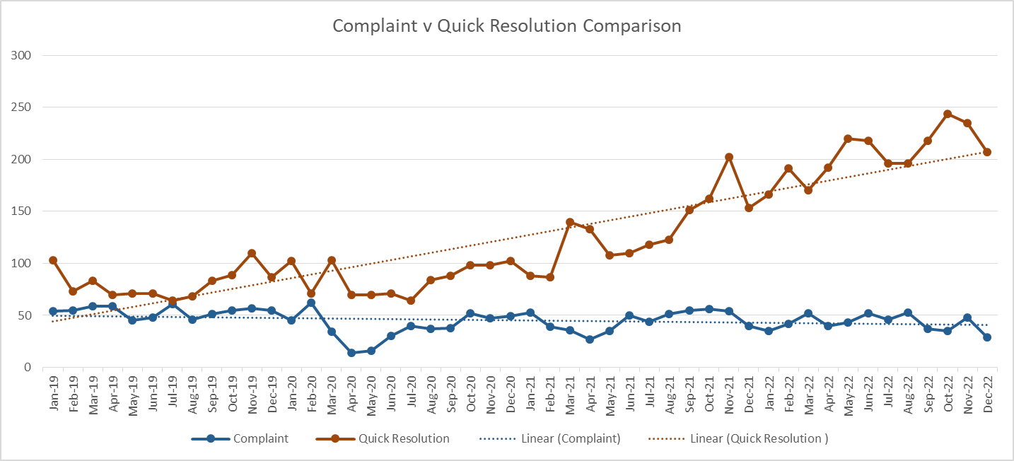
Success
www.cddft.nhs.uk

Slide 6
Improvements
Multi-disciplinary Meetings to investigate complaints.
Action Closure letters to close loop for complainants
Improved process for capturing ward level resolutions
New platform to allow complainants to reach Patient Experience.
Patient Story – Complainant videos for education.
www.cddft.nhs.uk

Slide 7
Next Steps
In-house training package reflecting that provided by the PHSO.
Rolling training program for refresher and new staff training.
New module to help staff log locally resolved cases.
Continue to re-evaluate with a cycle of improvement.
Simulation Centre to use complaints learning for education.
Use complaints to drive service improvement and identify opportunities for co-production work.
www.cddft.nhs.uk

Slide 8
Paula Brennan – Patient Experience Manager
Telephone: 0191 3726872 / 07909097798
Email: paulabrennan@nhs.net
www.cddft.nhs.uk

