Slide 1
Using National Audit to improve Care Locally
Cameron Swift.
King’s College London
November 2022

Slide 2
AN EXAMPLE OF NATIONAL IMPORTANCE: FALLS & FRAGILITY# IN LATER LIFE
30% >65: 50%>80 fall at least once yearly
Injury, disability, dependency, mortality
NHS annual cost >£2.3bn

Slide 3
Key evidence-based national audit resources (see also BOA/BGS Blue-book, SIGN etc)
(Focus on: *Fragility Hip#
*Falls Prevention in older people)
NICE Guidelines
(e.g. CG 124/161)
NICE Quality Standards
(e.g. QS 16/86
National Audit Databases
RCP FFFAP (NHFD (+BPT) /FLSDB/ NAIF)

Slide 4
NICE Quality Standards
Not fixed targets
Measurable high level audit measures of local quality in structure, process or outcome
Expressed as proportions – not necessarily 100% norm
Maximally evidence-based
Where possible, set in the context of national data collection – e.g. NAIF/ NHFD
Selection periodically adjusted for perceived priority improvement need.

Slide 5
EVIDENCE: Hip Fracture_CG124 (2011 -14 -17-19) Measurable evidence-based Categories
Imaging options in occult hip fracture
Timing of surgery
Analgesia
Anaesthesia
Planning the theatre team
Surgical procedures (2017 / 2019 updates)
Mobilisation strategies
Multidisciplinary management (HFP)
Patient and carer information

Slide 6
EVIDENCE Hip Fracture Programme Model [CG124]
Acute orthopaedic or orthogeriatric ward base
Orthogeriatric assessment
Rapid optimisation of fitness for surgery
Early identification of individual goals for multidisciplinary rehabilitation to recover mobility and independence, and to facilitate return to pre-fracture residence and long-term wellbeing
Continued, coordinated, orthogeriatric and multidisciplinary review
Liaison or integration with related services, particularly mental health, falls prevention, bone health, primary care and social services
Clinical and service governance responsibility for all stages of the pathway of care and rehabilitation, including those delivered in the community.

Slide 7
EVIDENCE:Management of hip fracture
Accident & Emergency: Preliminary Assessment -
Surgical, Anaesthetic, Medical, Nursing, Rehab goals
Theatre
Orthopaedic / Specialist Ward:
Perioperative surgical, nursing and related management with
referral as required
“Usual Care”
MDM: HFP
MDR: SD
MDR: GORU
MDR: IC
MDR: MARU
MDR: SC
FINAL DISCHARGE

Slide 8
EVIDENCE: Key model inputs and CEA findings
COSTS FOR EACH
STRATEGY:
Rehab programme
Complications
Readmissions
Health care costs after
hospital discharge
Social care costs (when
living in own home or in
residential or nursing home)
HEALTH OUTCOMES
FOR EACH STRATEGY
EQ-5Ds scores for
all health states*
Life expectancy
= QALYs
HEALTH
STATES
HFP is the DOMINANT STRATEGY
(more effective, less costly)
than both GORU/MARU and usual care

Slide 9
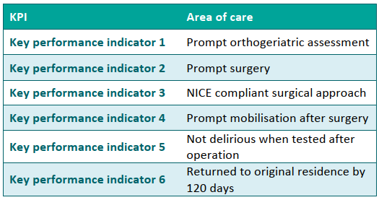
NHFD Evidence-based KPI’s 2019 & 2021 (COVID19) RCP NHFD 2022
2019 2021

Slide 10
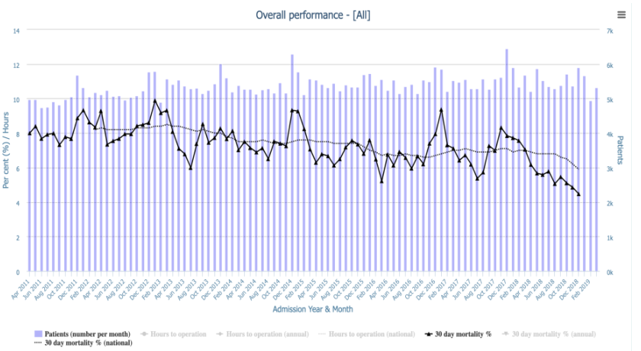
Outcome:Seasonal variation in 30-day hip# mortality, 2011-2018 (NHFD 2019) (See also Griffin et al 2021: EQ-5D-5L)

Slide 11
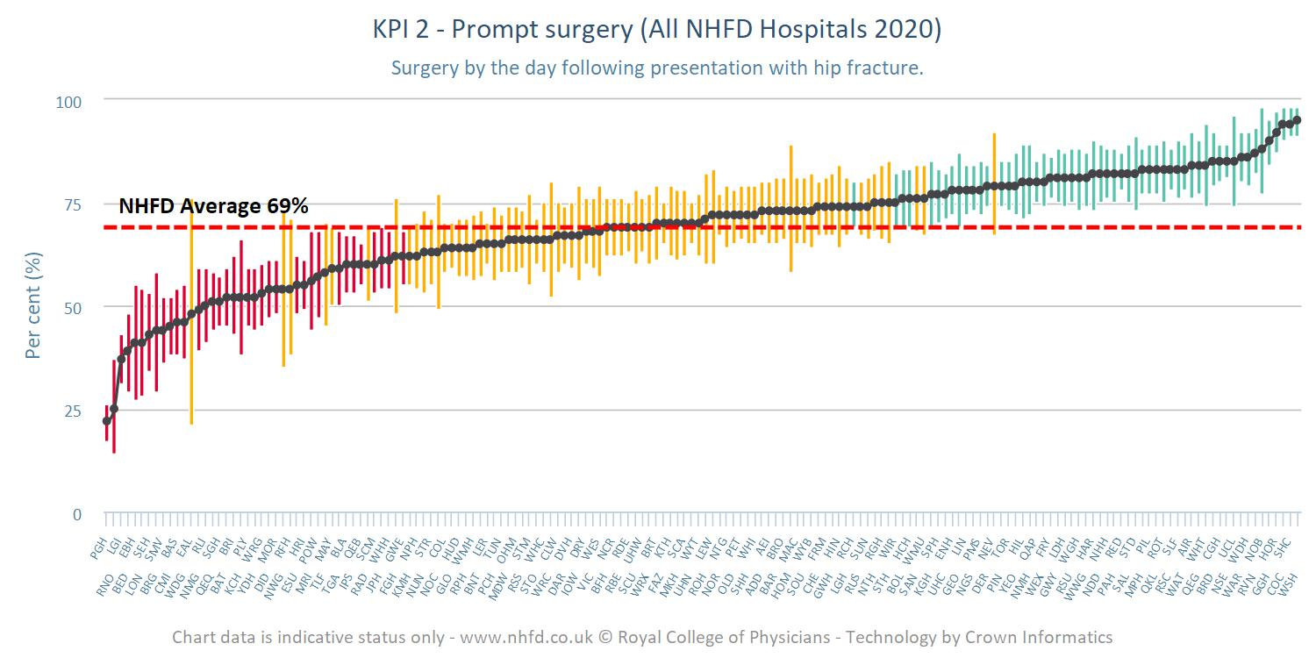
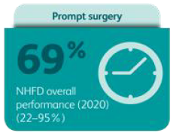
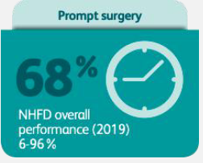
Variation: KPI 2 Caterpillar Plot (Time to surg,) (NHFD 2021)

Slide 12
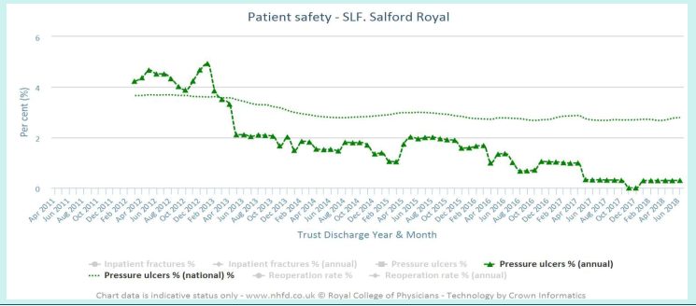
NHFD data use and local QI achievement: Waterlow assessment and hip# pressure sore incidence. [NHFD 2018]

Slide 13
Local implementation for progress across KPI’s: [NHFD 2018]
Examine own NHFD data in dashboards and run charts
Investigate and address causes of poor performance
Ensure full multidisciplinary clinical governance representation
Achieve continuity of clinical governance, including post-discharge follow-up
Identify local concerns/challenges and chart NHFD data prospectively to drive QI.

Slide 14
NHFD Development & Resources (NHFD 2022)
From 2011 annual national & local services audit & BPT delivery
Benchmarking tables; mortality data; realtime data run-charts; KPI caterpillar plots
2022 ahead – website as quarterly reporting cycle and Governance Tool to further support local data analysis, implementation and QI progress

Slide 15
Current NHFD audit recommendations (RCP NHFD, 2022)
Monthly clinical multidisciplinary and management governance meetings to monitor runtime data, address suboptimal performance and plan QI
Quarterly MDM access to NHFD site & Governance Tool as further QI drivers
[New additional KPI’s re analgesia (KPI0) & bone health (KPI7)]

Slide 16
FALLS IN LATER LIFE: A SIGNAL AS WELL AS A THREAT
Commonly detectable (Intrinsic / Extrinsic):
Ageing processes (diminished physiological reserve)
Suboptimal physical fitness
Stable specific impairment (e.g. sensory, motor, visual, CNS)
Unstable systemic illness (diagnosed or undiagnosed)
Environmental risk factors

Slide 17
EVIDENCE - POSITIVE: FALLS IN LATER LIFE – PREVENTABLE (i) (Close et al, Lancet 1999)

Slide 18
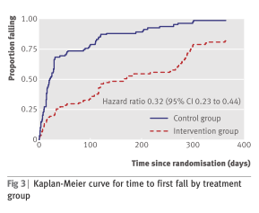
EVIDENCE - POSITIVE: FALLS IN LATER LIFE – PREVENTABLE (ii) (LOGAN et al, BMJ 2010)
(7.68 vs 3.46 control vs intervention)

Slide 19
EVIDENCE - POSITIVE: FALLS IN LATER LIFE – PREVENTABLE (iii) (DAVISON et al, 2005)

Slide 20
NICE Guidance (CG161) (update pending - 2024)
Case/risk identification
“Specialist” multifactorial falls risk assessment & diagnosis
Falls history
Assessment of:
gait, balance and mobility, and muscle weakness
osteoporosis risk
perceived functional ability and fear relating to falling
visual impairment
cognitive impairment and neurological examination
urinary continence
environmental hazards
Cardiovascular examination and medication review
Individualised multifactorial interventions

Slide 21
NATIONAL AUDIT – NICE quality standard QS86 (2017 UPDATE STATEMENTS)
1 Older people are asked about falls when they have routine assessments and reviews with health and social care practitioners, and if they present at hospital.
2. Older people at risk of falling are offered a multifactorial falls risk assessment.
3. Older people assessed as being at increased risk of falling have an individualised multifactorial intervention.
4.Older people who fall during a hospital stay are checked for signs or symptoms of fracture and potential for spinal injury before they are moved.
5. Older people who fall during a hospital stay and have signs or symptoms of fracture or potential for spinal injury are moved using safe manual handling methods.
6. Older people who fall during a hospital stay have a medical examination.
7. Older people who present for medical attention because of a fall have a multifactorial falls risk assessment.
8. Older people living in the community who have a known history of recurrent falls are referred for strength and balance training.
9. Older people who are admitted to hospital after having a fall are offered a home hazard assessment and safety interventions.

Slide 22
EVIDENCE: FALLS IN INPATIENTS
Highest risk category
Heterogeneous studies and settings (e.g. acute. non-acute, mixed)
Inconsistent or negative findings with single factor or non-tailored interventions
Risk factor prediction tools insufficiently sensitive or specific
More research needed
Some moderate/low evidence for multifactorial assessment and intervention strategies

Slide 23
EVIDENCE - POSITIVE: Effect of targeted risk factor reduction programme on inpatient falls (per thousand occupied bed days) (Healey et al, 2004)

Slide 24
EVIDENCE: NICE CG 161: COST-EFFECTIVENESS OF INPATIENT FALLS PREVENTION

Slide 25
“Fallsafe” care bundle key elements [RCP 2015]
Cognitive assessment*
Delirium screen*
Bed-rail/Ultra-low bed strategy*
Basic visual check*
Lying & standing blood pressure & pulse*
Medical & medication review*
Tailored on-ward (v 2-hr) observation regimen

Slide 26
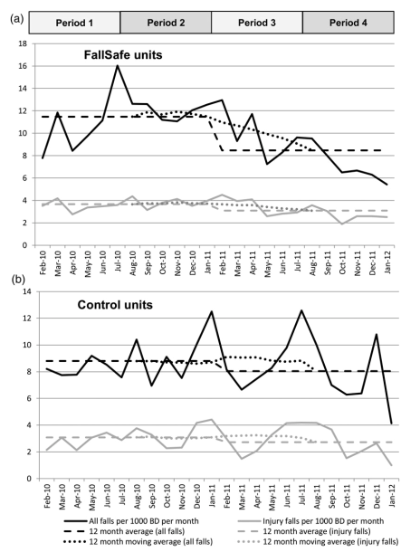
INPATIENT IMPLEMENTATION & OUTCOME MEASUREMENT “Fallsafe” QI evaluation [Healey et al 2014]

Slide 27
NATIONAL AUDIT – SNAPSHOT KPI DATA -INPATIENT FALLS PREVENTION 2017 (v 2015) (RCP NAIF 2019)

Slide 28
PROCEDURE USE NEEDING FURTHER EVIDENCE (NAIF Facilities audit 2019) (RCP 2020)

Slide 29
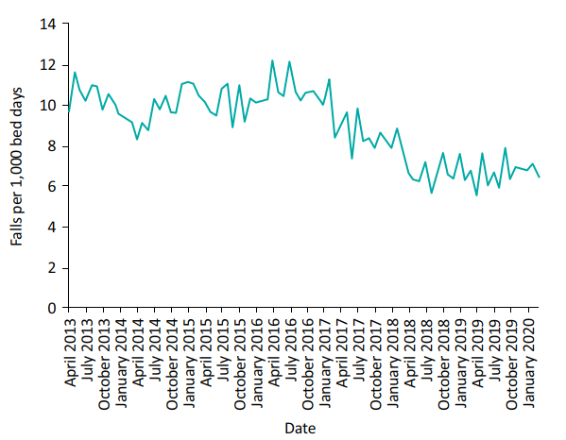
NATIONAL AUDIT & QI: Inpatient falls per 1,000 bed days AT Northumbria Healthcare NHS Foundation Trust 2013–2020. (Richardson et al., 2020)

Slide 30
NATIONAL AUDIT OF INPATIENT FALLS (NAIF) 2018-21 (RCP 2020)
Focus on inpatient hip fracture (IHF).
Rational sensitive audit outcome measure
Continuous year-round national data collection (NHFD)
Increased incentive for trust level participation
Fall prevention management audited for IHF only
All inpatient settings eligible to participate (inc. community, specialist, mental health trusts)
Data collection to include immediate post fall management (QS 86)
Data entered onto the NHFD as IHF
Once yearly facilities audit

Slide 31
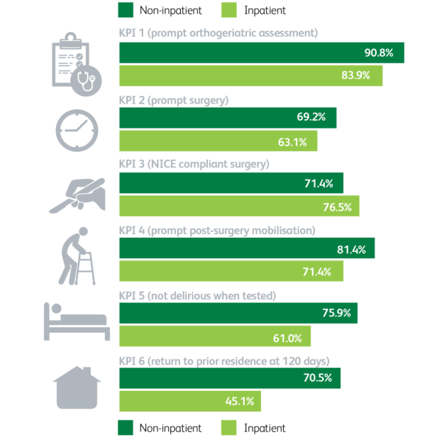
NHFD 6 KPI’s FOR INPATIENT & NON-INPATIENT HIP FRACTURE [NHFD 2021]

Slide 32
NATIONAL AUDIT OF INPATIENT FALLS (NAIF) 2018-21 (RCP 2021)
DATA – regularly updated, openly accessible
GUIDANCE – e.g.
Vision assessment
Postural blood pressure measurement
Post-fall management*
Gaining insight (v. incident review only)*
Hot debrief (immediate info collection)
After action review (MDT learning)
*In development

Slide 33
SOME BENEFITS OF NATIONAL AUDIT PARTICIPATION
Validity and availability of engagement with national evidence based guidance.
National peer comparison and resources as incentives.
Acquisition of reliable national data as a driver for local progress
Open, shared culture of serious risk recognition and prevention – e.g. hip#.
Focused, forward trust-level accountability

Slide 34
In Conclusion
Based on the FFFAP record to date:
Robust evidence is key to the sustainable real-world impact of all audit initiatives
Evidence-based national audit has major potential to drive local (as well as national) improvement
Configuration flexibility may be needed to ensure the pivotal required engagement
Standardised local clinical and administrative governance are essential

