Slide 1
Working with & Involving Families
after Serious Incidents
Julian Hendy
2 Feb 2023

Slide 2
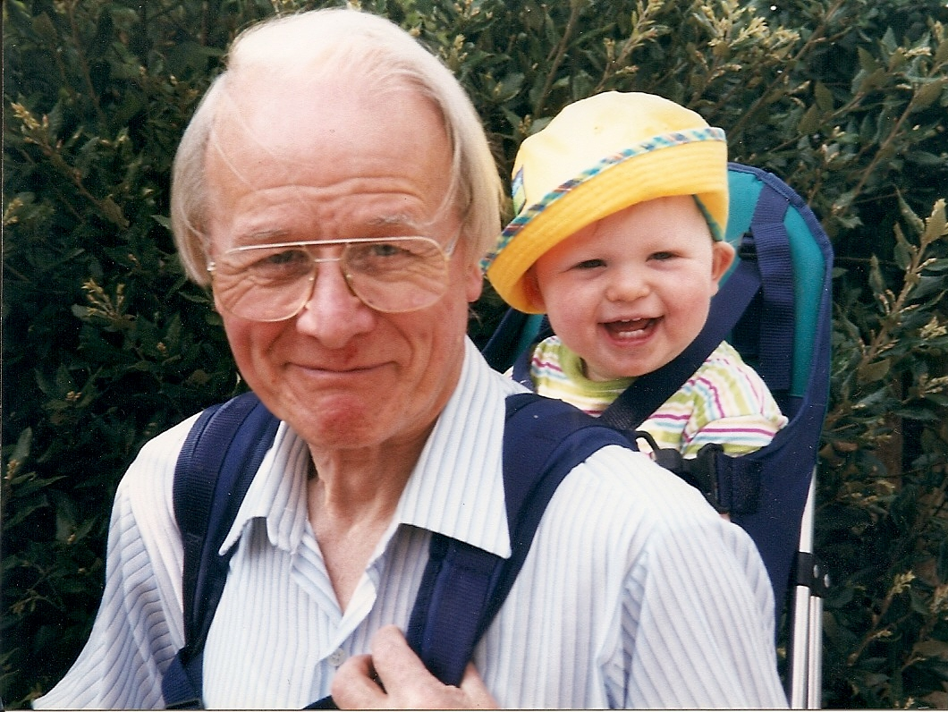
Notes:
My Dad
Four previous inquiries in Avon & Wiltshire before my Dad’s murder highlighted need to improve Risk assessment

Slide 3
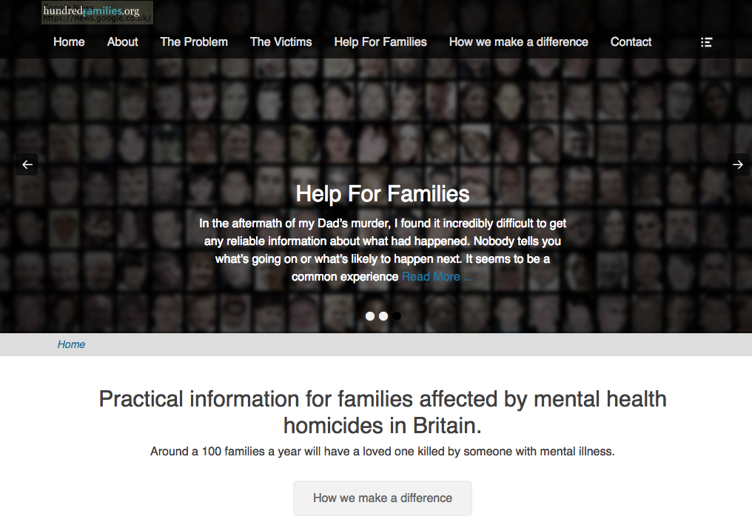

Slide 4
Support and advocate for families
Work with the NHS and others to prevent further tragedies
Provide evidence and training to influence change
Documented 2000+ MH homicides
800+ Inquiry reports available

Slide 5
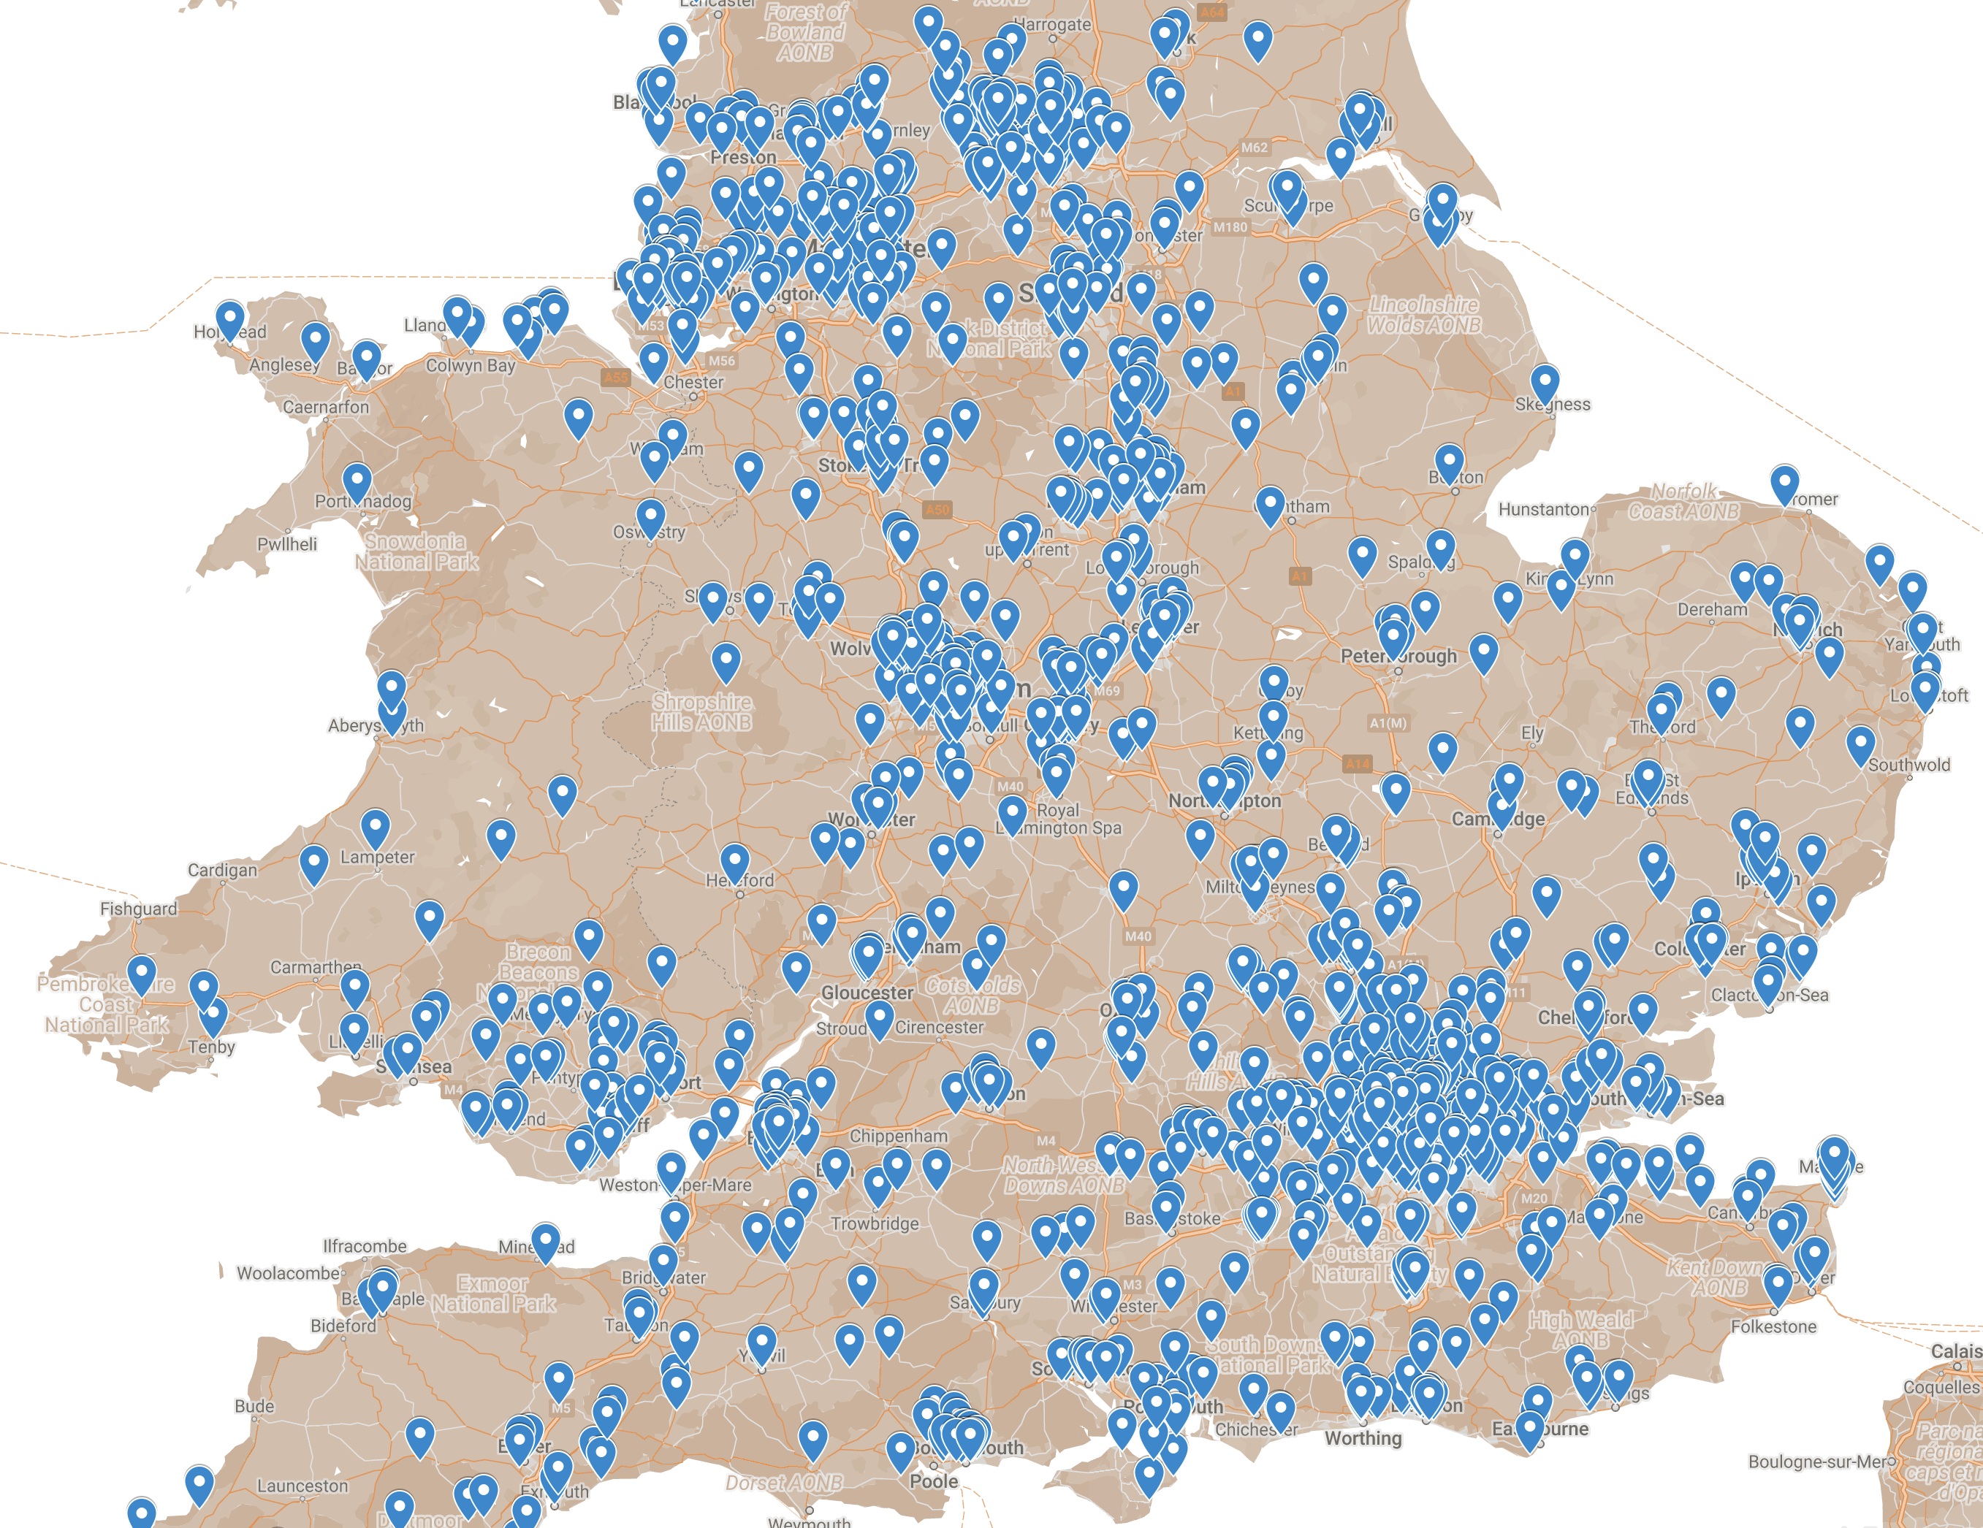

Slide 6
NHS England - Independent Investigations 2018-19 Annual Report
93
121
111
Notes:
Published July 2020 - Page 6 –
England only – Scotland Wales & NI extra

Slide 7
BJP - July 2020
Notes:
Flynn, S., Ibrahim, S., Kapur, N., Appleby, L., & Shaw, J. (2020). Mental disorder in people convicted of homicide: Long-term national trends in rates and court outcome.
The British Journal of Psychiatry, 1-7. doi:10.1192/bjp.2020.94

Slide 8
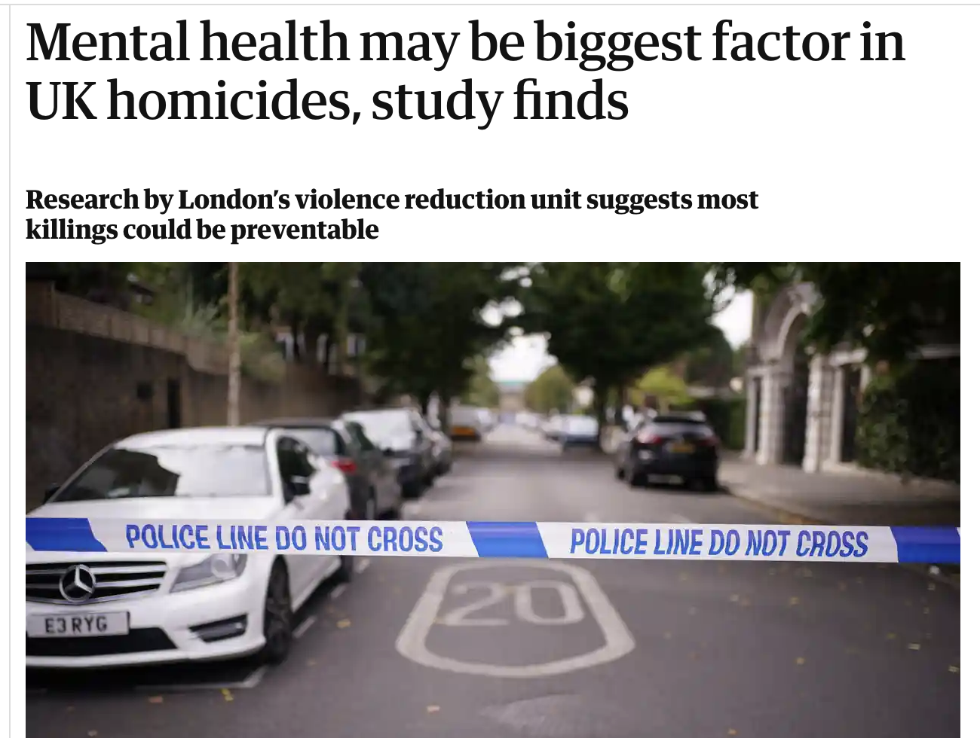
Notes:
Guardian - 14 Nov 22 – 50 London homicides – 58% MH related
https://www.theguardian.com/uk-news/2022/nov/14/mental-health-may-be-biggest-factor-uk-homicides-study
London Violence Reduction Unit report
https://t.co/SOnaySTU6C

Slide 9
Most victims are Families and Friends
“Perpetrators’ mental health was mentioned in 65% of DHRs; 49% of perpetrators had a mental health diagnosis. Healthcare services in particular, mental health services, were most likely to be involved with perpetrators.”
Notes:
Published March 2020 - Analysed 141 domestic homicide reviews (DHRs) in England and Wales.
https://onlinelibrary.wiley.com/doi/abs/10.1111/hsc.12881

Slide 10
People or Process ?
2013/29555 | 2017/14144 | 2011/13432 | 2019/14670 | 2014/42532 | 2018/23654
2012/18752 | 2016/18500 | 2012/16046 | 2014/42181 | 2014/25273 | 2017/15717
2011/17106 | 2013/28276 | 2016/18856 | 2018/951 | 2015/14132 | 2019/4407
2014/10128 | 2017/15440 | 2015/23056 | 2018/18636 | 2015/37663 | 2018/16725
2013/3454 | 2016/32823 | 2016/22096 | 2014/39959 | 2013/33945 | 2020/484
2013/14158 | 2016/19955 | 2017/7489 | 2014/24147 | 2014/2927 | 2017/26924
2012/15116 | 2018/19290 | 2014/22374 | 2016/17208 | 2014/31324 | 2019/12699
2013/23705 | 2019/4055 | 2014/29627 | 2017/29685 | 2014/626 | 2017/6089
2014/20490 | 2019/13411 | 2017/13260 | 2017/18462 | 2015/24621 | 2017/13849
2012/25285 | 2017/32700 | 2015/11584 | 2017/9654 | 2016/6113 | 2014/26905
2014/29533 | 2014/17675 | 2016/21910 | 2018/4054 | 2016/15284 | 2013/3454
2014/40060 | 2015/36282 | 2021/11335 | 2021/14665 | 2019/359 | 2020/19195
Notes:
NHS Steis numbers of patient homicides

Slide 11
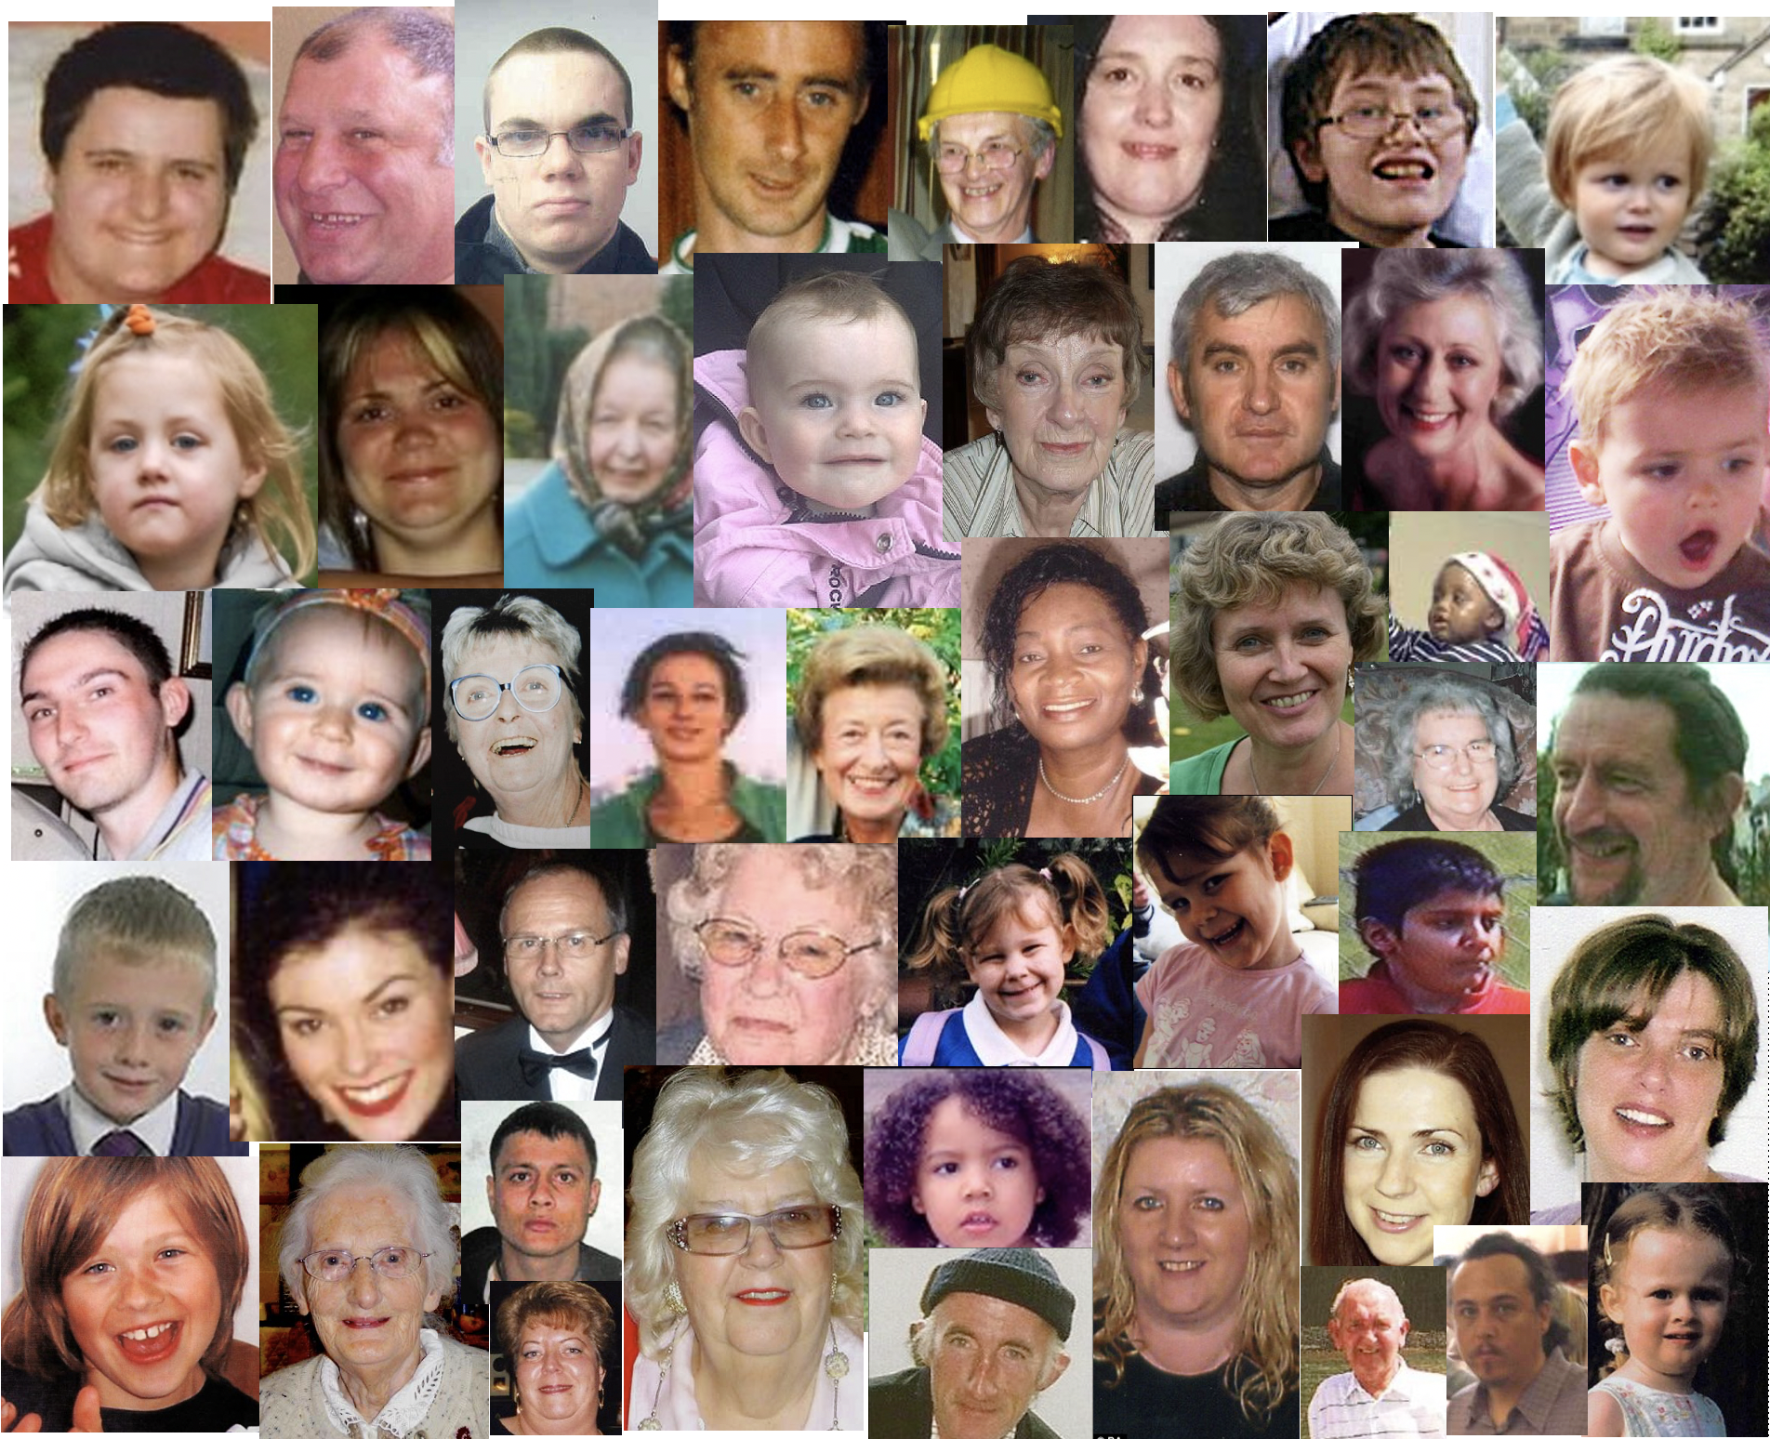
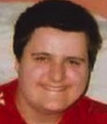
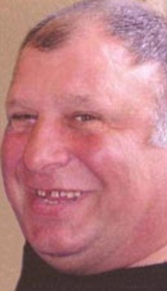
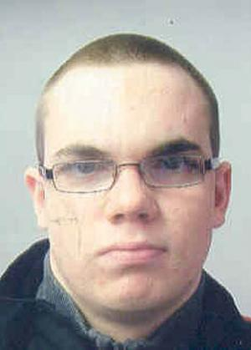
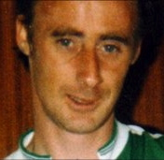
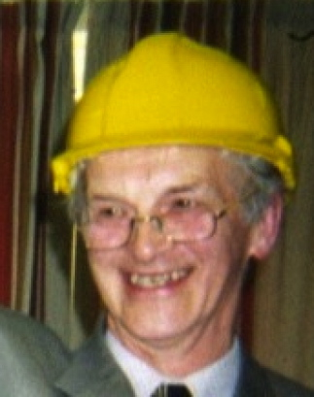
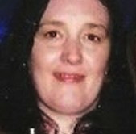
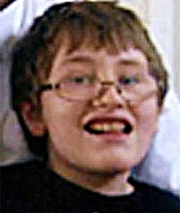
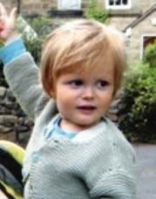
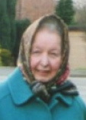
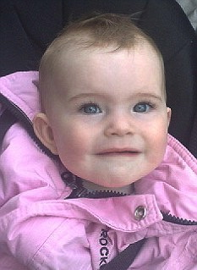
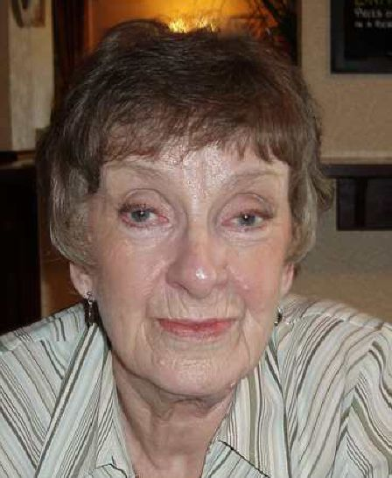
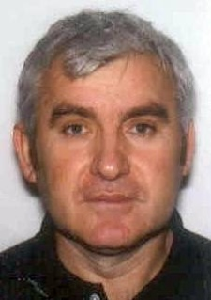
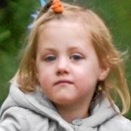
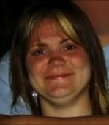
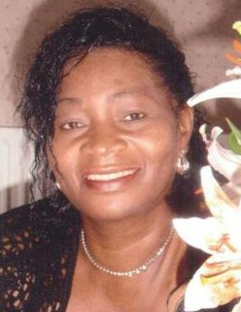
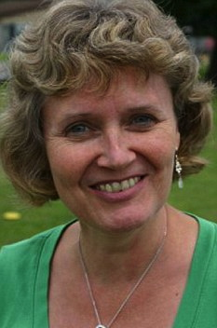
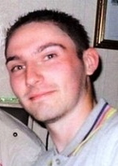
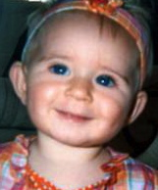
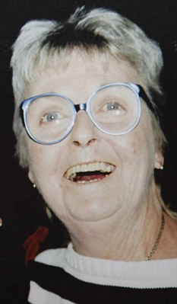
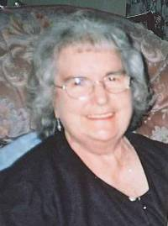
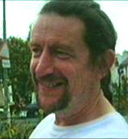
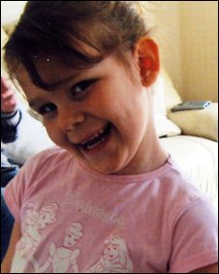
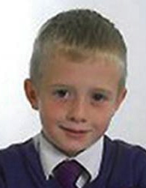
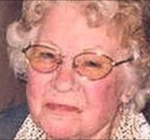
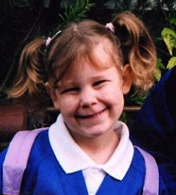
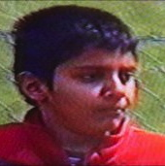
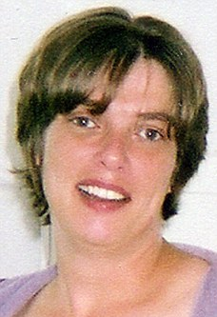
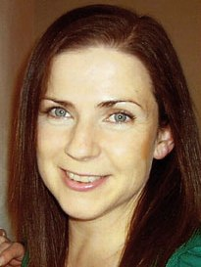
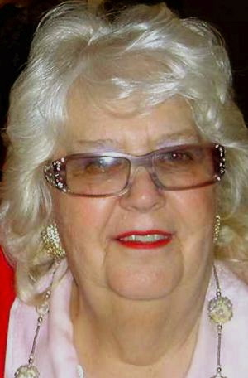
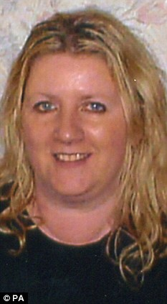
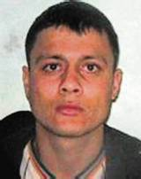
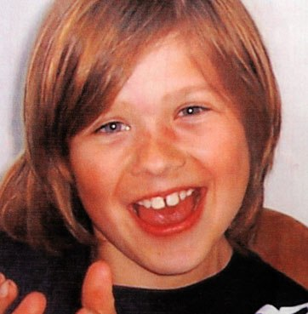
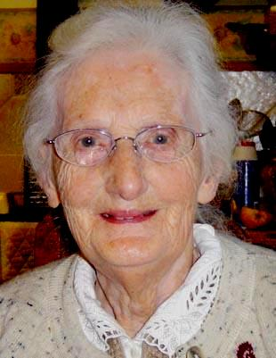
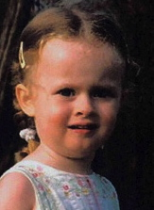
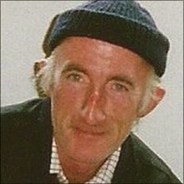
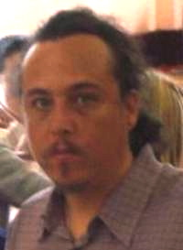
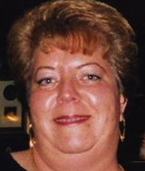
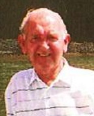
Notes:
Some recent homicide victims, large numbers of kids, elderly and some other mental health patients

Slide 12
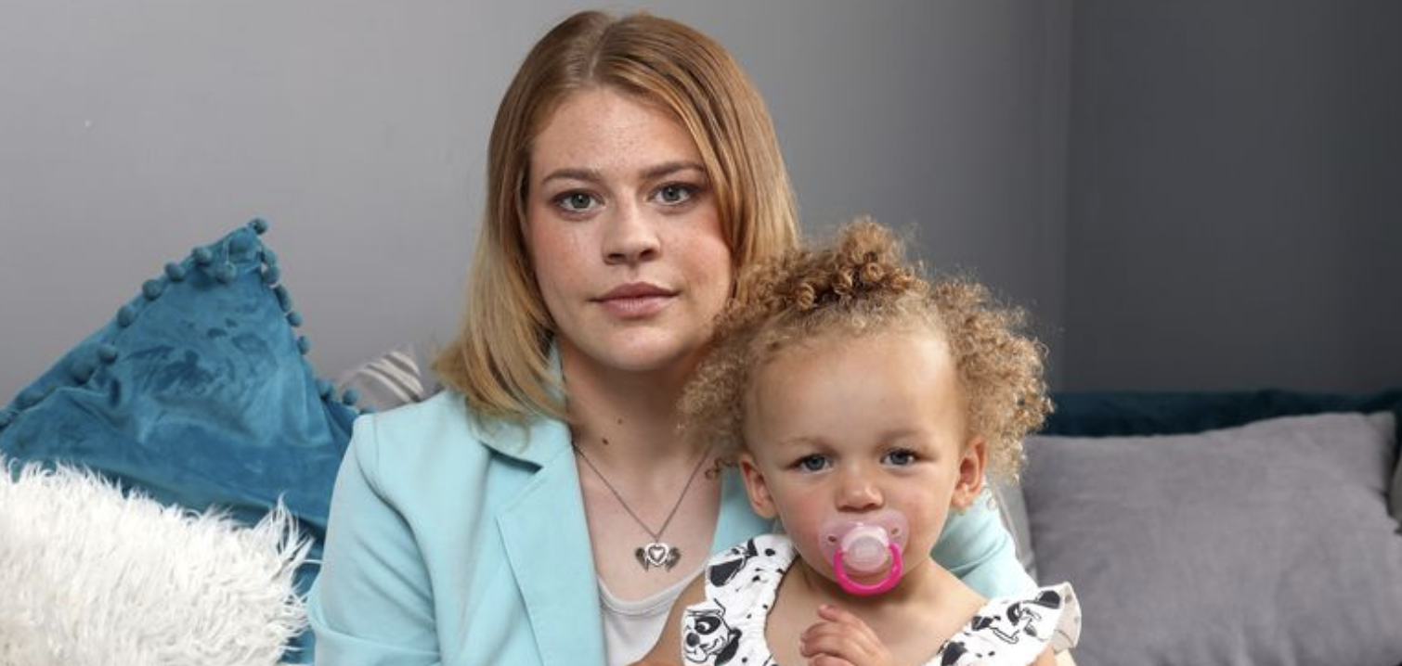
Notes:
Daily Mirror - 17 July 2021, Emma Blood

Slide 13
Victims & MH Homicides
Criminal Justice System
Health Service

Slide 14
Criminal Process
Who did it?
What should happen to them?
Doesn’t answer family’s questions

Slide 16
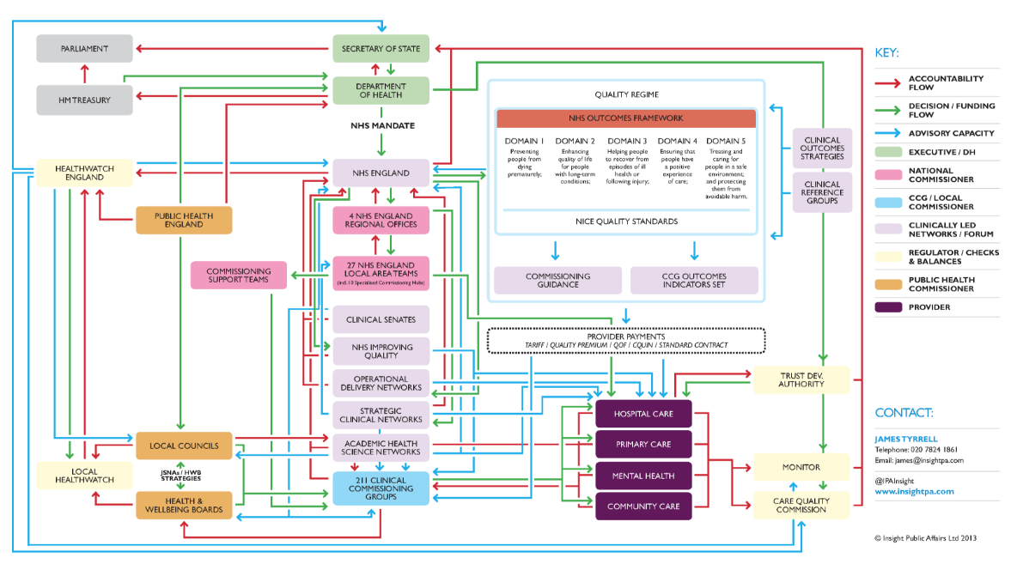
Notes:
Source : Insight public affairs
http://insightpublicaffairs.com/wp-content/uploads/2013/04/2013-NHS-Structure.png

Slide 18
What do families want?

Slide 19
Apology & Accountability
Recognition & Respect
Effective learning

Slide 20
Apologies
“Saying sorry is always the right thing to do.
It is not an admission of legal liability.
It’s the first step to learning from what happened and preventing it recurring.”
Notes:
https://resolution.nhs.uk/wp-content/uploads/2018/09/NHS-Resolution-Saying-Sorry.pdf

Slide 21
Notes:
Dec 2017
https://www.cqc.org.uk/sites/default/files/20161213-learning-candour-accountability-full-report.pdf

Slide 22
Families have poor experience of reviews and investigations
Not always treated with kindness, respect & sensitivity

Slide 23
Harry Morris
Notes:
June 2011 – Anthony Ogburn killed Harry Morris
Manslaughter - diminished responsibility

Slide 24
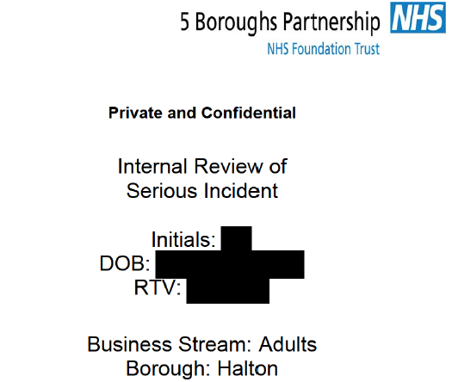

Slide 26
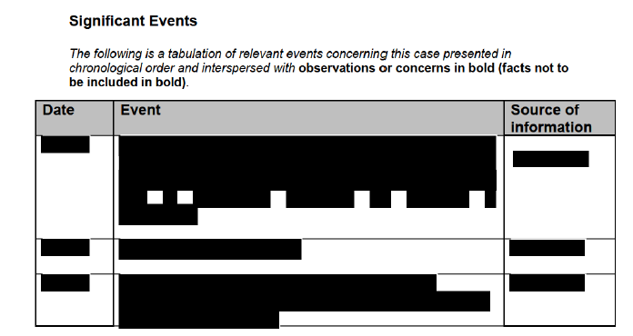

Slide 27
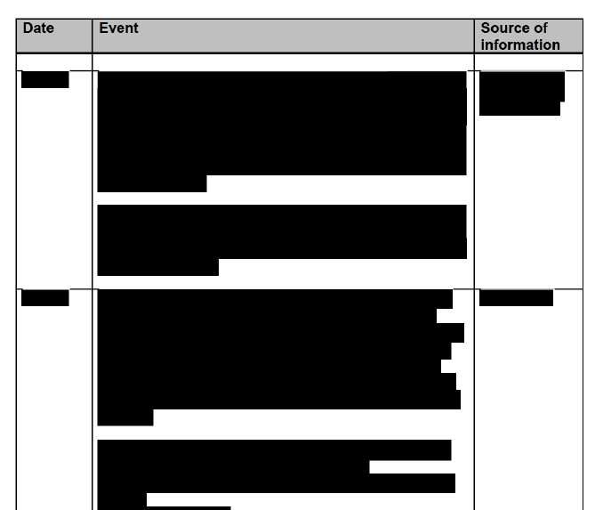

Slide 29
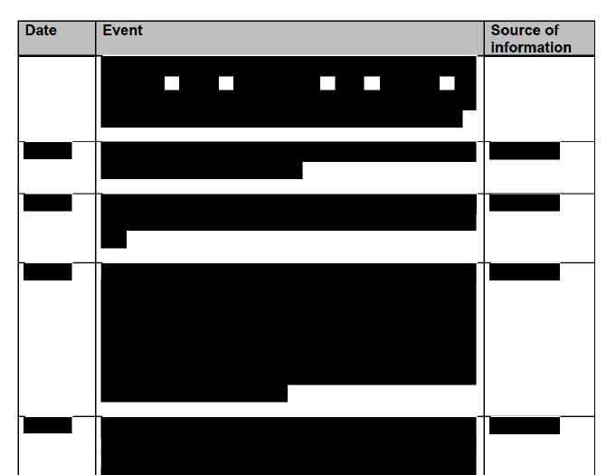

Slide 30
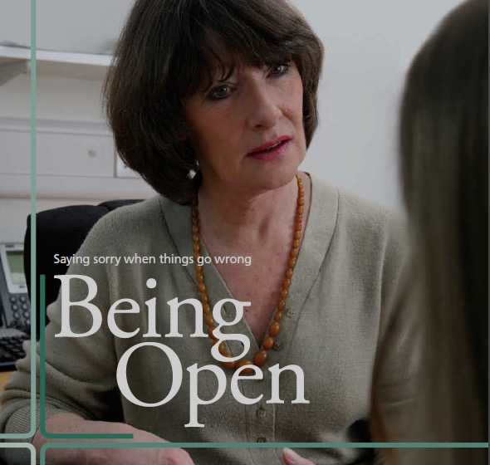
Open, truthful, timely and clear
Families receive the information they need
NPSA 2009
Notes:
NPSA -2009 Guidance
Truthful, timely and clear
Families receive the information they need

Slide 31
Notes:
https://www.cqc.org.uk/guidance-providers/all-services/regulation-20-duty-candour

Slide 32
Duty Of Candour
Providers have to act in an open and transparent way with relevant persons
(people who have been harmed or those acting on their behalf).
Provide support to them in relation to the incident.
Provide an account of the incident which, to the best of the provider’s knowledge, is true of all the facts.
Notes:
CQC requirement – CQC regulation 20 Applies to England and Wales
https://www.cqc.org.uk/guidance-providers/regulations-enforcement/regulation-20-duty-candour

Slide 33
(August 2022)
The moral obligation to be open, honest, supportive, and inclusive must be upheld for all affected…..
The requirement to comply with Duty of Candour regulations is unchanged:….
In cases of mental health related homicide, this will be both the patient and their family, and the victim’s family.
Notes:
PSIRF supporting guidance- Oversight roles and responsibilities specification – p 31
https://www.england.nhs.uk/wp-content/uploads/2022/08/B1465-4.-Oversight-roles-and-responsibilities-specification-v1-FINAL.pdf

Slide 34
What does good look like?

Slide 35
The prompt, effective liaison between a family and an investigation to ensure the family is integral to the investigation and is treated professionally, respectfully and according to their individual needs.
Notes:
HSIB 2020
https://hsib-kqcco125-media.s3.amazonaws.com/assets/documents/hsib-national-learning-report-giving-families-voice.pdf

Slide 36
What can happen when there’s poor
family engagement?

Slide 40
How can better family engagement benefit Health Services?
Notes:
Chto Delat

Slide 41
Listening to families & friends
Families know stuff
(not necessarily in the medical records)
They can tell you what you don’t know, what you are missing.
Manages expectations.
Keeps people safe.

Slide 42
Notes:
2021
https://www.who.int/publications/i/item/9789240032705

Slide 43
Patients, families and others bring insights from their experiences of care that cannot be substituted or replicated by clinicians, managers or researchers.
This is especially so for those who have suffered harm.

Slide 44
Some tips for better
family engagement

Slide 45
Establish Early Contact
Establish early contact with families
Write to them saying
Sorry
Investigate / Improve
Dedicated contact
Don’t be afraid to make the first move
Follow up

Slide 46
Don’t forget -
Not everyone can read and write well.
Check ability to understand
Don’t use jargon
Notes:
Remember ‘My mum’ test
MoJ – gov.uk website writes for a reading age of 12

Slide 47
Family Liaison Officers
Facilitate contact after Serious Incidents
Part of Investigation? (Police model)
Need dedicated time and resources
At least two needed

Slide 48
Learn effectively

Slide 49
Learn Effectively
If things went wrong,
put them right.
Change doesn’t end with an Action plan
Embed and evidence the learning

Slide 50
Four common underlying themes:
Absence of a systemic and joined-up approach to safety
Poor systems for sharing learning and acting on that learning
Lack of system oversight, monitoring, and evaluation
Unclear patient safety leadership
Notes:
https://s3-eu-west-1.amazonaws.com/ddme-psl/Mindtheimplementationgap_ThepersistenceofavoidableharmintheNHS_2022-04-07-121554_vhao.pdf
https://www.patientsafetylearning.org/blog/mind-the-implementation-gap-the-persistence-of-avoidable-harm-in-the-nhs

Slide 51
Engaging with families
Meets your statutory obligations
Shows you care
Makes for better investigations
Helps avoid litigation & hostile press coverage
Right thing to do

Slide 52
Some Resources
Notes:
https://www.england.nhs.uk/london/wp-content/uploads/sites/8/2019/08/Information-for-Mental-Health-Providers_V4.0.pdf
https://www.england.nhs.uk/london/our-work/mhsupport/

Slide 53
Julian Hendy
www.hundredfamilies.org
@hundredfamilies

