Slide 1
Self Harm and Suicide : A General Practice Perspective
Dr Sohrab Panday MRCGP
Clinical Lead Mental Health, Learning Disabilities & Autism
Suicide Prevention Lead for Primary Care
Derbyshire Integrated Care System
Improving Services & Outcomes for People who Self-Harm
Virtual Online Conference HC_UK Conferences Ltd
January 25th 2023

Slide 2
A Personal Perspective
‘In my general practice over 30 years I have found nothing more difficult than dealing with the aftermath of suicide; facing the grieving family, with a sense of failure to prevent it.‘
‘Conversely, I have found great satisfaction when I manage to help someone in emotional distress, to stay safe, get well and rediscover their joy of life.’
Sohrab Panday
The Derbyshire Journey
1000 GPs & Primary Care Staff have received suicide prevention training since 2018 with an emphasis on Compassion; Teamwork & Safety Planning

Slide 3
Self Harm Definition Intentional self-poisoning or self-injury irrespective of the apparent purpose of the act A way to ‘cope’ with their emotional dysregulation It is complex as it offers relief but also causes harm
Prevalence self-harm or attempted suicide
7.3% of girls & 3.6% of boys (aged11-16)
21.5% of girls & 9.7% of boys (aged 17-19)
Any age but recent increase among young people
Only a minority present to hospital services yet
200,000 ED presentations in England every year
20% of people repeat self-harm within a year.
About half of the people who attend ED with self harm have visited their GP in the previous month

Slide 4
Self Harm and Suicide: The relationship between self-harm and suicide is complex
People who SH have a greatly increased risk of suicide
Risk in the first year (30-50x) after SH
Peak suicide risk (200x) is one month after non-fatal self-harm hospitalisation
The increased risk of suicide reduces in subsequent years but still exists for 15 years
Males, Older people, repeated self harm
UK Suicides 6000 people per year
30-40% of suicides have a history of self harm

Slide 5
NICE guideline [NG225] Self-harm: assessment, management and preventing recurrence NICE guideline Published: 7 September 2022 www.nice.org.uk/guidance/ng225
Self Harm is everyone’s business’
Assessment and care in primary care
1.7.6 Consider a referral to mental health or social care services
1.7.7 Consider making referral to mental health professional a PRIORITY
1.7.8 GP responsibilities in caring for the person
Psychosocial Assessment by a trained mental health worker reduces risk of further SH by 40%

Slide 6
Assessment and care in primary care NICE
1.7.6 When a person presents in primary care after an episode of self-harm, consider referring them to mental health or social care services for a psychosocial assessment or informing their existing mental health team, with consent from the person and their family members or carers (as appropriate)
1.7.7 Make referral to mental health professionals a priority when:
• the person's levels of concern or distress are rising, high or sustained
• the frequency or degree of self-harm or suicidal intent is increasing
• the person providing assessment in primary care is concerned
• the person asks for further support from mental health services
• levels of distress in family members or carers of children, young people and
adults are rising, high or sustained, despite attempts to help
1.7.8 If the person who has self-harmed is being supported and given care in primary care, their
GP should ensure that the person has:
• regular appointments with their GP for review of self-harm
• a medicines review
• information re: social care, voluntary/non-NHS sector support & self-help resources
• care for any coexisting mental health problems, inc. referral to mental health services as appropriate

Slide 7
NICE
Principles for assessment and care by healthcare professionals & social care practitioners
1.7.1
• respect, dignity and compassion, awareness of cultural sensitivity
• seek consent to liaise with people involved in the person's care
- gather information to understand the context
- support network, any safety plan or coping strategies
Interventions for Self Harm
1.11.7
Consider developing a safety plan in partnership with people who have self-harmed
• recognise the triggers/warning signs of increased distress, further self harm or a suicidal crisis

Slide 8
Self Harm & Suicide General Practice: opportunities
Self Harm - 58% young people presenting at ED had seen their GP in prior 6 months
Suicide – 75% were not being seen by MH services in preceding 12 months
GP data studies show characteristics of suicides in people managed only in primary care:
Increasingly frequent attendance
Comorbidity
Chronic Pain
Alcohol misuse
Polypharmacy – amitriptyline, opiates,
hypnotics, beta-blockers

Slide 9
Challenges in General Practice Access ‘10-minute consultations’ Training Confidence of GPs Secondary Care Support Shortage of GPs
Positive Points about General Practice
A safe place without stigma
Comprehensive personal medical records
Free, all age healthcare accessible to all
Personal holistic & family care
GPs diagnose and treat common mental health problems, prescribe medication according to NICE guidelines, and refer to Mental Health & Social Services
Lifelong continuity of care is possible

Slide 10
Particular Challenges for Primary Care Potential Solutions
Patient Information
Flexibility
Prioritisation
Skills
Training
A ‘Safer
from
Suicide’
Practice
Continuity
Contingency
Integrated Care System
Collaboration
Notes:
So we need better patient information on websites and posters and leaflets - Training for all staff to be understanding and empathetic - the ICB to embed support into all services – collaboration between statutory and non statutory services – between PC and SC - Primary Care to facilitate flexible consultations and prioritise patients appointments with named GPs

Slide 11
Listening to the Patient’s Experience
The National Suicide Prevention Alliance NSPA
Lived Experience Network were asked ….
‘Was your GP empathetic, knowledgeable &
understanding about your experiences
in relation to suicidal thoughts or actions?’
Notes:
No doctor or health worker goes to work in the morning to do a poor job - they care! But in order to do the best job they need training and organisational support within a culture of compassion.

Slide 12
Listening to the Patient’s Experience
The actual answer was
46%
What service users say they would find helpful
Option of type of GP appointment
GP who listens with empathy
Good consistent relationship with GP
Safety Planning !
Referrals/Signposting for further support options
Notes:
No doctor or health worker goes to work in the morning to do a poor job - they care! But in order to do the best job they need training and organisational support within a culture of compassion.

Slide 13
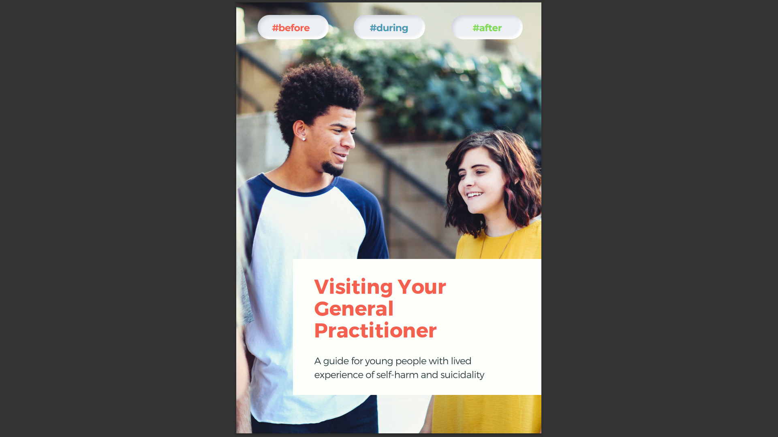
Michail M., Hunter, R., Mitchell L., Morgan J., Rathore I., Reid K., Tresadern C., Williams B.,
Campbell N.
Visiting your General Practitioner: A guide for young people with lived experience of self-harm and suicidality.
Birmingham: Institute for Mental Health, School of Psychology, University of Birmingham, 2021c
#MyGPguide - visiting your general practitioner: a guide for young people with lived experience of self-harm and suicidality — University of Birmingham

Slide 14
The RCGP Top Tips for Managing Self Harm in Children & Young People

Slide 15
Non-harmful and Harmful Coping Skills
The link with suicide
Self-harm
Health Risk Behaviours
Ambivalence
Coping
Suicidal thinking / behaviour
Suicide
Non-harmful Coping Skills
Triggers, Factors
StormSkillsTraining.com
Notes:
Note – the truth is it is not always linear and very dynamic – so this is a simplification

Slide 16
consultation skills
Indirect questions
“Do you feel like harming yourself?”
“Do you feel like getting away from it all?”
Suicidal
Thoughts or
Intentions or
Plan?
Direct questions
“Have you been thinking about suicide?”
“Do you want to kill yourself?”
Normalising question
“Sometimes when people feel distressed, they think of ending their life’’
“Is this something you’ve been thinking of?”
NICE: DO NOT USE RISK ASSESSMENT TOOLS OR SCALES TO ‘PREDICT’ SUICIDE OR DECIDE TREATMENT
StormSkillsTraining.com
Notes:
STORM offer Skills Training

Slide 17
www.stayingsafe.net
Person Owned
Co-production
Dynamic
Explore safe alternative coping strategies
Note: Consider Collaboration, Carers, Consent, Confidentiality & Capacity

Slide 18
Safe Prescribing
NICE Guidelines for Depression [NG222]
Do not withhold treatment on the basis of suicide risk
However, consider toxicity in overdose, drug interactions, half-life of drug, safe quantities
Active Monitoring GP follow up according to need and risk
Practice Pharmacist support, unwanted stocks, irregular ordering, medication reviews
GP to arrange follow up and consider increased frequency of support
Beware Polypharmacy … amitriptyline, beta blockers, Z drugs, opioids
Alcohol & Drug Misuse
Self Harm, Mental State & Suicidal enquiry during initiation & medication reviews

Slide 19
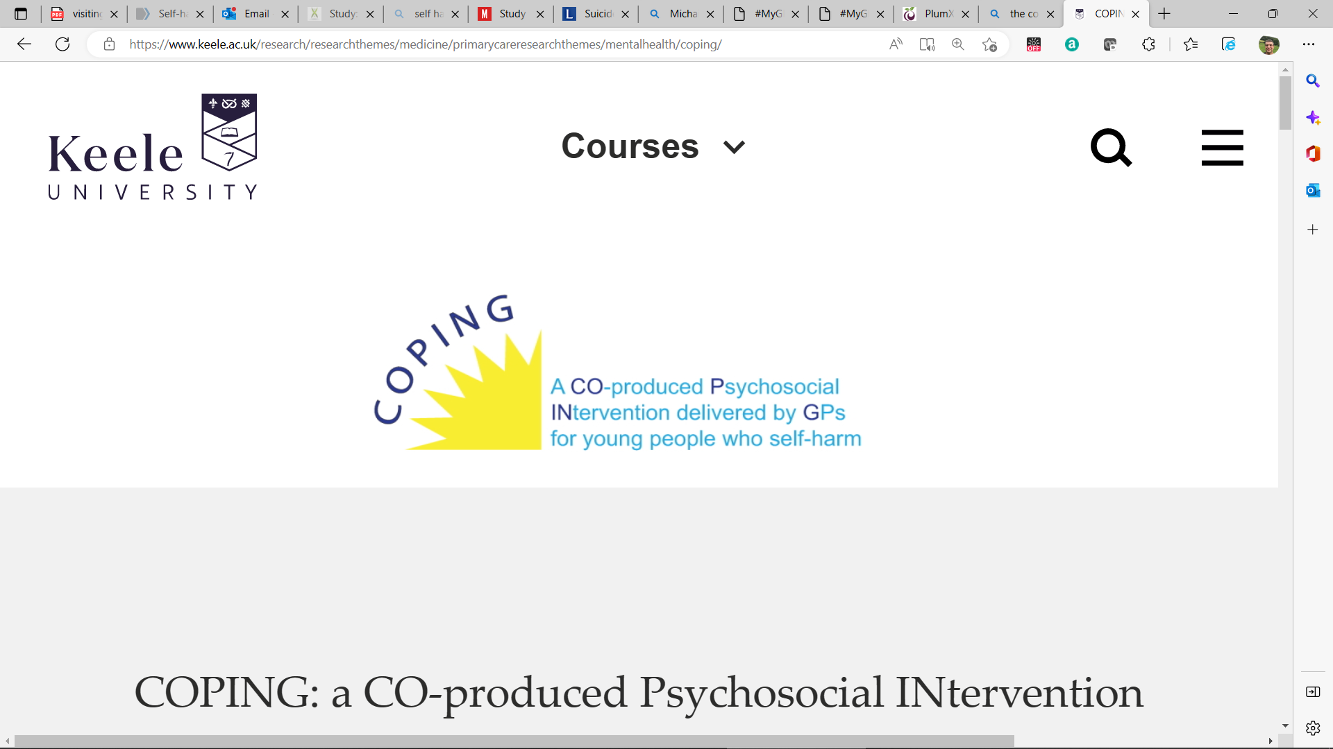
Self Harm in primary care research
The COPING study research programme 2021-2025
Young people commonly reach out to their GP for help with their self-harm.
There is a lack of evidence and clinical guidelines of how GPs should help young people who struggle with self-harm.
The COPING study aims to change this by providing high-quality research evidence to inform a future full-scale clinical trial of COPING in the NHS to guide GPs in managing self-harm in young people.
Faraz Mughal et al. Role of the GP in the management of patients with self-harm behaviour:
a systematic review, British Journal of General Practice (2020). DOI: 10.3399/bjgp20X708257Journal information: British Journal of General Practice

Slide 20
Self Harm in primary care
GPs play a vital role in helping those who self harm or are suicidal and offer holistic compassionate care in a safe environment
NICE guidance aims to improve GP care, -- active monitoring and more referrals on
Safety Planning to prevent suicide is key
Commissioning of CBT- informed therapy
Research ongoing to find GP intervention
Training of Primary Care Teams essential

Slide 21
Self Harm in primary care
Thank you for listening
Questions welcome
My contact details below
spanday@nhs.net

