Slide 1
What makes an excellent Clinical Director? Christine Blanshard, Chief Medical Officer, Worcestershire Acute Hospitals NHS Trust

Slide 2
The Clinical Directors Role
Clinical leadership and management of a collection of (related) services
Leader of the Directorate Triumvirate
Line management responsibilities
Not the doctors’ representative
But – the medical voice in the DMT
Assumed clinical expertise in all directorate matters

Slide 3
The Clinical Director as line manager
Objective setting
Regular 1:1s
Team meetings/huddles
IPRs – usually 6 monthly
Providing references and recommendations
Career guidance and development – including succession planning

Slide 4
Responsibilities of the Clinical Director: directorate and individual
Finance
Performance
Quality
Workforce
Reporting upward – relation with the Exec team
Managing downwards – service meetings, reports, deep dives
Role modelling, example setting

Slide 5
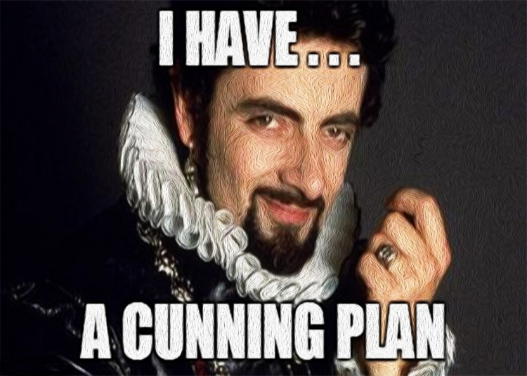
Responsibilities: strategy and planning
Developing and implementing a clinical service strategy
Alignment with Trust strategy
Knowledge of place/system strategies and priorities
Annual planning cycle
Three year Capacity plans
Align with consultant team job plans
Workforce planning

Slide 6
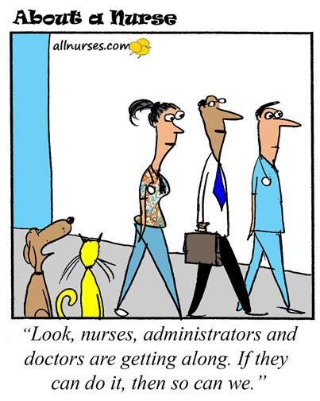
Accountability of Clinical Directors
Line manager – clinical or non-clinical (differences)
Professional standards and quality
CQC (well led)
System partners, clinical networks
Patients and the population

Slide 7
Skills needed
Prepared to feel unprepared!
Communication skills
Teamwork/collaboration
Planning
Research
Problem-solving
Writing
Building effective relationships
Organizational Skills
Leadership

Slide 8
Leadership Qualities needed for the role
Commonest style is pace-setting – getting quick results from a highly motivated and competent team
Crises – eg covid, winter, flu emphasise or even necessitate a directive, problem-solving style
Longer term:
Affiliative
Participative
Coaching
Learning from successes and failures, outward facing: “In times of change, learners inherit the earth, while the learned find themselves beautifully equipped to deal with a world that no longer exists.” - Eric Hoffer

Slide 9
Leadership qualities (Franklin Covey)
Inspire Trust by being models of character and competence
Create vision by rallying their teams around an important purpose
Execute strategy through constant focused discipline and alignment
Coach potential by unleashing the untapped talent and potential of heir team

Slide 10
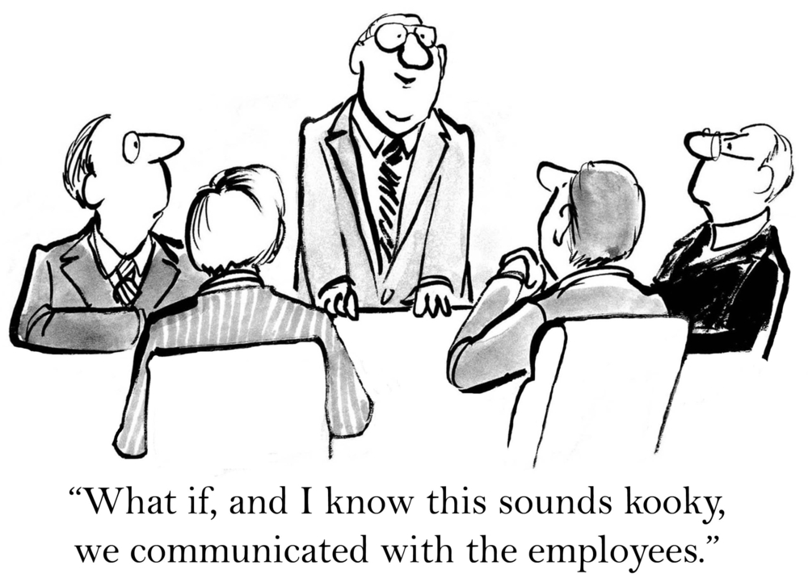
Drivers of Engagement
Effective leaders create a culture where each team member can say “I am a valued member of a winning team doing meaningful work in an environment of Trust”

Slide 11
The Clinical Director’s role in driving improvement: learning from our experience
The effective clinical director must have a knowledge of at lease one improvement methodology and be able to employ it in practice
Outstanding rated Trusts use a single improvement methodology throughout
WHAT has partnered with VMI – 4ward improvement system
Based on Toyota lean improvement system
Led and driven by front line clinicians
Eliminate waste and defects
Continuous cycles of improvement

Slide 12
Know the business, improve the business
The patient is always first
Focus on the highest quality and safety
Engage all employees
Strive for the highest satisfaction
Maintain a successful economic enterprise

Slide 13
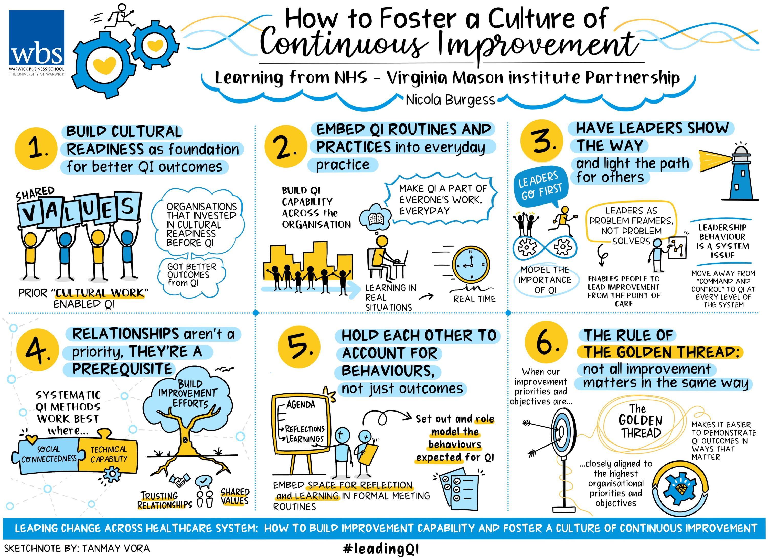

Slide 14
Challenges and learning from the pandemic
Morale
Reluctance to do extra
Complexity – terms and conditions, pay scales, rotas, cross cover
Nimble, flexible and adaptable solutions
Working within networks and with system partners
Skills and confidence to make decisions in times of uncertainty – based on values, and ethical first principles
Importance of valuing and caring for staff to get the best care for patients

Slide 15
Staff already under great strain are now flagging - there may be a long lasting impact on mental health
Risk of career changes and early retirement
Caring for many patients who died
Caring for colleagues
Reflecting on clinical decisions especially if adverse outcome
Fear of passing on the virus to the vulnerable
Financial and employment worries in friends and family, domestic abuse, social isolation
Pressure of waiting lists and backlogs

Slide 16
Supporting Clinical Directors under pressure through Covid-19
Major incidents have long term consequences: Looking after each other in a crisis—Lessons from Novichok and the parallels with Covid-19. Kate S. M. Jenkins, Jess Thomas, Megan Duggan, Hannah Scott, Jenny LangAt one year:
Hospital Anxiety and Depression Scale
Maslach Burnout Inventory
Impact of Events Scale—Revised
Showed:
13% depression 4.4% PTSD
17% anxiety 12% emotional exhaustion
27% depersonalisation
Anxiety, depression and burnout (especially depersonalization) higher in managers

Slide 17
Where next for current Clinical Directors?
Back to the ranks
Retirement
System leadership roles
Education/training or academic/research
Regional/ National Project Leads
CCIOs
Divisional Directors/Associate Medical directors – revalidation, QI, clinical effectiveness
Medical Directors/ Chief Medical Officers

